Slide 1


ANALYTICAL STORYTELLING : CUSTOMER SEGMENTATION DATA
DHARMIN SANGHVI
ISOM-837:DATA MINING & BUSINESS INSIGHT)

Slide 2
BUSINESS UNDERSTANDING
Segmentation Group | Count of Customer ID
Segment1 | 8683
Segment2 | 11442
Segment3 | 9277
Segment4 | 10125
Segment5 | 13976
Grand Total | 53503
The dataset reveals five distinct customer segments, indicating diverse customer bases that require tailored strategies.
Opportunities exist for developing insurance products tailored to the unique needs of each segment, enhancing satisfaction and loyalty.
Insights from segment sizes and characteristics inform targeted retention and acquisition strategies to maximize customer lifetime value.
The importance of leveraging customer data for informed decision-making highlights the ability to dynamically respond to changing customer needs and market conditions.

Slide 3


DATA UNDERSTANDING
Variables | Variables | Variables | Variables
Customer ID | Geographic Information | Interactions with Customer Service | Customer Preferences
Age | Occupation | Insurance Products Owned | Preferred Communication Channel
Gender | Income Level | Coverage Amount | Preferred Contact Time
Marital Status | Behavioral Data | Premium Amount | Preferred Language
Education Level | Purchase History | Policy Type | Segmentation Group (Target )
“The dataset provides a structured framework for customer segmentation, highlighting demographic and behavioral variables critical for insurance market analysis. It enables the identification of distinct customer clusters, offering strategic insights for personalized engagement and service optimization.”
53504 Rows of Data
20 Variables

Slide 4
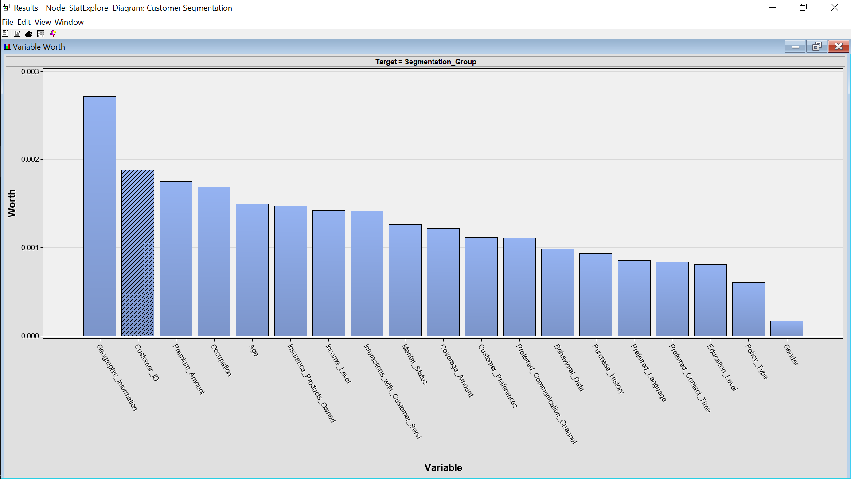
DATA PREPARATION
Confirmed data completeness with StatExplore Node analysis, revealing zero missing values across all variables, eliminating the need for imputation.
Identified key variables influencing segmentation through variable worth assessment: Geographic Information, Premium Amount, Occupation, and Age.
Ensured data readiness for modeling, with all records verified for accuracy and no replacements required.

Slide 5
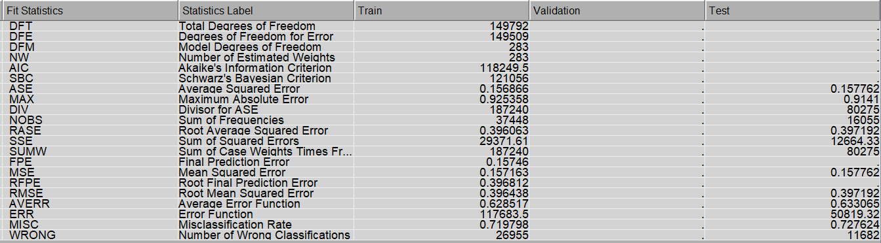
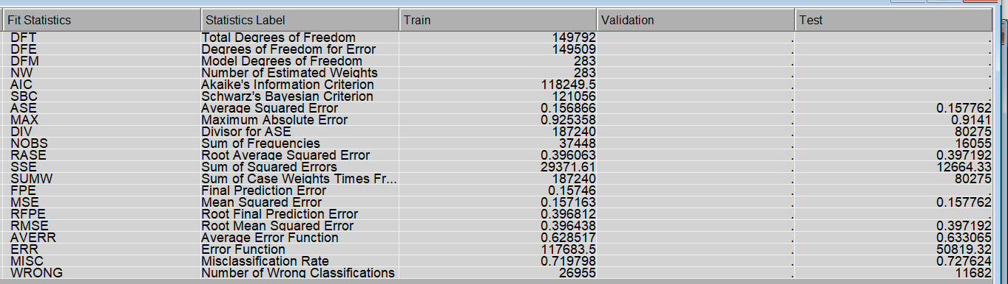
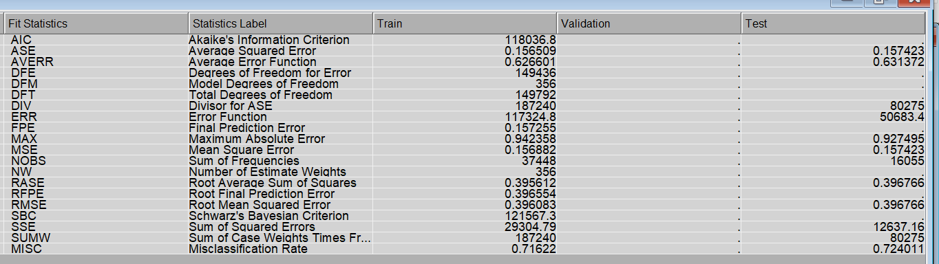
Analysis models
The dataset was partitioned in a 70:30 split for Training and Testing
Explored three predictive models: Decision Tree, Neural Network, and Regression Model, to determine the best fit for customer segmentation.
The Regression Model emerged as the most accurate, achieving the lowest Average Squared Error, indicative of its superior ability to capture the nuances of customer data.
Opted for the Regression Model for its optimal balance of simplicity, interpretability, and predictive performance, suitable for segmenting customers effectively.
Decision Tree
Neural Network
Regression Model

Slide 6

Conclusion and recommendations
Launch precision marketing drives tailored to the unique profiles of the five segments.
Craft customized loyalty rewards to boost segment-specific customer retention.
Direct resources strategically based on key variables: Location, Premiums, Profession, Age.
Monitor and adapt to evolving segment behaviors and market shifts.
Utilize customer service feedback to fine-tune segmentation for enhanced personalization.
Capitalize on cross-selling opportunities within segments, guided by model predictions.
Regularly update segmentation to stay aligned with dynamic market trends.

Slide 7
Challenges and limitations
1) The dataset's breadth, comprising 53,503 rows across 20 variables, introduces significant analytical complexity, necessitating simplification that may omit nuanced insights.
2) High variability in income levels and premium amounts suggests diverse financial backgrounds of customers, which could affect the robustness of segmentation.
3) Variations in variable worth, with geographic information being highly predictive and gender having low predictive power, present challenges in achieving balanced segmentation.

Slide 8
Thankyou

