Slide 1
NASA web server logs’ parsing and analysis using Apache Spark
Dharmit Dalvi
CS 779, Advanced Database Management Systems

Slide 2
About Apache Spark
unified analytics engine for big data and machine learning
The largest open source project in data processing.
Features:
Speed
Ease of use
Runs everywhere

Slide 3
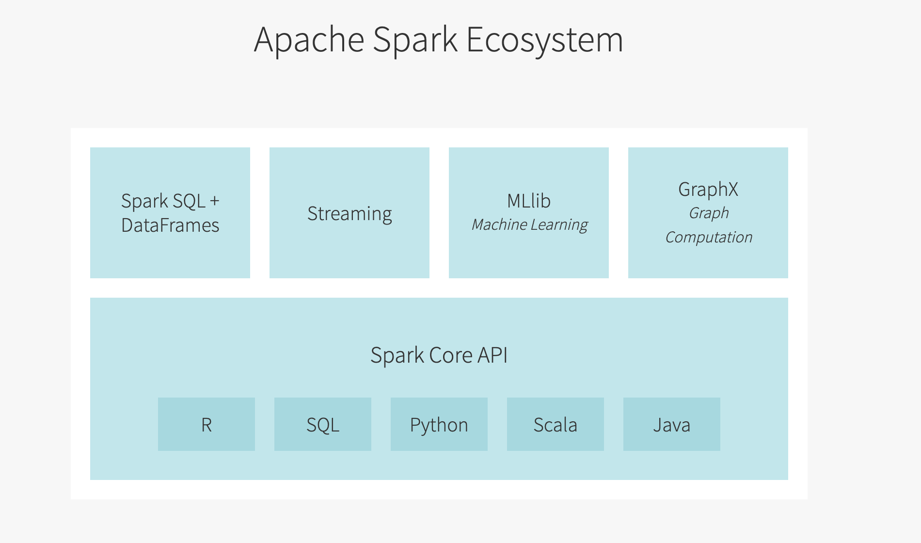
Spark Ecosystem

Slide 4
Spark Data Structures
RDD
Data Frames
Dataset

Slide 5
Databricks
Founded by original creators of Apache Spark
A web-based platform for working with Spark
Provides:
Automated cluster management
Ipython style notebooks

Slide 6
Web server logs’ analysis
process of collecting, parsing and analyzing log files generated by web servers
To gain insights such as:
What happened?
When?
By whom?
Where?
Why happened?

Slide 7
Dataset
NASA Kennedy Space Center’s publicly available server logs for two months: July ‘95 and August ’95
Contains two months worth of all HTTP requests to the server

Slide 8
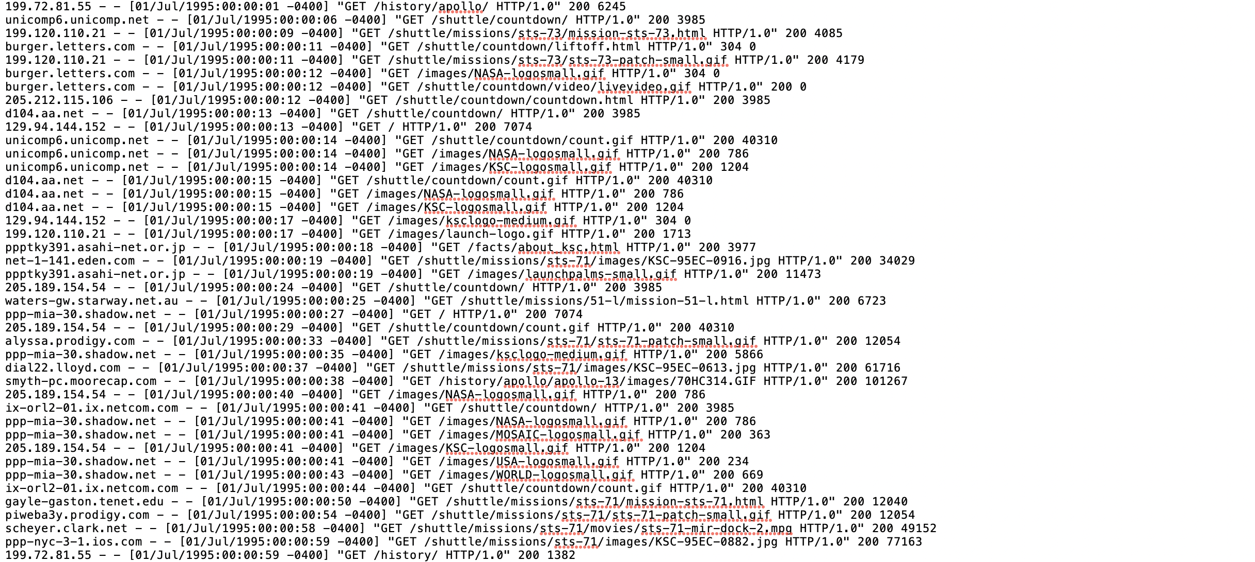
Semi-structured data

Slide 9
Data Wrangling
Converting the semi-structured data into a structured dataset
Extracting attributes from each log message

Slide 10
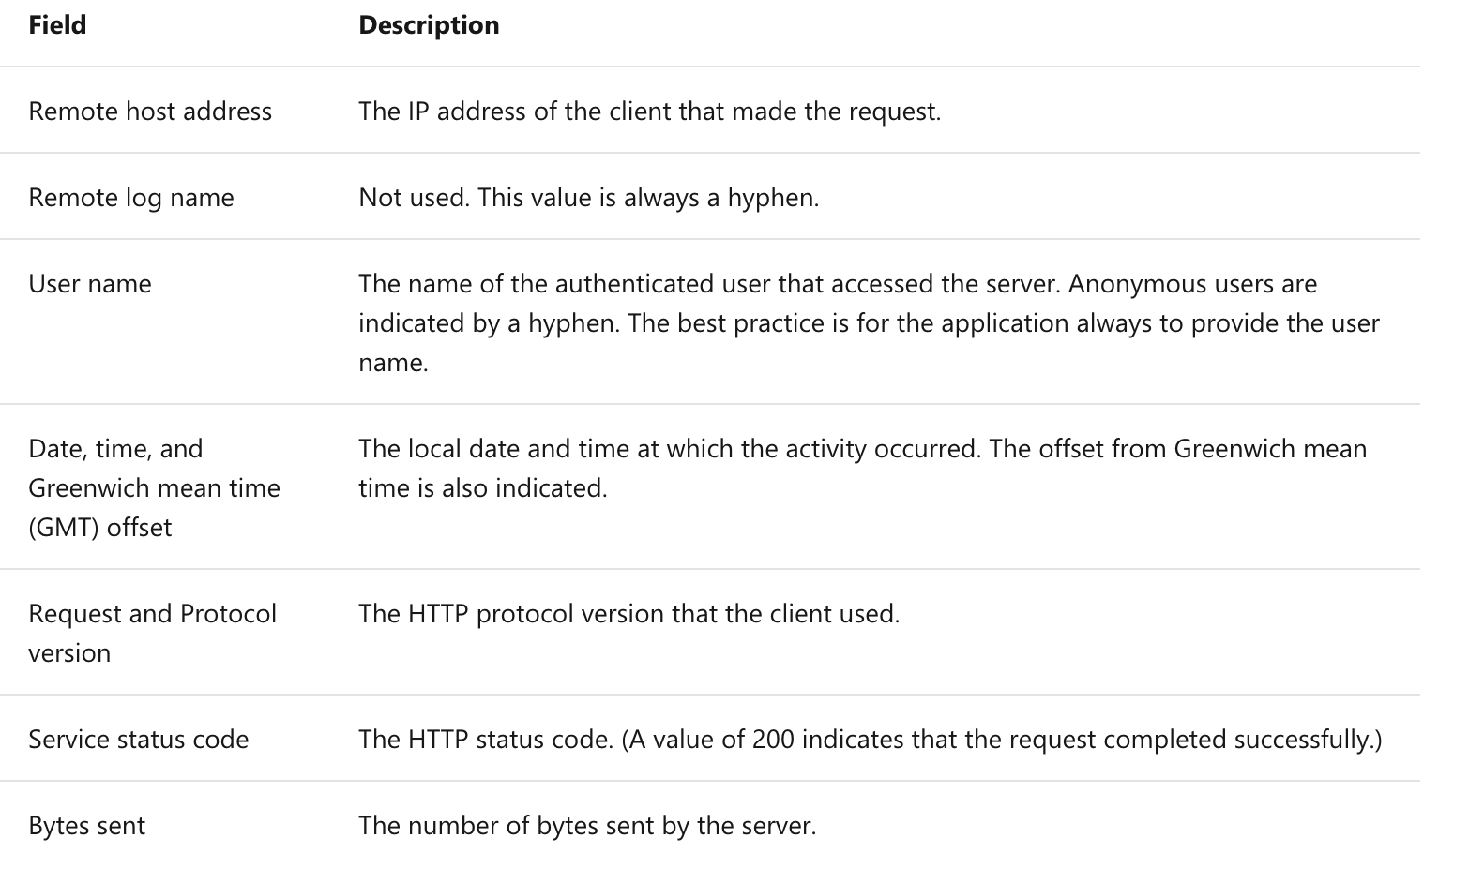
NCSA common log format

Slide 11
Regular expressions
Useful in extracting information from any text
Searches for one or more matches of a specific search pattern
https://www.geeksforgeeks.org/write-regular-expressions/
regexp_extract()

Slide 12
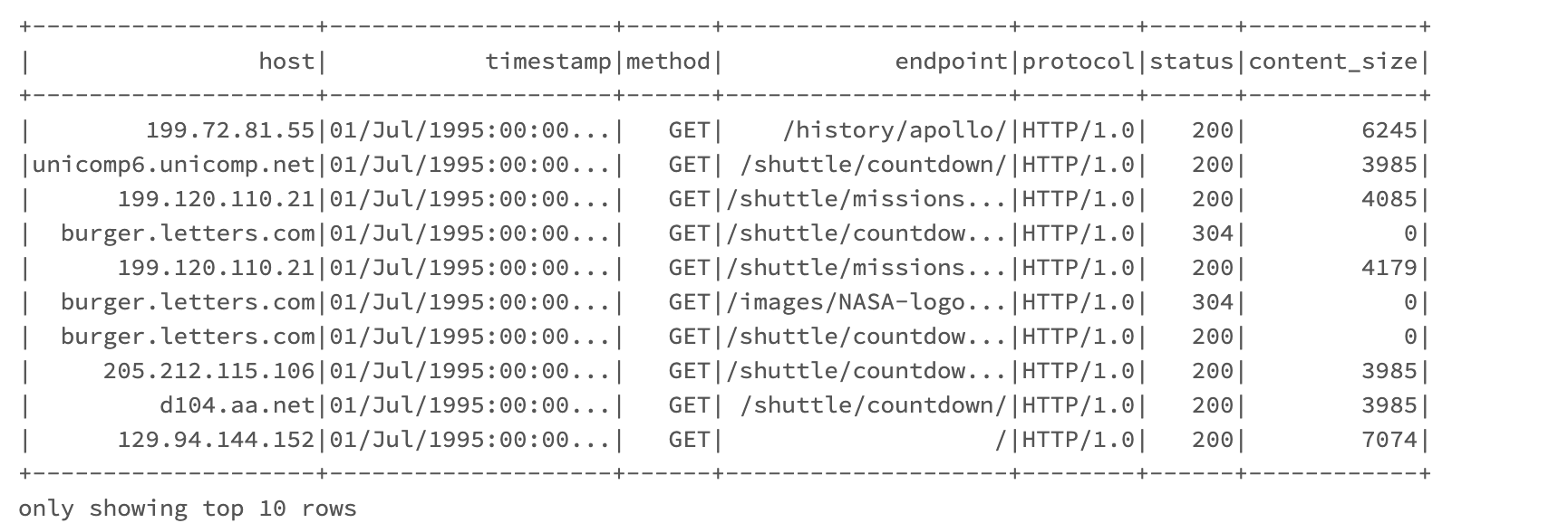
Structured DataFrame

Slide 13
Analysis
Analyzing Frequent Hosts
Finding number of unique hosts
Finding distinct endpoints and the number of times they were requested
Top ten error endpoints
All logs for the “not-found” error
Analyzing and visualizing distinct status code values and the number of times they have occurred
Content size statistics
Distinct hosts on a particular day

Slide 14
Further scope
Deeper analysis into number of hosts, endpoints, etc per day.
Extensive visualization to clearly understand all the analysis.

Slide 15
Thank you!

