Slide 1

By WellViva HealthTech India Pvt Ltd
CIN No.: U62011GJ2025PTC164160
Connecting India’s Heartland to Urban Healthcare

Slide 2


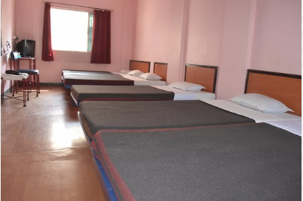

PROBLEM
Millions in Tier II/III/IV cities lack access to advanced healthcare (oncology, cardiac surgeries)
No real-time hospital bed availability or transparent referral system
Over 50% of tertiary care patients in Tier I hospitals come from smaller towns
Families struggle with lodging and medical travel.
Diagnostics and surgical referrals remain largely unmet in rural India
Diagnostics and surgical referrals remain largely unmet in rural India

Slide 3


Solution & customer journey
A platform, connecting rural & semi-urban patients with Tier I hospitals
Features:
Real-time hospital bed booking.
Super-specialist consultations.
Diagnostics & medical equipment rentals (e.g., BiPap).
Lodging for patient families.
End-to-end seamless healthcare ecosystem

Slide 4
PLATFORM FEATURES
Explore Hospital
Support Therapies
Support System
Pathology Lab
Nearest Hospital Details:
Name
Address
Location
In house facilities (like availability of CT Scan, MRI, Path Lab, Medical, etc.)
Wards & ICU beds availability:
Total no. of beds and vacant beds
Bed cost as per class availability
Class specification & facilities available in class
Therapy coverage
No. of ventilators
Doctor attachment details with hospital
Dr Name, specialty and experiences
OPD time if any
Nearest dealer information:
Name and license
Address
Location
Products availability with dealers
Product name
Availability status
Application and specification of product
Selling type (Outright or Rent)
Cost of product
Delivery time
Ratings and reviews
Buy back options
Scouting economical hotels, lodge, homestays, dormitory, etc nearby to hospital
Name
Address with location
Room cost
Amenities provided by hotels
Connect to loan provider, trust, NGO to tackle the hospital expenses gets overshoot
Connect to counsellors for patients and his relatives mental wellbeing if requires
Nearest Path Lab Details:
Name
Address with location
Details of test conducted at lab
Cost of each test
Final report will be flash once it is ready
Financial institution
Loan product
Loan details like ROI, documents requirement etc.
Insurance

Slide 5
PLATFORM VIEW

Slide 6
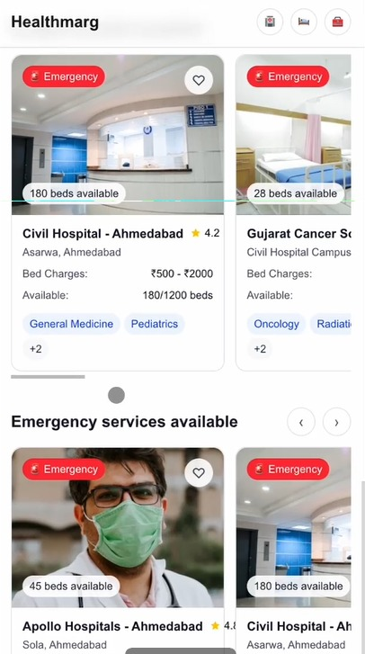
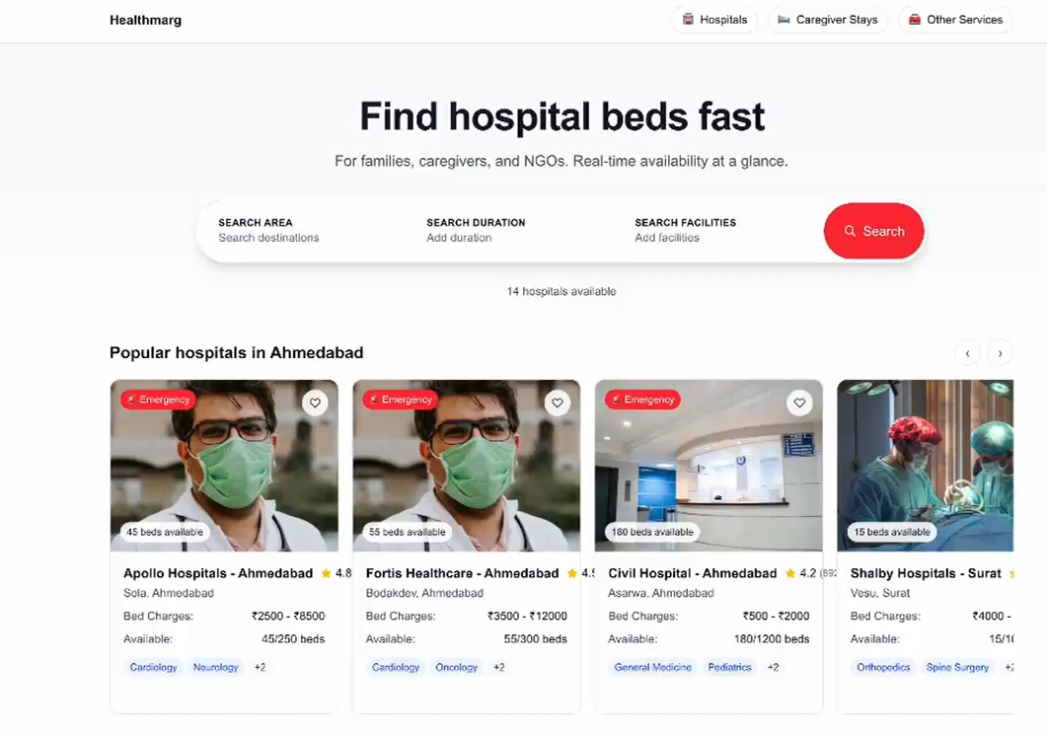
PLATFORM VIEW (contd..)

Slide 7
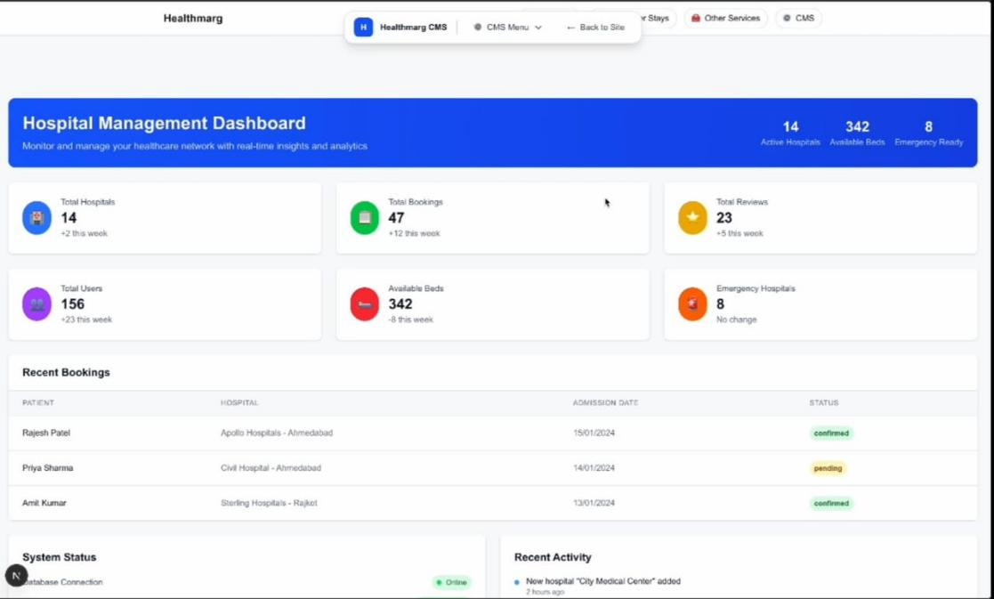
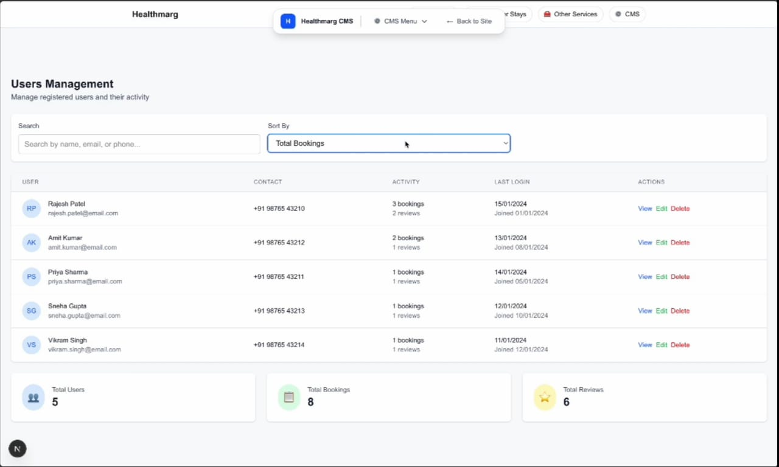
DASHBOARD VIEW

Slide 8
UNIQUE SELLING PROPOSITION (USP)
Differentiators:
First aggregator dedicated to Tier II/III/IV → Tier I access.
Complete service loop: Hospital + Diagnostics + Lodging + Equipment.
No pharmacy (avoids complex regulations).
Strong social impact + scalable tech model

Slide 9
MARKET OPPORTUNITY
(Tier II/III/IV to Tier I referrals)
(Digital health aggregators)
TAM: Total Available Market by 2025
SAM: Serviceable Available Market in 2025
SOM: Serviceable Obtainable Market by 2030

Slide 10
COMPETITION & COMPETATIVE ADVANTAGE
Competitors | Our Edge
Credithealth | Tier II/III/IV city focus
Practo | Lodging + Equipment Rentals (not served by competitors)
MediBuddy | Partnerships with urban hospitals, ASHA workers
HealthAssure
Portea

Slide 11
BUSINESS MODEL
Revenue streams
💰
Fees charges on booking bed will be INR 500-1000 booking fees
Booking fees from hospital bed
💰
Fee charges will be INR 10 to 100 on lab test
Booking fees from pathology labs
Commission from
dealers and lodging
🤝
5% to 10% commission will be charge from dealers and lodging boarding partners
Medical equipment
rental margin
🛠
Rental fees commission will be INR 100 to 1500
Future premium plans
or subscriptions
⭐
Subscription plan for retention will be INR 500 to 1000

Slide 12
GO TO MARKET STRATEGY
Phase 1: Pilot in Mehasana, Palitana, Konkan region etc. (linked to Ahmedabad, Mumbai)
Phase 2: Partner with urban hospital chains, diagnostic centers, budget hotels/lodges
Channels:
ASHA worker-led referrals
WhatsApp & regional digital ads
Local influencers & clinics
Retention:
Loyalty program for frequent users
AI-based recommendation personalization

Slide 13
TRACTION & MILESTONES
Current Status:
Business plan developed, market study completed
Milestones:
Q3 2026
MVP development, pilot partnerships
Q1 2027
Pilot go-live in 3 Tier II/III cities
Q4 2027
Expand to 10 cities, 100 urban hospitals on boarded

Slide 14
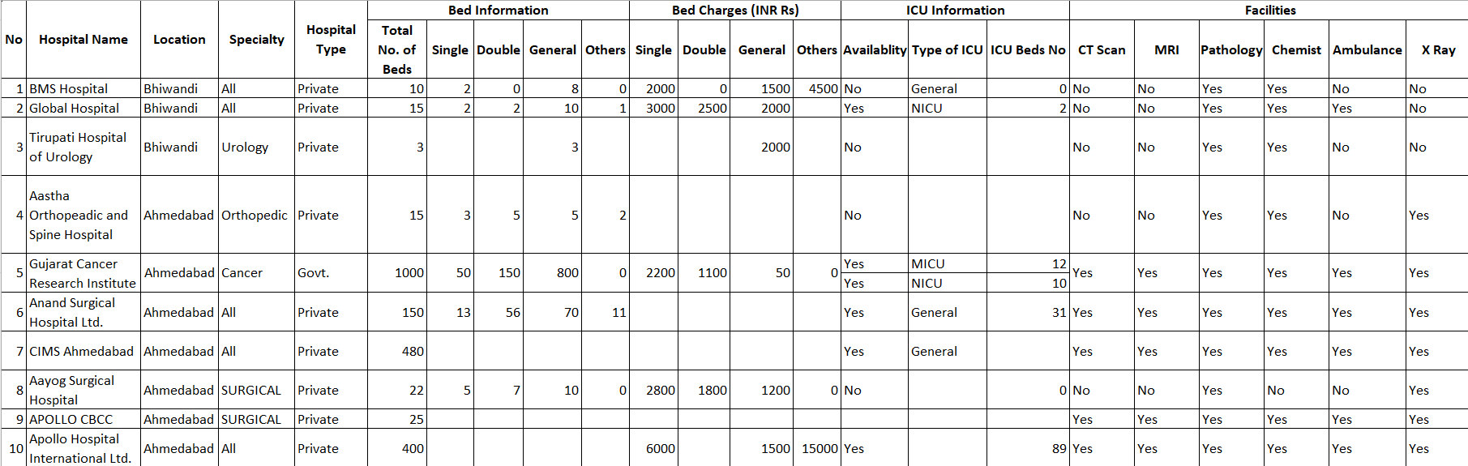
TRACTION & MILESTONES
Data Collection and Onboarding in progress-
Hospitals
Lodging and Boarding
Medical Device Dealers
Hospital Data

Slide 15
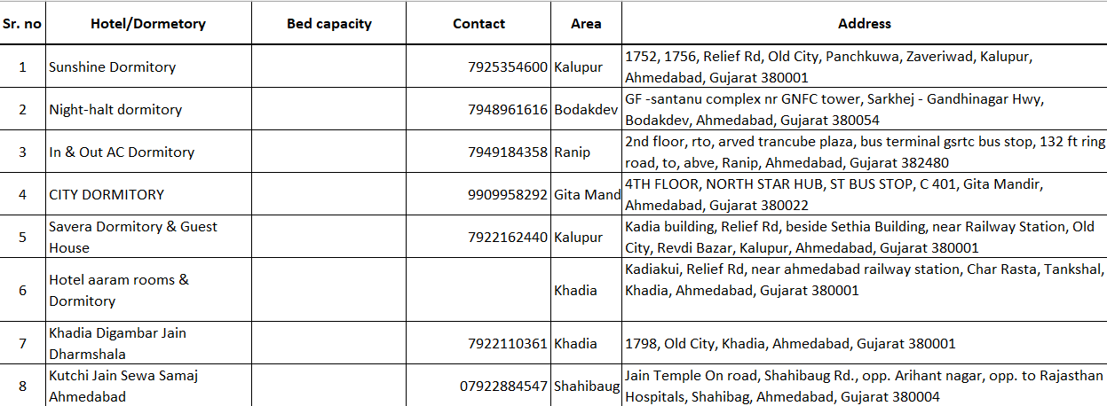
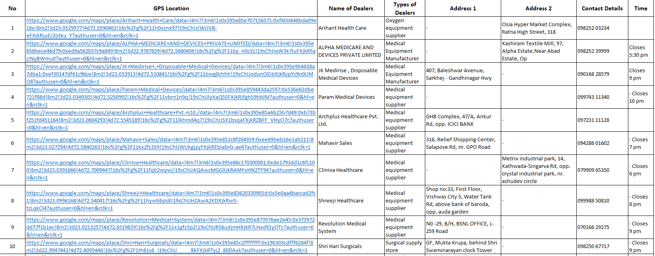
TRACTION & MILESTONES
Lodging – Boarding Data
Data Collection and Onboarding in progress-
Hospitals
Lodging and Boarding
Medical Device Dealers
Medical Device Dealers Data

Slide 16
Thank you
Naresh Tawde
+919820462984/ 9537995556
info@healthmarg.in
healthmarg.wellviva@gmail.com

