Slide 1

MCA Major Project Mid Term Evaluation
Data Analysis Project
Under the guidance of
Dr. Chandrashekhar patel
Department of Computer Applications
Faculty of Science, Technology and Architecture
Manipal University Jaipur
By
Dharmesh Singh Choudhary
23FS20MCA00115
2023-25

Slide 2
Outline
Introduction
Motivation
Process Model
Software Requirement Specification(SRS)
Data Flow Diagram (DFD)
Output
Conclusion
Future Scope

Slide 3
Introduction
In today’s fast-paced and highly competitive business environment, companies generate an enormous volume of sales data through multiple channels—online transactions, in-store purchases, customer interactions, and marketing campaigns. However, raw data alone does not create value; the real power lies in analyzing and interpreting this data to uncover actionable insights.
Sales Data Analysis is a transformative approach that enables businesses to:
Identify key trends and patterns in sales behavior.
Understand customer preferences and tailor marketing strategies accordingly.
Optimize pricing and promotional campaigns for maximum revenue.
Improve inventory management by predicting demand fluctuations.
Enhance decision-making with fact-based, data-driven strategies.
This project aims to leverage advanced data analytics and machine learning techniques to provide businesses with meaningful insights, helping them make informed decisions that drive growth and efficiency.

Slide 4
Motivation
Despite having access to vast amounts of sales data, many businesses struggle to extract valuable insights due to:
Manual reporting inefficiencies: Traditional sales reports are static, time-consuming, and lack predictive power.
Missed revenue opportunities: Businesses often fail to detect emerging trends and customer buying behaviors.
Poor demand forecasting: Inaccurate predictions lead to overstocking (increased storage costs) or understocking (missed sales opportunities).
Fragmented data sources: Sales data is often scattered across different platforms (POS, CRM, e-commerce, etc.), making it hard to analyze comprehensively.
Key Motivational Factors for This Project:
✅ Enhancing Sales Strategies – Identifying successful tactics and optimizing pricing models. ✅ Understanding Consumer Behavior – Segmenting customers based on purchasing habits. ✅ Predicting Market Trends – Using data-driven forecasts to stay ahead of competitors. ✅ Reducing Business Risks – Minimizing losses through accurate forecasting and data-backed decisions. ✅ Automation & Efficiency – Eliminating manual errors and increasing operational speed.
This project is motivated by the vision of turning data into strategic intelligence, empowering businesses with real-time insights and recommendations.

Slide 5
Process Model
To ensure a structured and systematic approach to sales data analysis, the project follows a multi-step process:
Phase 1: Data Collection
Gathering sales data from various sources such as Point-of-Sale (POS) systems, e-commerce websites, ERP systems, and customer feedback reports.
Data attributes include sales figures, customer demographics, product details, seasonal trends, and transaction history.
Phase 2: Data Cleaning & Preprocessing
Removing duplicate, missing, or inconsistent data to ensure high-quality input.
Standardizing formats and converting categorical data into numerical values for machine learning models.
Phase 3: Exploratory Data Analysis (EDA)
Identifying trends, correlations, and sales performance indicators using visual analytics (heatmaps, bar charts, scatter plots).
Detecting seasonal variations, high-demand products, and customer buying patterns.
Phase 4: Predictive Modeling & Machine Learning
Implementing algorithms like Linear Regression, Time-Series Forecasting (ARIMA, Prophet), Decision Trees, and Clustering (K-means) to predict future sales trends.
Phase 5: Data Visualization & Insights Generation
Creating interactive dashboards (Power BI, Tableau) displaying real-time sales insights.
Generating automated reports for decision-makers with recommendations for pricing, promotions, and inventory adjustments.

Slide 6
Software Requirement Specification (SRS)
The Software Requirement Specification (SRS) document outlines the key functional and non-functional requirements of the Sales Data Analysis project. It serves as a blueprint for the system's design, development, and implementation.
Purpose
The primary goal of this project is to develop an intelligent sales data analysis system that helps businesses:
Extract meaningful insights from large volumes of sales data.
Identify key sales trends, customer behavior patterns, and revenue-driving factors.
Forecast future sales trends using machine learning techniques.
Enhance business decision-making by providing real-time dashboards and automated reports.
This system aims to replace traditional manual reporting with automated, data-driven analytics, improving efficiency and accuracy in business operations.

Slide 7
2. Scope
The scope of this project covers the following major aspects:
2.1 Business Scope
This system is designed for e-commerce platforms, retail chains, and enterprises looking to optimize sales strategies.
It provides real-time data visualization, predictive analytics, and sales forecasting.
The insights generated will help businesses reduce operational risks, improve inventory management, and enhance marketing campaigns.
2.2 Technical Scope
Data Sources: Sales data will be collected from ERP systems, POS terminals, online transactions, and customer databases.
Data Processing: The system will use data cleaning, transformation, and machine learning algorithms to generate insights.
User Interface: The system will feature an interactive dashboard for data visualization (Tableau/Power BI).
Scalability: The system will be designed to handle large datasets and multiple data sources efficiently.

Slide 8
3. Functional Requirements:
The system must provide the following features: ✅ Data Collection: Ability to integrate sales data from multiple sources. ✅ Data Cleaning & Processing: Removal of duplicates, handling missing values, and ensuring data consistency. ✅ Exploratory Data Analysis (EDA): Identifying trends, correlations, and customer segments. ✅ Predictive Analytics: Implementing machine learning models (Linear Regression, ARIMA, Decision Trees, etc.) to forecast sales trends. ✅ Data Visualization: Graphical representation of key metrics using charts, dashboards, and reports. ✅ Automated Alerts & Reports: Generating recommendations for inventory, pricing, and promotional strategies.
4. Non-Functional Requirements:
🚀 Scalability: The system should efficiently process large datasets and support increasing data volume. 🔐 Security & Privacy: Customer and sales data should be protected using encryption and authentication protocols. ⚡ Performance: The system should generate reports and insights in real-time or near real-time. 📊 User-Friendly Interface: The dashboard should be intuitive, interactive, and easy to navigate.

Slide 9
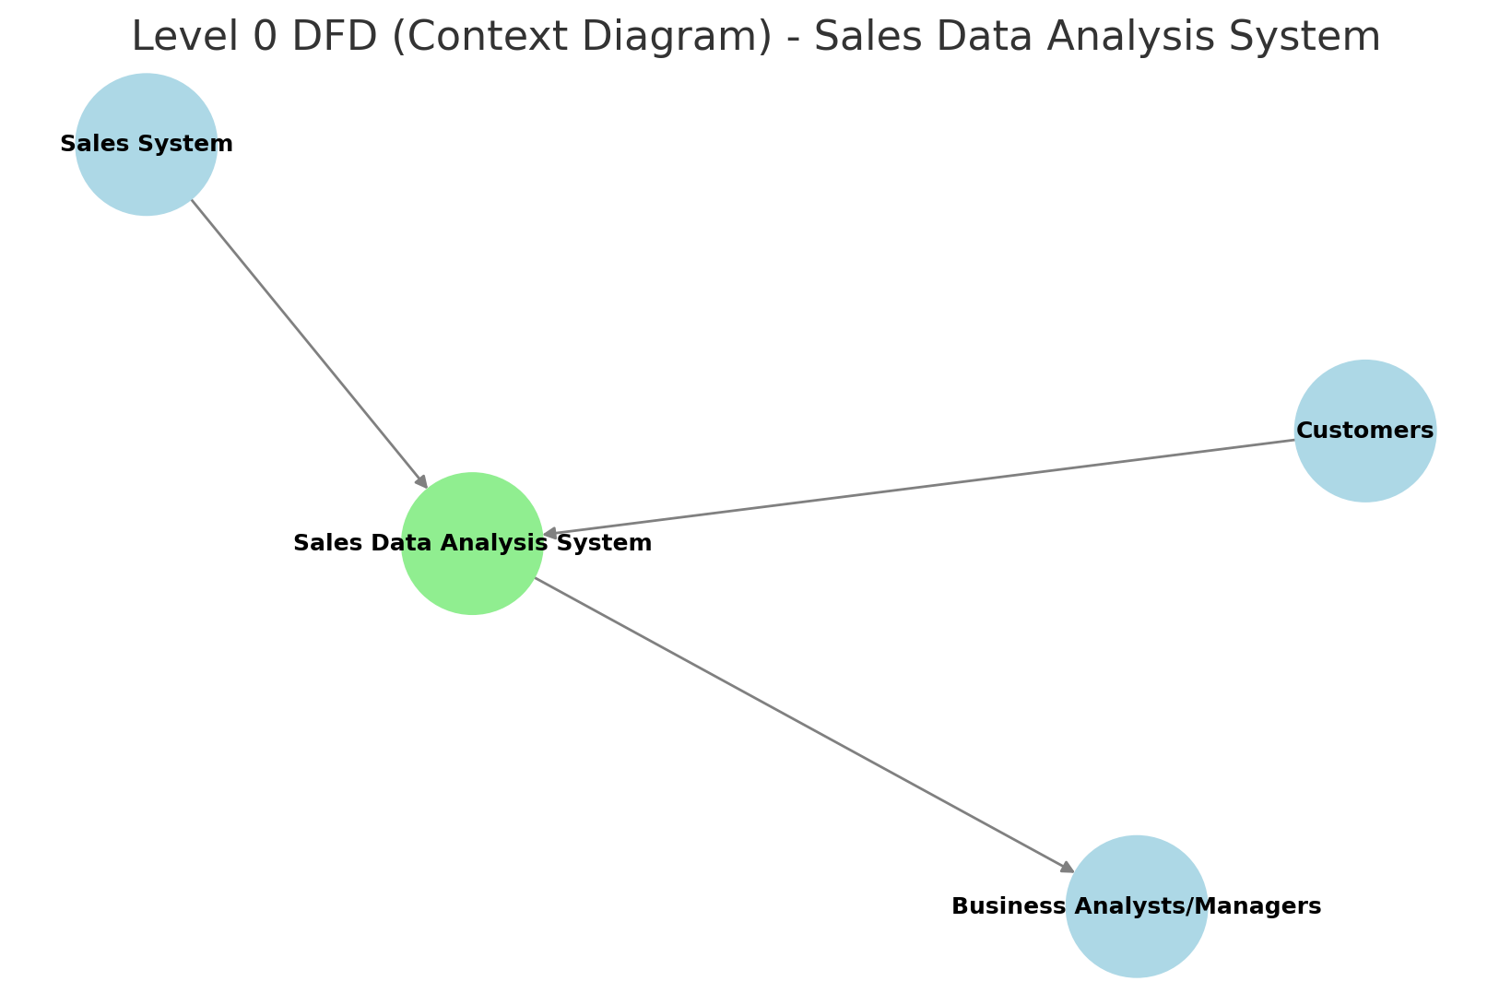
Data Flow Diagram

Slide 10
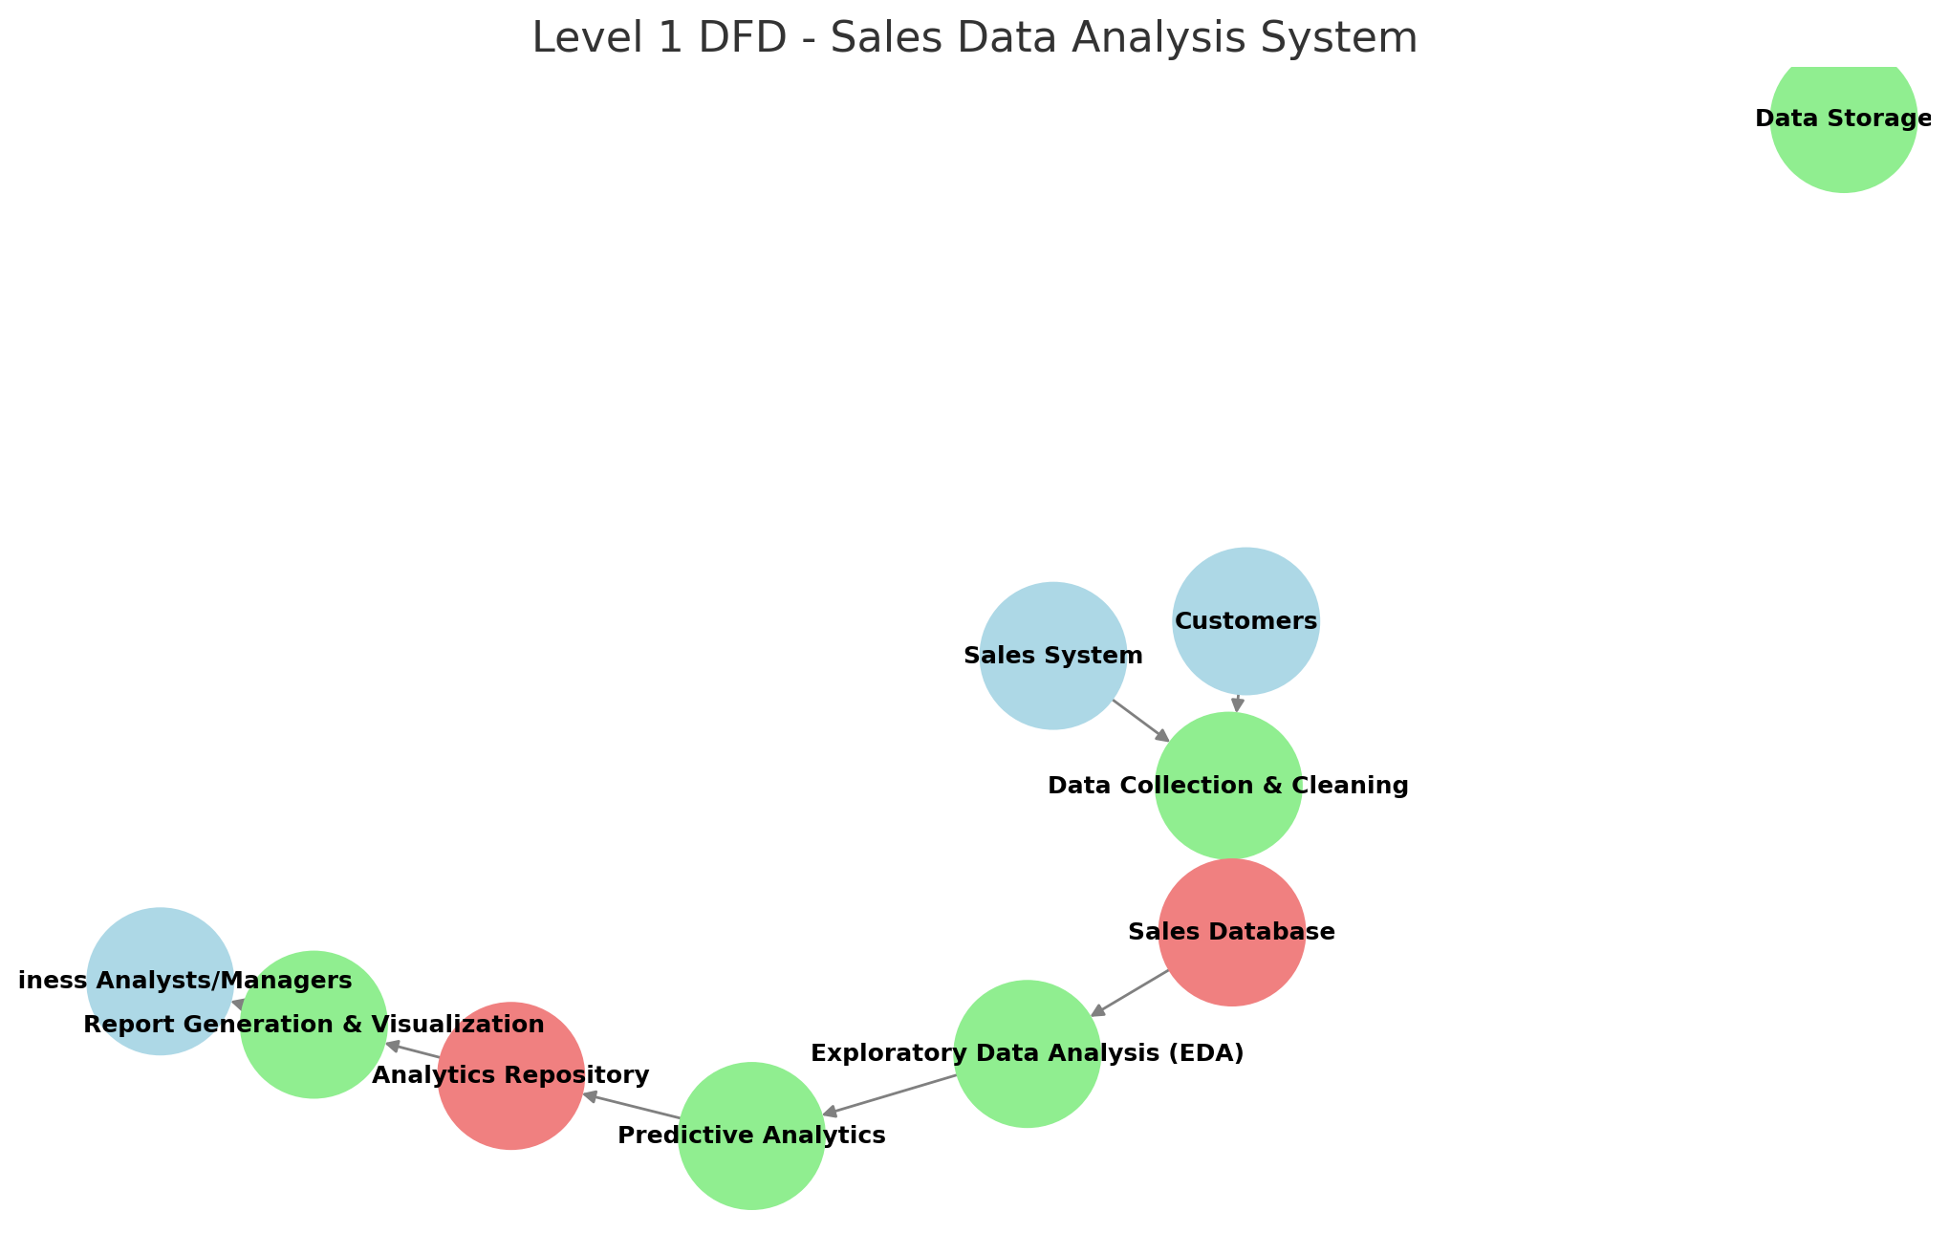

Slide 11
Output
At the end of the analysis, the system generates the following key insights:
Sales Trends: Identifies peak sales periods and slow-moving products.
Customer Segmentation: Groups customers based on behavior for targeted marketing.
Product Performance: Highlights top-selling and underperforming products.
Demand Forecasting: Predicts future sales to help in decision-making.
These insights help businesses maximize revenue, optimize stock levels, and create personalized marketing campaigns.

Slide 12
Conclusion
This project demonstrates how data analytics transforms sales operations by providing real-time insights and predictive capabilities.
Sales teams and business managers can leverage the findings to improve revenue strategies, reduce costs, and enhance customer satisfaction.
Data-driven decision-making allows businesses to stay ahead of competitors by responding proactively to market trends.

Slide 13
Future Scope
The project lays the foundation for advanced sales analytics and can be extended in various directions in the future:
Real-time Sales Monitoring: Enhancing the system by integrating real-time data streaming, enabling businesses to track sales performance dynamically and make instant adjustments.
Customer Segmentation & Personalization: Implementing clustering algorithms to segment customers based on purchasing behavior, allowing businesses to tailor marketing strategies for different customer groups.
AI-based Recommendations: Developing AI-driven recommendation systems that suggest personalized products to customers, increasing conversion rates and enhancing customer satisfaction.
Integration with Business Applications: Connecting the analytics platform with enterprise solutions like ERP and CRM systems to provide seamless access to sales insights within business operations.
Sentiment Analysis & Market Trends: Incorporating natural language processing (NLP) to analyze customer reviews and social media discussions, providing insights into market trends and customer sentiments.

