Slide 1
Predicting the best neighborhood for a new restaurant Dharni Shah April 30, 2020

Slide 2
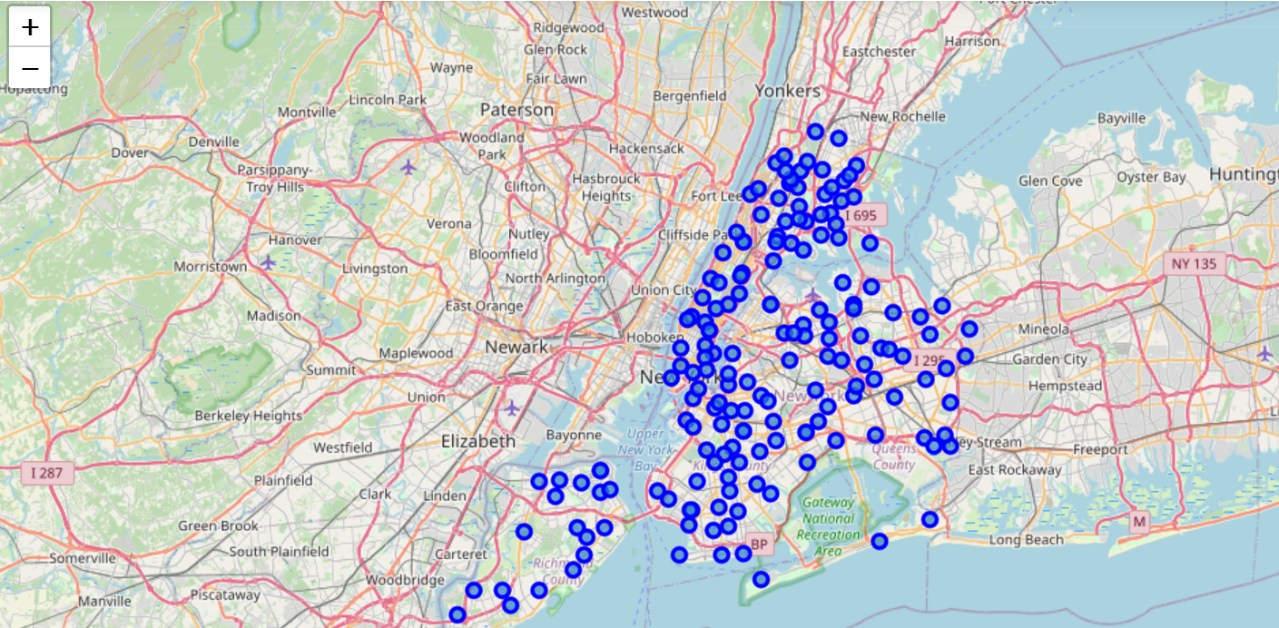
Business problem
To find the best location options to open a new restaurant in New York city
Exploring the neighborhoods further to determine which type of cuisine would be favorable for the selected neighborhood.

Slide 3
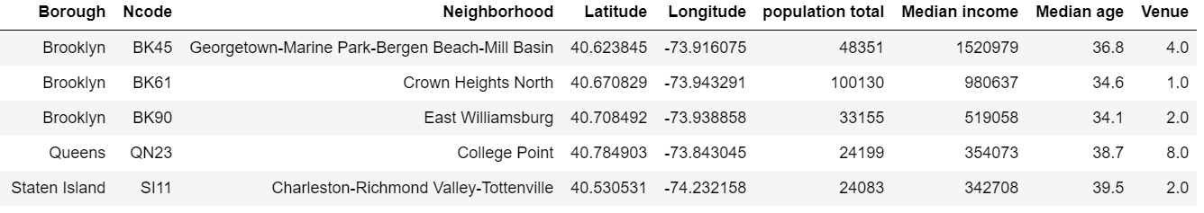
Data sources
The neighborhood demographics data was obtained from census data https://www.census.gov/ and https://popfactfinder.planning.nyc.gov/
The data consisting of the venues for each neighborhood was obtained using the Foursquare API for the city of New York.

Slide 4
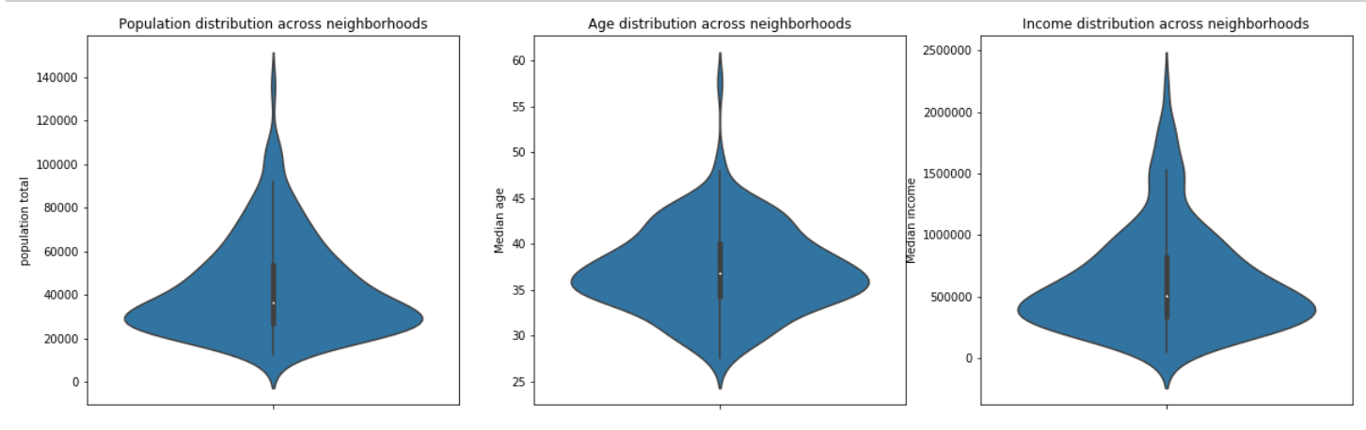
Exploratory Data Analysis
The frequency of demographics parameters is determined by visualizing the population size, median age and median income of all the neighborhoods.

Slide 5
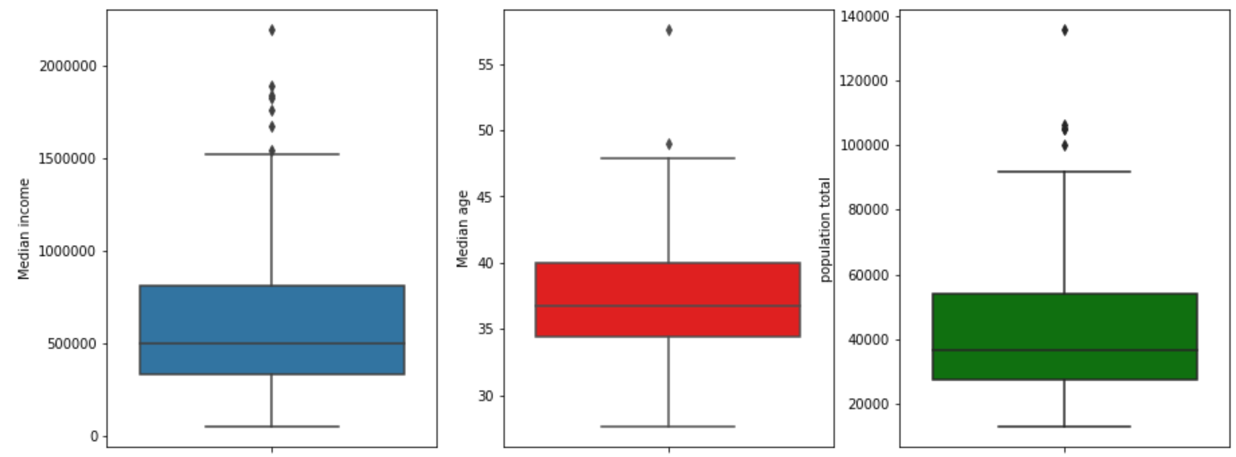
Exploratory Data Analysis
Box plots to better visualize the distribution range

Slide 6
Results
Cluster label | Cluster description
0 | Very small population, low income, very less number of restaurants
1 | Very large population, high income, very high number of restaurants
2 | Small population, very low income, high number of restaurants
3 | Large population, very high income, less number of restaurants
After examining the centers of 4 clusters. The following description is added across the corresponding labels.

Slide 7
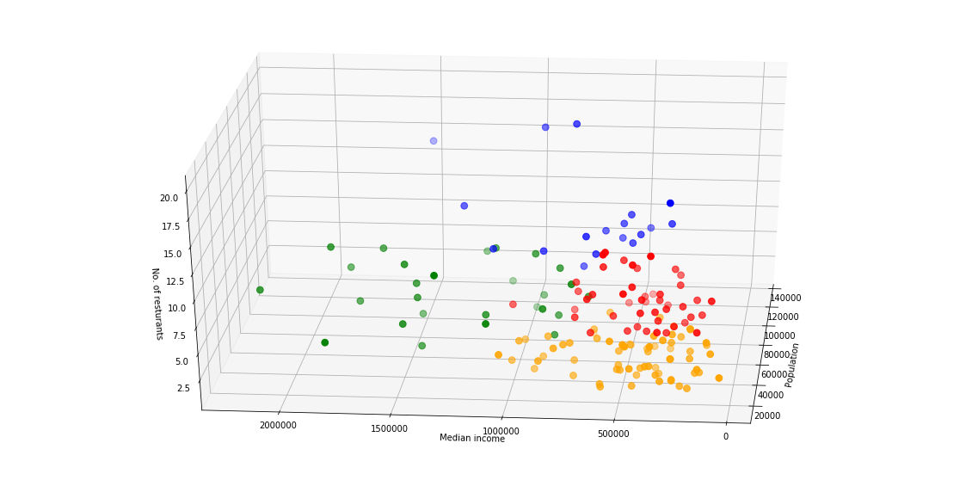
Results
The clusters formed are visualized using 3D scatter plot. The parameters used for clustering are Median income, population and number of restaurants. There 4 clusters formed which separates the neighborhoods w.r.t these features.

Slide 8
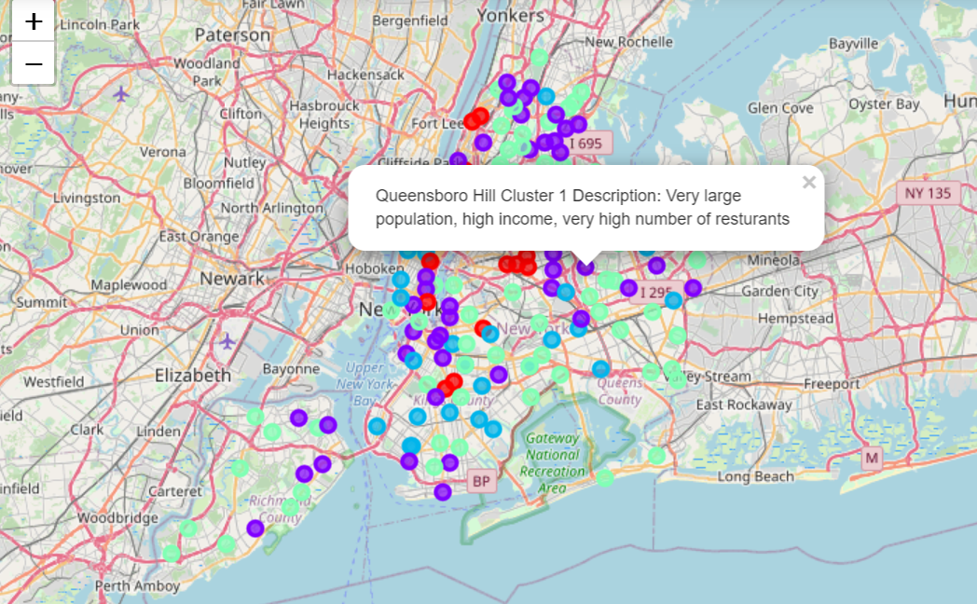
Results
To visualize which neighborhoods belongs to which cluster, Folium map with neighborhoods superimposed on it was created. The label for each neighborhood shows the cluster number and its description. Further, on using K-means clustering on all the “Venue Category” to predict the best type of restaurant for the new outlet

Slide 9
Conclusion
In this study, I analyzed cluster 3 would be the best option from which the neighborhoods for a new restaurant should be selected. Depending on the budget and size of population the owner plans to serve, other clusters can be investigated. The clusters can be made non-overlapping with more demographics, geographically accessibility of the location and competitors’ data.

