Slide 1

The Doorks
when one door closes another opens

Slide 2
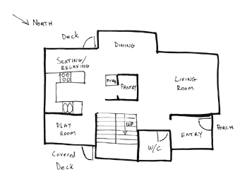
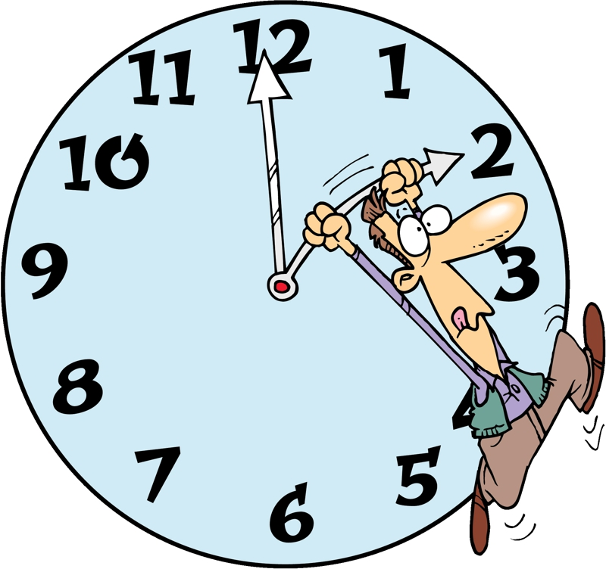

The Need
It is really hard to understand Building plans.
You must to be an engineer.
And even if you are an engineer it is really time consuming

Slide 3
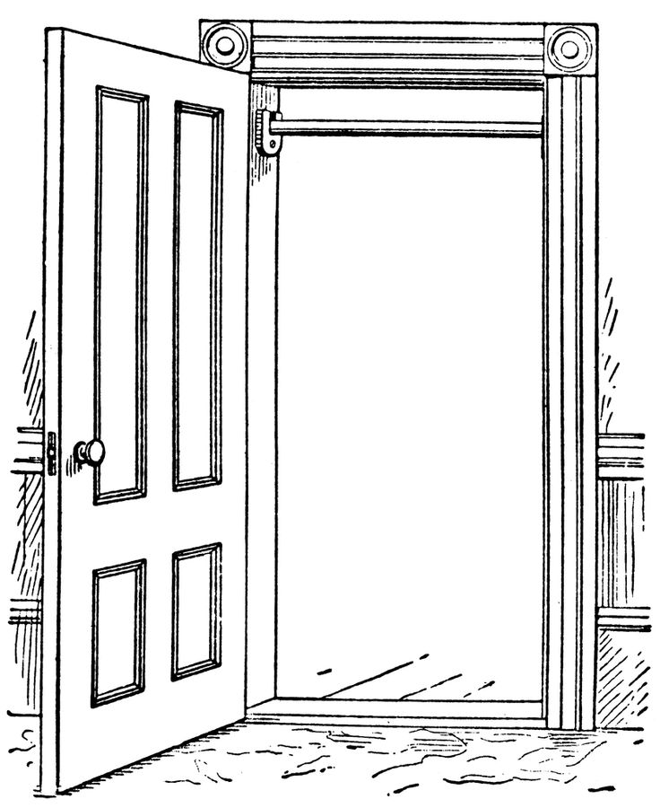


Our Challenge

Slide 4
Solution
Direct Feature detection
Convolutional Neural Network learning solution
Feasible

Slide 5
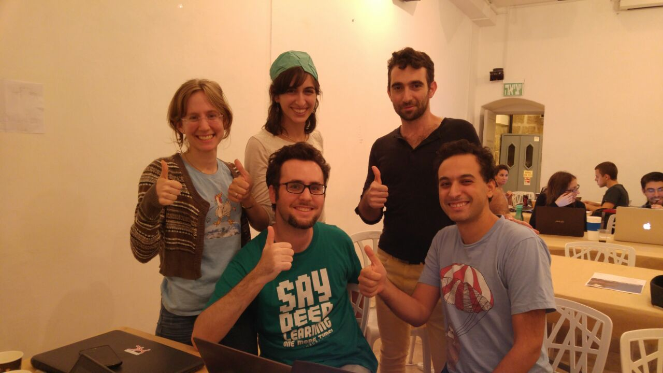
Meet the doorks
Moran
Ruslan
Liat
Special thanks to
Guy
Gal

