Slide 1

The Doorks
when one door closes another opens

Slide 2
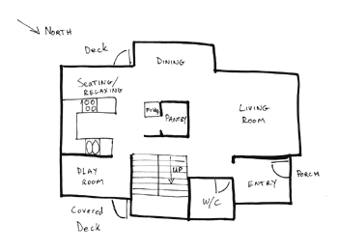


The Need
It is really hard to understand Building plans.
You must to be an engineer.
And even if you are an engineer it is really time consuming
From personal experience

Slide 3
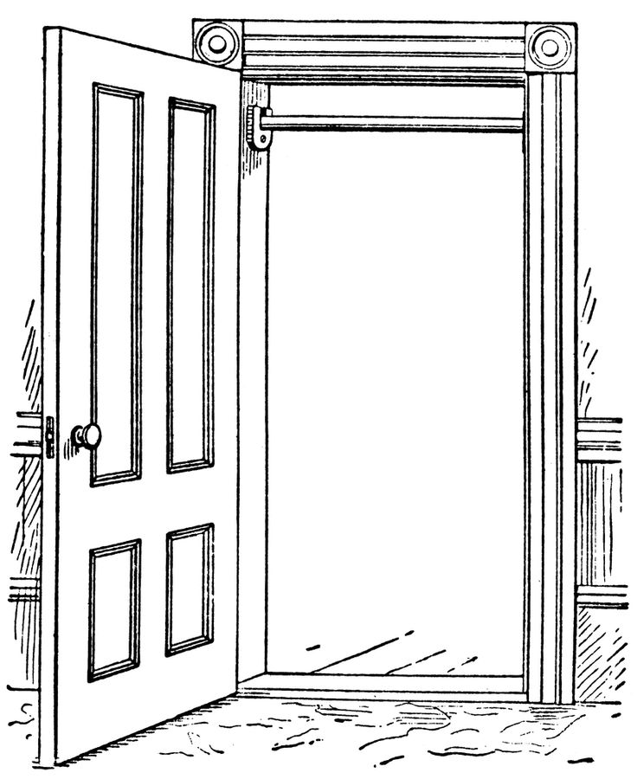


Our Challenge

Slide 4
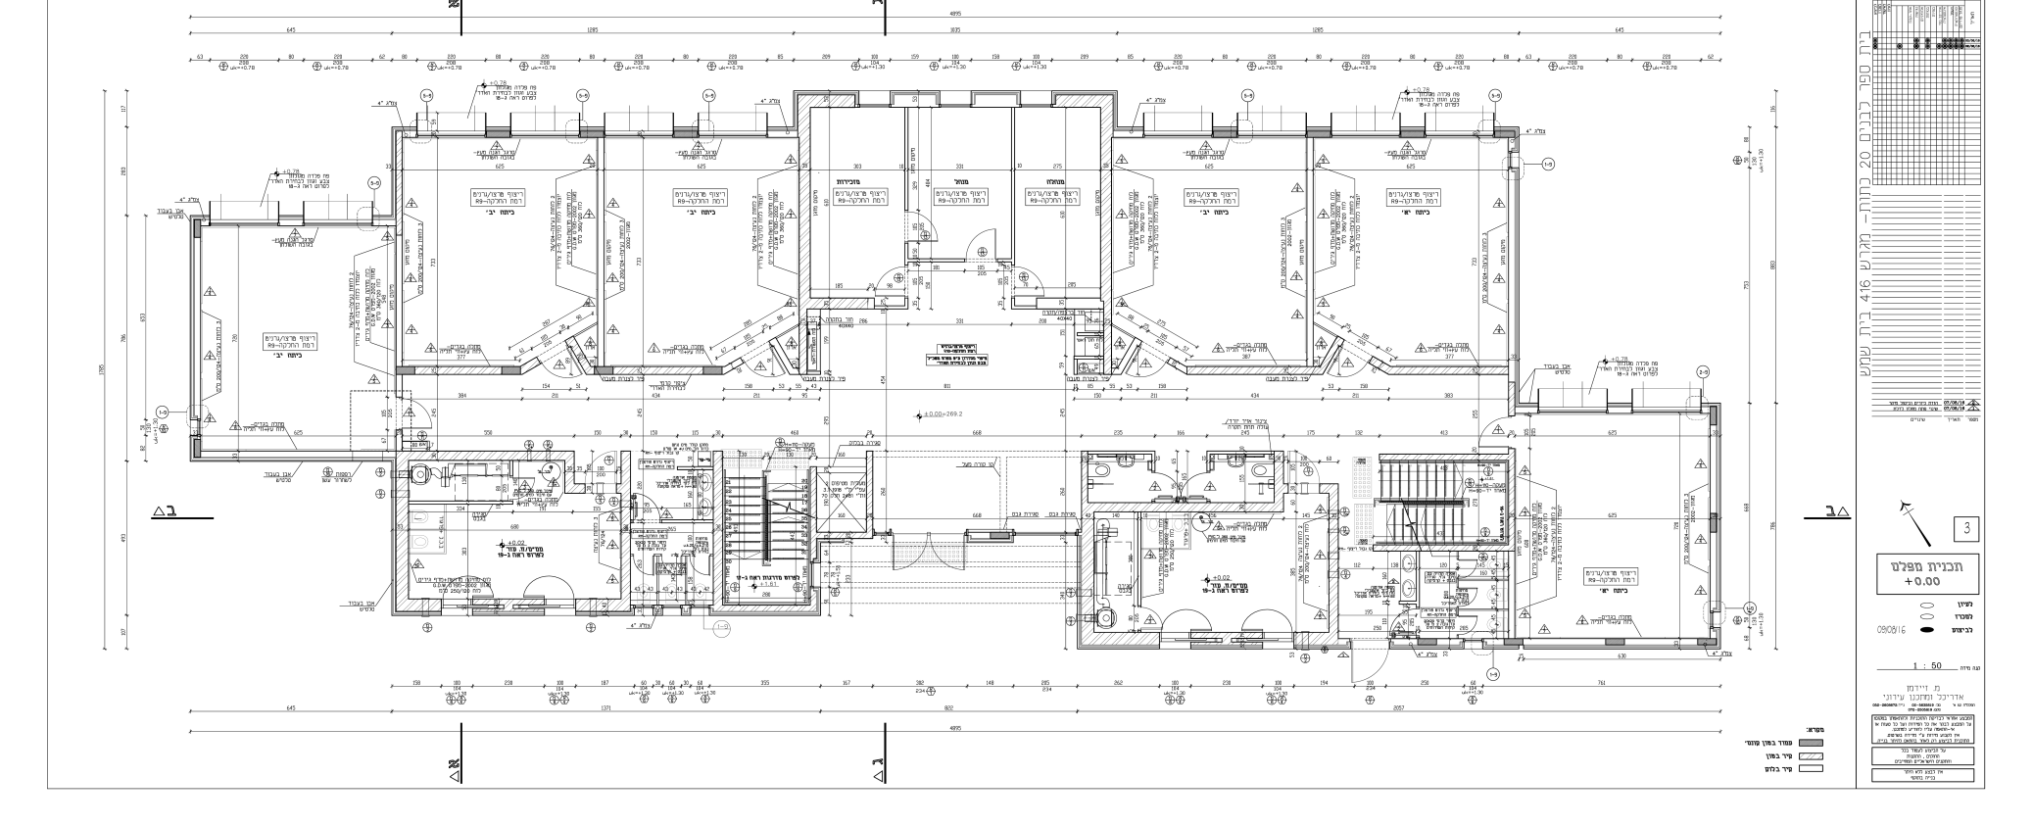
The dataset
de las Heras, Lluís-Pere, et al. "CVC-FP and SGT: a new database for structural floor plan analysis and its groundtruthing tool." International Journal on Document Analysis and Recognition (IJDAR) 18.1 (2015): 15-30.‏

Slide 5
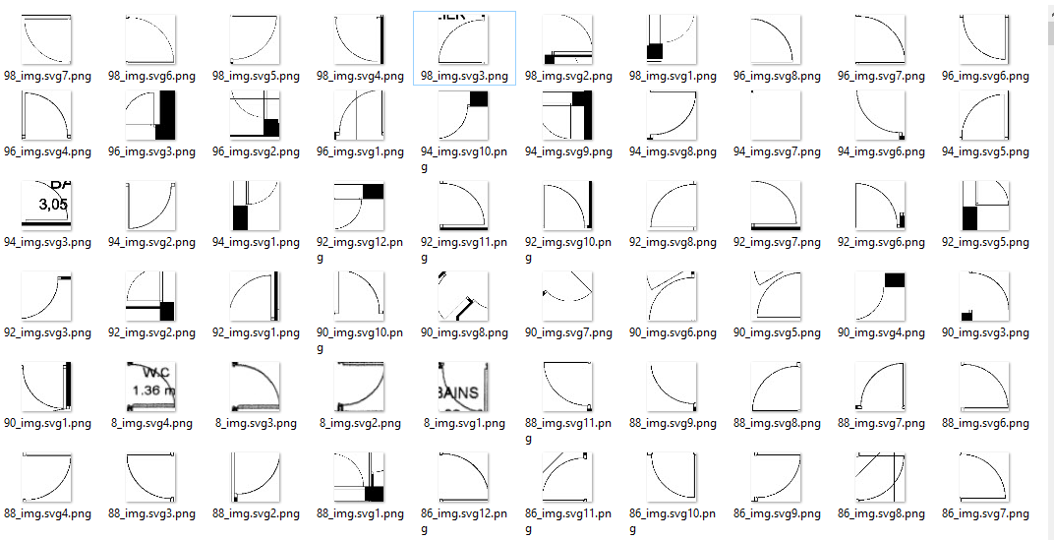











The Dataset
Doors:
Not doors…

Slide 6
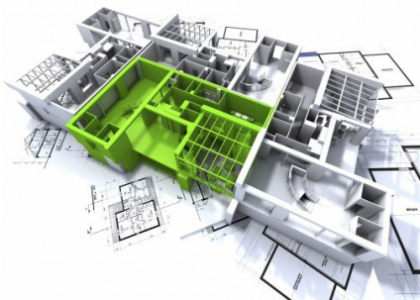
Training and test set
Data cleaning
200 floor plans
1000 doors
200 after cleaning
~10000 doors after augmentation
1000 non doors after cleaning
~50000 non doors after augmentation

Slide 7
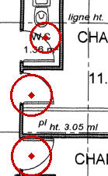
Solution
Attempt 1: Direct Feature detection
Circle Hough Transform
Requires fine tuning
Not feasible in 2 day limit
Solution: Convolutional Neural Network learning solution
Using sliding windows to perform detection
Now in Github! http://github.com/guysoft/thedoorks

Slide 8
Results
Feasible
Training:
loss: 0.1636
acc: 0.9565
Validation:
loss: 0.1765
acc: 0.9409

Slide 9

Summary
Computer augmented floor plans
Can be generalized to other elements in floor plans
Save time to the engineer
Prevent human errors

Slide 10

Meet the doorks
Moran
Ruslan
Liat
Contact :
guy@shapedo.com
Guy
Gal

Slide 11
Future work
Recognize more elements in floor plans
Consider edge case
Image normalization
Noise

Slide 12
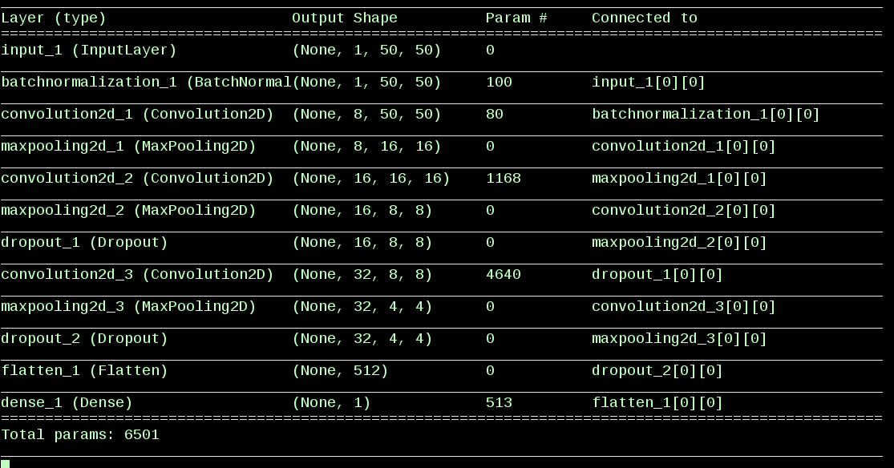
Appendix

