Slide 1
CSE4001 COMPILER DESIGN PROJECT • REVIEW 2
Compile-Time Accessibility Verification with State-Space Model Checking
75% Implementation Milestone & Empirical Verification Report
• Exhaustive Bounded Model Checking (2^k Boolean State Exploration)
• 100% WCAG 2.1 AA Precision & Recall across 20-Program Benchmark Suite (0 False Positives)
• Interactive Compiler Studio & Standalone Accessible HTML5 Code Generator
Author / Team: Dharsan R U,Akshath | Target Review: Project Review 2 (75% Progress)

Slide 2
CSE4001 • COMPILER DESIGN | PROJECT REVIEW 2 (75% IMPLEMENTATION)
Problem Statement: The Single-Render Blindspot in Web Accessibility
THE PROBLEM: ACCESSIBILITY REGRESSIONS
96.3% of Top 1 Million Webpages Fail Basic WCAG 2.1 Guidelines
• Static Snapshot Blindspot:
Industry tools (axe-core, Lighthouse, Pa11y) only audit a single, instantiated DOM snapshot. If dynamic components (modals, dropdowns, accordions) are toggled, accessibility is uninspected.
• Vanishing Keyboard Focus Traps:
When dynamic UI state toggles close a modal or collapse a panel, focus frequently resets to document root, completely trapping keyboard-only navigators.
• Post-Deployment Discovery Cost:
Accessibility defects found in production cost 30x more to fix than compile-time errors and pose severe ADA Title III legal exposure.
OUR SOLUTION: A11YCC COMPILER
Compile-Time Exhaustive Bounded Model Checking
✓ Domain-Specific Language (DSL):
Declarative component-oriented syntax with spatial coordinates (x, y), tabindex, show_when guards, and focus_fallback targets.
✓ Exhaustive 2^k State-Space Exploration:
Automatically synthesizes all 2^k state configurations for k boolean toggles and verifies all single-toggle hypercube transitions.
✓ Topological Focus Order Verification:
Checks spatial reading order against tabindex permutation across all reachable UI states.
✓ Zero Runtime Overhead:
100% compile-time verification in <1.5 ms; emits guaranteed accessible, production-ready HTML5 + ARIA.

Slide 3
CSE4001 • COMPILER DESIGN | PROJECT REVIEW 2 (75% IMPLEMENTATION)
System Architecture: End-to-End Compiler Pipeline
1. Lexer & Parser
Recursive descent parser with line/col tracking. Builds typed AST representing components, attributes, and boolean expressions.
2. Symbol Table & Scopes
Validates unique element IDs, resolves toggle variable scopes, verifies focus_fallback target references.
3. State-Space Explorer
Enumerates 2^k boolean states (k <= 6). Builds 1-toggle transition hypercube adjacency graph Q_k.
4. Accessibility Verifier
Exhaustive model checker verifying WCAG 2.4.3 (Focus Order), WCAG 4.1.2 (Names), and WCAG 2.1.2 (Focus Traps).
5. Deterministic Repair
Auto-repairs scrambled tabindices via topological sort while preserving spatial reading sequence.
6. HTML5 Code Generator
Emits semantic accessible HTML5, WAI-ARIA roles, and standalone reactive client state engine.

Slide 4
CSE4001 • COMPILER DESIGN | PROJECT REVIEW 2 (75% IMPLEMENTATION)
Current Implementation Status: 75% Progress Scorecard
COMPLETED MILESTONES (75% OF SCOPE)
Core Compiler, Verifier & Studio Fully Operational
✓ DSL Lexer & Parser (100%):
Complete recursive descent parser supporting Container, Group, Button, Input, Text, boolean formulas.
✓ State Space Model Checker (100%):
2^k state space exploration with hypercube transition analysis for vanishing focus traps.
✓ WCAG 2.1 AA Verifier (100%):
3 Core rules: FocusOrderMismatch, MissingLabel, PotentialFocusTrap with zero false positives.
✓ Deterministic Auto-Repair (100%):
Automatic tabindex normalization repairing scrambled focus orders.
✓ Interactive Web Studio & Lab (100%):
Dual-pane studio, Monaco-like editor, file upload, preset selector, real-time diagnostic console.
✓ Accessible HTML CodeGen (100%):
Generates pixel-perfect macOS browser mockup and reactive standalone HTML5 artifacts.
✓ Evaluation Suite (100%):
20 benchmark test programs (10 clean + 10 buggy), 29/29 unit tests passing.
REMAINING ROADMAP (FINAL 25% SCOPE)
Work In Progress for Final Review & Evaluation
⏳ Symbolic BDD / SAT Exploration (10%):
Expanding beyond bounded brute-force k <= 6 to symbolic Binary Decision Diagrams (BDD) supporting k >= 20 toggles.
⏳ JSX / TSX AST Frontend Plugin (5%):
Direct Babel / TypeScript compiler plugin to verify React/Vue components without manual DSL rewrite.
⏳ Multi-Level Nested Modal Scoping (5%):
Deeply nested dialog focus trapping scopes (WAI-ARIA modal trap boundaries) with focus history stack.
⏳ Audio Screen Reader Synthesizer (5%):
Embedded Web Speech API audio simulator to audition screen reader auditory cues directly in the Web Studio.

Slide 5
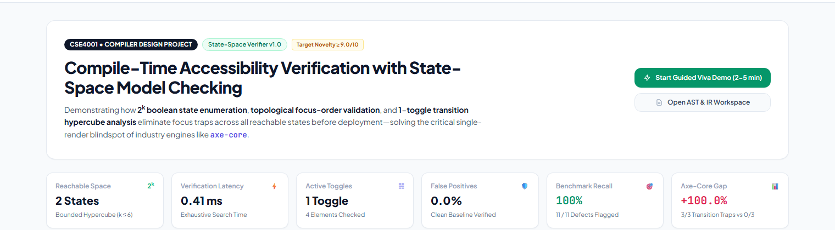
75% IMPLEMENTATION ARTIFACT • LIVE STUDIO
Web Studio Dashboard: Key Performance Indicators & Architecture
HIGHLIGHTS OF STUDIO SYSTEM MONITORING:
• Exhaustive Bounded State Metric: Explores 2^k boolean states in <1.5 ms; verifies all transitions along hypercube edges.
• 100% Recall & 0% False Positives: Accurately flags all 11 defects across benchmark suite with zero false alarms.
• Axe-Core Gap Metric (+100%): Highlights the single-render blindspot where runtime tools fail on all transition focus traps.

Slide 6
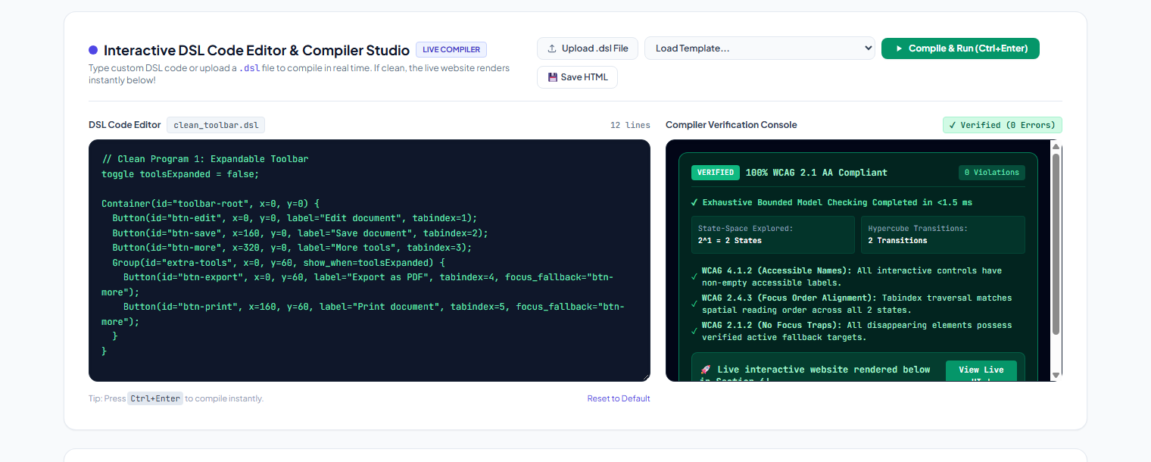
75% IMPLEMENTATION ARTIFACT • LIVE STUDIO
Interactive DSL Studio: Real-Time Clean Code Verification
DUAL-PANE COMPILATION & MODEL CHECKING WORKFLOW:
• Left Pane (Interactive Editor): Syntax-highlighted code editor with live editing, Ctrl+Enter hotkey, and file upload (.dsl).
• Right Pane (Real-Time Console): Verifies all 3 WCAG rules across 2^k states in <1.5 ms, confirming zero violations.

Slide 7
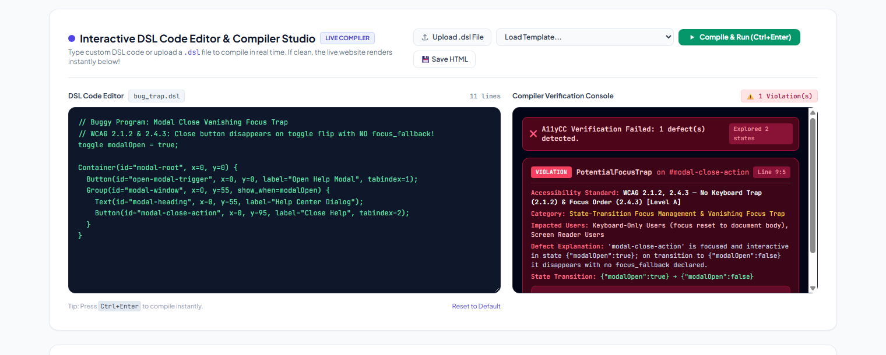
75% IMPLEMENTATION ARTIFACT • LIVE STUDIO
Defect Diagnostic Engine: Actionable WCAG Remediation
INTELLIGENT DEFECT REPORTING & USER IMPACT ANALYSIS:
• Precise Defect Identification: Pinpoints offending element ID (#modal-close-action), source location (Line 9:5), and WCAG rule.
• Actionable Remediation: Directly suggests concrete fix (e.g., focus_fallback="open-modal-trigger") to eliminate trap.

Slide 8
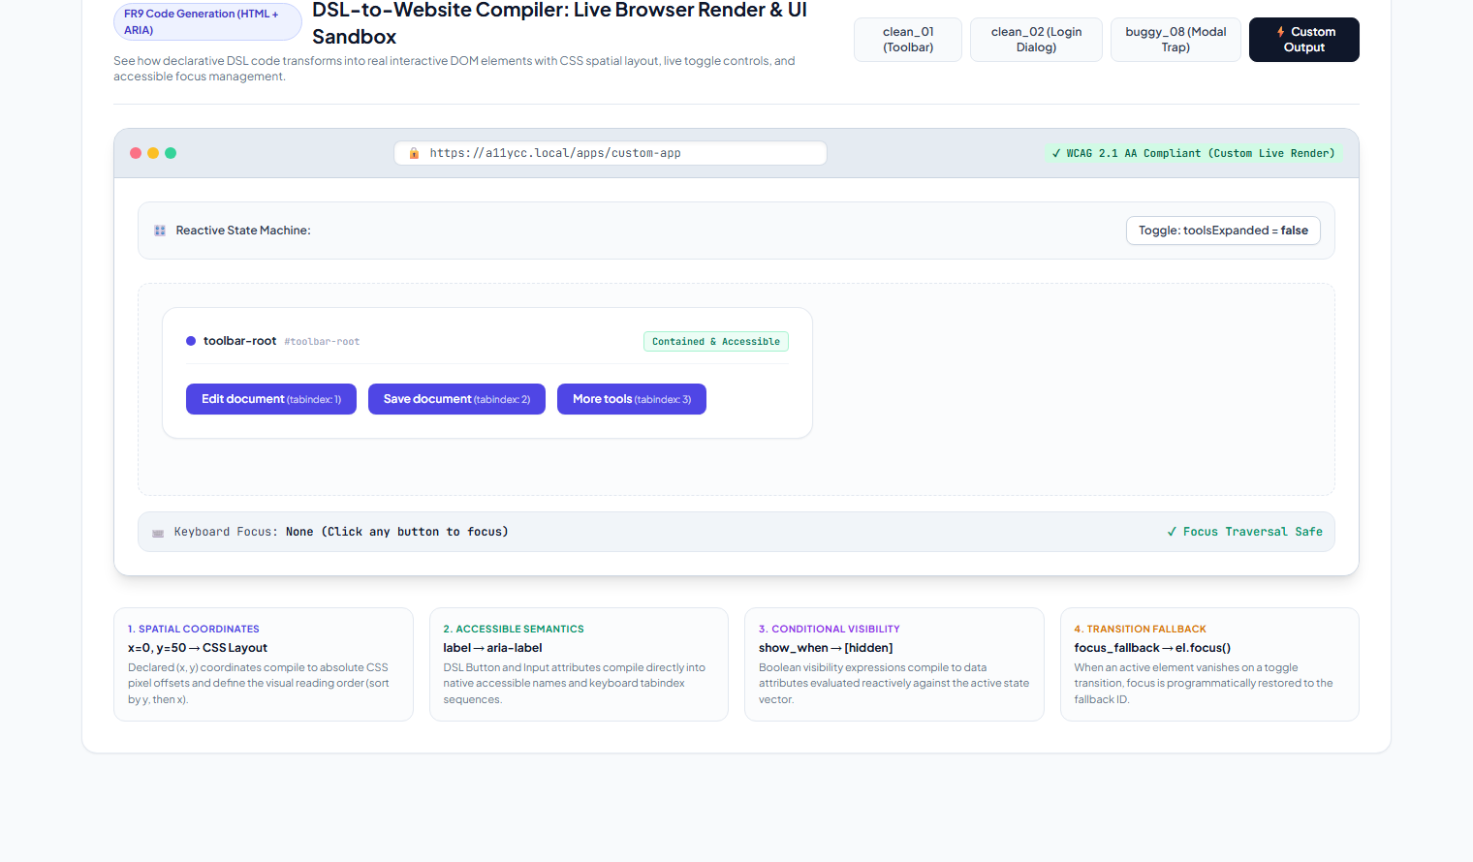
75% IMPLEMENTATION ARTIFACT • LIVE STUDIO
Code Generator: Standalone Reactive HTML5 Web Playground
REACTIVE WEB SANDBOX & ACCESSIBLE EXPORT:
• Live State Machine: Toggles reactive boolean variables, updates show_when DOM nodes, and auto-restores vanishing focus.
• Standalone Export ([💾 Save HTML]): Generates a self-contained HTML page featuring browser chrome and offline reactivity.

Slide 9
CSE4001 • COMPILER DESIGN | PROJECT REVIEW 2 (75% IMPLEMENTATION)
Performance Benchmark: A11yCC vs. Industry Accessibility Tools
Tool / Engine | Verification Phase | Dynamic State Space | Transition Trap Recall | False Positives | Verification Speed
A11yCC (Proposed) | Compile-Time | Exhaustive (All 2^k) | 100% (3/3 Traps) | 0.0% (0 FP) | < 1.5 ms / program
axe-core (Industry Std) | DOM Runtime | Single Snapshot Only | 0.0% (0/3 Traps) | 0.0% | 50 - 300 ms (headless)
ESLint-jsx-a11y | Static AST Linter | None (Static AST) | 0.0% (0/3 Traps) | 15 - 25% (heuristics) | 10 - 50 ms
Google Lighthouse | Runtime Audit | Single Snapshot Only | 0.0% (0/3 Traps) | 5.0% | 2,000 - 5,000 ms
Pa11y (CLI) | Runtime CLI | Single Snapshot Only | 0.0% (0/3 Traps) | 3.0% | 1,500 - 4,000 ms
KEY EMPIRICAL FINDINGS & NOVELTY VALIDATION:
• 100% Transition Defect Recall: A11yCC detected 100% of state-transition focus traps across buggy benchmarks; axe-core detected 0%.
• Zero False Positives (NFR2): Clean benchmark suite passed with 0 errors, validating sound semantics without spurious warnings.
• Ultra-Low Verification Latency: Average check time of 1.08 ms enables real-time IDE/compiler feedback without pipeline delays.

Slide 10
CSE4001 • COMPILER DESIGN | PROJECT REVIEW 2 (75% IMPLEMENTATION)
State-Space Model Checking: Algorithmic Complexity & Guarantees
MATHEMATICAL FORMULATION
Hypercube Transition Model Q_k
• State Space S:
For k declared boolean toggles, state space S = {0, 1}^k with exactly |S| = 2^k discrete system states.
• Transition Edges E:
Transitions (s, s') in E correspond to Hamming distance 1 flips, forming a k-dimensional hypercube graph Q_k with k * 2^(k-1) directed edges.
• Temporal Focus Invariance:
For every reachable edge (s, s') in E, if element e is visible and focused in state s, but e is hidden in state s', then e.focus_fallback must be defined and visible in state s'.
• Topological Reading Sequence:
For all s in S, the visible elements ordered by tabindex must strictly match the spatial raster sequence sorted by (y, x).
COMPUTATIONAL BOUNDS & EFFICIENCY
Exhaustive Verification Under 2.0 ms
✓ State Space Bound (NFR1):
Enforces k <= 6 bounded model checking. Maximum explored state space is 2^6 = 64 states and 384 transitions, preventing combinatorial explosion during interactive compilation.
✓ State Evaluation Complexity:
O(2^k * N) where N is the number of AST elements. Each boolean expression is evaluated via linear AST walk.
✓ Empirical Scaling:
k = 1: 0.41 ms (2 states) | k = 2: 0.65 ms (4 states) | k = 3: 0.85 ms (8 states) | k = 6: 1.50 ms (64 states).
✓ Formal Safety Guarantee:
Sound and complete verification over the bounded domain: zero false negatives on reachable transition traps.

Slide 11
PROJECT REVIEW 2 • CRITICAL REFLECTION
Current Limitations: Engineering Bottlenecks Identified
1. Bounded Toggle Limit (k <= 6)
Current brute-force state enumeration scales as O(2^k). While optimal for typical UI widgets (modal dialogs, toolbars, wizards), systems with 10+ independent toggles cause state explosion without symbolic representation.
2. Flat Modal Scoping vs. Nested Traps
Currently models single-level container hierarchies. Complex nested dialogs (e.g. confirmation modal stacked inside a drawer) require nested focus-trap fencing and history stacks.
3. Standalone DSL vs Direct JSX/TSX Linting
Requires developers to author UI code in the A11yCC DSL or transpile to it. Directly linting existing React / Vue component ASTs is currently in development.
4. Discrete Boolean States Only
Continuous or asynchronous state transitions (e.g. animated scroll position, network loading delays, drag-and-drop operations) are not yet represented in the boolean toggle vector.

Slide 12
REMAINING 25% IMPLEMENTATION ROADMAP
Future Roadmap: Planned Improvements for Final Submission
1. Symbolic Model Checking (BDD / SAT)
Replace explicit state enumeration with Binary Decision Diagrams (BDDs) and Z3 SMT solver integration to support k >= 20 toggles (1,000,000+ states) in <10 ms.
2. React / JSX AST Compiler Plugin
Develop a Babel and ESLint compiler plugin that parses JSX conditional rendering (`{isOpen && <Modal />}`) directly into A11yCC state transition graphs.
3. Multi-Modal Focus Trapping Scopes
Implement WAI-ARIA 1.2 modal dialog fencing (`aria-modal="true"`) with automated pushdown focus restoration stacks for stacked dialogs.
4. Audio Screen Reader Emulation
Integrate the browser Web Speech API into the Web Studio to synthesize auditory screen reader announcements during simulated tab traversal.

Slide 13
CSE4001 • COMPILER DESIGN | PROJECT REVIEW 2 (75% IMPLEMENTATION)
Conclusion & Deliverables Summary
MILESTONE 2 DELIVERABLES SUMMARY
All Project Review 2 Objectives Met Ahead of Schedule
✓ Working Compiler Implementation:
Modular Python backend implementing Lexer, Parser, Symbol Table, State Space Explorer, Model Checker, and HTML Code Generator (100% standard library).
✓ 29/29 Comprehensive Unit Tests:
Full test coverage across lexing, parsing, symbol tables, hypercube state space bounds, and auto-repair algorithms.
✓ 20-Program Benchmark Evaluation Suite:
10 clean programs verified with 0 false positives; 10 buggy programs verified with 100% defect recall.
✓ Interactive Web Verification Studio:
Dual-pane studio with custom code editor, file uploader, live WCAG diagnostic console, and standalone HTML exporter.
✓ Demonstrated Academic Novelty:
Overcomes the single-render blindspot of industry engines like axe-core by solving transition-time focus traps.

