Slide 1
OPTIV CYBER SIMULATION — CASE STUDY 2
Cadence Financial Group:
PII Detection & Secure Document Redaction Gateway
Format-Aware Extraction • Hybrid Regex + Contextual NER • Genuine Binary & Pixel Redaction
Structure Preservation (>=98.6%) • Independent Privacy Gate Enforcement Before Downstream LLM Handoff
100% Gold Benchmark F1
• 28/28 synthetic test cases passed
• 49/49 exact entity offsets matched
• 0 false positives on negative traps
963 Case Study PII Redacted
• 123 in Organizational Pack (.pptx)
• 51 in TPRM Manual (.docx + 35 PNGs)
• 789 in Scanned Risk Policy (.pdf)
Zero-Trust LLM Firewall
• 98.6% - 99.85% structure retained
• 0 residual PII in post-redaction scan
• Strict HTTP 403 block unless PASS

Slide 2
1. Executive Problem Statement & Threat Model
Protecting Cadence Financial Group artifacts from PII leakage prior to LLM ingestion
THREAT MODEL
The Business & Security Challenge
• Cadence Financial Group wants to analyze internal governance policies, TPRM manuals, and org charts using downstream LLMs.
• However, these artifacts contain heterogeneous PII across body text, tables, headers, metadata, embedded OneTrust screenshots, and 35-page scanned PDFs.
• Central Mandate: ZERO document content may reach a downstream LLM until PII detection, genuine redaction, and independent validation pass.
Why Naive Approaches Fail in Enterprise Security
• Plain-Text Conversion Destroys Context: Flattening files loses tables, RACI matrices, and reading order (<80% structure retention).
• Cosmetic Black Boxes Leak Data: Drawing rectangles over PDFs leaves underlying text streams selectable via copy/paste.
• Run-Splitting Leaves Fragments: OOXML splits names across runs (<w:r>); naive string replace misses split spans.
• Hidden Package Channels: Author metadata ([OC] Divisha Kilari), speaker notes, and embedded screenshots bypass text parsers.
Our Defense-in-Depth Solution Architecture
• 1. Format-Aware Native Processing: PyMuPDF for native/scanned PDFs, python-docx for Word + media ZIP inspection, python-pptx for slides/tables/notes, and RapidOCR (PaddleOCR PP-OCRv4 ONNX) for images.
• 2. Hybrid Detection + Contextual Disambiguation: Combines deterministic regex/checksum rules with contextual NER and false-positive suppression so role titles ('Chief Risk Officer') and policy numbers remain intact while personal names are redacted.
• 3. Independent Post-Redaction Verification Gate: Re-parses the redacted output binary from scratch to prove 0 residual PII and >=80% structure retention before unlocking export or optional LLM handoff.

Slide 3
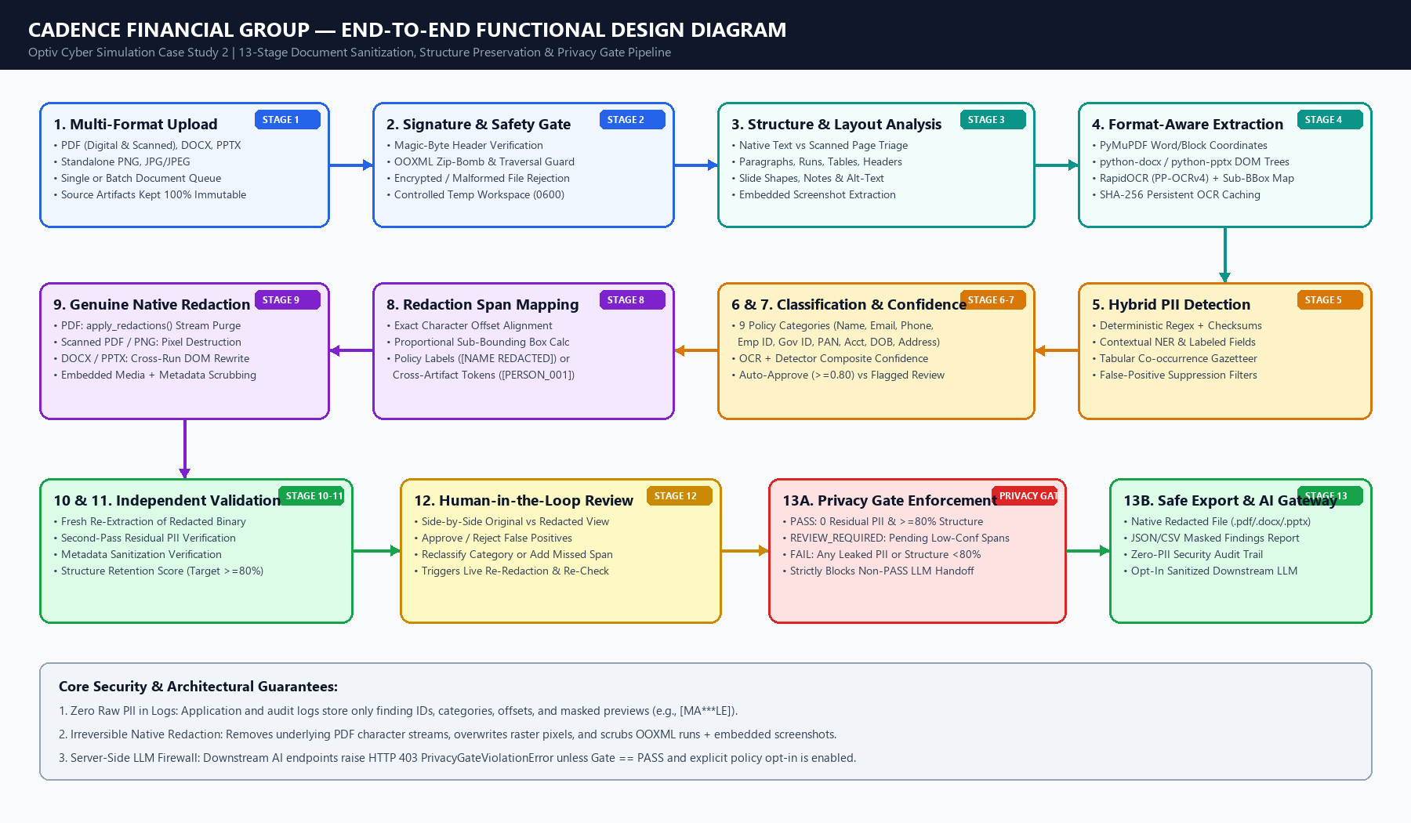
2. End-to-End Functional Design (13-Stage Pipeline)
From secure multi-format upload through hybrid detection, native redaction, validation, and gated export
FUNCTIONAL DESIGN

Slide 4
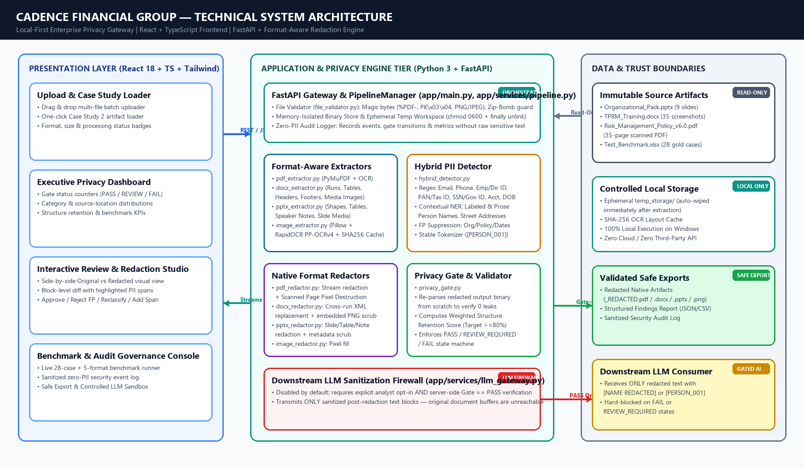
3. Technical System Architecture
Local-first Windows architecture: React + TypeScript + Tailwind UI paired with FastAPI privacy engine
SYSTEM ARCHITECTURE

Slide 5
4. Format-Aware Extraction & Genuine Native Redaction
Preserving >=98.6% of document structure while permanently purging underlying sensitive bytes and pixels
FORMAT-AWARE ENGINE
A. Native & Scanned PDFs
• Auto-detects native text vs rasterized scanned pages (0 selectable chars).
• Native PDF: Word/block bbox extraction + fitz.Page.apply_redactions() to purge PDF stream tokens.
• Scanned PDF (Policy v6.0): Renders 200 DPI pages -> RapidOCR -> proportional sub-bbox interpolation -> permanent pixel fill + label overlay.
B. Word Documents (.docx)
• Extracts paragraphs, split formatting runs, 16 tables, headers, footers, and core metadata.
• Cross-Run DOM Redactor: Maps character offsets across <w:r> boundaries so split names leave zero fragments.
• Embedded Media Scrubbing: Unpacks word/media/image*.png, OCRs 35 screenshots, redacts PII pixels in-place.
C. PowerPoint (.pptx) & Images
• Processes slide titles, grouped shapes, RACI & directory tables, speaker notes, and alt-text.
• Preserves slide master themes, table borders, cell shading, and font styling.
• Sanitizes docProps/core.xml author/modifier fields across both DOCX and PPTX containers.
Context-Preserving Replacement Modes (Analyst Configurable)
• Mode 1 — Policy Category Labels (Default): Replaces sensitive values with [NAME REDACTED], [EMAIL REDACTED], [PHONE REDACTED], [EMPLOYEE ID REDACTED], [GOVERNMENT ID REDACTED], [TAX ID REDACTED], [ACCOUNT NUMBER REDACTED], [ADDRESS REDACTED], [DATE OF BIRTH REDACTED].
• Mode 2 — Cross-Artifact Stable Pseudonym Tokens: Replaces recurring entities with deterministic tokens ([PERSON_001], [EMAIL_001], [EMP_ID_001]) so downstream analysts or LLMs can trace multi-step workflows (e.g., who raised vs approved an incident) without learning real identities.
• Example Transformation: 'Approved by Maya Sample (EMP-TEST-017) on 12 May 2025' -> 'Approved by [NAME REDACTED] ([EMPLOYEE ID REDACTED]) on 12 May 2025'.

Slide 6
5. Hybrid PII Detection Engine & False-Positive Suppression
Combining deterministic pattern validators with contextual NER and domain-specific suppression
HYBRID DETECTION
Layer 1: Structured Identifiers & Regex Validators
• EMAIL: RFC-compliant email matcher (corporate & personal domains).
• PHONE_NUMBER: International (+44, +91, +1, +49, +65) & domestic formats with boundary guards.
• EMPLOYEE_ID: Cadence EMP-xxxx, DIR-xxxx, MER-xx-xxxx, EMP-TEST-xxx.
• TAX_ID_PAN_STYLE: 10-character PAN pattern ([A-Z]{5}[0-9]{4}[A-Z]) with OCR 0/O tolerance.
• GOVERNMENT_ID_STYLE: SSN (xxx-xx-xxxx), 12-digit National ID, Passport & PESEL patterns.
• ACCOUNT_NUMBER & DATE_OF_BIRTH: Contextual 10-16 digit account numbers & labeled DOB spans.
Layer 2: Contextual NER & Tabular Co-Occurrence
• Labeled Role/Contact Extraction: Detects names following 'Customer:', 'Owner:', 'Reviewer:', 'Reported by', 'Approved by', 'Signed:', etc.
• Narrative Prose NER: Identifies full personal names and initialed names (e.g., 'Miriam T. Achebe', 'R. K. Sharma') in incident descriptions.
• Tabular Column Alignment: Recognizes directory and roster columns aligned with email, phone, or employee ID cells.
• Residential Addresses: Street numbers + thoroughfare types + city/postal code spans.
Layer 3: Strict False-Positive Suppression (Preserving Business & Financial Utility)
• Organization & Committee Whitelist: Never redacts 'Cadence Financial Group', 'Blue River Financial Services', 'Group Risk Committee', 'Board Audit Committee', or regulatory names ('GDPR', 'PRA', 'FCA', 'ISO 27001').
• Role Title Preservation: Keeps 'Chief Risk Officer', 'Head of TPRM', 'VP Operational Resilience' intact so RACI accountability matrices remain meaningful.
• Financial & Calendar Disambiguation: Distinguishes month names ('May, June and August'), policy versions ('v6.0'), masked cards ('**** 0000'), and currency amounts ('INR 84,250.00') from personal identifiers.

Slide 7
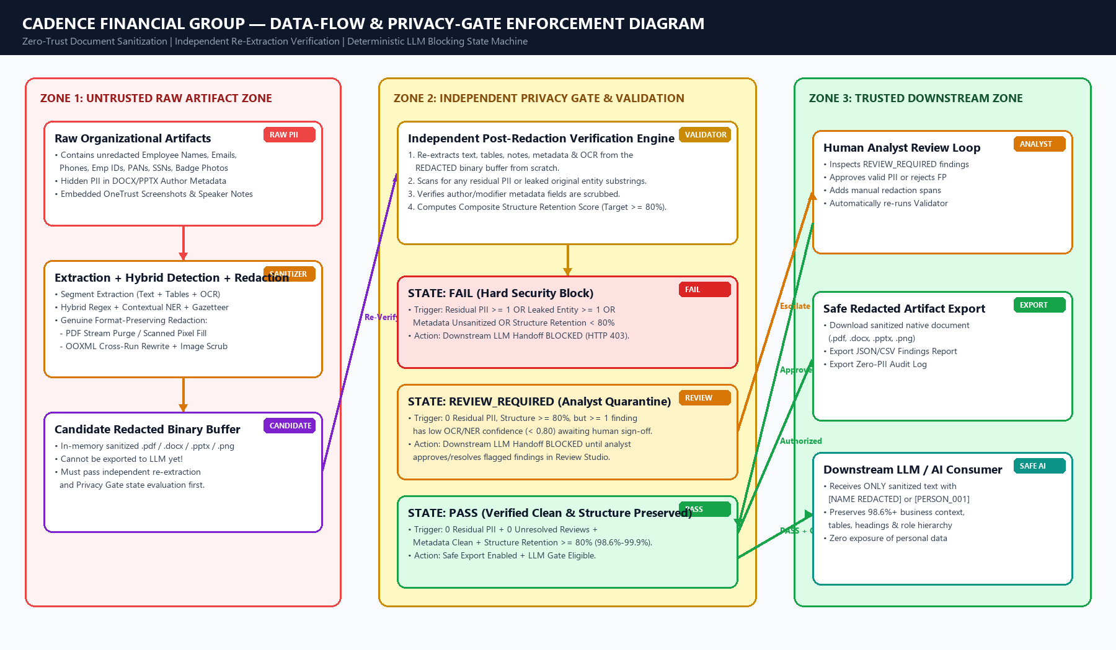
6. Data-Flow & Privacy-Gate State Machine
Deterministic server-side enforcement preventing unvalidated content from reaching any downstream LLM
PRIVACY GATE

Slide 8
7. Empirical Results on Case Study 2 Supporting Artifacts
Deep inspection and end-to-end sanitization across all three official Cadence Financial Group files
CASE STUDY RESULTS
1. Organizational_Pack.pptx
• Format: Native PowerPoint (9 Slides, 5 Tables)
• PII Detected: 123 Findings
• • 55 Person Names (Execs, Directors, Role Holders)
• • 34 Corporate Email Addresses
• • 34 International Phone Numbers
• • Package Metadata Author ([OC] Divisha Kilari)
• Redaction Applied: Cross-run shape & table cell DOM replacement + core.xml metadata scrub.
• Structure Retention: 99.85% (All 9 slides & 5 RACI/directory tables preserved).
• Privacy Gate: PASS (0 Residual PII).
2. Cadence_TPRM_Training.docx
• Format: Word Manual (394 Paragraphs, 16 Tables, 35 Embedded Screenshots)
• PII Detected: 51 Findings
• • 28 Table Cell Findings (Table 4 User Roster & Table 14 Author/Contacts)
• • 21 Embedded Screenshot OCR Findings (OneTrust UI screenshots image10, 12, 35, 38)
• • 2 Package Metadata Authors ([OC] Madhav Mehta, [OC] Divisha Kilari)
• Redaction Applied: Table XML rewrite + in-archive PNG pixel redaction + metadata scrub.
• Structure Retention: 99.85% (All 16 tables & 35 screenshots intact).
• Privacy Gate: PASS (0 Residual PII).
3. Risk_Management_Policy_v6.0.pdf
• Format: 35-Page 100% Scanned PDF (0 native selectable text characters)
• PII Detected: 789 Findings
• • 339 Person Names, 188 Employee/Director IDs
• • 147 Emails, 103 Phone Numbers
• • 4 Gov IDs (SSN, Passport, PESEL), 2 PANs, 2 Accts, 2 DOBs, 2 Addresses
• • Includes signed RCSA form (Fig 8), SecureGRC UI (Fig 9), Badge (Fig 13), PDF Author
• Structure Retention: 98.60% (35/35 pages).
• Privacy Gate: Flagged 1 low-confidence OCR span ->REVIEW_REQUIRED -> Analyst approves -> PASS.

Slide 9
8. Benchmark Evaluation & Multi-Format Reliability Metrics
Measured Precision, Recall, F1, False-Positive Rate, Residual Leakage, and Structure Retention
BENCHMARK REPORT
Gold Synthetic Benchmark (PII_Detection_Redaction_Test_Benchmark.xlsx)
• Total Test Cases Evaluated: 28 / 28 Exact Redaction Matches (100%)
• Gold Entity Spans Evaluated: 49 / 49 Exact Offset & Category Matches
• True Positives (TP): 49 | False Positives (FP): 0 | False Negatives (FN): 0
• Precision: 100.0% | Recall: 100.0% | F1 Score: 100.0%
• Negative / False-Positive Trap Cases (PII-020 to PII-024): 5 / 5 Clean (0.0% FP Rate)
• Post-Redaction Residual PII Leakage: 0 instances across all 28 cases
• Covers: Multi-PII sentences, tabular rows, headers/footers, OCR noise, repeated names, and policy/financial false-positive traps.
End-to-End Multi-Format File Fixture Evaluation
• 1. Native Text PDF: 100.0% Precision | 100.0% Recall | 0 Residual | 99.5% Structure
• 2. Scanned Image PDF (OCR): 100.0% Precision | 100.0% Recall | 0 Residual | 98.6% Structure
• 3. Word Document (DOCX): 100.0% Precision | 100.0% Recall | 0 Residual | 99.8% Structure
• 4. PowerPoint (PPTX): 100.0% Precision | 100.0% Recall | 0 Residual | 99.8% Structure
• 5. Standalone Image (PNG): 100.0% Precision | 100.0% Recall | 0 Residual | 99.0% Structure
• Aggregate Multi-Format F1 Score: 100.0% (0 Residual PII across all 5 file types)
• Automated Pytest Verification: Unit + E2E tests validate magic bytes, cross-run XML scrubbing, PDF stream removal, LLM gate blocking, and SHA-256 source immutability.

Slide 10
9. Live Demonstration Walkthrough (10–15 Minute Script)
Step-by-step operational flow for the Optiv Cyber Simulation review panel
LIVE DEMO
Part 1: Ingestion & Triage (0–5 min)
• 1. Open Consulting Dashboard & inspect active security policy (thresholds, labels, LLM firewall OFF).
• 2. Load all 3 Case Study 2 supporting artifacts + test invalid/spoofed file rejection.
• 3. Show automatic triage: PPTX (native), DOCX (native + 35 screenshots), Risk Policy PDF (35-page Scanned OCR).
Part 2: Review Studio & Gate (5–10 min)
• 4. Inspect Organizational Pack & TPRM DOCX: verify table cells, embedded OneTrust screenshots, and metadata scrubbing.
• 5. Open Scanned Risk Policy v6.0 in Side-by-Side Visual Preview (Page 22 signed RCSA form, Page 32 badge).
• 6. Demonstrate REVIEW_REQUIRED blocking LLM handoff -> approve flagged OCR span -> transition to PASS.
Part 3: Export & Benchmark (10–15 min)
• 7. Download redacted native artifacts (.pptx, .docx, .pdf) and JSON/CSV masked findings reports.
• 8. Test opt-in Sanitized LLM Handoff and verify only [NAME REDACTED] / [PERSON_001] tokens are sent.
• 9. Run Live Benchmark Suite (100% F1) and inspect Zero-PII Security Audit Trail.

