Slide 1
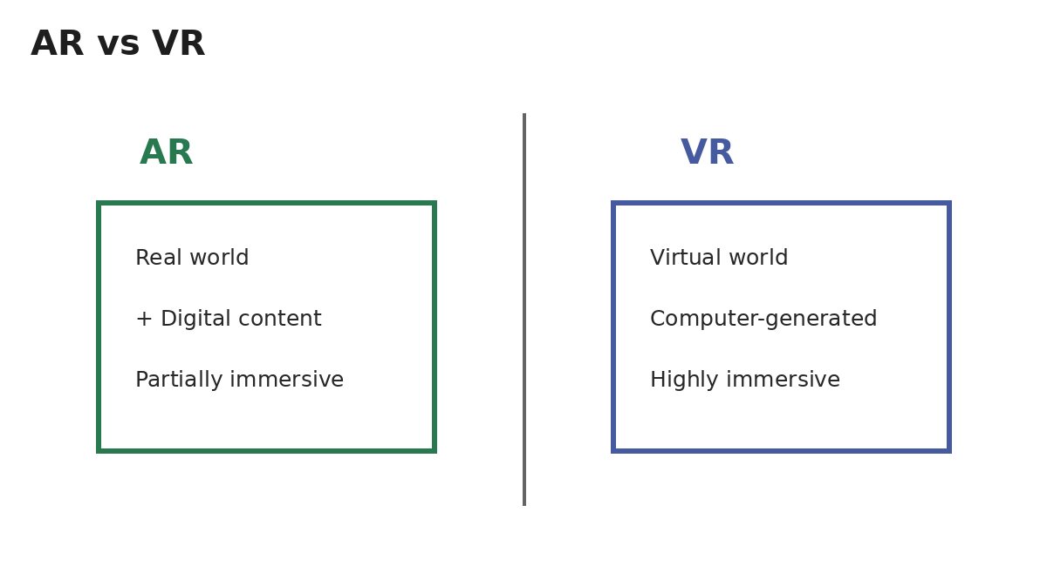
AR/VR Development
Learning Materials & Notes

Slide 2
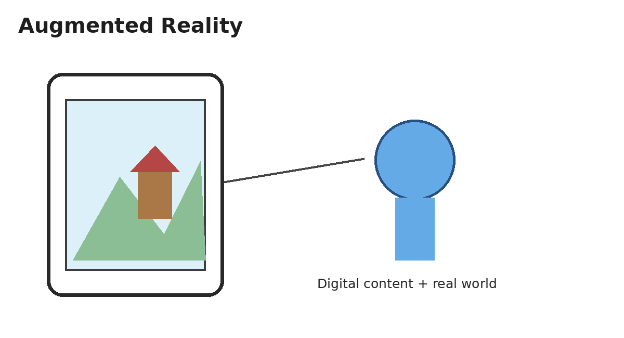
1. Introduction to AR
AR adds digital content to the real-world view.
Content may include 3D objects, text, images, or animations.
Cameras and sensors help understand the user's environment.
Example: viewing a 3D product through a smartphone.

Slide 3
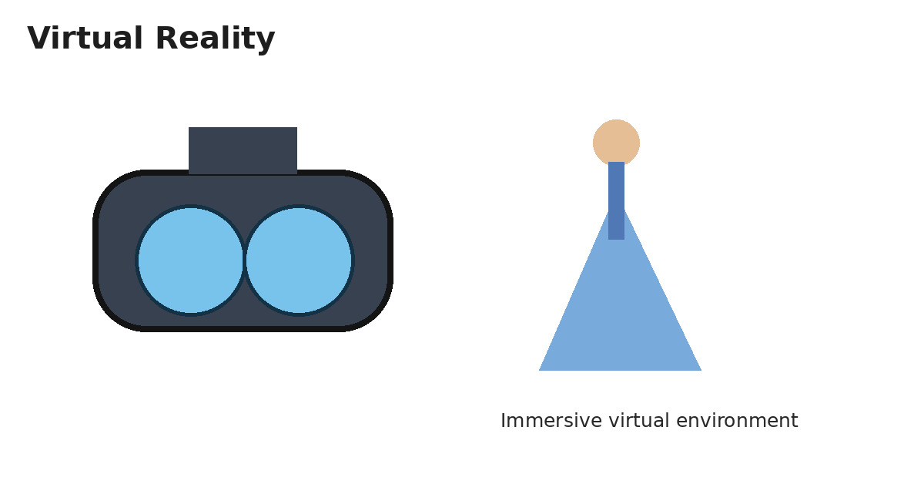
2. Introduction to VR
VR creates a computer-generated environment.
Users can look around and interact with a simulated world.
VR commonly uses headsets, controllers, sensors, and tracking.
Applications include training, education, simulation, and gaming.

Slide 4
3. AR vs VR
AR keeps the real world visible and adds digital content.
VR replaces the normal view with a virtual environment.
AR is useful for information over real objects.
VR is useful for fully simulated experiences.

Slide 5
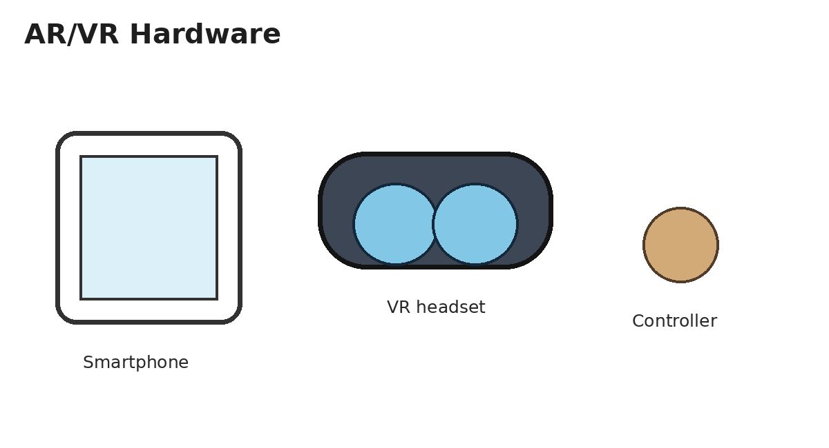
4. AR/VR Hardware
AR: smartphones, tablets, smart glasses.
VR: headsets, controllers, tracking sensors, audio.
Cameras, gyroscopes, and accelerometers support tracking.
Haptic devices can provide physical feedback.

Slide 6
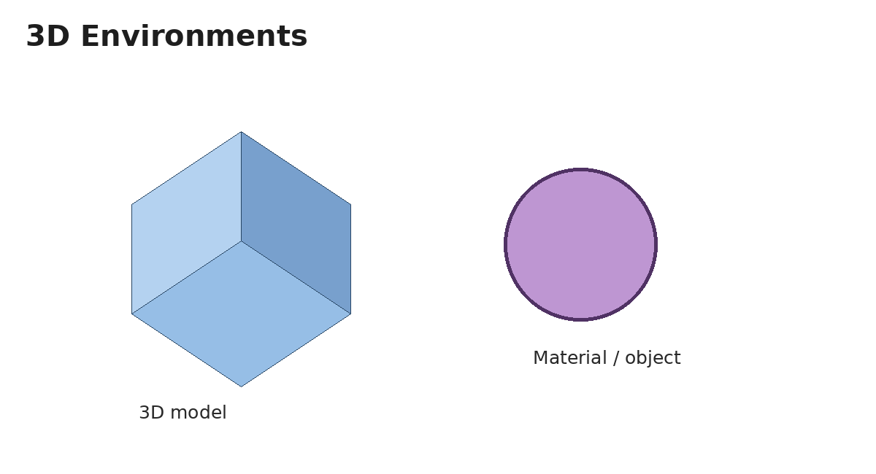
5. 3D Models and Environments
3D models digitally represent objects.
Textures define appearance and materials define surface behavior.
Lighting and cameras improve realism.
A virtual environment combines objects, space, sound, and interaction.

Slide 7
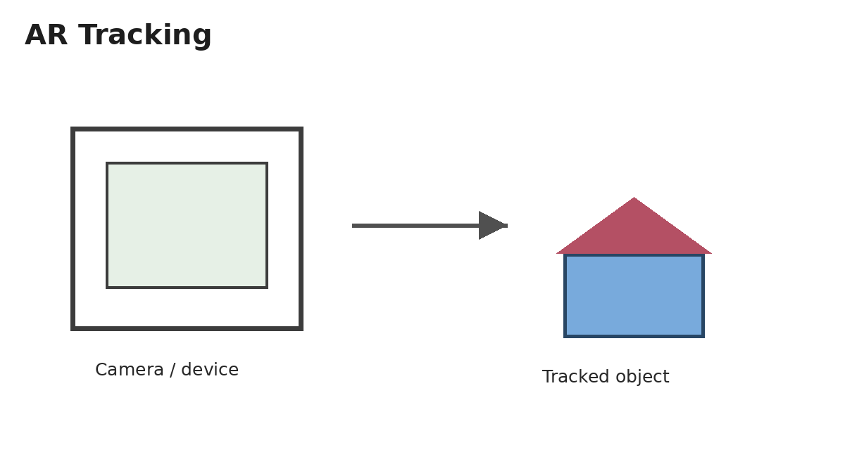
6. AR Tracking
Tracking detects device movement and surroundings.
Marker-based AR uses known visual markers.
Markerless AR uses environmental features and surfaces.
Accurate tracking keeps digital objects stable.

Slide 8
7. AR Interaction
Users can interact through touch, gestures, movement, or device controls.
Objects can be rotated, scaled, selected, or moved.
Good interaction should be simple and responsive.

Slide 9
8. VR Interaction and Immersion
VR allows users to move and interact with virtual objects.
Immersion depends on visuals, audio, tracking, and responsiveness.
Clear controls improve usability.
Comfort should be considered when designing experiences.

Slide 10
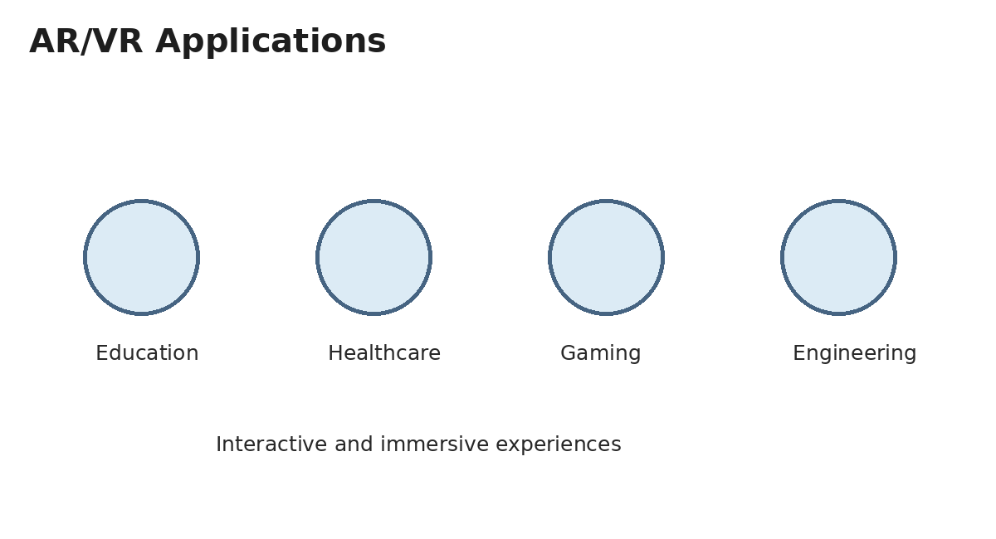
9. AR/VR Applications
Education: interactive models and virtual laboratories.
Healthcare: training, visualization, and rehabilitation.
Engineering: design visualization and simulation.
Gaming and entertainment: immersive digital worlds.

Slide 11
10. AR/VR Development Process
1. Identify the problem and target users.
2. Choose AR or VR for the use case.
3. Design the experience and interaction flow.
4. Create/import 3D assets.
5. Implement tracking and interaction.
6. Test performance and usability.

Slide 12
11. Advantages
Interactive and engaging experiences.
Visualization of complex concepts.
Safe practice through simulations.
Useful for training and product visualization.
Creates new forms of digital interaction.

Slide 13
12. Challenges
Hardware and development can be costly.
High-quality 3D content requires effort.
Tracking and performance must be reliable.
Some users may experience discomfort.
Privacy and security should be considered.

Slide 14
13. Mini Project
Project: AR Educational Object Viewer.
Allow students to view and explore 3D educational objects.
Features: placement, rotation, scaling, labels, and interaction.
Learning outcome: understand tracking, 3D objects, and AR interaction.

