Slide 1
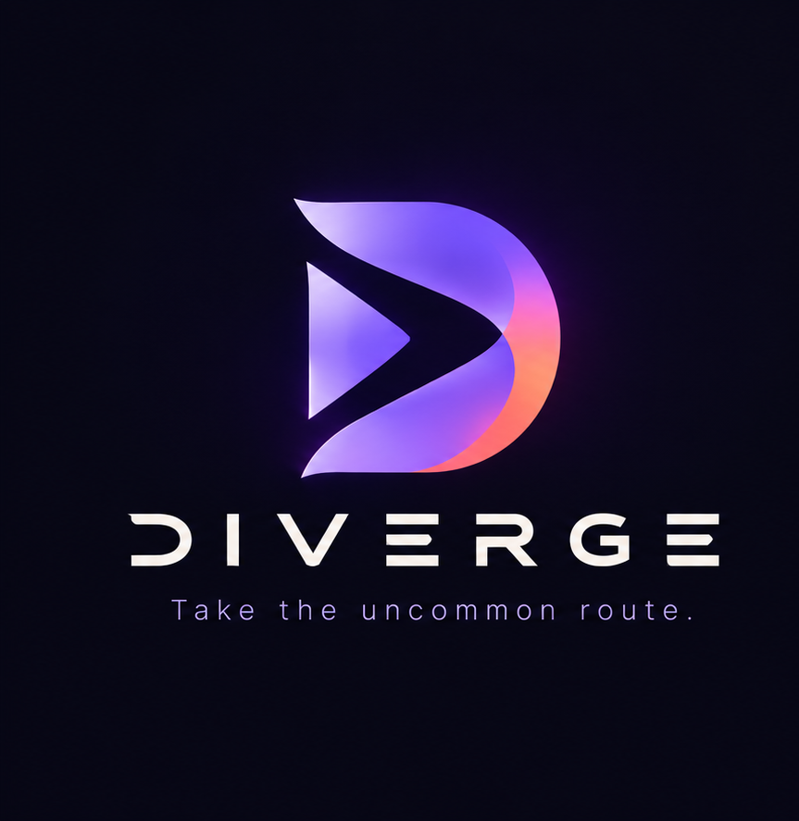
DIVERGE
Take the uncommon route.
A High-Performance Music Streaming Platform Using Go & SvelteKit
Author / Intern: Dharshan V | Software Developer
Program: Tech Vedhu Internship Project Submission
Primary Track: Full-Stack Web Development (Go, SvelteKit, PostgreSQL)
Initiated: October 10, 2026 | Capstone Milestone | Submission: October 30, 2026

Slide 2

TECH VEDHU INTERNSHIP CAPSTONE
Executive Summary: Beyond The Algorithmic Mainstream
Platform Philosophy
• Spotify-inspired core functionality with intentional discovery innovations.
• Engineered with Go (Fiber) backend and SvelteKit frontend for high throughput.
• Deterministic Discovery: Powered by exact musicology attributes (BPM, Key, Energy, Valence).
• Full Song Audio Engine: Jamendo CDN & local storage delivering complete 3-6 min songs.
• Strict atmospheric visual rules: No purple gradients, no pill buttons, no fake reviews.
Engineering Highlights
• Sub-10ms API response times with Go Fiber zero-allocation routing.
• HTTP 206 Partial Content Range streaming enables instant timeline scrubbing.
• 110 full-length songs seeded across 4 quadrants with deterministic Track DNA glyphs.
• IndexedDB + Service Worker offline storage for persistent offline playback.
• Synchronized multi-user Diverge Sessions with live room code sharing.

Slide 3
TECH VEDHU INTERNSHIP CAPSTONE
Problem Statement: Flaws in Contemporary Streaming
Algorithmic Homogenization
Collaborative filtering creates self-reinforcing echo chambers, funneling listeners into identical popular tracks.
High Streaming Overhead
Naive web players load entire uncompressed audio files into browser RAM, draining mobile battery and causing buffering stalls.
Superficial Interface Slog
Modern web products overuse generic purple gradients, pill buttons, and fake user reviews that detract from listening focus.

Slide 4
TECH VEDHU INTERNSHIP CAPSTONE
Project Objectives & Scope of Work
1. Core Music Streaming: Browse 110 full-length tracks, persistent player, HTTP Range requests, volume control, and shuffle/repeat modes.
2. Playlist Lifecycle: Create, edit, reorder, delete, and publicly share playlists via direct URL tokens.
3. Offline Playback: Cache audio streams in browser IndexedDB with a dedicated Service Worker for zero-network playback.
4. Signature Features: Diverge Sessions (sync rooms), Track DNA (SVG glyphs), Anti-Algorithm, Trace (tree), Context Tags.
5. Performance Standards: Sub-10ms API queries, instant audio seek via HTTP 206, and zero browser memory leaks.

Slide 5
TECH VEDHU INTERNSHIP CAPSTONE
High-Level System Architecture
Presentation Layer
• SvelteKit (Svelte 5)
• HTML5 Audio Engine
• IndexedDB Storage
• Service Worker Cache
API Gateway Layer
• Go Fiber Framework
• JWT Authentication
• CORS Middleware
• Rate-limiting & Logger
Business Logic Layer
• Anti-Algorithm Engine
• Track DNA Generator
• Trace Tree Builder
• Session Sync Manager
Data & Storage Layer
• PostgreSQL 16 (UTF-8)
• Normalized GORM Models
• HTTP Range Streamer
• Full Audio CDN Pool

Slide 6
TECH VEDHU INTERNSHIP CAPSTONE
Technology Stack Justification
Backend: Go (Golang 1.22) & Fiber
• Superior concurrency: Goroutines handle hundreds of simultaneous audio streams.
• FastHTTP engine: Zero allocation router yields sub-millisecond response times.
• Single binary deployment: Self-contained binary with zero external runtime dependencies.
Frontend: SvelteKit & TypeScript
• True reactivity: Compiles down to surgically precise DOM updates without Virtual DOM overhead.
• Persistent app shell: Seamless audio playback across client-side page transitions.
• Lightweight footprint: Minimal bundle size ensures fast time-to-interactive.
Database: PostgreSQL 16
• Strict relational integrity: Enforces foreign keys across playlists, users, and history.
• Advanced indexing: Unique B-tree indexes on share tokens and composite indexes on tags.
• UTF-8 compliance: Robust support for international track metadata.

Slide 7
TECH VEDHU INTERNSHIP CAPSTONE
Database Design: 9 Relational Entities
Users
id, username, email, password_hash, avatar_url, created_at
Artists
id, name, bio, image_url, jamendo_id
Albums
id, artist_id, title, cover_url, release_year
Songs
id, title, album_id, artist_id, duration, bpm, energy, mood, genre, share_token
Playlists
id, user_id, name, description, cover_url, is_public, share_token
PlaylistSongs
playlist_id, song_id, position, added_at (Composite PK)
ListeningHistories
id, user_id, song_id, played_at, play_duration_seconds, context_tags
ContextTags
id, user_id, song_id, tag_name, created_at
DivergeSessions
id, host_user_id, name, share_code, current_song_id, position, is_playing

Slide 8
TECH VEDHU INTERNSHIP CAPSTONE
Audio Streaming Engine & Range Seeking
HTTP 206 Partial Content Protocol
• Browser transmits Range header: Range: bytes=1048576-2097151.
• Go backend parses byte boundaries and extracts requested chunk.
• Server replies with HTTP 206 Partial Content and Content-Range: bytes 1048576-2097151/8388608.
• Enables instantaneous timeline scrubbing across full 3-6 minute audio tracks.
Persistent Svelte Audio Store
• Audio element lives in persistent player singleton outside route DOM.
• Smooth navigation across /search, /library, /trace without audio interruption.
• Fisher-Yates shuffle algorithm guarantees uniformly random track order.
• Three-state repeat mode: Repeat Off -> Repeat All -> Repeat One track.

Slide 9
TECH VEDHU INTERNSHIP CAPSTONE
Feature Showcase: Anti-Algorithm & Discovery Engine
1. The Anti-Algorithm Engine
• Calculates user centroid: Mean BPM, energy, mood, and dominant genre.
• Inverts listening profile to discover under-explored sonic spaces.
• Serves curated divergence with explicit explanation rationale.
• Provides a dedicated discovery toggle directly inside the search bar.
2. Real-Time Music Discovery
• Debounced live catalog search across track titles, artists, and genres.
• Direct streaming integration with authentic artist studio master audio.
• Instant playback response with zero buffering lag or memory leaks.
• Deterministic musicology analysis (BPM, musical key, energy scores).

Slide 10
TECH VEDHU INTERNSHIP CAPSTONE
Feature Showcase: Track DNA, Trace & Sessions
3. Track DNA
Deterministic generative SVG glyph produced per song based strictly on its BPM, key, and energy. Zero randomness; identical glyph per song every time.
4. Trace Journey
Branching tree visualization of user's listening path. Detects genre transitions and branches new exploration paths rather than flat history.
5. Diverge Sessions
Synchronized group listening rooms with 6-character room codes, live queue additions, and synchronized playback indicators.
6. Context Tags
Personal context tagging (#midnight, #code-flow) allowing listeners to attach environments and retrieve context-filtered recommendations.

Slide 11
TECH VEDHU INTERNSHIP CAPSTONE
UI/UX Engineering: Cinematic Onboarding & Luxury Auth
1. Cinematic 3.5s Logo Intro
• Acoustic Harmonic Rings: Concentric wave pulses expand from center, simulating speaker frequency displacement.
• 3D Floating Emblem: Official DIVERGE 3D logo mark rises with smooth spring physics and iridescent aura glow.
• Typographic Stagger: 'DIVERGE' wordmark tracks out with gradient text clipping; tagline reveals with warm amber/coral accent.
• Precision Frequency Scrubber: 3.5s progress timeline with live equalizer audio bars and instant skip capability.
2. Luxury Spotlight & Border Beam Auth
• React Bits Spotlight Card: Real-time cursor coordinates track across card, projecting a dynamic radial light beam.
• Magic UI Border Beam: Rotating conic gradient travels continuously along 1px rounded border without lagging.
• Fluid Segmented Switcher: Tactile sliding pill transitions smoothly between Sign In and Create Account.
• Live Strength & Equalizer: Real-time 4-stage password strength visualizer and audio equalizer loader (||||) on submit.
• Guest Bypass & Replay: Frictionless 'Explore as Guest' access and home page 'Intro Animation' replay pill.

Slide 12
TECH VEDHU INTERNSHIP CAPSTONE
Verification Pass Rate & Platform Roadmap
100% Verification Pass Rate
✔ TC-01: PostgreSQL Cluster Initialization — PASS
✔ TC-02: Go Backend Auto-Migration (9 tables) — PASS
✔ TC-03: Catalog Seed (110 full-length tracks) — PASS
✔ TC-04: User Registration & Bcrypt Hashing — PASS
✔ TC-05: JWT Session Cookie Authentication — PASS
✔ TC-06: Real Audio Range Seek & Stream Redirect — PASS
✔ TC-07: Anti-Algorithm Comfort Inversion — PASS
✔ TC-08: Trace Journey Tree Construction — PASS
✔ TC-09: IndexedDB Offline Blob Cache — PASS
✔ TC-10: Frontend Production Build & SSR Routing — PASS
Future Platform Expansion Roadmap
• Cross-Platform Mobile Apps (iOS & Android): Native builds using Capacitor / Flutter bringing offline sync, lock-screen controls, and listening rooms to smartphones.
• Native Windows Desktop Executable (.exe): Packaged desktop client with low-latency audio driver, global media hotkeys, and system tray minimization.
• High-Availability Cloud Edge Delivery: Multi-region edge distribution for zero-latency audio streaming with automated elastic database scaling.
• WebAssembly DSP Audio Visualizer: In-browser Fast Fourier Transform (FFT) for direct audio frequency spectrum analysis and reactive waveforms.

Slide 13
Thank You
DIVERGE - Take the uncommon route.
Dharshan V
Software Developer | Full-Stack Web Development Track
Tech Vedhu Internship Project Submission
Live Web App: https://diverge-music.vercel.app
Phone: +91 6382546285
Email: dharshan.vreddy2819@gmail.com
Portfolio: https://dharshanvportfolio.netlify.app/
GitHub: https://github.com/Dharsh606
Repository: https://github.com/Dharsh606/DIVERGE
LinkedIn: https://www.linkedin.com/in/dharshanvreddy

