Slide 1
Dharshan S
2021506018
B.Tech Information Technology
Madras Institute of Technology
TNSDC - Machine Learning to
Generative AI
Final Project
DATE:02/04/2024

Slide 2
PROJECT TITLE
Indian Food Classification Using CNN ( Deep Learning Algorithm )
GITHUB LINK:https://github.com/Dharshan465/TNSDC-Generative-AI.git

Slide 3


AGENDA
Problem Statement
Project Overview
Objectives
End Users
Solution and Value Proposition
Model Explanation
Results
Conclusion
3/21/2024 Annual Review

Slide 4

PROBLEM STATEMENT
Identifying and categorizing Indian dishes from images can be challenging due to the diversity and complexity of Indian cuisine. Manual classification of food items is time-consuming and prone to errors, hindering the efficiency of tasks such as menu management, food blogging, and culinary education.

Slide 5

PROJECT OVERVIEW
This project aims to address the challenge of Indian food classification using deep learning techniques. By leveraging Convolutional Neural Networks (CNNs), the project automates the process of identifying and categorizing various Indian dishes from images. This enhances user experience and facilitates tasks such as menu organization, food blogging, and restaurant management.

Slide 6
OBJECTIVES
Develop a deep learning model capable of accurately classifying images of Indian dishes.
Train the model on a dataset consisting of diverse Indian food items.
Evaluate the model's performance using metrics such as accuracy and loss.
Implement the model in a user-friendly interface to enable easy access and utilization by end users.

Slide 7

WHO ARE THE END USERS?
Food enthusiasts
Food bloggers and social media influencers
Restaurant owners and managers
Culinary educators and students

Slide 8

YOUR SOLUTION AND ITS VALUE PROPOSITION
Automated and accurate classification of Indian dishes from images
Time-saving and efficient menu management for restaurants
Streamlined content creation for food bloggers and influencers
Enhanced culinary education through visual recognition of dishes

Slide 9

THE WOW IN YOUR SOLUTION
The wow factor of this project lies in its ability to accurately identify and categorize a wide range of Indian dishes, irrespective of variations in presentation or ingredients. The solution provides users with a seamless and intuitive experience, empowering them to efficiently manage, share, and explore Indian cuisine.
3/21/2024 Annual Review

Slide 10
SYSTEM REQUIREMENTS
HARDWARE REQUIREMENTS
CPU: A multi-core processor (such as Intel Core i5 or higher) is recommended for efficient training and inference.
GPU (Optional): A dedicated graphics processing unit (GPU) from NVIDIA (such as GeForce GTX 1060 or higher) can significantly accelerate deep learning tasks, especially training large models like CNNs.
RAM: At least 8 GB of RAM is recommended for running deep learning frameworks and handling large datasets.
Storage: Sufficient disk space to store the dataset, trained models, and related files. SSDs are preferable for faster data access.

Slide 11
SYSTEM REQUIREMENTS
SOFTWARE REQUIREMENTS
.Python: Python 3.x installed with essential libraries such as NumPy, pandas, and Matplotlib.
Deep Learning Framework: TensorFlow or PyTorch for building and training the CNN model. The code provided in the project uses TensorFlow.
Image Processing Libraries: Libraries like OpenCV and PIL (Python Imaging Library) for image pre-processing and augmentation.
Development Environment: An integrated development environment (IDE) like Jupyter Notebook or PyCharm for coding and experimentation.
Additional Dependencies: Libraries such as scikit-learn, seaborn, and h5py may be required for data analysis, visualization, and model serialization

Slide 12
Algorithm:
The project employs an InceptionV3 CNN model, adept at hierarchical feature extraction from images, ideal for image classification tasks.
Deployment:
The trained CNN model can be deployed across diverse environments like local machines, cloud platforms (Google Cloud, AWS, Azure), and edge devices (Raspberry Pi, NVIDIA Jetson), serialized in HDF5 format for easy sharing and storage.
Evaluation:
Utilizing split datasets for training, validation, and testing, the project evaluates the CNN model's performance using metrics like accuracy, precision, recall, and F1-score, offering insights into its classification capabilities.
Prediction:
After training and evaluation, the project enables real-time prediction of Indian dishes from images, providing users with instant classification results along with confidence scores for each prediction.

Slide 13
MODELLING
Convolutional Neural Networks (CNNs) are a specialized class of deep neural networks designed to process visual data efficiently.
At the core of a CNN's architecture are convolutional layers, which apply convolution operations to input images to extract meaningful features like edges, textures, and shapes.
These layers are followed by pooling layers, which downsample the feature maps to reduce dimensionality while preserving important information.
The final layers of a CNN typically consist of fully connected layers, which perform classification based on the extracted features.
CNNs are particularly effective for tasks such as image classification, object detection, and segmentation due to their ability to automatically learn hierarchical representations of visual data.

Slide 14
MODELLING
This Project utilizes the InceptionV3 architecture, a pre-trained deep learning model known for its exceptional performance in image recognition tasks.
InceptionV3 is capable of extracting intricate features from images, enabling accurate classification of complex objects such as Indian dishes.
The model is fine-tuned on a dataset comprising various types of Indian food items to adapt it specifically to the task of Indian food classification.

Slide 15
RESULTS
Achieved a validation accuracy of 93% after 20 epochs of training.
Successfully classified a diverse range of Indian dishes with high accuracy.
Demonstrated robustness and generalization capabilities across different food presentations and variations.

Slide 16
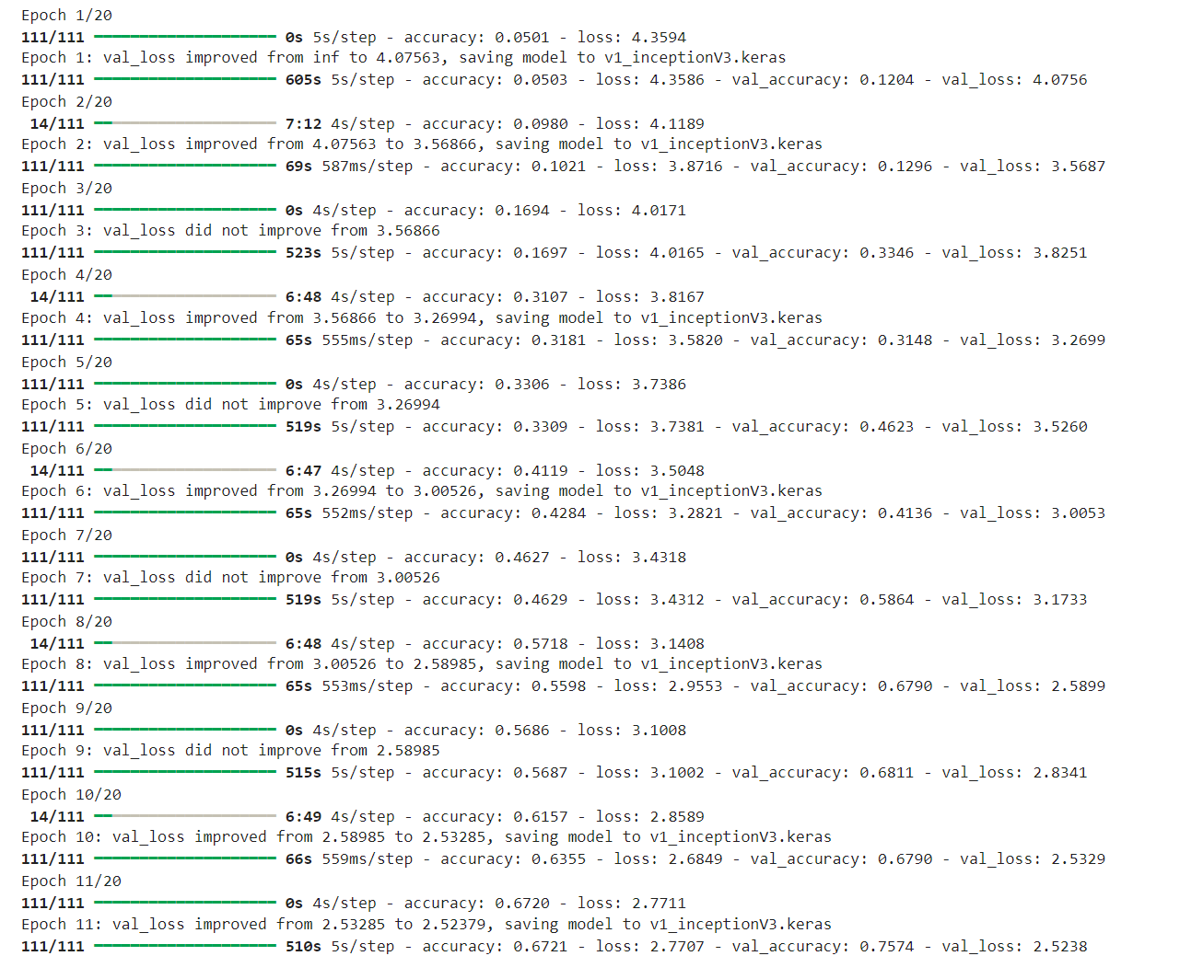
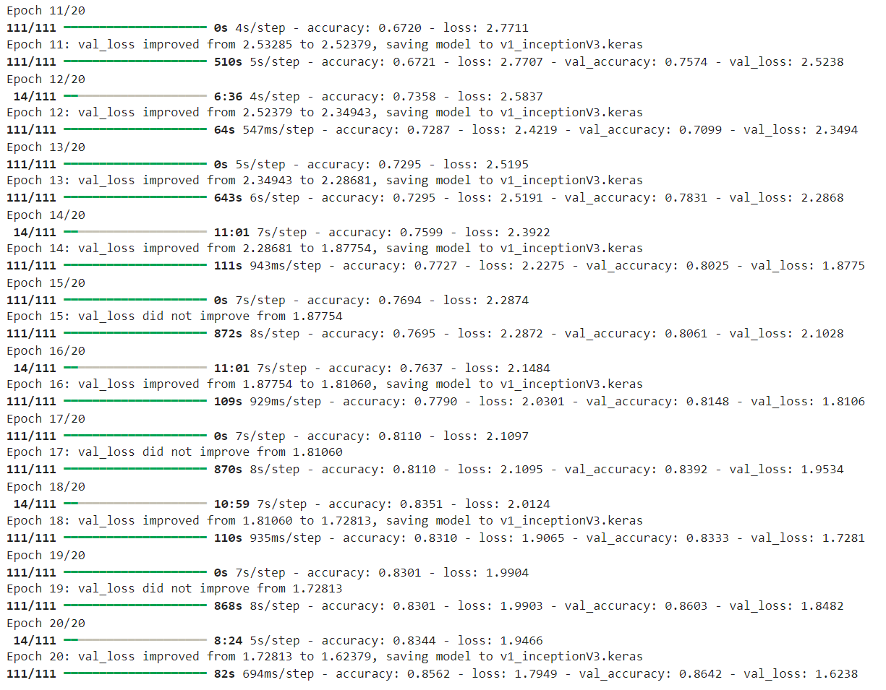
RESULTS

Slide 17
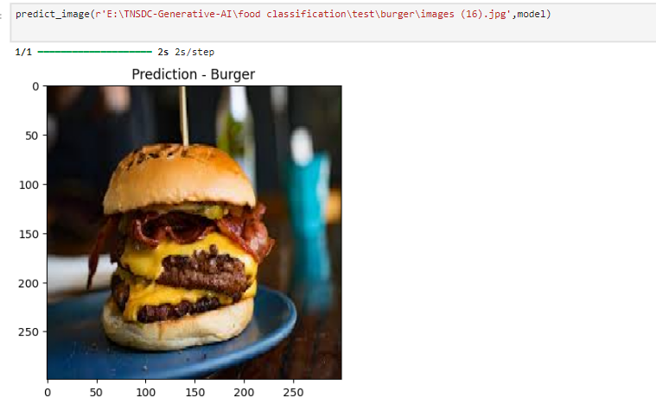
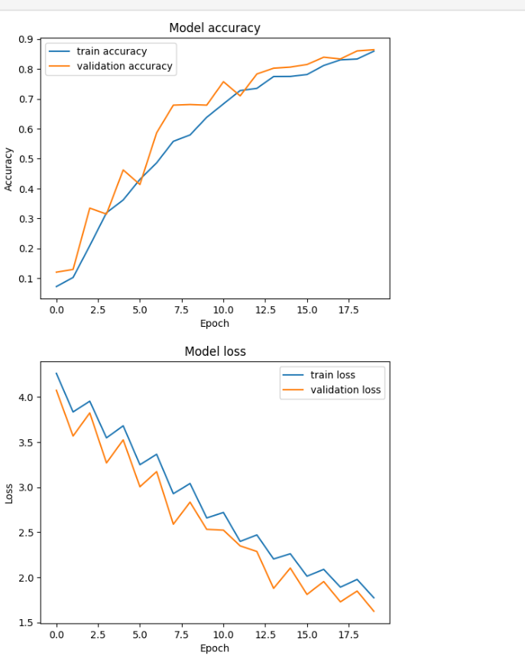
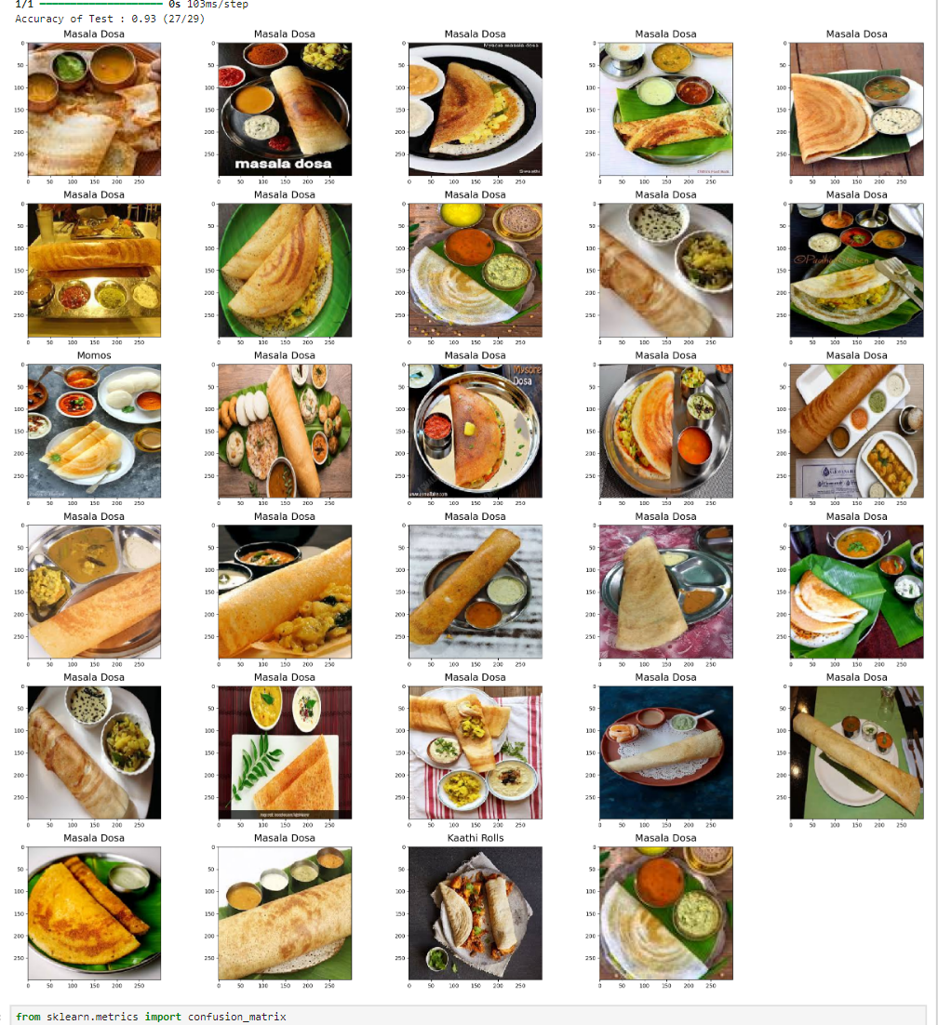
RESULTS

Slide 18
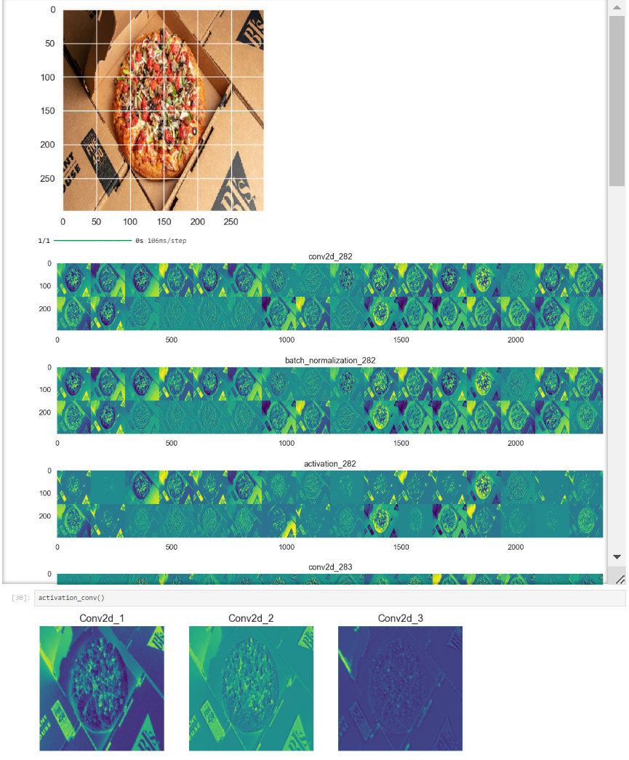
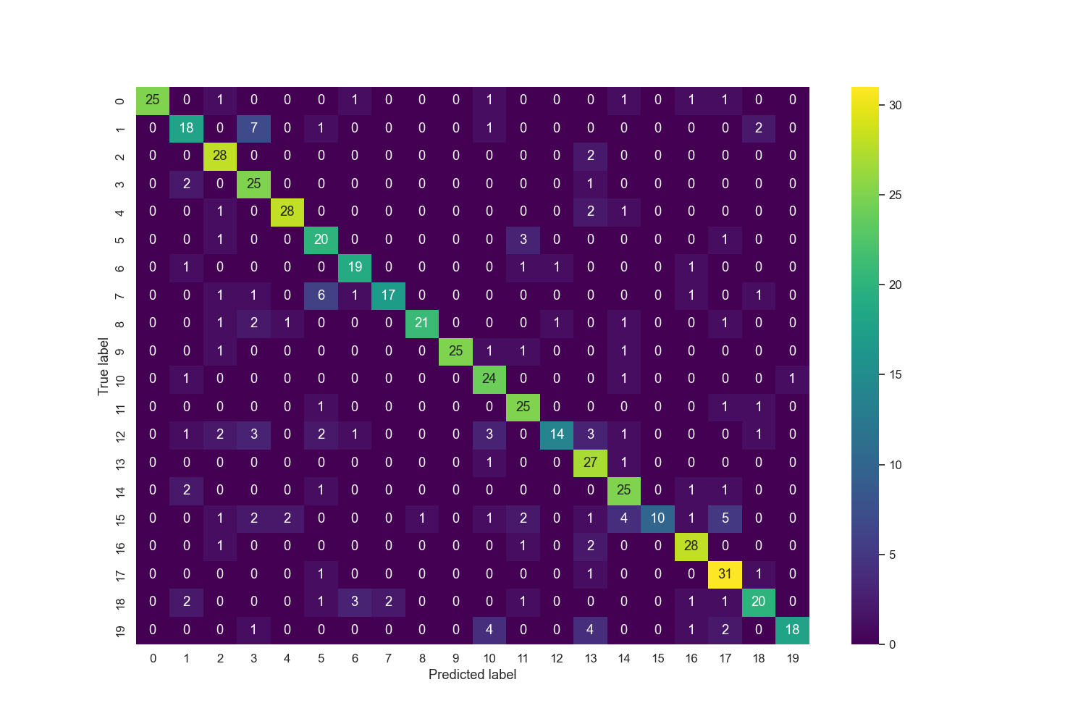
RESULTS

Slide 19
CONCLUSION
This project demonstrates the effectiveness of deep learning algorithms, particularly CNNs, in addressing real-world challenges such as food classification. By automating the process of Indian food identification, the project enhances user experience and unlocks opportunities for innovation in culinary domains. This Project represents a step towards leveraging AI-driven solutions to enrich cultural experiences and streamline food-related tasks in diverse contexts.
Reference:
GITHUB LINK:https://github.com/Dharshan465/TNSDC-Generative-AI.git

