Slide 1
AGENTIC AI
Placify
Autonomous AI Placement Orchestration
A stateful multi-agent system for eligibility, communication, shortlisting & interview scheduling
AD23731 · Foundations of Agentic AI — Mini-Project
Team Members: Shri Dharshini M (231501153)
Sharan M (231501151)
Sooryanath SD (231501158)
Department of Artificial Intelligence and Machine Learning · September 2026
Notes:
Introduce Placify: an agentic AI system that coordinates a whole campus placement drive, from the company's job description to an approved interview schedule. Mini-project for AD23731 Foundations of Agentic AI.

Slide 2



Problem Statement & Business Case
THE PROBLEM
BUSINESS CASE
Fragmented Manual Coordination
Forms, spreadsheets, emails and messaging groups are stitched together by hand — eligibility and academic data are re-checked repeatedly.
Coordination Efficiency
Routine work is routed automatically, so placement officers focus on exceptions, approvals and recruiters.
Storage-Only Placement Portals
Fewer Missed Opportunities
Portals store applications but don't decide the next action, choose the right data source, or recover when a condition changes.
Timely, targeted notifications and clear application status; reminders go only to students who still need to act.
Fragile Schedules, Lost Traceability
Reliable & Auditable Drives
Clashes with exams or other drives and last-minute HR changes force manual rescheduling; decisions get buried across messages.
Shared state, conflict-checked schedules and human approval give a consistent pipeline and a full audit trail.
02
Notes:
Campus placement is a chain of dependent stages, yet most colleges run it through disconnected tools. A portal stores data but doesn't reason about what should happen next. Placify adds an adaptive coordination layer.

Slide 3




User & Stakeholder Analysis
Students
Placement Officer / TPO
Receive relevant opportunities, invitations, reminders, application status and interview schedules.
Creates drives, reviews eligibility rules and exceptions, approves shortlists and releases schedules.
HR / Recruiters
Faculty / Coordinators
Provide JDs and criteria; receive verified candidate lists, assessment outcomes and interview schedules.
Provide exam and event constraints, monitor placement activity and identify schedule conflicts.
Also involved: Placement Administrator (users, integrations, policies, audit records) · Faculty panel (reviews architecture, workflow and results)
03
Notes:
Four main user groups: students, TPO, HR and faculty. Each needs something different: students need timely communication, TPOs need control and auditability, recruiters need a reliable pipeline, faculty need conflict information.

Slide 4
Proposed Agentic AI Solution
A stateful multi-agent system where a central orchestrator routes each placement stage to a dedicated specialist agent.
01
02
03
Orchestration & State Layer
Specialist Agent Layer
Knowledge, Memory & Tool Layer
A stateful LangGraph orchestrator holds the drive state, routes every task to the right agent, monitors progress and triggers re-planning.
Ten agents — Company, Eligibility, Verification, Application, Communication, Assessment, Shortlisting, Scheduling, Conflict Checker and Critic — each with one responsibility.
Agentic RAG grounds decisions in policies and JDs, memory keeps context, and email, forms, calendar and MCP tools carry out actions.
Separation of concerns: deterministic services handle filtering, database updates and conflict checks; the LLM handles interpretation, planning and explanation. Humans approve critical actions such as the final shortlist and schedule release.
04
Notes:
Three layers: orchestration and shared state; ten specialist agents; and a knowledge, memory and tool layer. Deterministic operations stay separate from language-based reasoning, and humans keep authority over critical decisions.

Slide 5
Dataset & Knowledge Source Identification
KNOWLEDGE SOURCES & DATA STORES
PRIMARY DATA
Student & Academic Records
Company & Placement Data (PostgreSQL)
Role, JD, eligibility conditions, deadlines, assessment and interview requirements, recruiter contacts — one isolated state per drive.
Student ID, name, department, graduation batch, CGPA, school marks, arrear status and other institution-approved attributes.
DATA SOURCE
Schedule Data
Treated as an authorized result service. The prototype uses a controlled dataset with simulated service responses — no unrestricted portal access.
Exam dates, classes and events, other placement drives, rooms, panels, interview slots and student availability — modelled as constraints.
DATA PREPARATION
Policy Knowledge Base (Vector DB)
Schema validation, department/degree normalization, CGPA & mark standardization, duplicate detection and missing-value handling — all traceable.
Placement policies, eligibility guidelines, JDs, application, assessment and interview procedures — chunked, embedded and indexed.
05
Notes:
There is no fixed public dataset for this project. The prototype uses controlled student, company and schedule data plus a policy knowledge base for Agentic RAG. Real deployment would use authorized institutional APIs.

Slide 6
Selection of Tools & Frameworks
Category | Technology Chosen | Justification / Role
Programming | Python | Core implementation, agent and tool services.
Agent Orchestration | LangGraph + LangChain | Stateful graph workflow with conditional transitions; reusable prompt, retrieval and tool interfaces.
LLM | LLM Service | Requirement interpretation, reasoning, planning and explanation.
Backend | FastAPI | APIs and service endpoints connecting UI, agents and data.
Database | PostgreSQL | Structured student, company, application and schedule records.
Knowledge Retrieval | Embeddings + Vector Database | Semantic retrieval of policies and JDs for Agentic RAG.
Frontend | React | Role-based web interface for students, TPOs, HR and faculty.
Integration | MCP + APIs | Controlled, consistent access to external tools and services.
Communication | Email / Notification API | Invitations, reminders and schedule updates.
Forms | Form Service / Google Forms API | Company-specific application collection.
06
Notes:
Python with LangGraph and LangChain for the stateful agent workflow, FastAPI backend, PostgreSQL for structured data, a vector database for Agentic RAG, React for the role-based UI, and MCP plus APIs for controlled tool access. Credentials stay outside prompts.

Slide 7
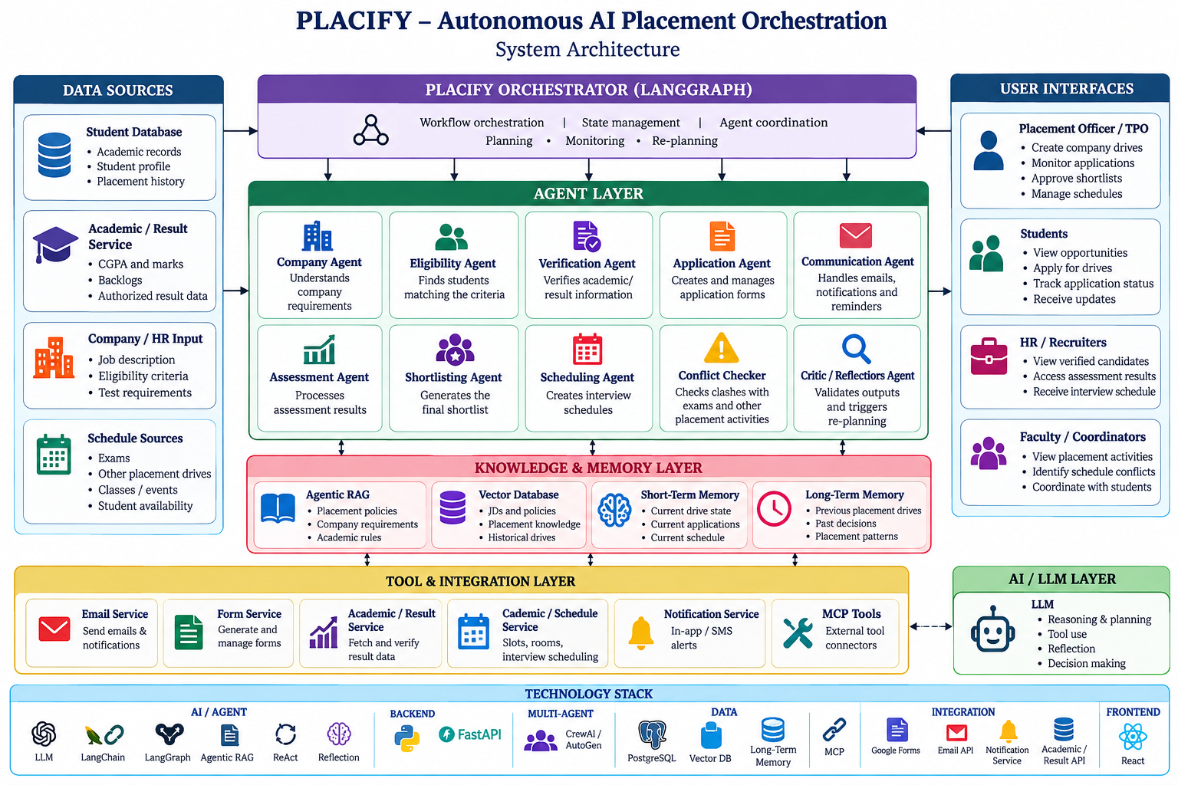
System Architecture
ARCHITECTURE PRINCIPLES
1
Stateful coordination
One shared drive state across agents.
2
Specialized agents
Each agent owns one placement function.
3
Tool-based action
Email, forms, calendar and result services via APIs / MCP.
4
Grounded retrieval
Decisions backed by policies and JDs.
5
Human approval
TPO signs off on critical actions.
07
Notes:
Walk the diagram top to bottom: data sources feed the LangGraph orchestrator, which drives the ten-agent layer, backed by the knowledge and memory layer and the tool and integration layer, with role-specific user interfaces on the right and the technology stack at the bottom.

Slide 8









Agent Architecture — Roles & Responsibilities
Company Agent
Eligibility Agent
Verification Agent
Application Agent
Communication Agent
Turns JDs into structured requirements
Filters students against the criteria
Checks evidence with the authorized result source
Configures the company-specific application flow
Sends invites and reminders to pending students
Assessment Agent
Shortlisting Agent
Scheduling Agent
Conflict Checker
Critic / Reflection
Processes authorized test results
Applies approved criteria to verified candidates
Builds slots around exams, drives, rooms and panels
Validates schedules and flags clashes
Reviews outputs and triggers re-planning
Each agent receives only the state it needs and returns a structured result; the orchestrator records it and decides the next transition.
08
Notes:
Ten specialists plus the orchestrator. Shared state holds company identity, criteria, eligible IDs, verification and application status, assessment results, shortlist, schedule, conflict reports, approvals and audit events.

Slide 9
Agent Workflow & Orchestration Design
1
Company JD
›
2
Requirements
›
3
Eligibility
›
4
Verification
Recruiter input
Company Agent
Eligibility Agent
Verification Agent
5
Application
›
6
Communication
›
7
Assessment
›
8
Shortlisting
Application Agent
Communication Agent
Assessment Agent
Shortlisting Agent
9
Scheduling
›
10
Conflict Check
›
11
Reflection
›
12
Human Approval
Scheduling Agent
Conflict Checker
Critic Agent
TPO sign-off
Output → HR + Students: approved candidate list and conflict-free interview schedule
DECISION ROUTING & RECOVERY
Conflict detected
Criteria incomplete
Verification unavailable
HR changes timing
Returns to the Scheduling Agent with new constraints; nothing invalid is published.
Requests clarification or flags the drive for TPO review — no invented conditions.
Candidate marked pending verification, never wrongly rejected.
Affected candidates found, plan re-generated and re-validated before notifying.
09
Notes:
The workflow is a state-transition process in LangGraph. Note the closed loop at the end: the Conflict Checker and Critic can send the state back to Scheduling. Example: if HR moves an interview from 10 AM to 2 PM, only the affected part of the plan is recalculated.

Slide 10
Agentic RAG, Memory & Safeguards
Placement Policies & JDs
›
Chunk + Metadata
›
Embeddings + Vector DB
›
Agentic Retrieval
›
LLM + Decision
Grounded Retrieval
Memory
Safeguards
Query built from company, role, student condition and current task
Example: the Eligibility Agent retrieves the arrears policy instead of hardcoding it
Sources kept in the decision context: verified facts, retrieved text and generated reasoning stay distinct
Short-term: current drive state, applications and schedule
Long-term: previous drives, past decisions and placement patterns
Each drive keeps its own state, so companies never mix
Role-based access enforced at the service layer
Credentials never placed in prompts
Sensitive student records kept out of unrestricted retrieval
Audit log + human approval for shortlist and schedule release
10
Notes:
Agentic RAG lets an agent decide when to retrieve and what to ask for. Documents change across recruitment cycles, so source and revision metadata are retained. Memory gives agents both current-drive context and historical context.

Slide 11
Comparison, Innovation & Scalability
Traditional / Fragmented Workflow | Placify Workflow
Manual eligibility checking | Eligibility Agent applies structured criteria
Separate academic verification | Verification Agent checks authorized data
Manual forms and invitations | Application + Communication Agents run the cycle
Manual reminder lists | Reminders target only pending applicants
Manual shortlist preparation | Assessment + Shortlisting Agents combine conditions
Manual schedule reconciliation | Scheduler + Conflict Checker validate constraints
Restarting after changes | Orchestrator preserves state and re-plans
INNOVATION
End-to-end lifecycle
Eligibility to scheduling in one stateful workflow.
Adaptive re-planning
Schedules are plans that can be checked and revised — no restart.
RAG + institutional memory
Explainable, policy-grounded decisions.
SCALABILITY
Same agent roles scale to more students, drives and documents; extend with ERP, recruiter platforms and analytics.
11
Notes:
Conventional automation runs one fixed step at a time. Placify keeps the state of the whole drive and picks the next action from it. Extensions: college ERP integration, recruiter platform integration, advanced scheduling optimization, placement analytics and preference-aware matching.

Slide 12
Project Plan & Milestones
P1
P2
P3
P4
P5
P6
Requirements
Architecture
Core Agents
Scheduling
Integration
Evaluation
Weeks 1–2
Weeks 3–4
Weeks 5–7
Weeks 8–10
Weeks 11–13
Weeks 14–16
Requirement analysis, placement workflow mapping and controlled dataset design.
Agent architecture, state model, database and RAG design.
Eligibility, verification, application and communication agents.
Assessment, shortlisting and scheduling agents with conflict checking.
Reflection loop, tool integration, dashboard and audit state.
Testing, evaluation, documentation and final demonstration.
12
Notes:
Sixteen-week plan in six phases, from requirement analysis and controlled dataset design through the agents, scheduling and integration, ending with testing, evaluation and the final demonstration.

Slide 13
Conclusion & Future Work
CONCLUSION
FUTURE WORK
From company JD to approved interview schedule — in one stateful workflow.
ERP and academic-result integration
Stronger identity and role-based access
Multiple simultaneous drives with shared constraints
Advanced constraint optimization for scheduling
Recruiter feedback and placement analytics
Versioned policies; preference-aware discovery
Placify shows that Agentic AI can coordinate a real institutional process: reasoning, retrieval, memory, tool use and reflection work together, while the placement cell stays the human authority.
EVALUATION PLAN (KPIs)
Prototype boundary: controlled data and simulated services. Production use needs authorized APIs, privacy controls and validation.
Eligibility accuracy · Verification consistency · Application tracking · Shortlist consistency · Schedule conflict rate · RAG relevance · Workflow completion — measured on controlled scenarios.
13
Notes:
The report does not contain final benchmark numbers, so no accuracy or latency figures are shown. The KPI list is what will be measured in the final controlled experiments.

Slide 14
Thank You
Placify · Autonomous AI Placement Orchestration
Shri Dharshini M · Sharan M · Sooryanath SD

