Slide 1
Data-Driven Stock Analysis
Organizing, Cleaning, and Visualizing Market Trends
Presented By
Dharshini A

Slide 2
Skills
Pandas
Python
Power BI
Streamlit
SQL
Statistics
Data Organizing
Cleaning
Visualizing

Slide 3
Problem Statement
Analyze Nifty 50 stocks' performance over the past year
Clean and process daily stock data (open, close, high, low, volume)
Generate insights and visualize top-performing stocks
Interactive dashboards using Streamlit and Power BI

Slide 4
Business Use Cases
Stock Performance Ranking: Top 10 best/worst stocks
Market Overview: Average performance, green vs red ratio
Investment Insights: Consistent growth/decline trends
Decision Support: Volatility, average prices, behavior

Slide 5
Approach

Slide 6
Metrics
Daily Return = (Close - Previous Close) / Previous Close
Volatility = Std Dev of daily returns
Cumulative Return = Running total of daily returns
Sector-wise average yearly return
Correlation matrix of closing prices
Monthly top 5 gainers and losers

Slide 7
Visualization
Top 10 Most Volatile Stocks: Bar chart
Cumulative Return: Line chart for top 5 stocks
Sector-wise Performance: Bar chart
Stock Price Correlation: Heatmap
Monthly Gainers/Losers: 12 bar charts

Slide 8
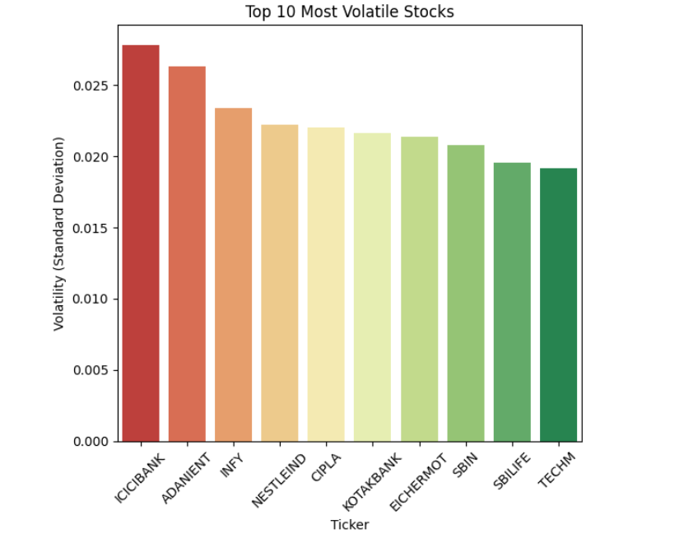
Top 10 Most Volatile Stocks

Slide 9
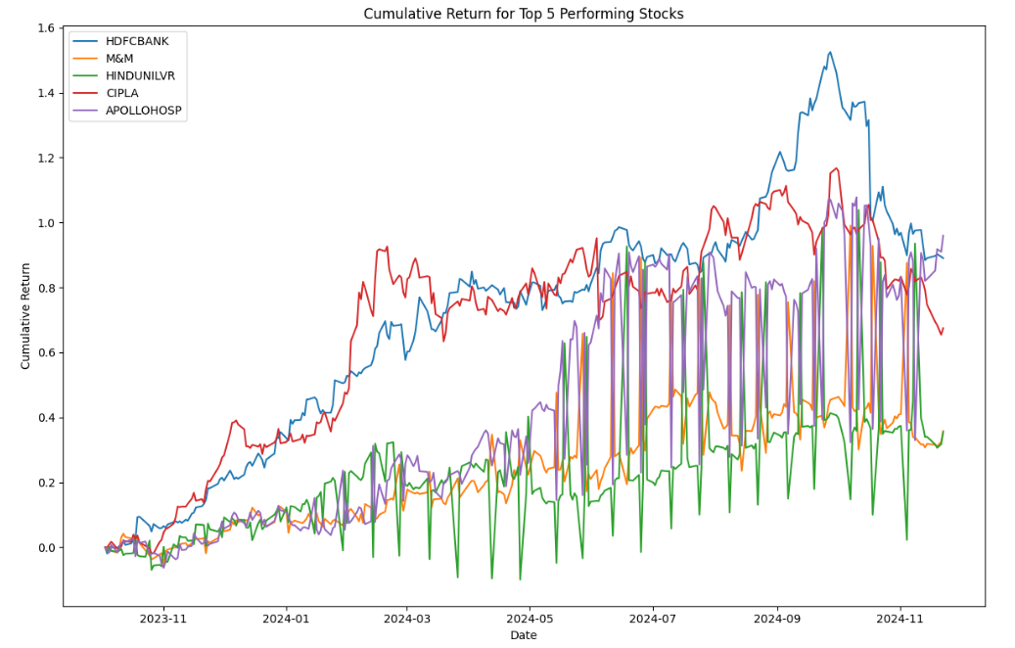
Cumulative Return

Slide 10
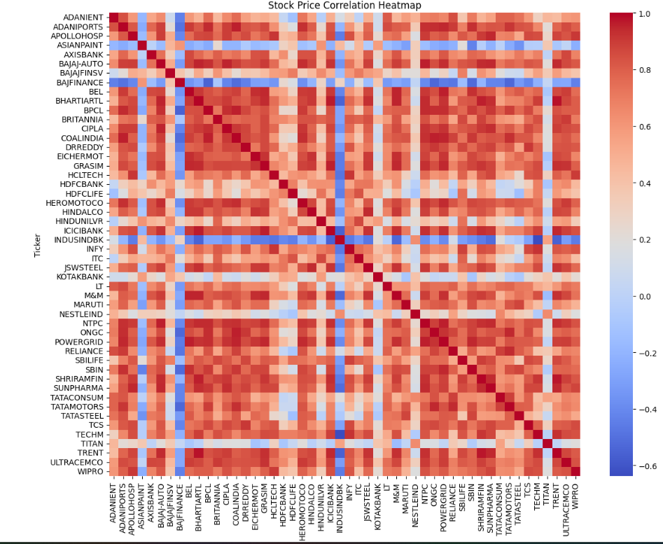
Stock Price Correlation

Slide 11
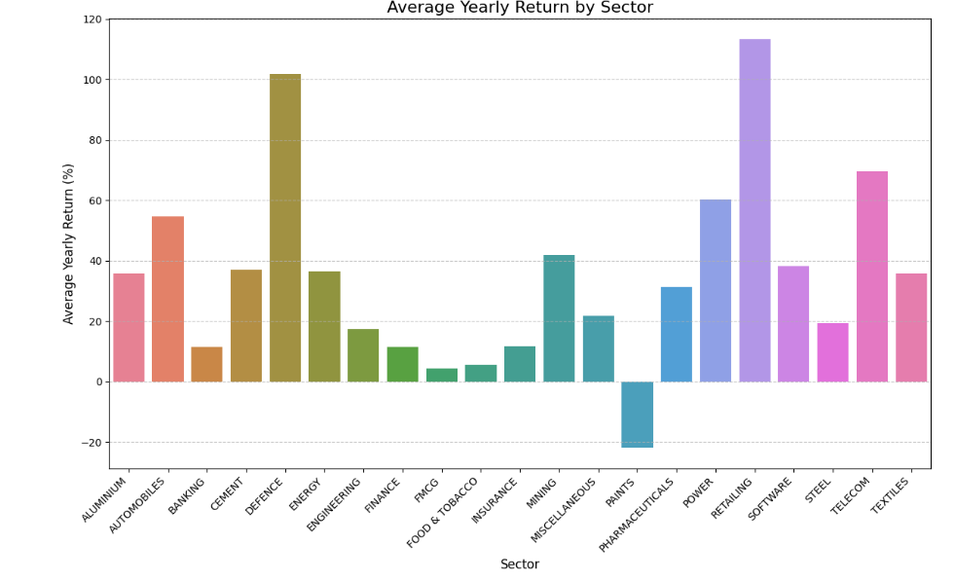
Sector-wise Performance

Slide 12
Top 5 Gainers and Losers – Month-wise

Slide 13
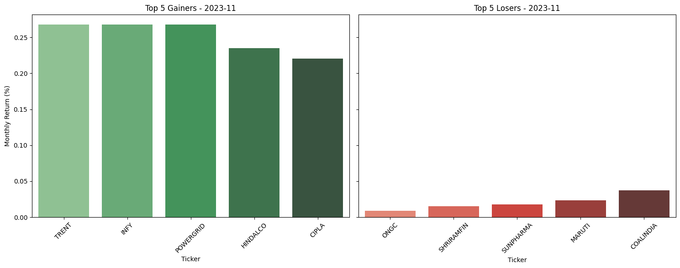
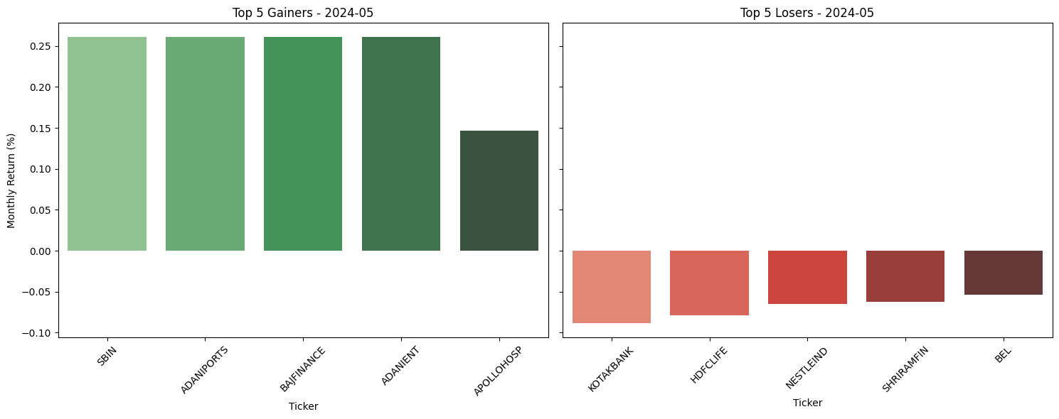

Slide 14
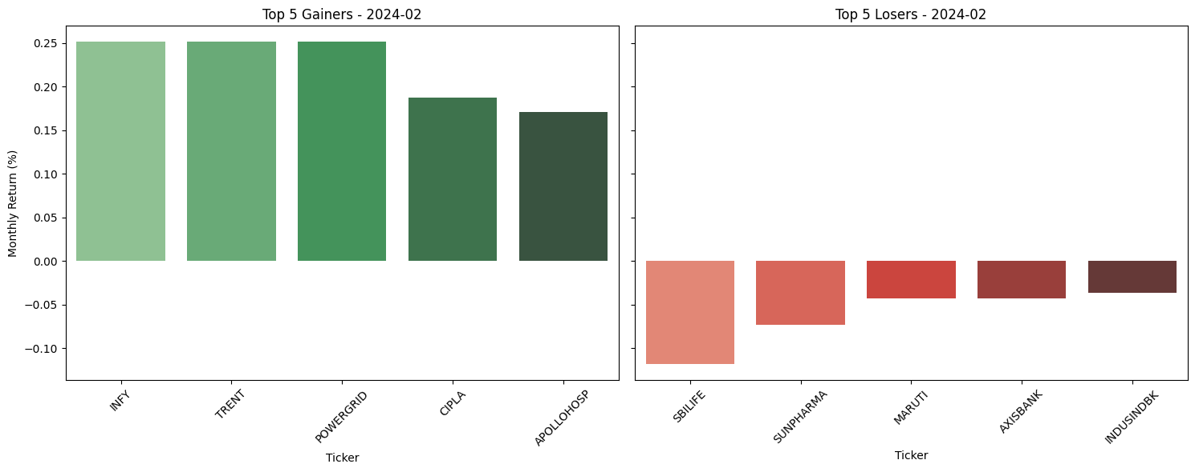
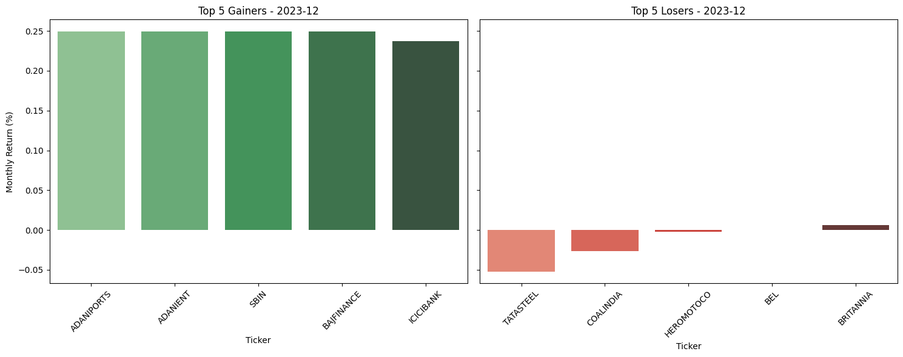

Slide 15
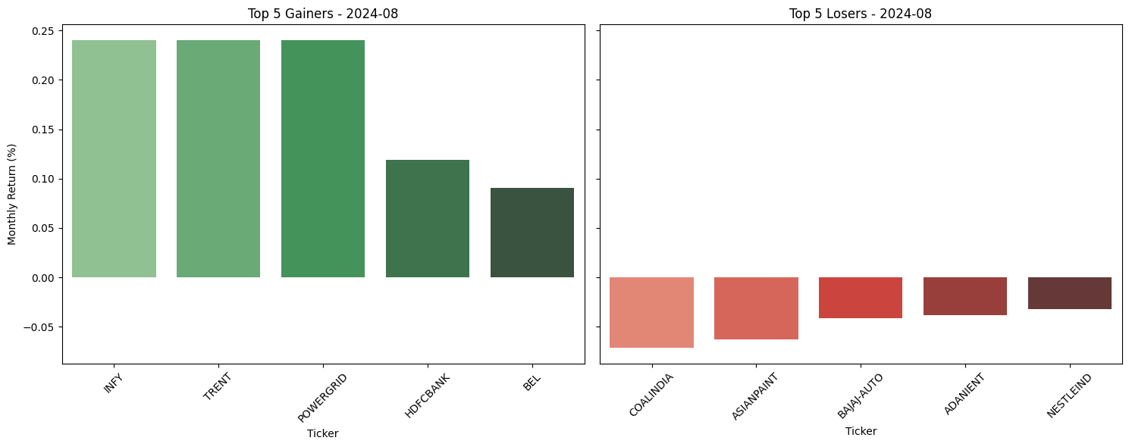
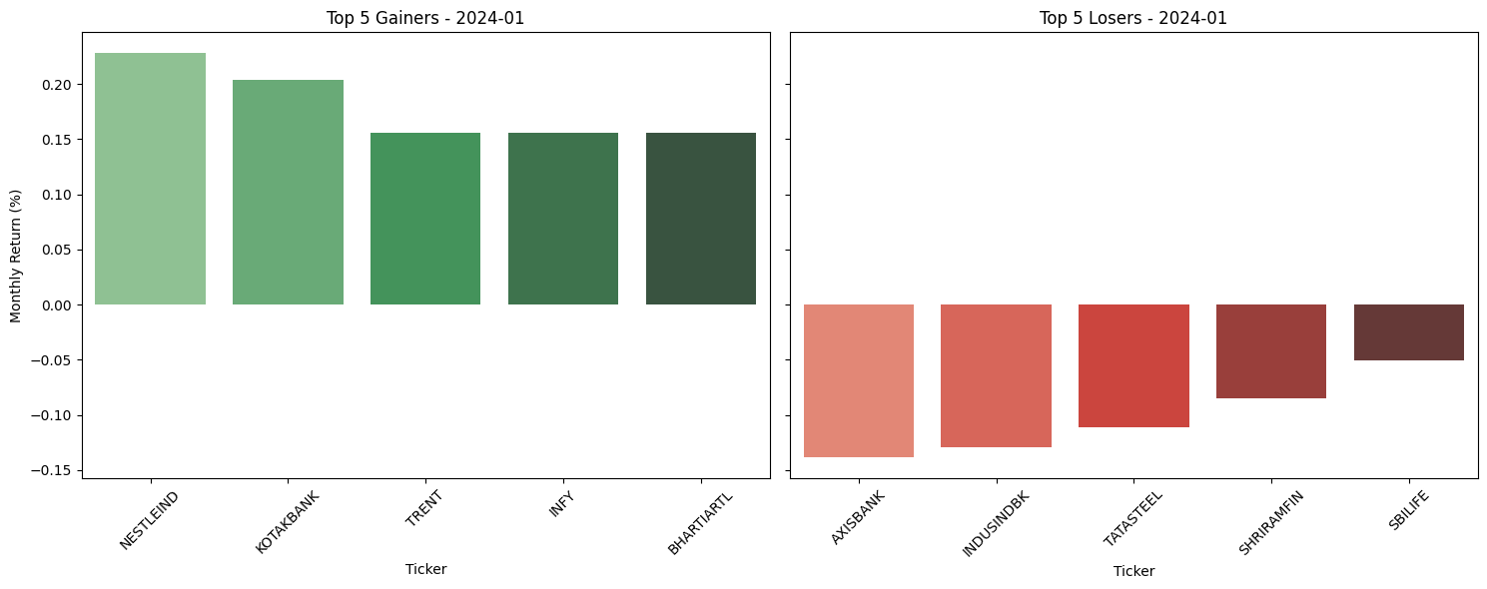

Slide 16
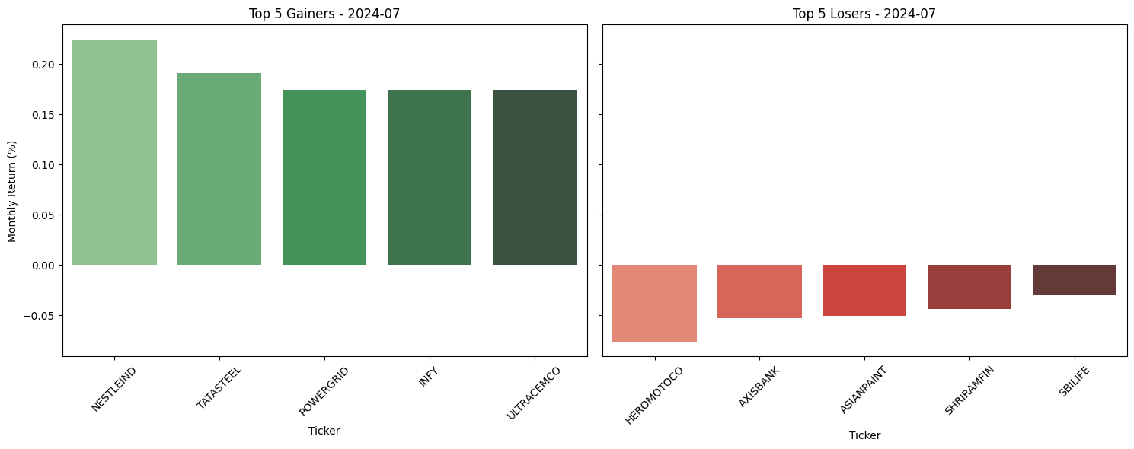
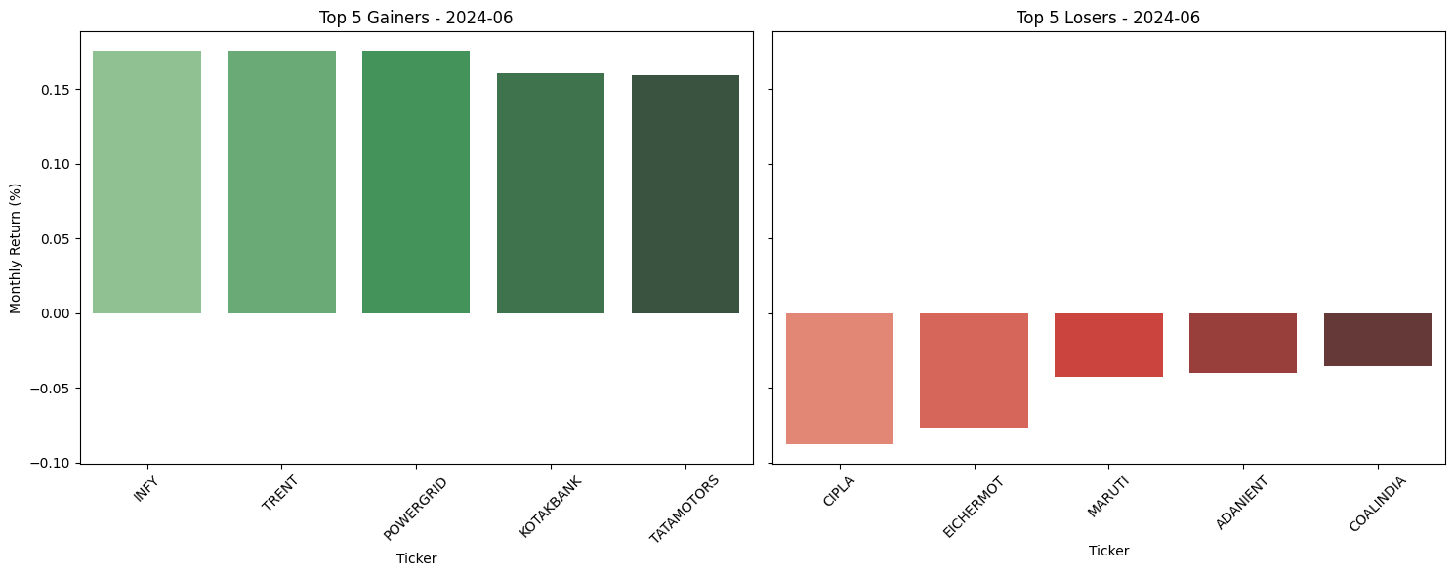

Slide 17
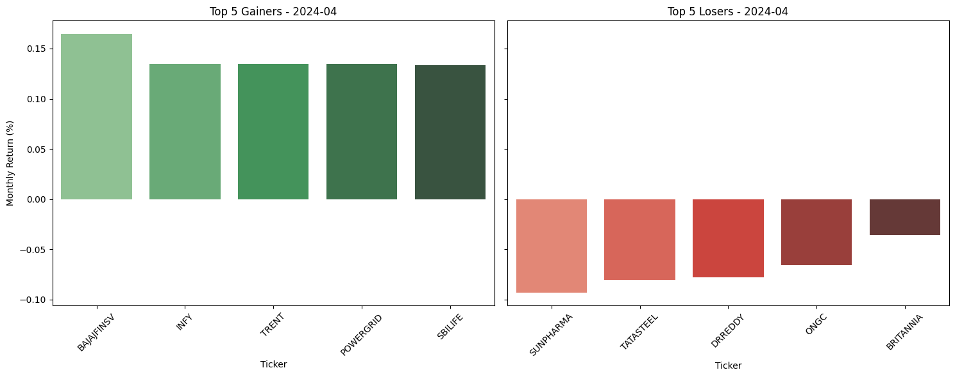
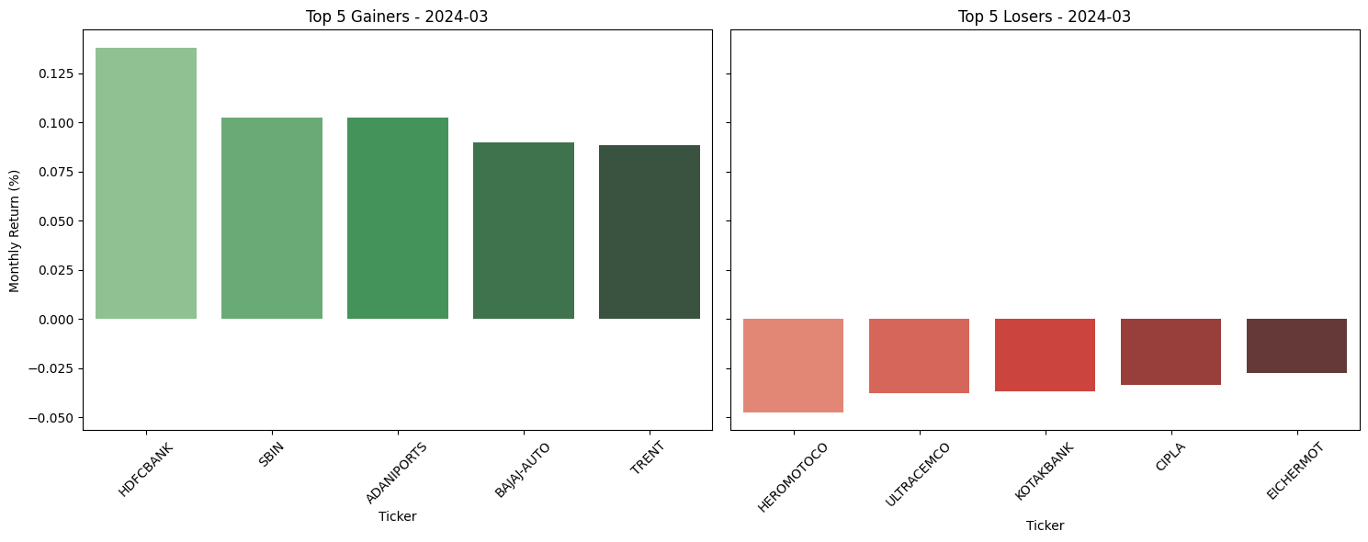

Slide 18
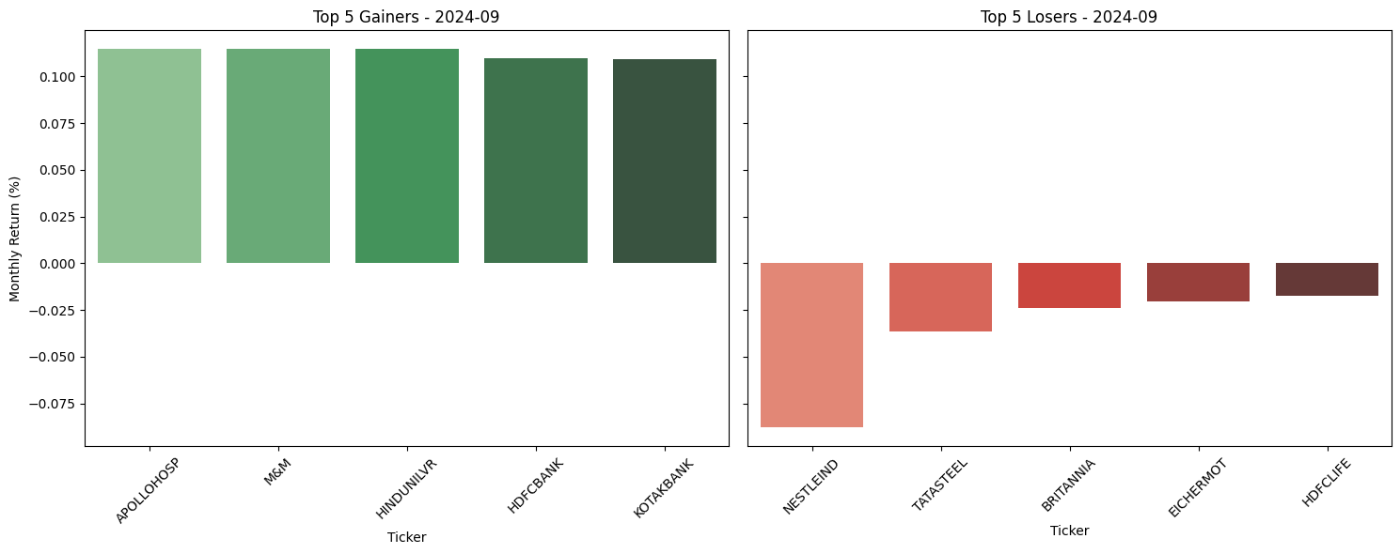
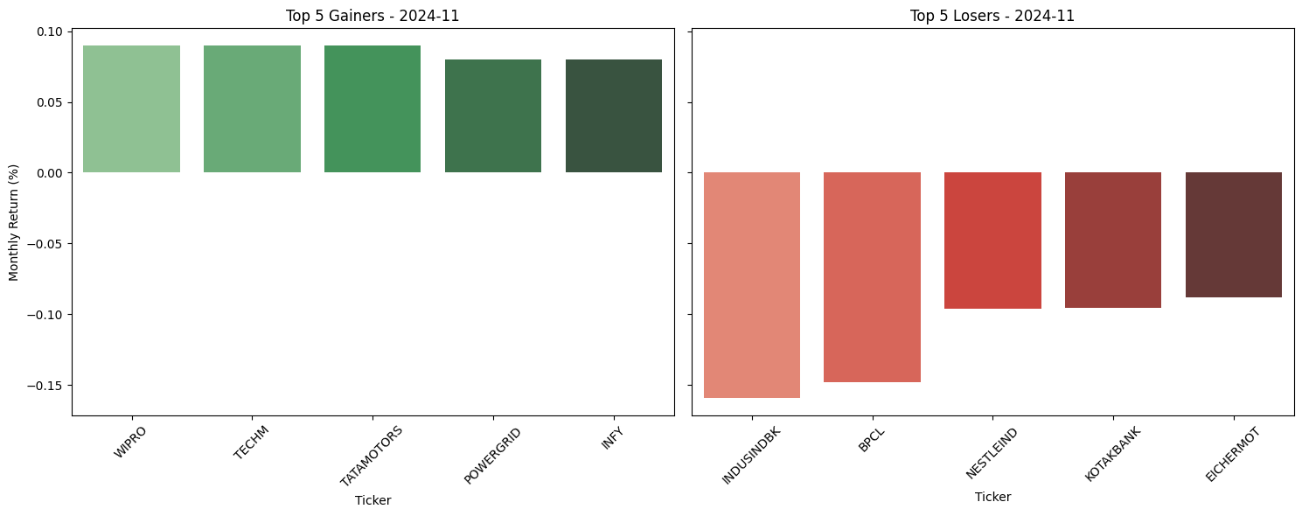

Slide 19
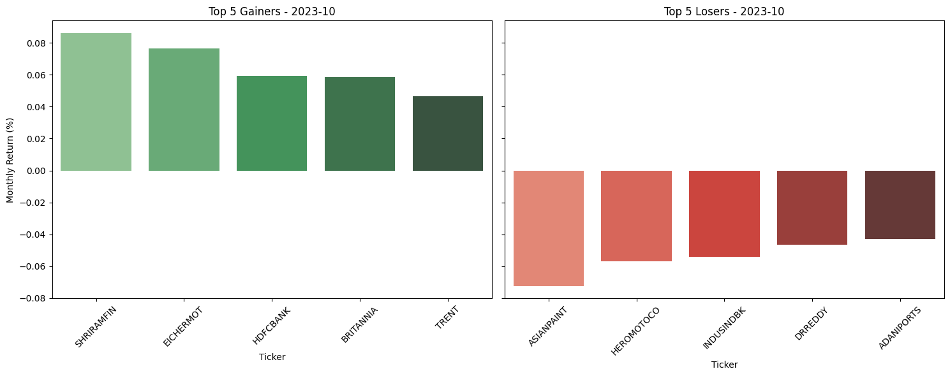
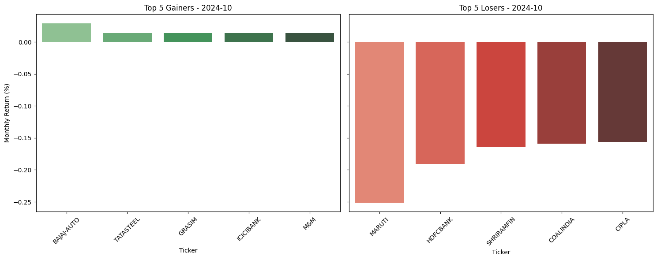

Slide 20
Results
Functional dashboard with top/worst performers
Market insights with performance indicators
Interactive visualizations for decision-making

Slide 21
THANK YOU

