Slide 1
Multiclass Fish Image Classification
Presented By
Dharshini A

Slide 2
Problem Statement
Classify fish images into multiple categories using deep learning.
Train CNN from scratch and use transfer learning.
Save models and deploy Streamlit app for predictions.

Slide 3
Business Use Cases
Enhanced Accuracy: Identify best model architecture.
Deployment Ready: Real-time prediction web app.
Model Comparison: Evaluate metrics across models.

Slide 4
Approach
Data Preprocessing: Rescale, augment images.
Model Training: CNN from scratch, 5 pre-trained models.
Model Evaluation: Accuracy, precision, recall, F1-score.
Deployment: Streamlit app for predictions.

Slide 5
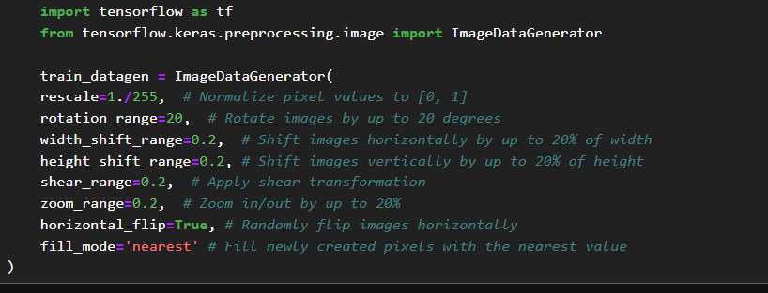
Data Preprocessing: Rescale, augment images

Slide 6
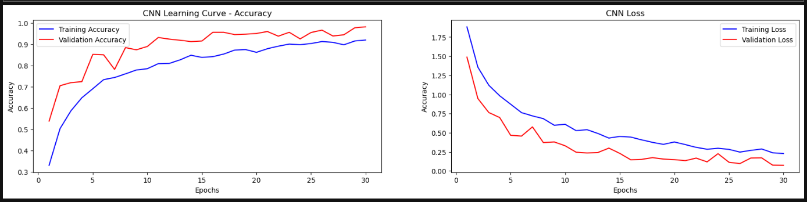
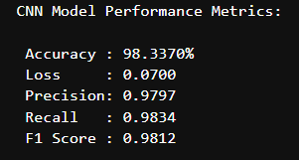
Model Training:
The CNN model demonstrates excellent generalization and stable learning.
This model is a strong candidate for deployment

Slide 7
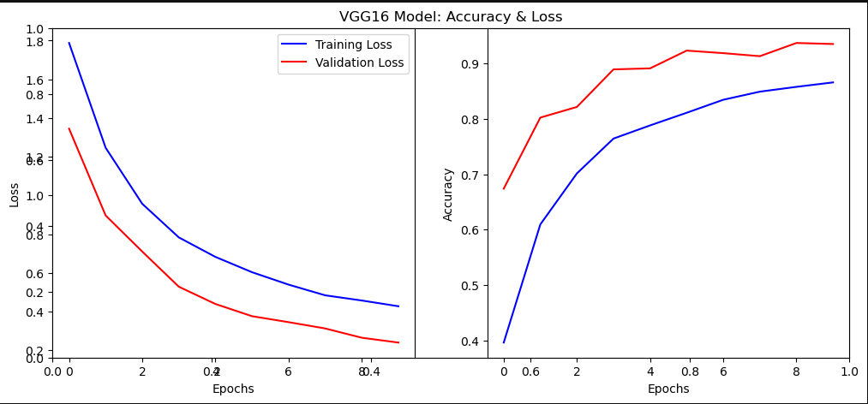
Pre-trained model – VGG16
VGG16 shows stable learning, low error, and high generalization.
The model is likely benefiting from transfer learning and proper regularization.
It’s a top performer in your model comparison and should be highlighted in your final report and Streamlit app.
Would you like me to help you create a comparison slide showing CNN vs. VGG16 performance for your presentation? It could include a mock dashboard or chart layout to impress recruiters.

Slide 8
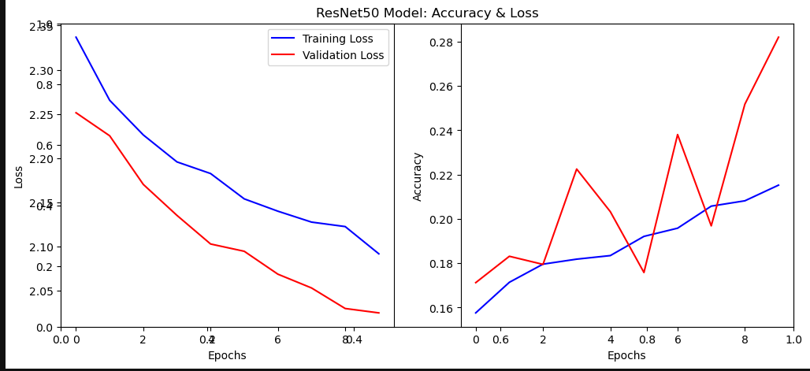
Pre-trained model – ResNet50
ResNet50 demonstrates strong learning capability and reasonable generalization.
It’s a competitive model in your lineup, though slightly less stable than VGG16 based on validation accuracy behavior.

Slide 9
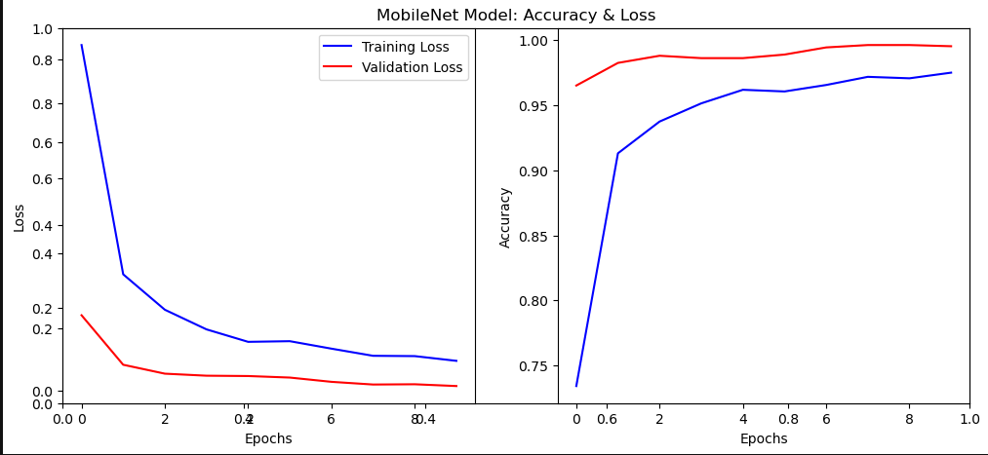
Pre-trained model – MobileNet
MobileNet demonstrates efficient learning, low error, and high generalization.
Its lightweight architecture makes it ideal for real-time deployment.

Slide 10
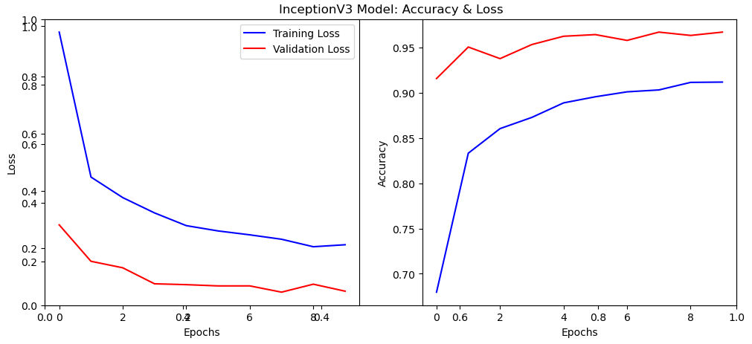
Pre-trained model – InceptionV3
InceptionV3 exhibits exceptional generalization, low error, and stable learning.
It’s a top-performing model in your comparison, ideal for deployment.

Slide 11
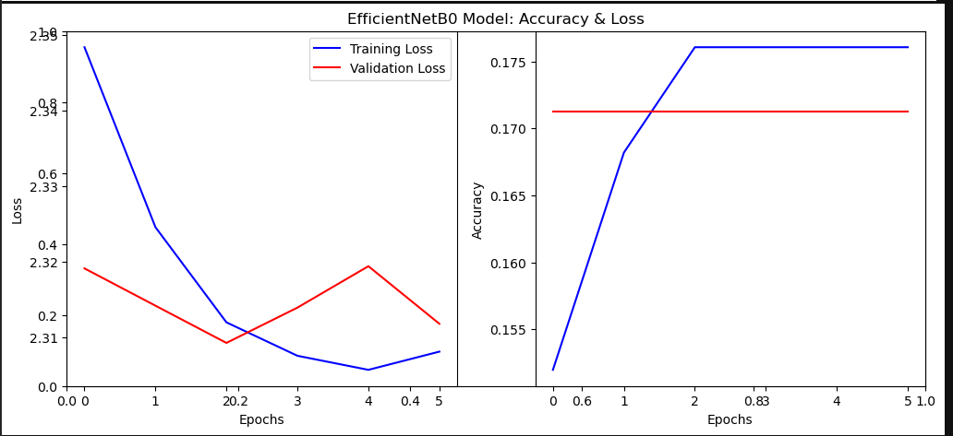
Pre-trained model – EfficientNetB0
EfficientNetB0 shows limited learning and low generalization in its current configuration.
It’s likely undertrained (only 5 epochs) and may benefit from:
More epochs
Better data augmentation
Learning rate tuning
Compared to other models (CNN, VGG16, ResNet50, MobileNet, InceptionV3), EfficientNetB0 currently ranks lowest in performance.

Slide 12
STREAMLIT APPLICATION

Slide 13
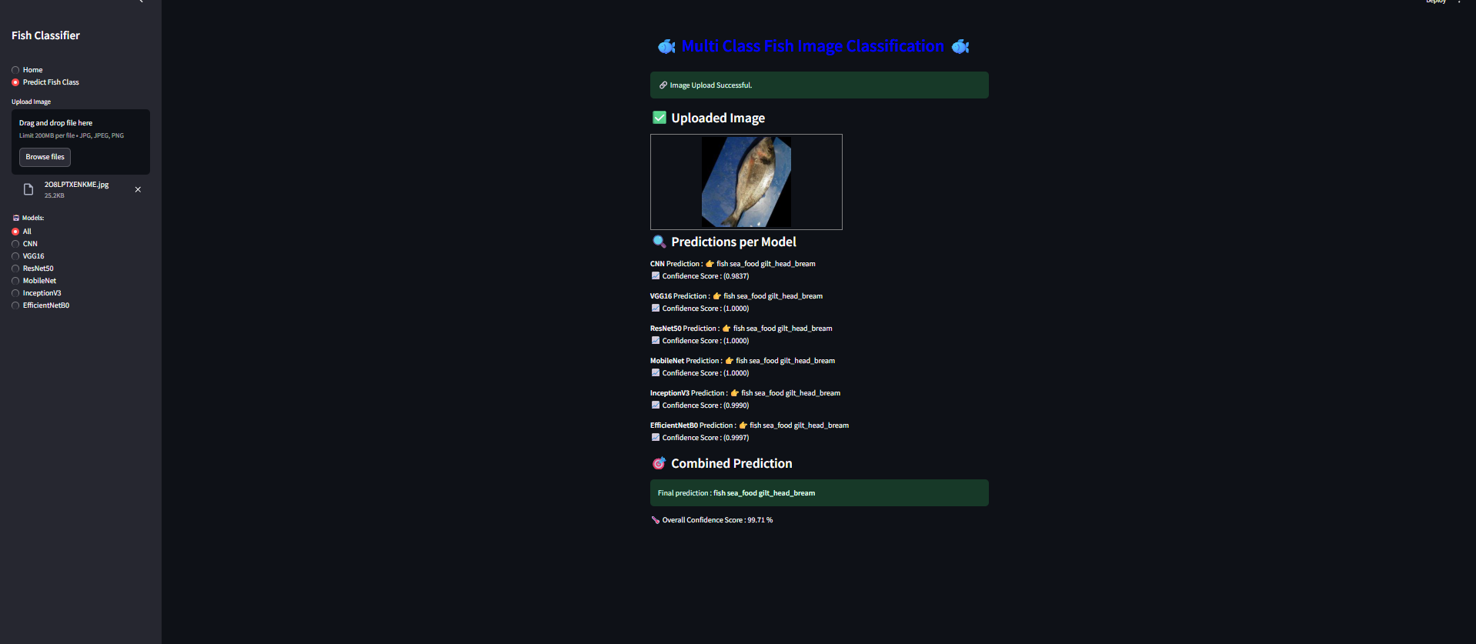
Fish Image Classifier

Slide 14
THANK YOU

