Slide 1
UML Diagrams for Seven Software Projects
Use case, class, sequence, collaboration, activity, state, package and component diagrams
2 Stock Maintenance | 3 Passport Automation | 4 Book Bank | 5 Personnel Management | 6 E-Ticketing | 7 BPO Management | 8 Conference Management

Slide 2
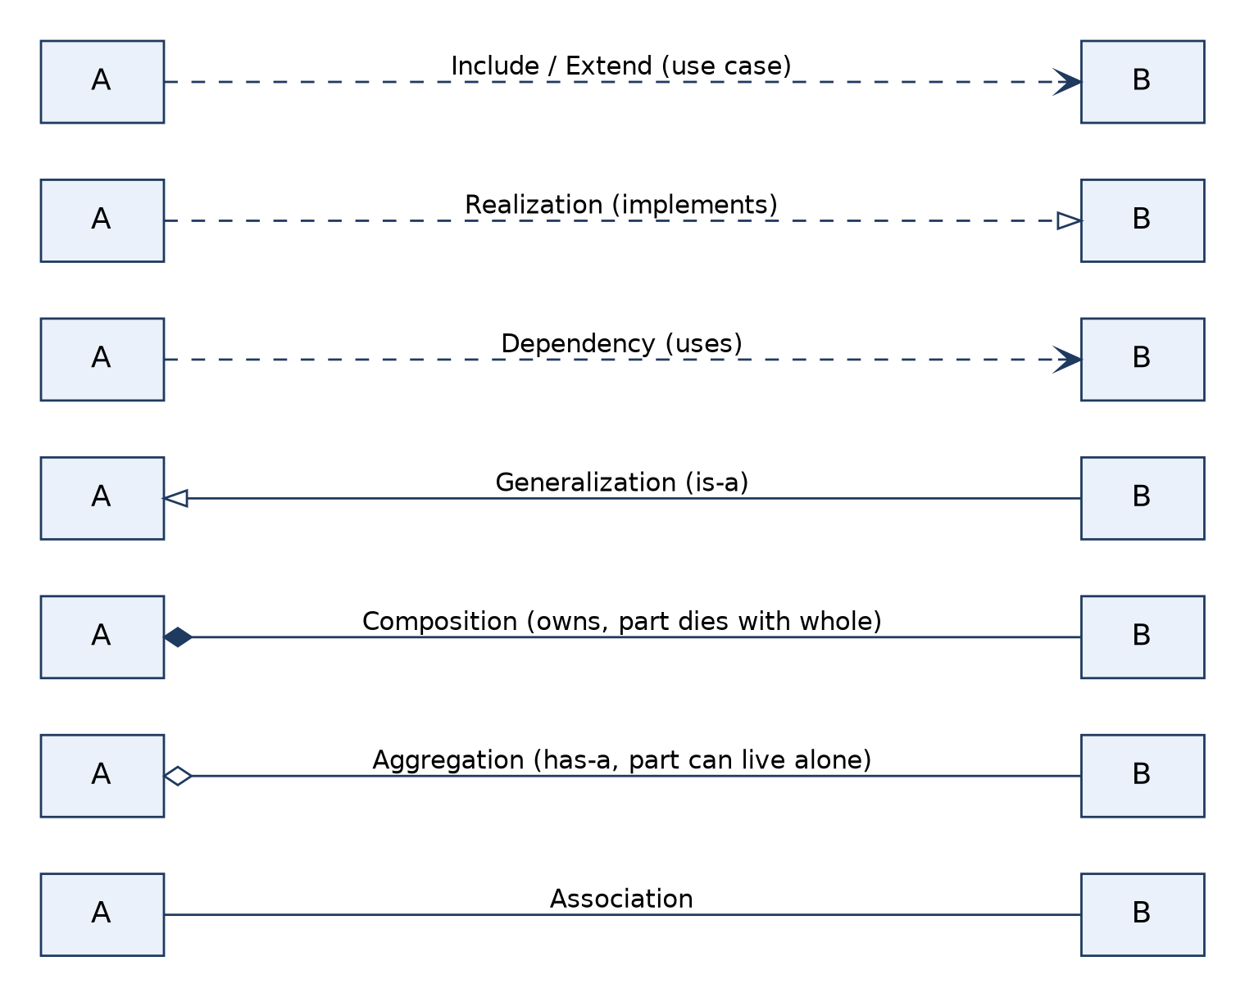
Relationships used in these diagrams
Association: a structural link with multiplicity, e.g. Applicant 1 — * Application
Aggregation: whole–part where the part can exist alone, e.g. Category ◇— Book
Composition: strong ownership, part dies with the whole, e.g. PurchaseOrder ◆— POLine
Generalization: is-a inheritance, e.g. User ← Customer, Agent
Dependency: one element uses another, e.g. Presentation ⇢ Business Logic
Realization: a component implements an interface (lollipop)
«include» / «extend»: mandatory vs. conditional sub-behaviour between use cases

Slide 3
Components used in each diagram
Diagram | Main elements | Limitation
Use case | Actors, use cases, system boundary, include/extend | No order or data detail
Class | Classes (name, attributes, operations), multiplicities, relationships | Static view only
Sequence | Lifelines, activation bars, synchronous/return messages, self-calls | One scenario at a time
Collaboration | Objects, links, numbered messages | Cluttered with many objects
Activity | Start/end, actions, decisions, fork/join | Weak on object ownership
State | States, transitions (event [guard] / action), start/end | One object per diagram
Package | Packages, «use», «import», «access» dependencies | Hides internal detail
Component | Components, provided/required interfaces, database | No run-time behaviour

Slide 4
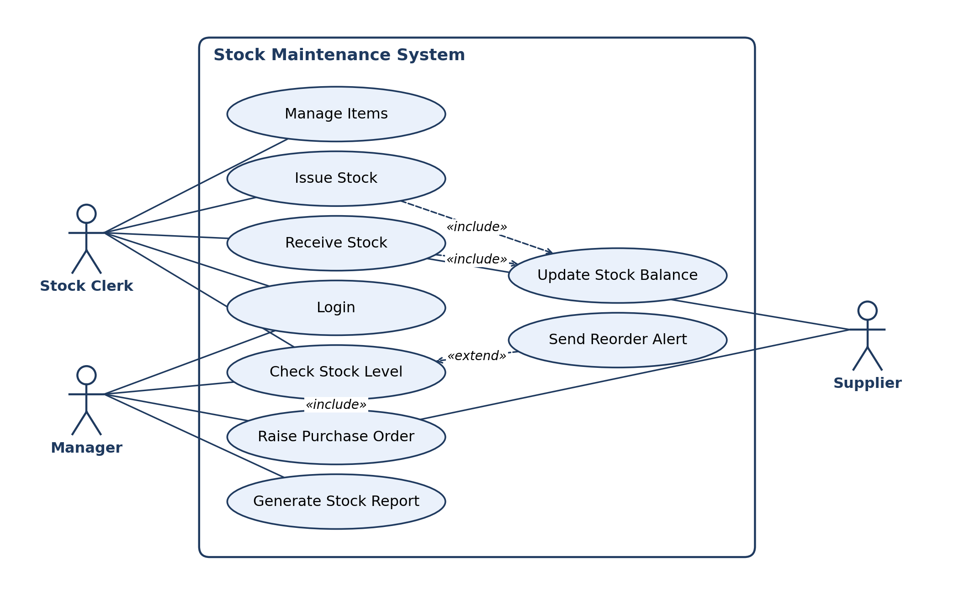
2. Stock Maintenance: Use Case Diagram
Rule / limitation: Shows WHAT the system does for its actors, not HOW. Actors stay outside the boundary; no ordering or data detail; «include» is mandatory, «extend» is conditional.
Notes:
2. Stock Maintenance: Use Case Diagram. Shows WHAT the system does for its actors, not HOW. Actors stay outside the boundary; no ordering or data detail; «include» is mandatory, «extend» is conditional.

Slide 5
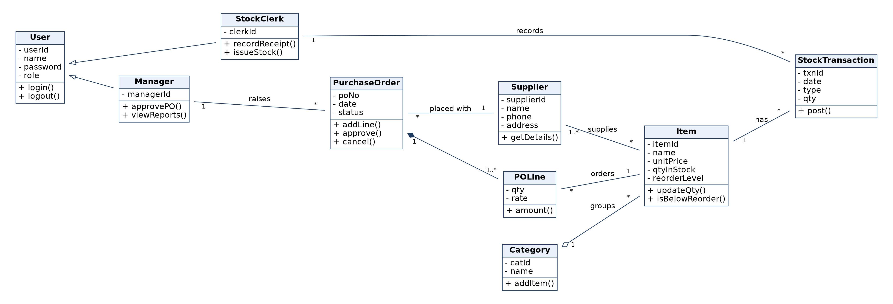
2. Stock Maintenance: Class Diagram
Rule / limitation: Static structure only; behaviour over time is not shown. Show multiplicity on associations; composition parts are not shared; generalization must not be circular.
Notes:
2. Stock Maintenance: Class Diagram. Static structure only; behaviour over time is not shown. Show multiplicity on associations; composition parts are not shared; generalization must not be circular.

Slide 6
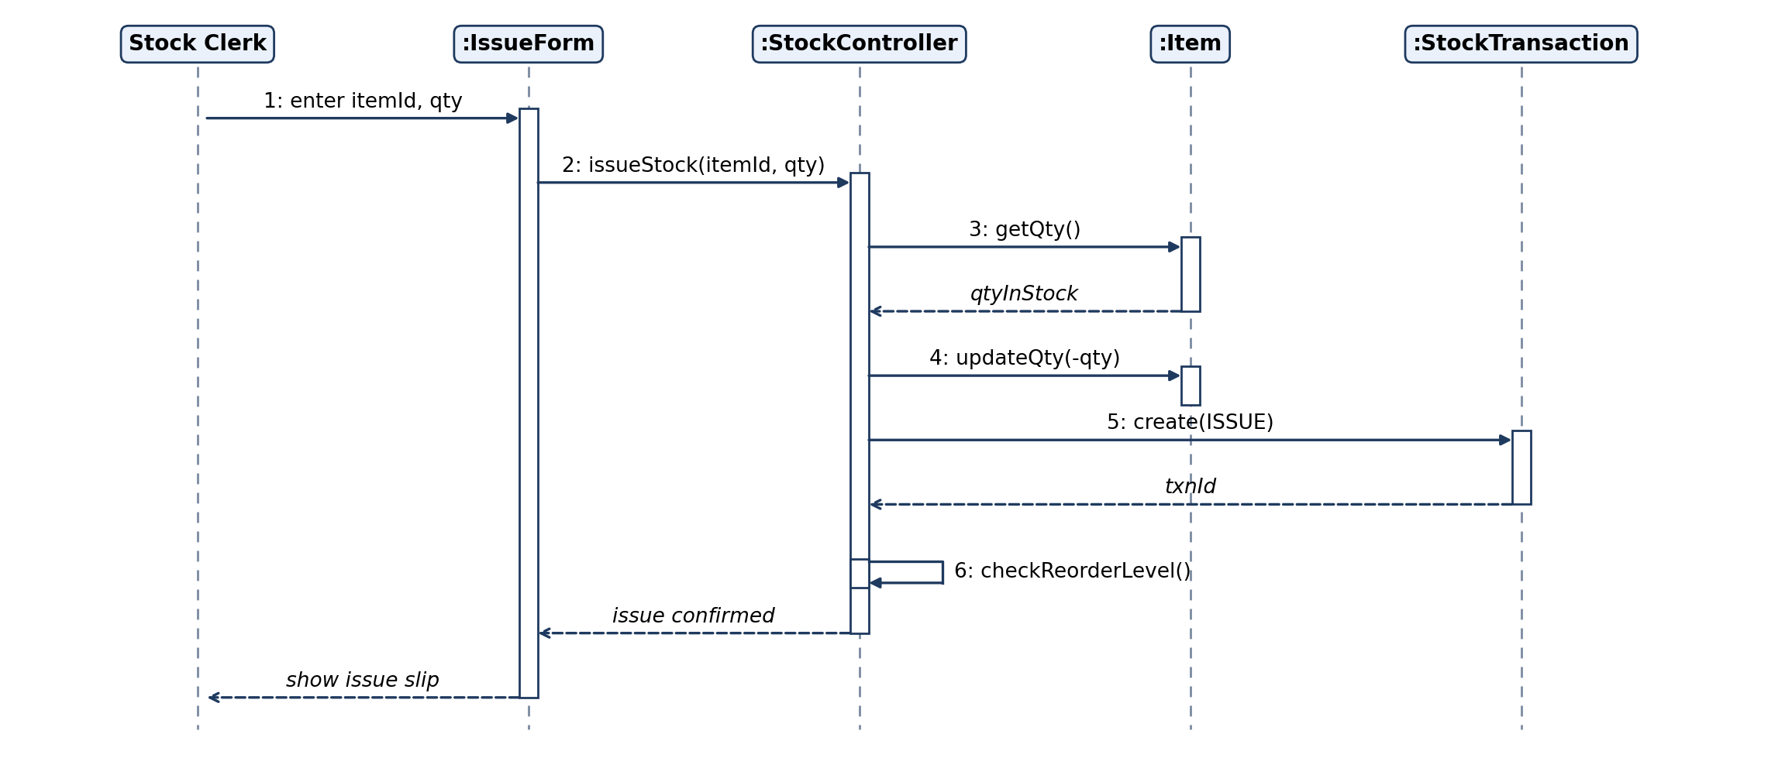
2. Stock Maintenance: Sequence Diagram
Rule / limitation: Shows ONE scenario in time order (top to bottom). Poor for loops and many branches; use alt/loop frames or an activity diagram instead.
Notes:
2. Stock Maintenance: Sequence Diagram. Shows ONE scenario in time order (top to bottom). Poor for loops and many branches; use alt/loop frames or an activity diagram instead.

Slide 7
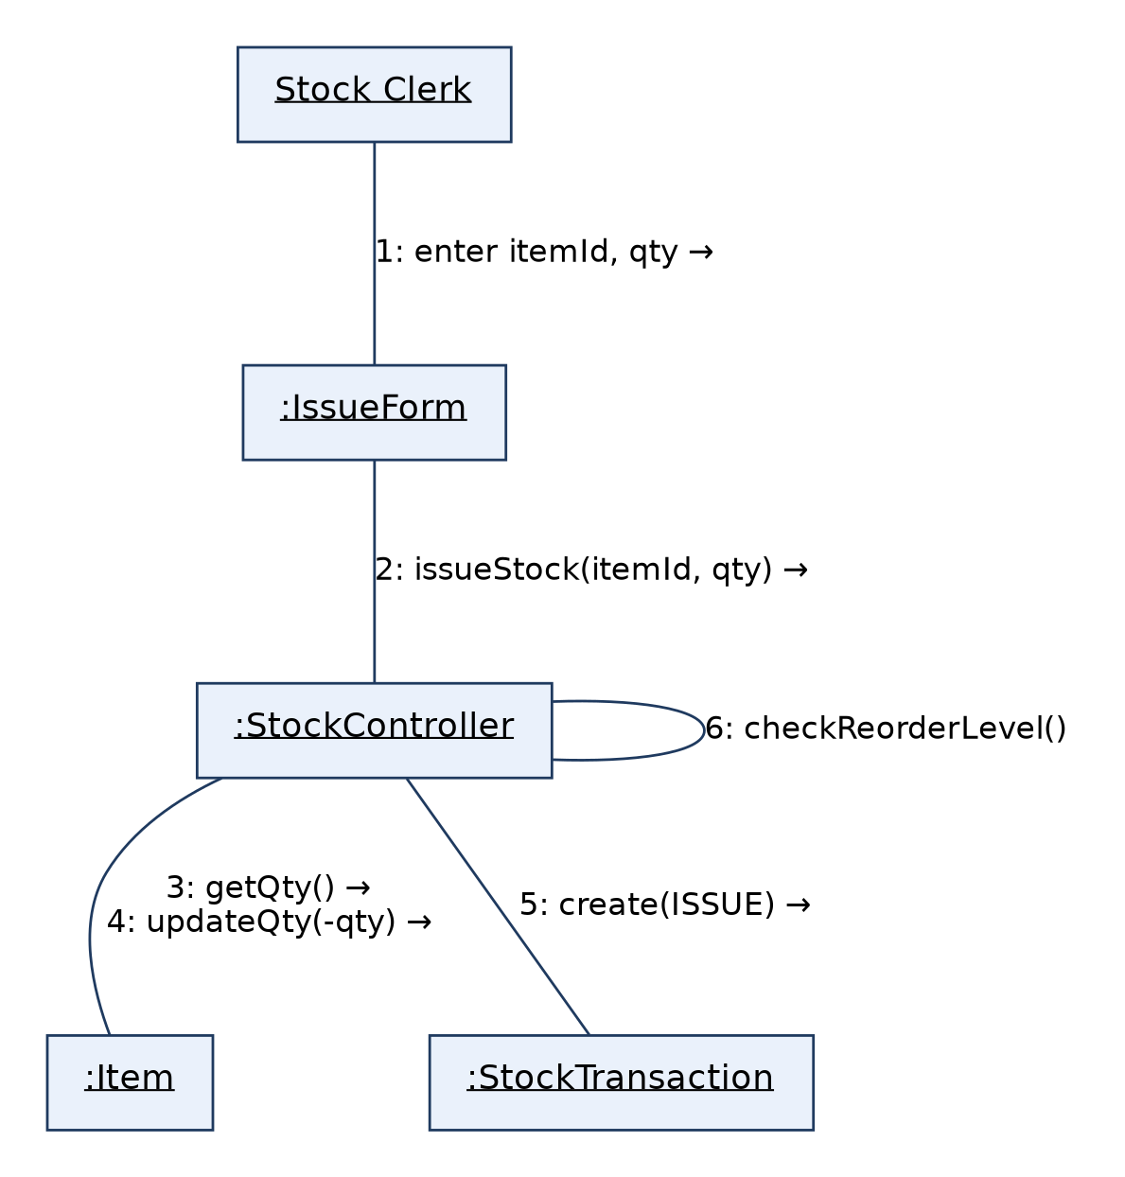
2. Stock Maintenance: Collaboration Diagram
Rule / limitation: Same information as the sequence diagram, but emphasises object links; message order is shown only by numbers, and it gets cluttered with many objects.
Notes:
2. Stock Maintenance: Collaboration Diagram. Same information as the sequence diagram, but emphasises object links; message order is shown only by numbers, and it gets cluttered with many objects.

Slide 8
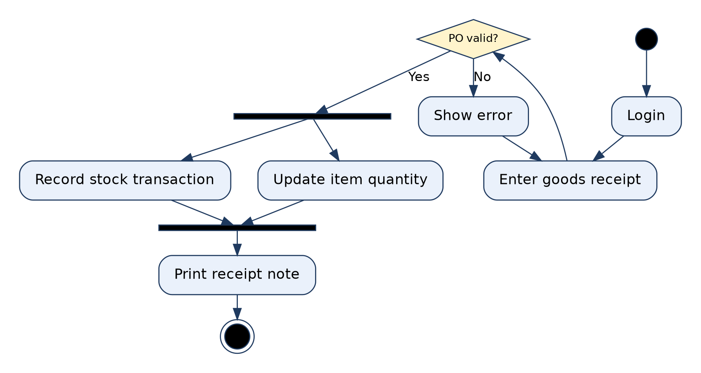
2. Stock Maintenance: Activity Diagram
Rule / limitation: Shows flow of control: one initial node, guards on decisions must be mutually exclusive, every fork needs a matching join. Weak at showing which object owns an action.
Notes:
2. Stock Maintenance: Activity Diagram. Shows flow of control: one initial node, guards on decisions must be mutually exclusive, every fork needs a matching join. Weak at showing which object owns an action.

Slide 9
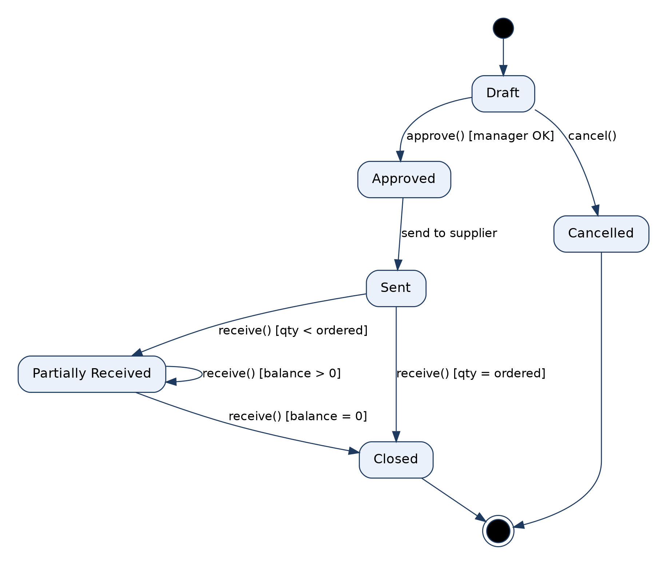
2. Stock Maintenance: State Diagram (PurchaseOrder)
Rule / limitation: Models the lifecycle of ONE object only. Every transition needs an event, guards must not overlap, and it suits reactive objects, not every class.
Notes:
2. Stock Maintenance: State Diagram (PurchaseOrder). Models the lifecycle of ONE object only. Every transition needs an event, guards must not overlap, and it suits reactive objects, not every class.

Slide 10
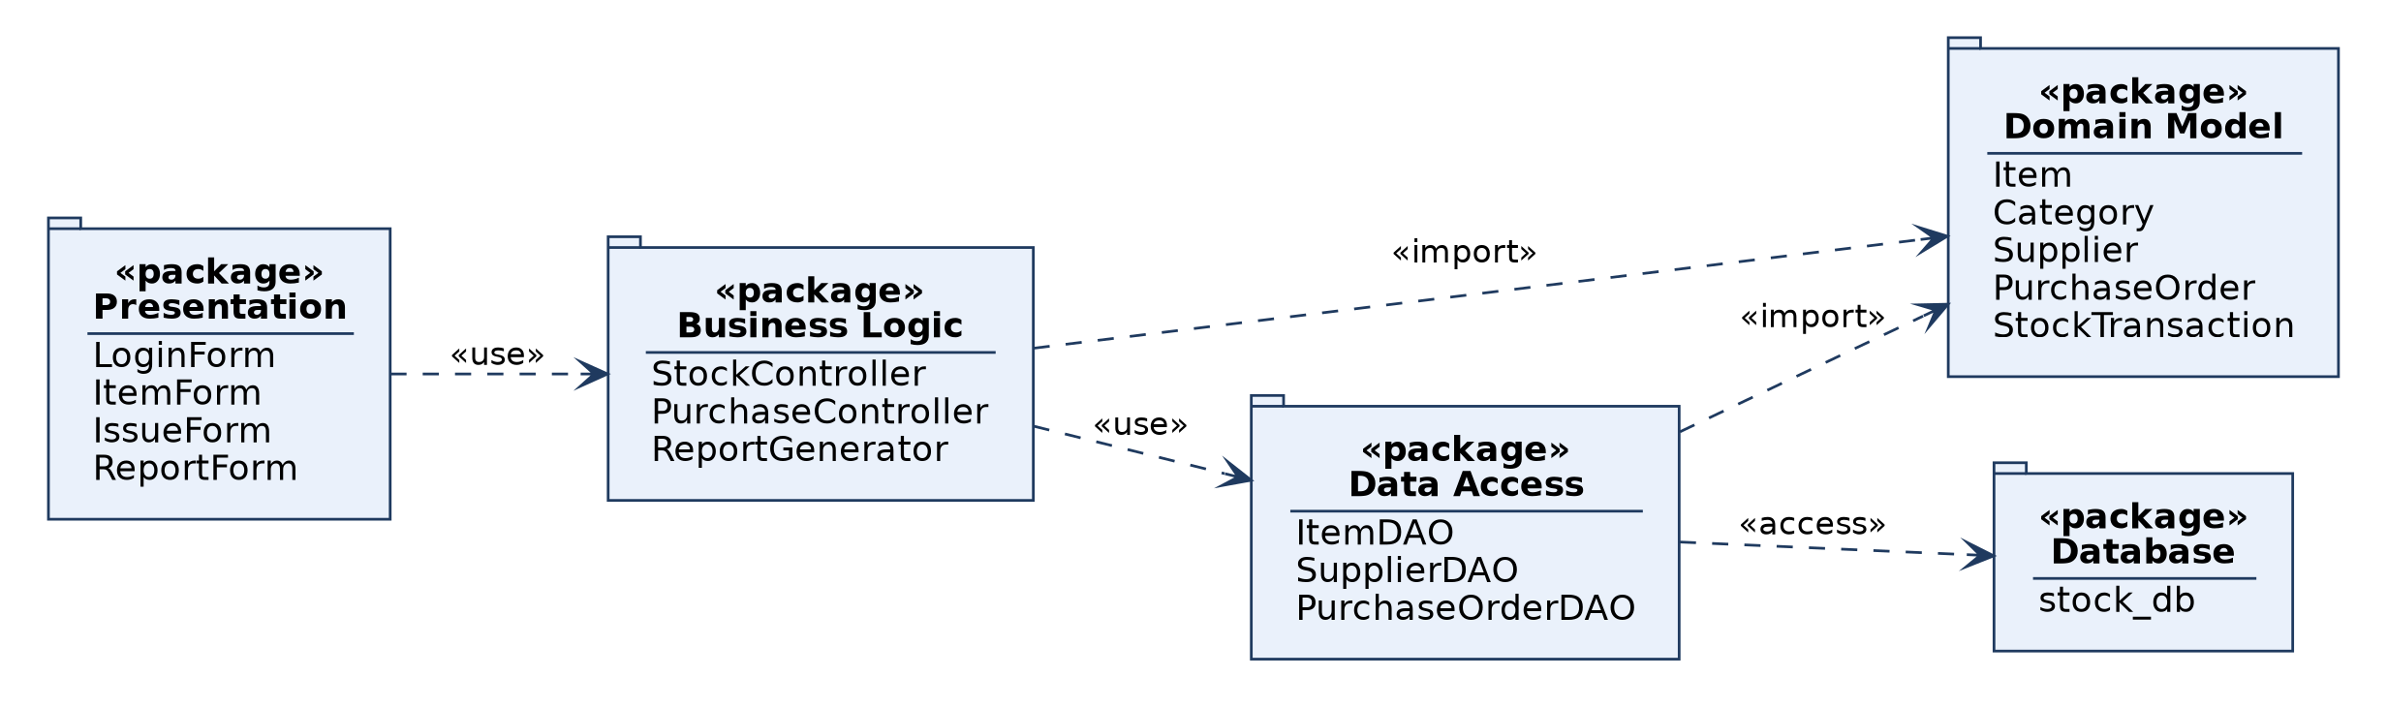
2. Stock Maintenance: Package Diagram
Rule / limitation: Groups elements into namespaces and shows dependencies between groups; dependencies should not form cycles; internal detail is hidden.
Notes:
2. Stock Maintenance: Package Diagram. Groups elements into namespaces and shows dependencies between groups; dependencies should not form cycles; internal detail is hidden.

Slide 11
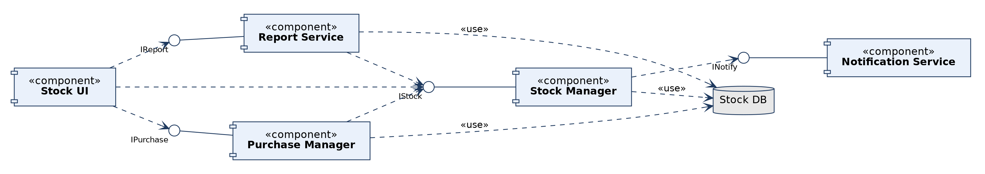
2. Stock Maintenance: Component Diagram
Rule / limitation: Physical, modular view with provided (lollipop) and required (dashed) interfaces; shows no run-time behaviour and hides internal classes.
Notes:
2. Stock Maintenance: Component Diagram. Physical, modular view with provided (lollipop) and required (dashed) interfaces; shows no run-time behaviour and hides internal classes.

Slide 12
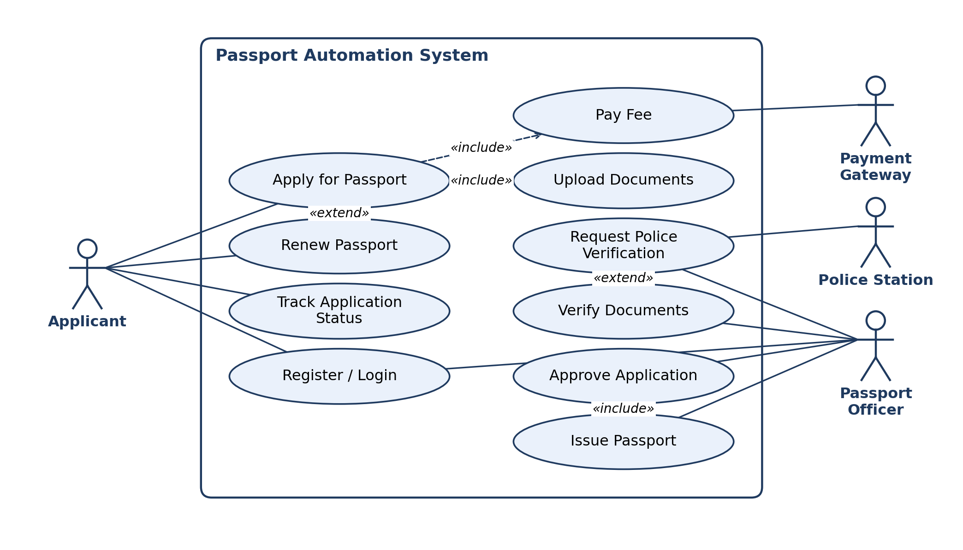
3. Passport Automation System: Use Case Diagram
Rule / limitation: Shows WHAT the system does for its actors, not HOW. Actors stay outside the boundary; no ordering or data detail; «include» is mandatory, «extend» is conditional.
Notes:
3. Passport Automation System: Use Case Diagram. Shows WHAT the system does for its actors, not HOW. Actors stay outside the boundary; no ordering or data detail; «include» is mandatory, «extend» is conditional.

Slide 13
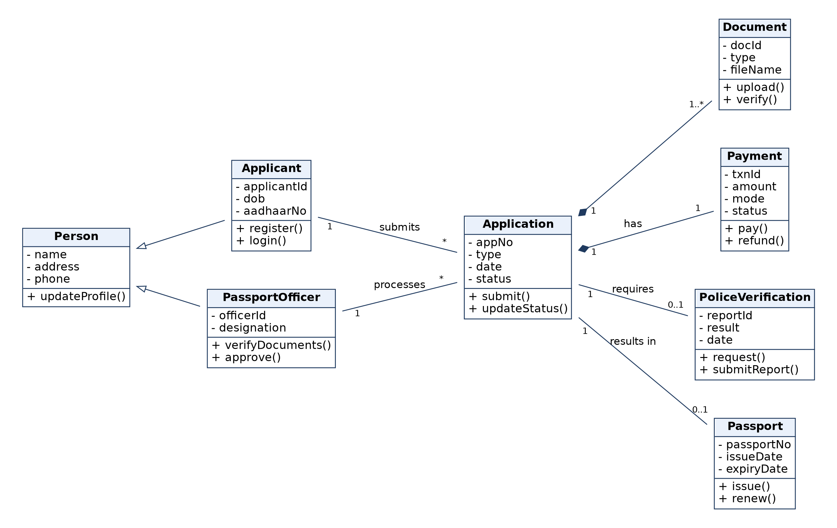
3. Passport Automation System: Class Diagram
Rule / limitation: Static structure only; behaviour over time is not shown. Show multiplicity on associations; composition parts are not shared; generalization must not be circular.
Notes:
3. Passport Automation System: Class Diagram. Static structure only; behaviour over time is not shown. Show multiplicity on associations; composition parts are not shared; generalization must not be circular.

Slide 14
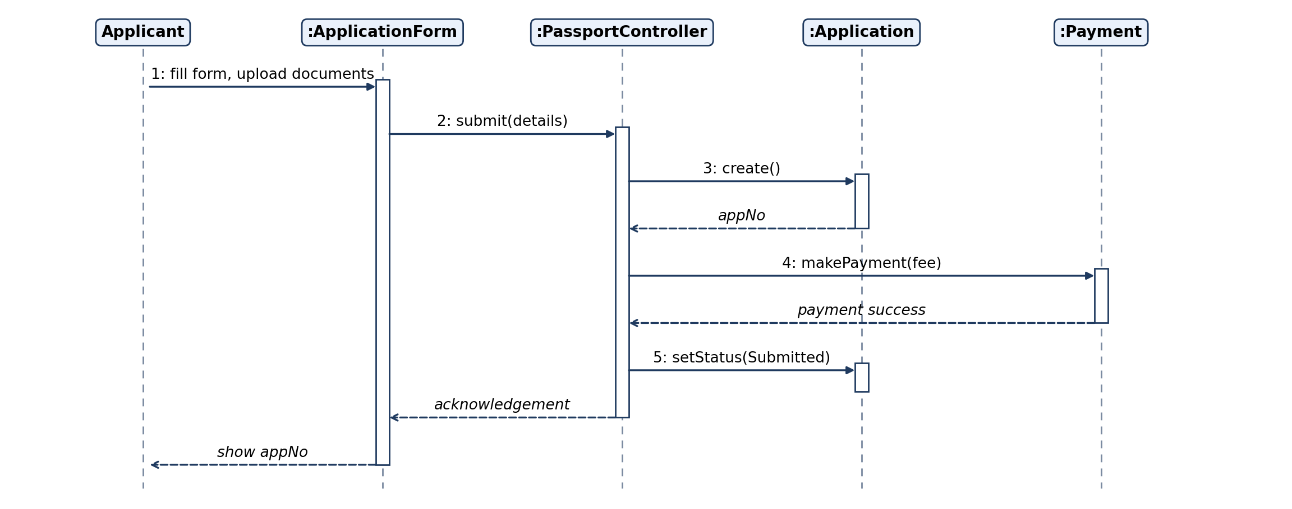
3. Passport Automation System: Sequence Diagram
Rule / limitation: Shows ONE scenario in time order (top to bottom). Poor for loops and many branches; use alt/loop frames or an activity diagram instead.
Notes:
3. Passport Automation System: Sequence Diagram. Shows ONE scenario in time order (top to bottom). Poor for loops and many branches; use alt/loop frames or an activity diagram instead.

Slide 15
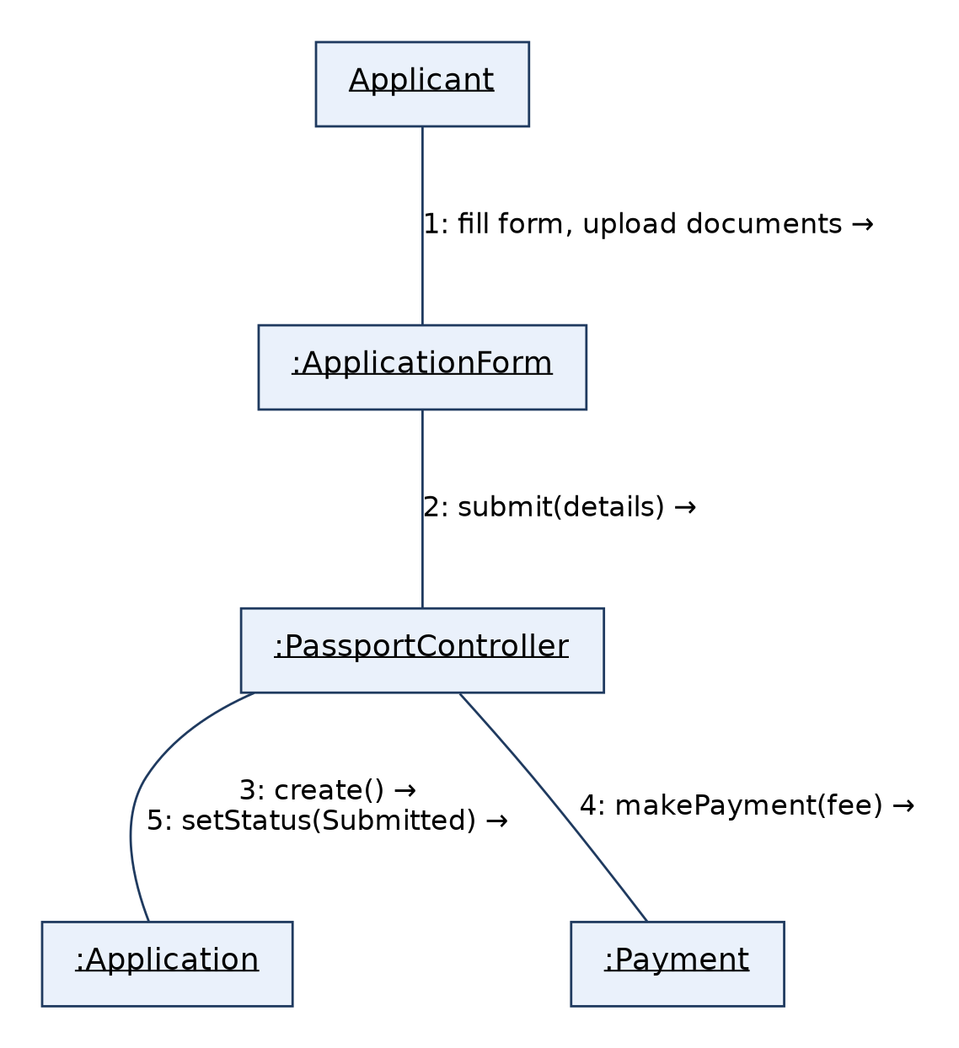
3. Passport Automation System: Collaboration Diagram
Rule / limitation: Same information as the sequence diagram, but emphasises object links; message order is shown only by numbers, and it gets cluttered with many objects.
Notes:
3. Passport Automation System: Collaboration Diagram. Same information as the sequence diagram, but emphasises object links; message order is shown only by numbers, and it gets cluttered with many objects.

Slide 16
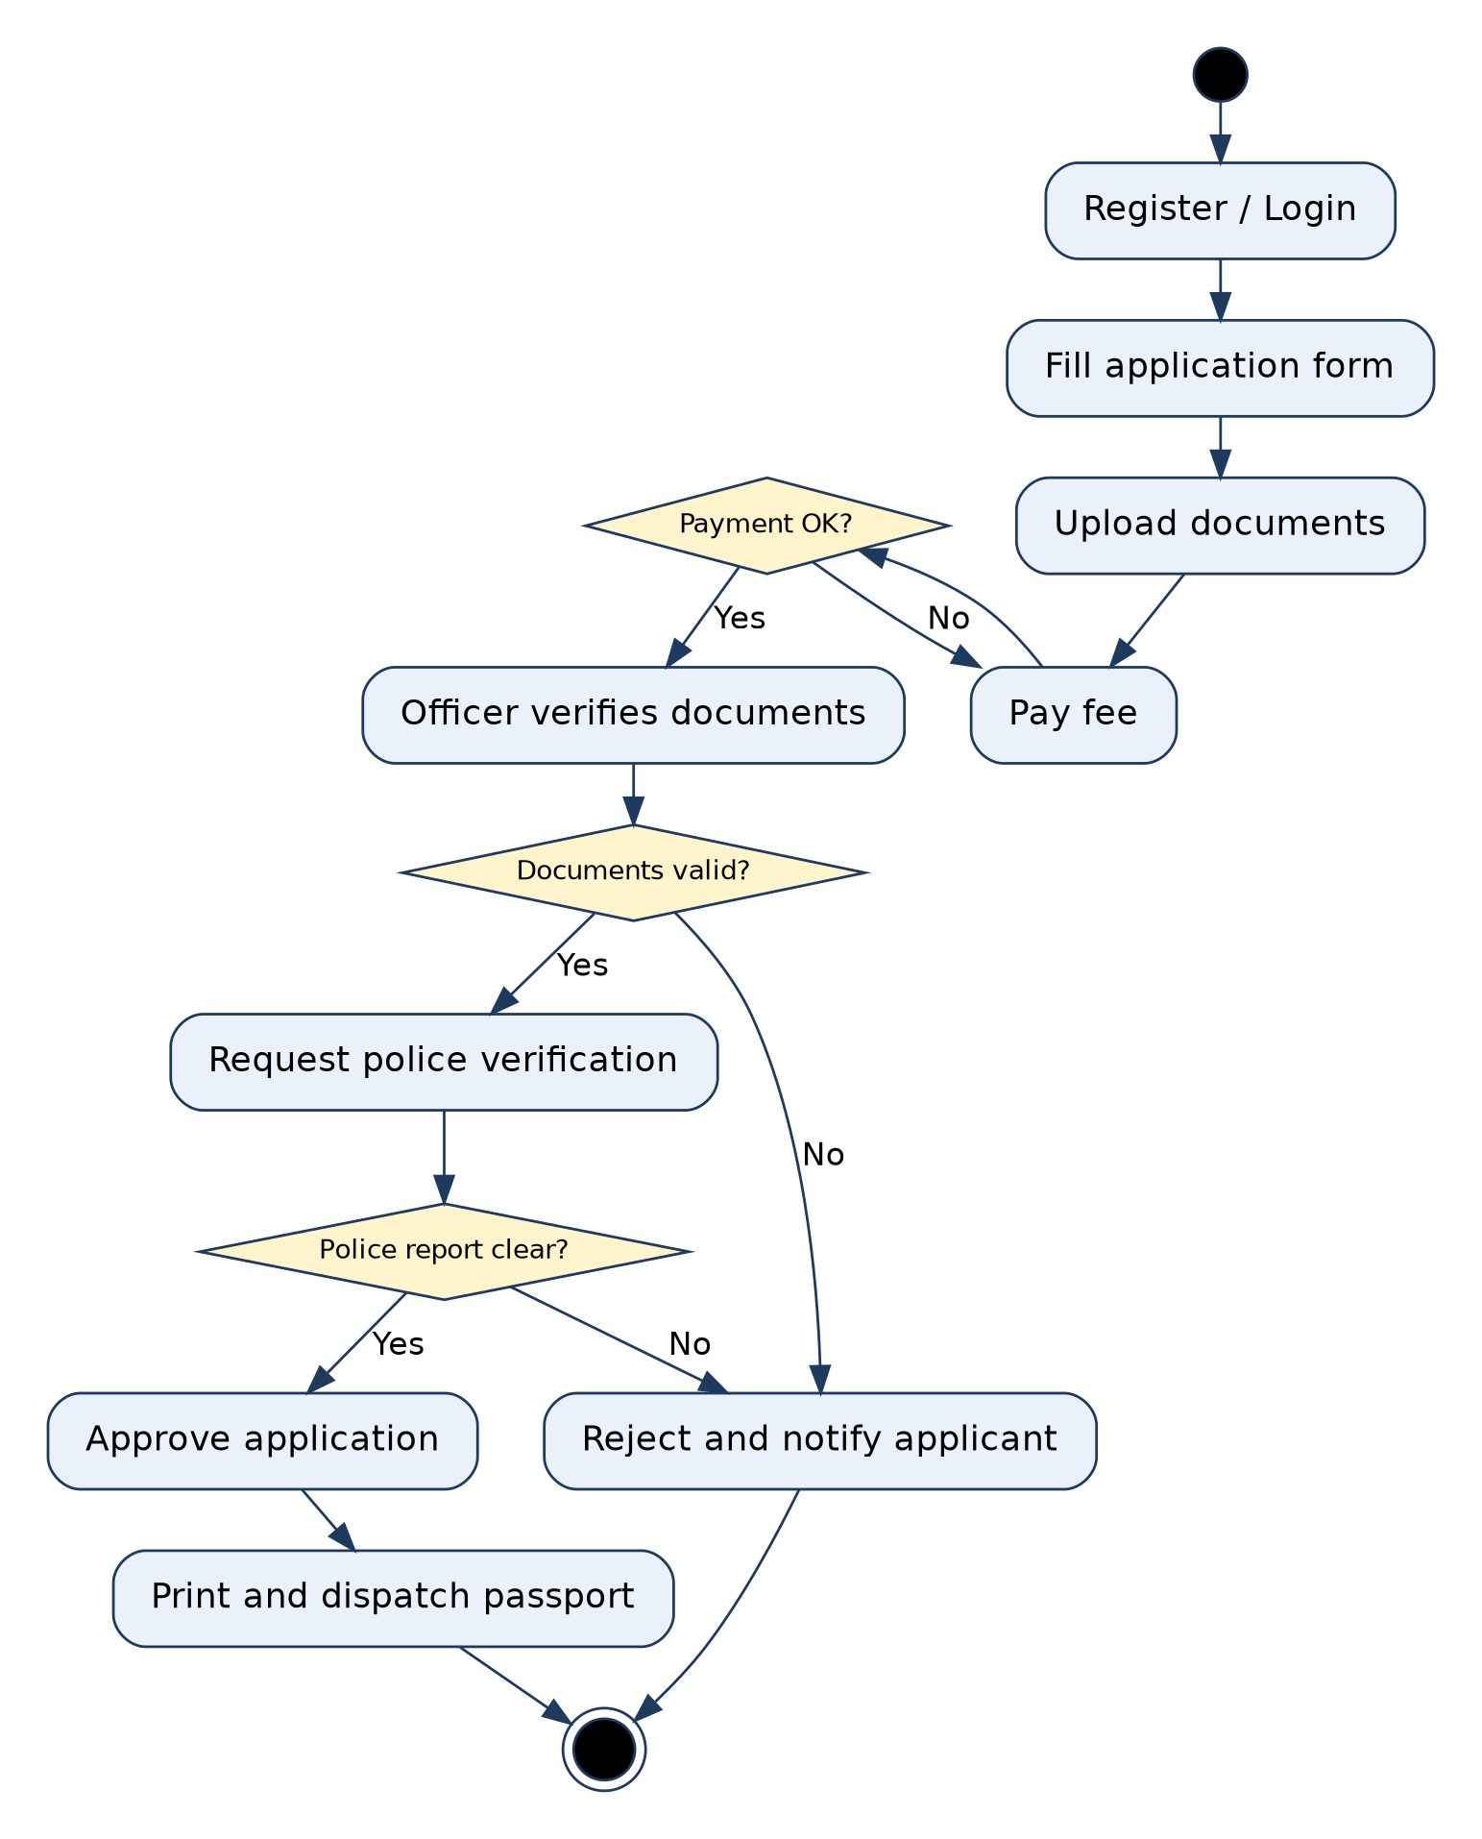
3. Passport Automation System: Activity Diagram
Rule / limitation: Shows flow of control: one initial node, guards on decisions must be mutually exclusive, every fork needs a matching join. Weak at showing which object owns an action.
Notes:
3. Passport Automation System: Activity Diagram. Shows flow of control: one initial node, guards on decisions must be mutually exclusive, every fork needs a matching join. Weak at showing which object owns an action.

Slide 17
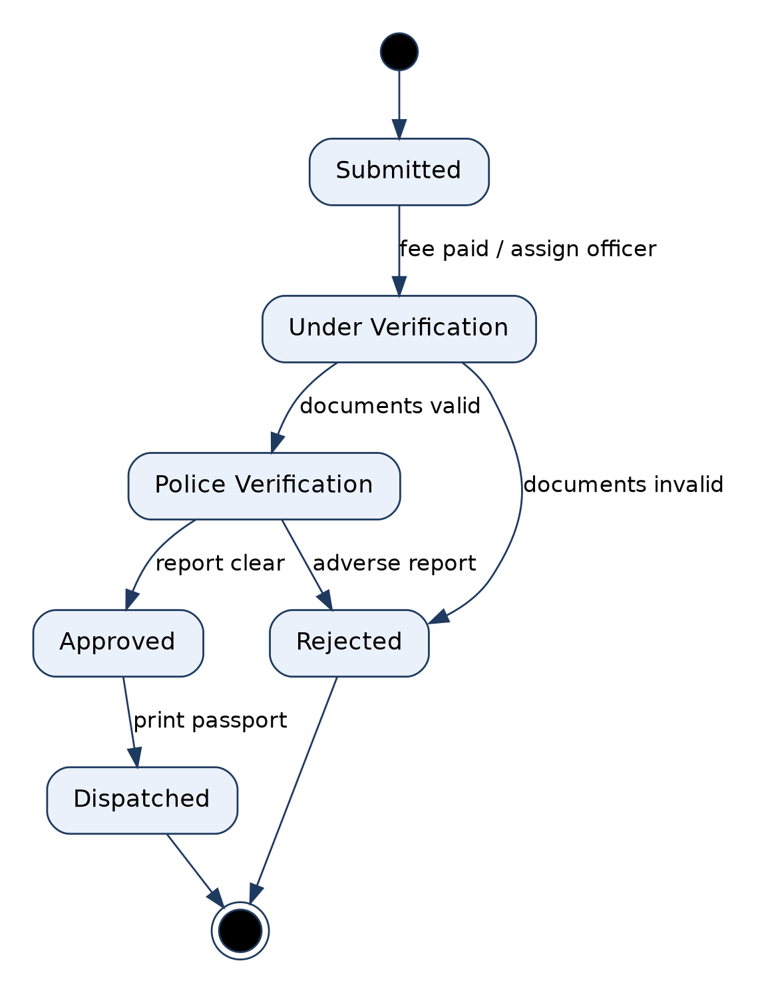
3. Passport Automation System: State Diagram (Application)
Rule / limitation: Models the lifecycle of ONE object only. Every transition needs an event, guards must not overlap, and it suits reactive objects, not every class.
Notes:
3. Passport Automation System: State Diagram (Application). Models the lifecycle of ONE object only. Every transition needs an event, guards must not overlap, and it suits reactive objects, not every class.

Slide 18
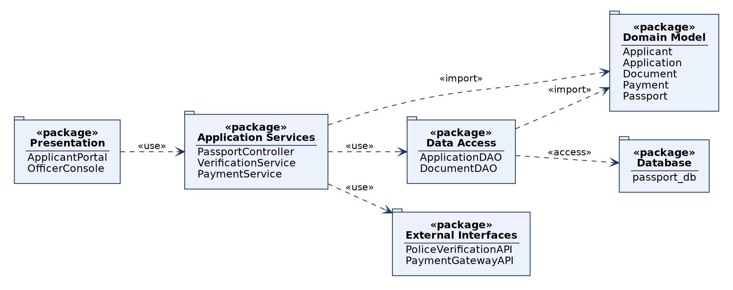
3. Passport Automation System: Package Diagram
Rule / limitation: Groups elements into namespaces and shows dependencies between groups; dependencies should not form cycles; internal detail is hidden.
Notes:
3. Passport Automation System: Package Diagram. Groups elements into namespaces and shows dependencies between groups; dependencies should not form cycles; internal detail is hidden.

Slide 19
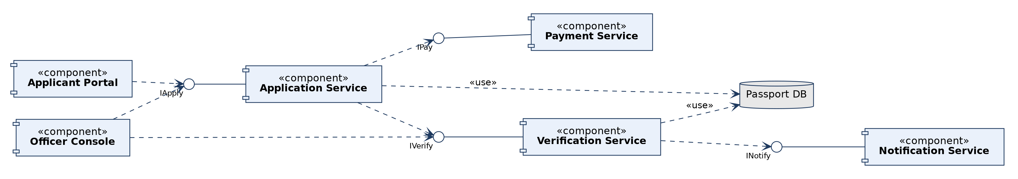
3. Passport Automation System: Component Diagram
Rule / limitation: Physical, modular view with provided (lollipop) and required (dashed) interfaces; shows no run-time behaviour and hides internal classes.
Notes:
3. Passport Automation System: Component Diagram. Physical, modular view with provided (lollipop) and required (dashed) interfaces; shows no run-time behaviour and hides internal classes.

Slide 20
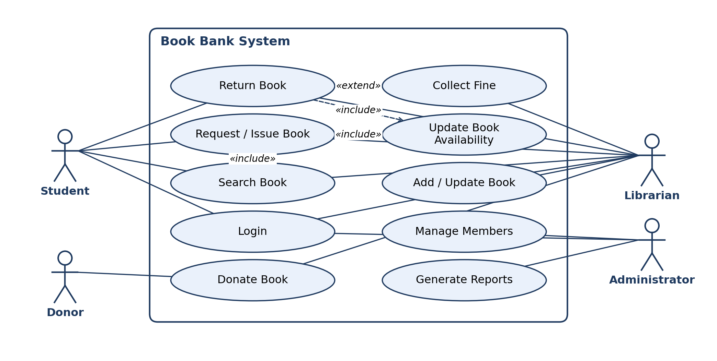
4. Book Bank: Use Case Diagram
Rule / limitation: Shows WHAT the system does for its actors, not HOW. Actors stay outside the boundary; no ordering or data detail; «include» is mandatory, «extend» is conditional.
Notes:
4. Book Bank: Use Case Diagram. Shows WHAT the system does for its actors, not HOW. Actors stay outside the boundary; no ordering or data detail; «include» is mandatory, «extend» is conditional.

Slide 21
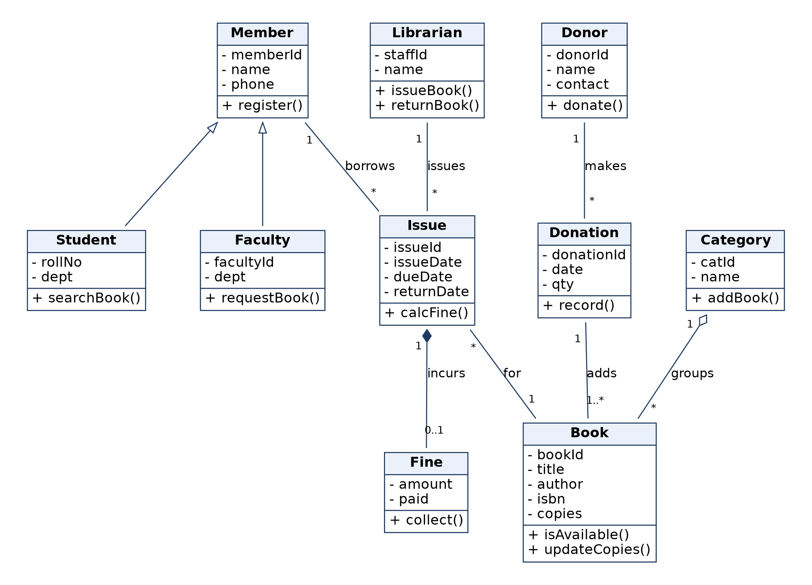
4. Book Bank: Class Diagram
Rule / limitation: Static structure only; behaviour over time is not shown. Show multiplicity on associations; composition parts are not shared; generalization must not be circular.
Notes:
4. Book Bank: Class Diagram. Static structure only; behaviour over time is not shown. Show multiplicity on associations; composition parts are not shared; generalization must not be circular.

Slide 22
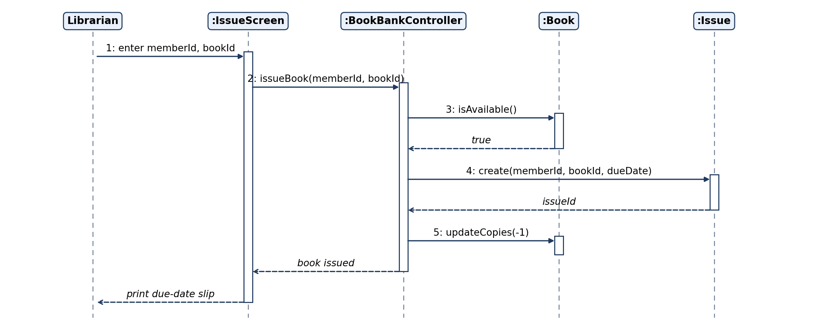
4. Book Bank: Sequence Diagram
Rule / limitation: Shows ONE scenario in time order (top to bottom). Poor for loops and many branches; use alt/loop frames or an activity diagram instead.
Notes:
4. Book Bank: Sequence Diagram. Shows ONE scenario in time order (top to bottom). Poor for loops and many branches; use alt/loop frames or an activity diagram instead.

Slide 23
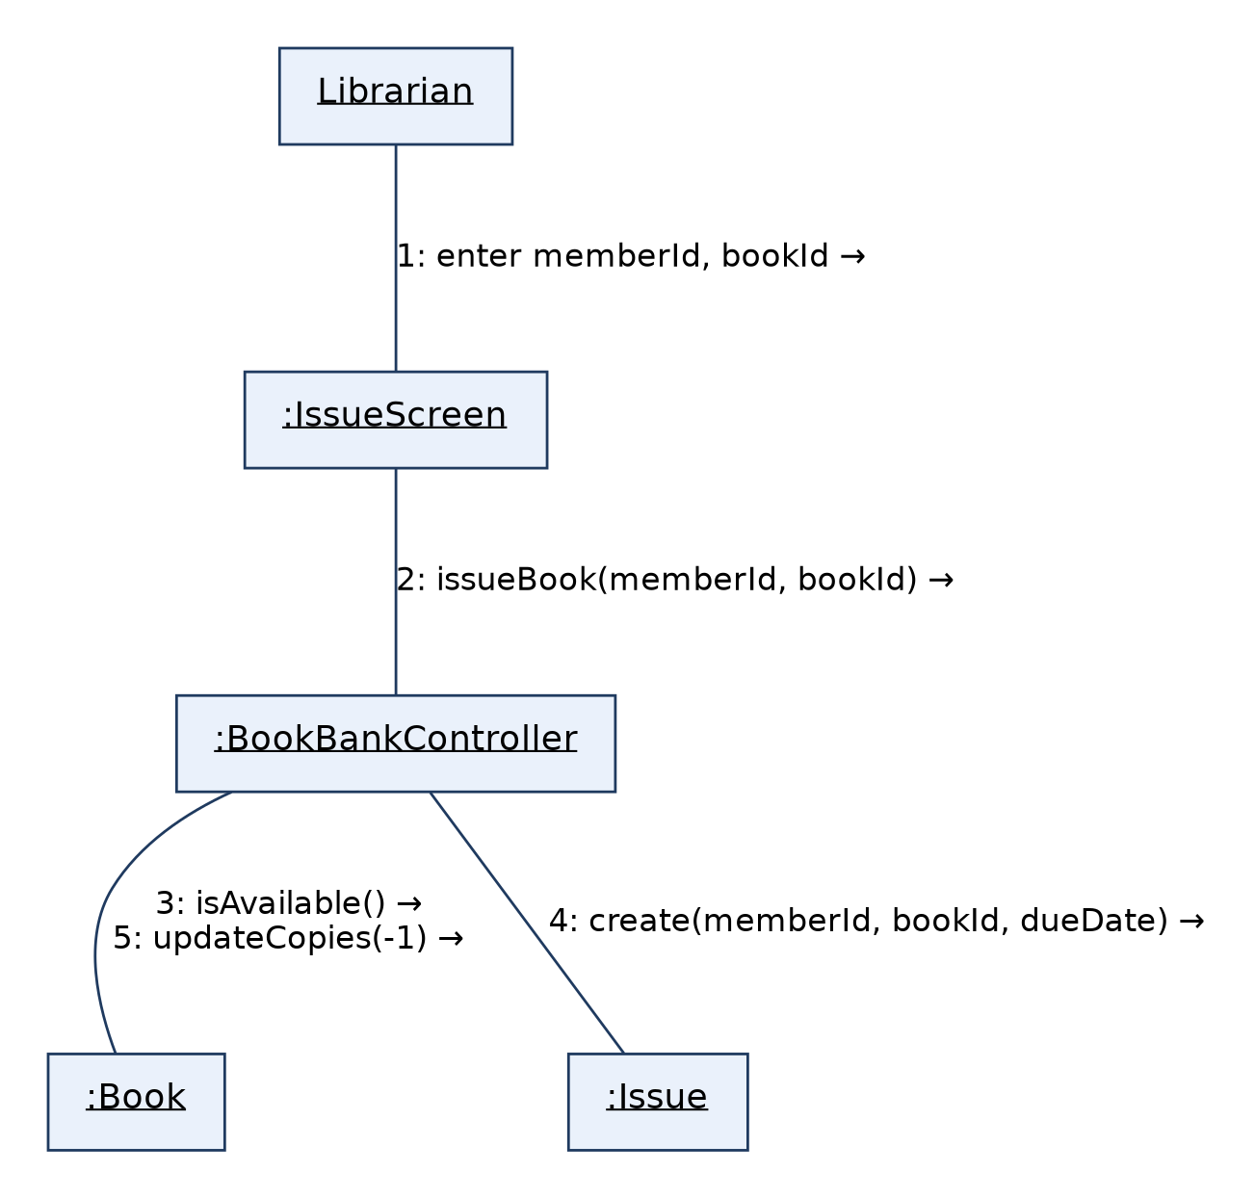
4. Book Bank: Collaboration Diagram
Rule / limitation: Same information as the sequence diagram, but emphasises object links; message order is shown only by numbers, and it gets cluttered with many objects.
Notes:
4. Book Bank: Collaboration Diagram. Same information as the sequence diagram, but emphasises object links; message order is shown only by numbers, and it gets cluttered with many objects.

Slide 24
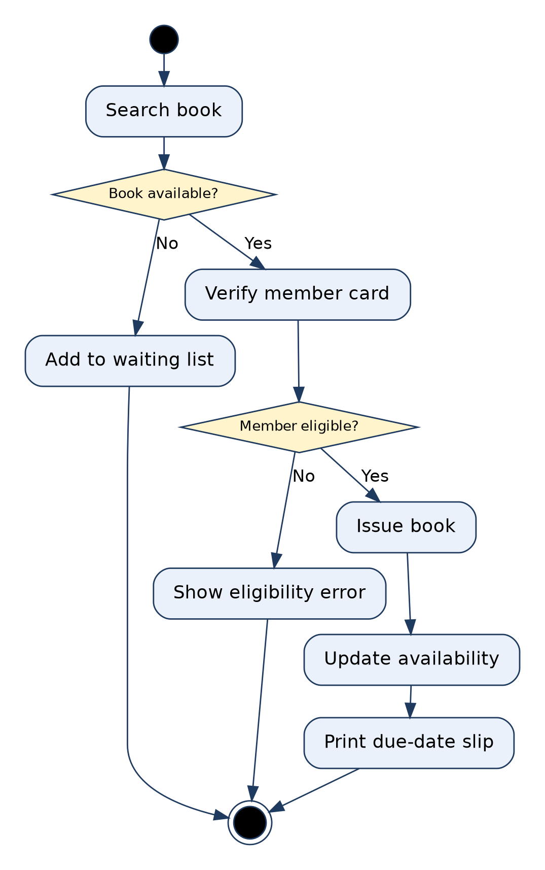
4. Book Bank: Activity Diagram
Rule / limitation: Shows flow of control: one initial node, guards on decisions must be mutually exclusive, every fork needs a matching join. Weak at showing which object owns an action.
Notes:
4. Book Bank: Activity Diagram. Shows flow of control: one initial node, guards on decisions must be mutually exclusive, every fork needs a matching join. Weak at showing which object owns an action.

Slide 25
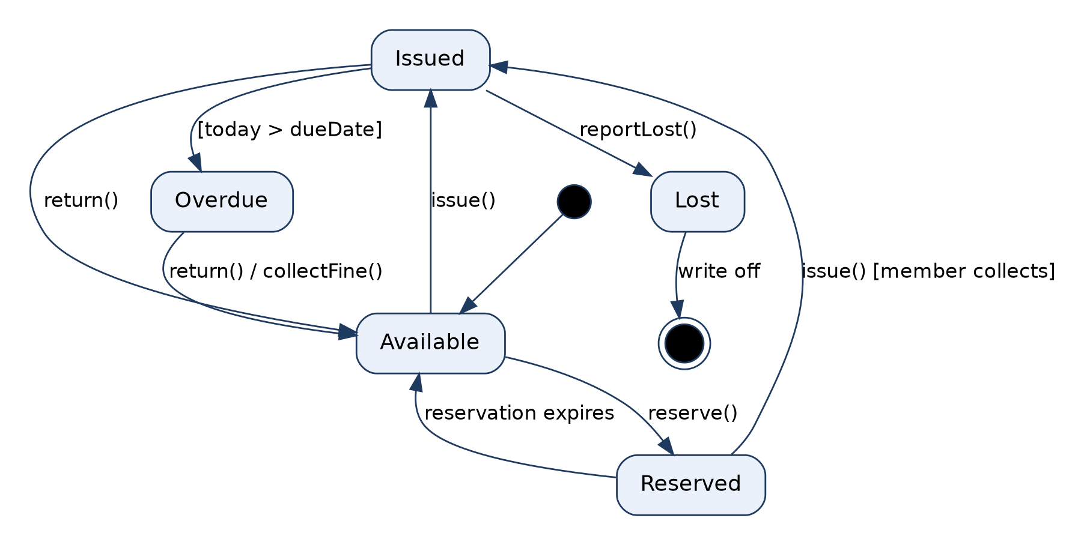
4. Book Bank: State Diagram (Book Copy)
Rule / limitation: Models the lifecycle of ONE object only. Every transition needs an event, guards must not overlap, and it suits reactive objects, not every class.
Notes:
4. Book Bank: State Diagram (Book Copy). Models the lifecycle of ONE object only. Every transition needs an event, guards must not overlap, and it suits reactive objects, not every class.

Slide 26
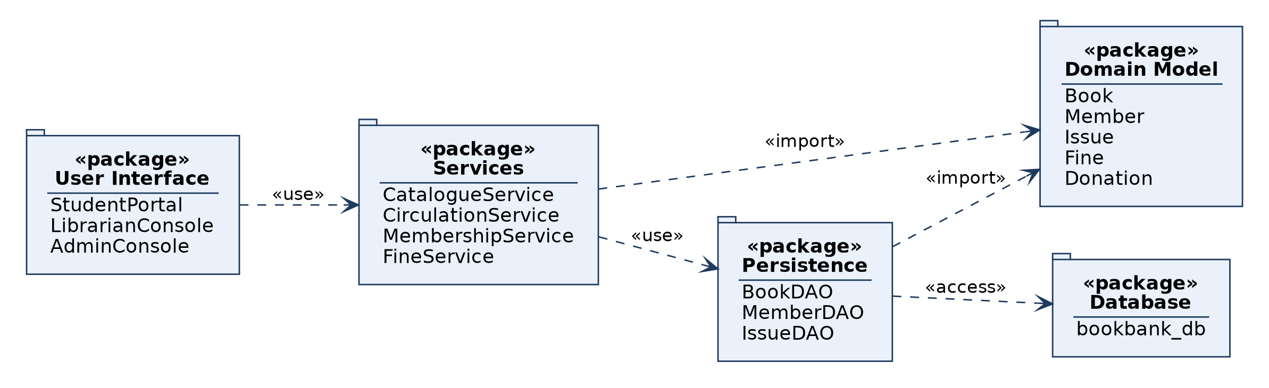
4. Book Bank: Package Diagram
Rule / limitation: Groups elements into namespaces and shows dependencies between groups; dependencies should not form cycles; internal detail is hidden.
Notes:
4. Book Bank: Package Diagram. Groups elements into namespaces and shows dependencies between groups; dependencies should not form cycles; internal detail is hidden.

Slide 27
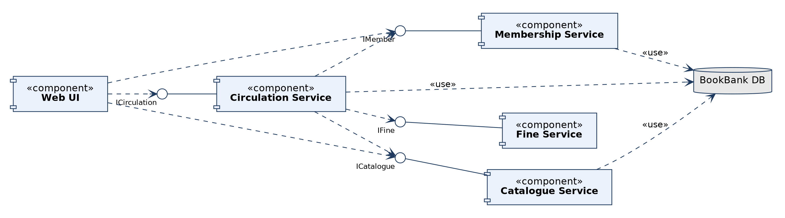
4. Book Bank: Component Diagram
Rule / limitation: Physical, modular view with provided (lollipop) and required (dashed) interfaces; shows no run-time behaviour and hides internal classes.
Notes:
4. Book Bank: Component Diagram. Physical, modular view with provided (lollipop) and required (dashed) interfaces; shows no run-time behaviour and hides internal classes.

Slide 28
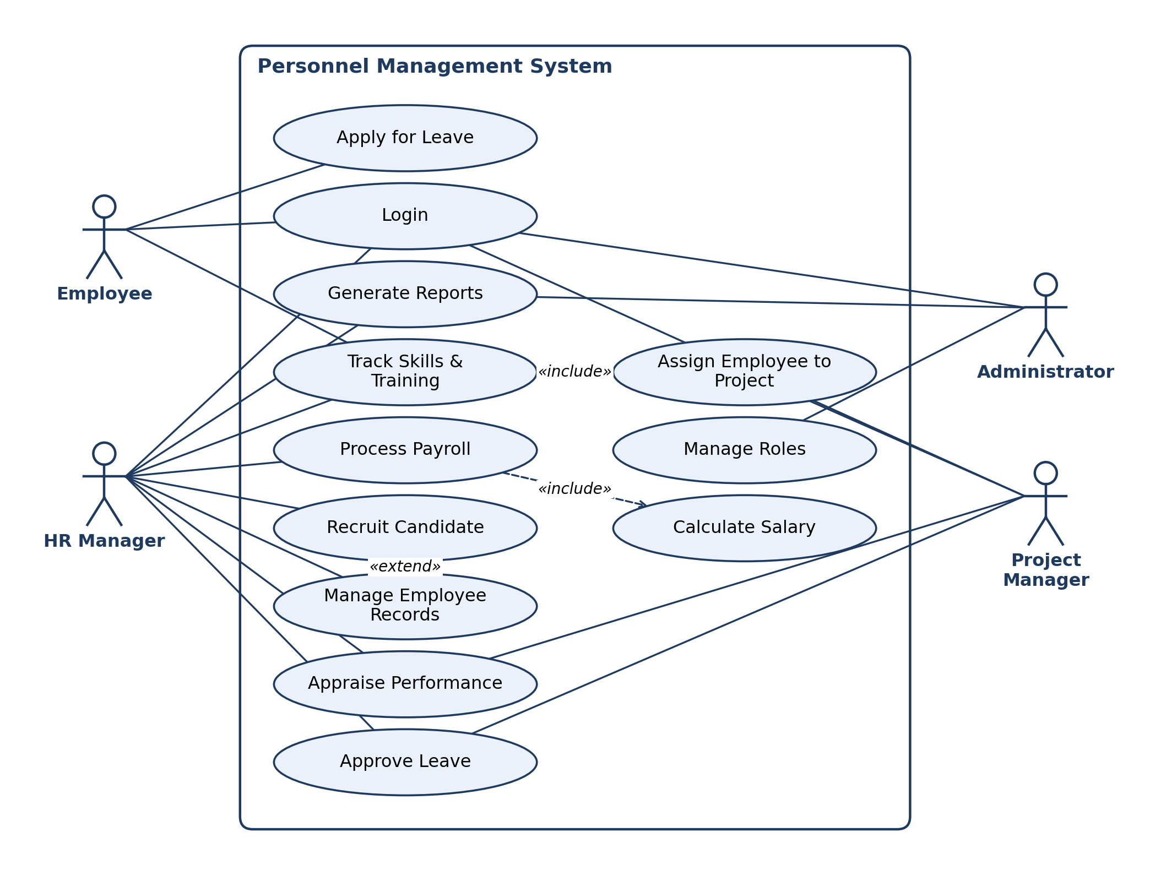
5. Software Personnel Management System: Use Case Diagram
Rule / limitation: Shows WHAT the system does for its actors, not HOW. Actors stay outside the boundary; no ordering or data detail; «include» is mandatory, «extend» is conditional.
Notes:
5. Software Personnel Management System: Use Case Diagram. Shows WHAT the system does for its actors, not HOW. Actors stay outside the boundary; no ordering or data detail; «include» is mandatory, «extend» is conditional.

Slide 29
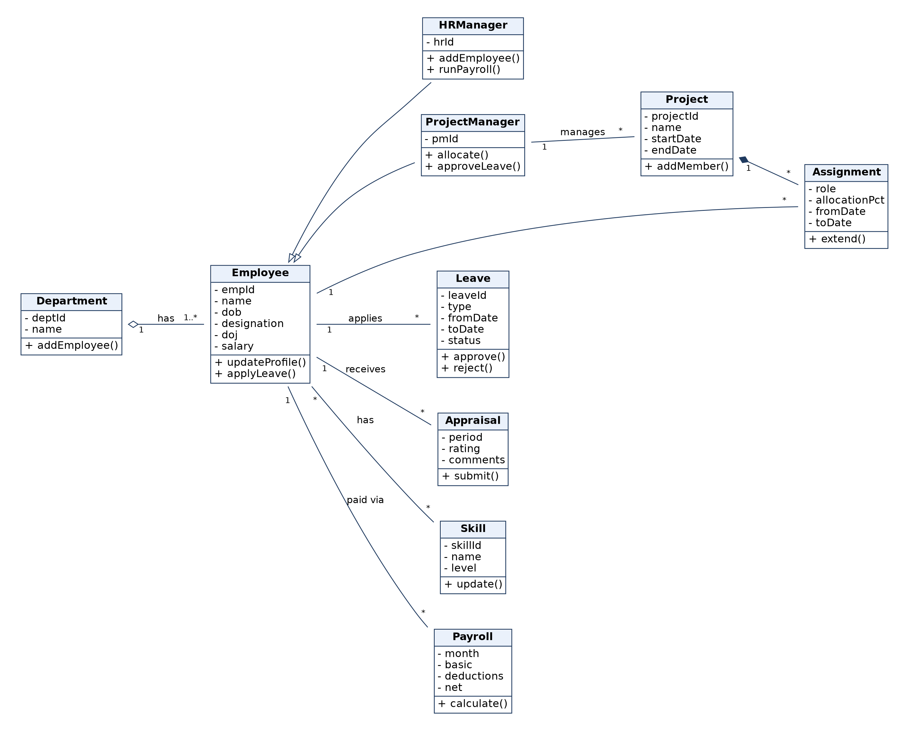
5. Software Personnel Management System: Class Diagram
Rule / limitation: Static structure only; behaviour over time is not shown. Show multiplicity on associations; composition parts are not shared; generalization must not be circular.
Notes:
5. Software Personnel Management System: Class Diagram. Static structure only; behaviour over time is not shown. Show multiplicity on associations; composition parts are not shared; generalization must not be circular.

Slide 30
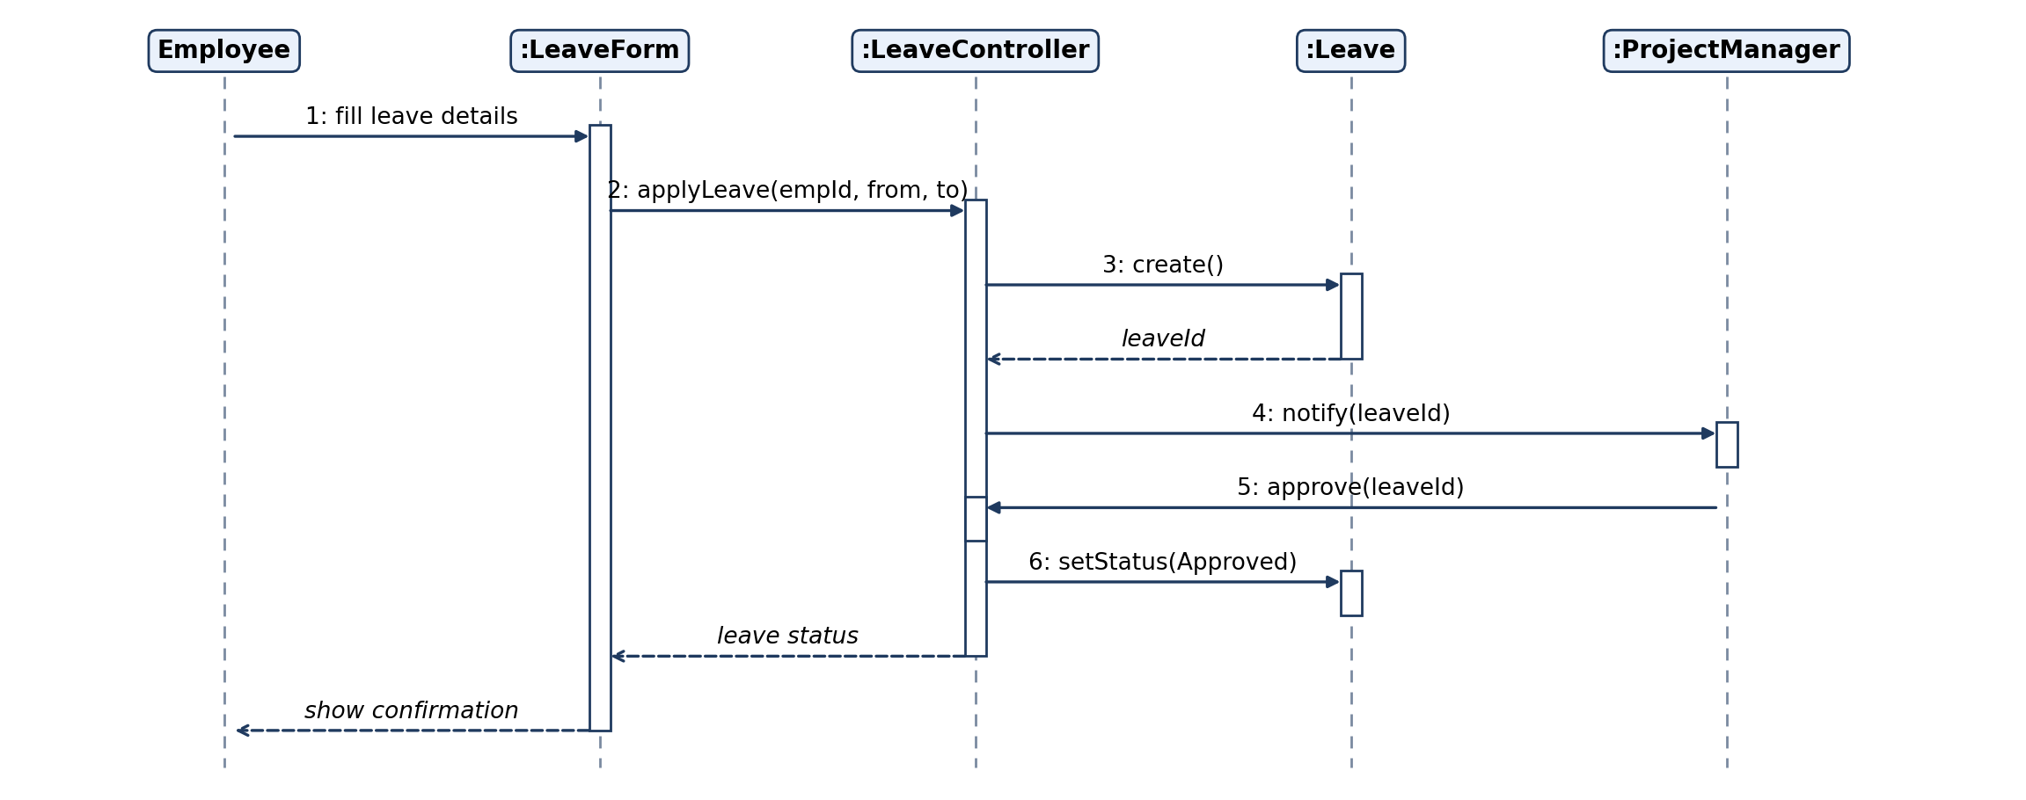
5. Software Personnel Management System: Sequence Diagram
Rule / limitation: Shows ONE scenario in time order (top to bottom). Poor for loops and many branches; use alt/loop frames or an activity diagram instead.
Notes:
5. Software Personnel Management System: Sequence Diagram. Shows ONE scenario in time order (top to bottom). Poor for loops and many branches; use alt/loop frames or an activity diagram instead.

Slide 31
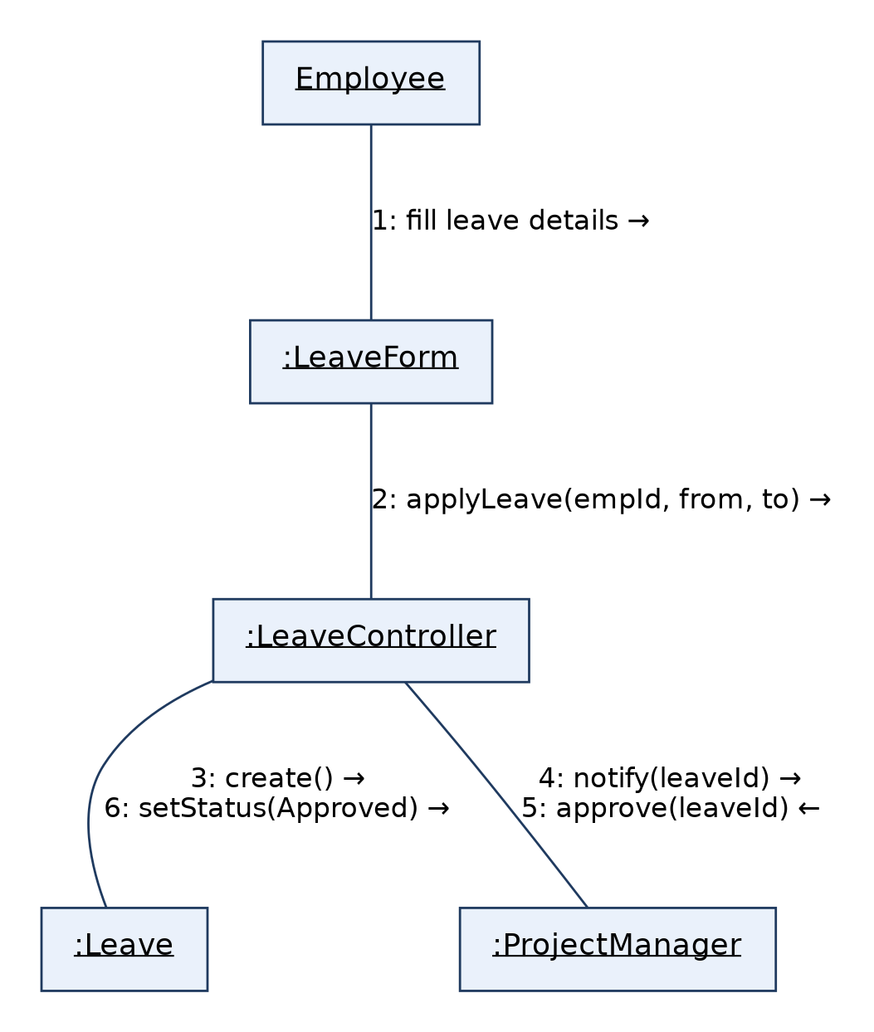
5. Software Personnel Management System: Collaboration Diagram
Rule / limitation: Same information as the sequence diagram, but emphasises object links; message order is shown only by numbers, and it gets cluttered with many objects.
Notes:
5. Software Personnel Management System: Collaboration Diagram. Same information as the sequence diagram, but emphasises object links; message order is shown only by numbers, and it gets cluttered with many objects.

Slide 32
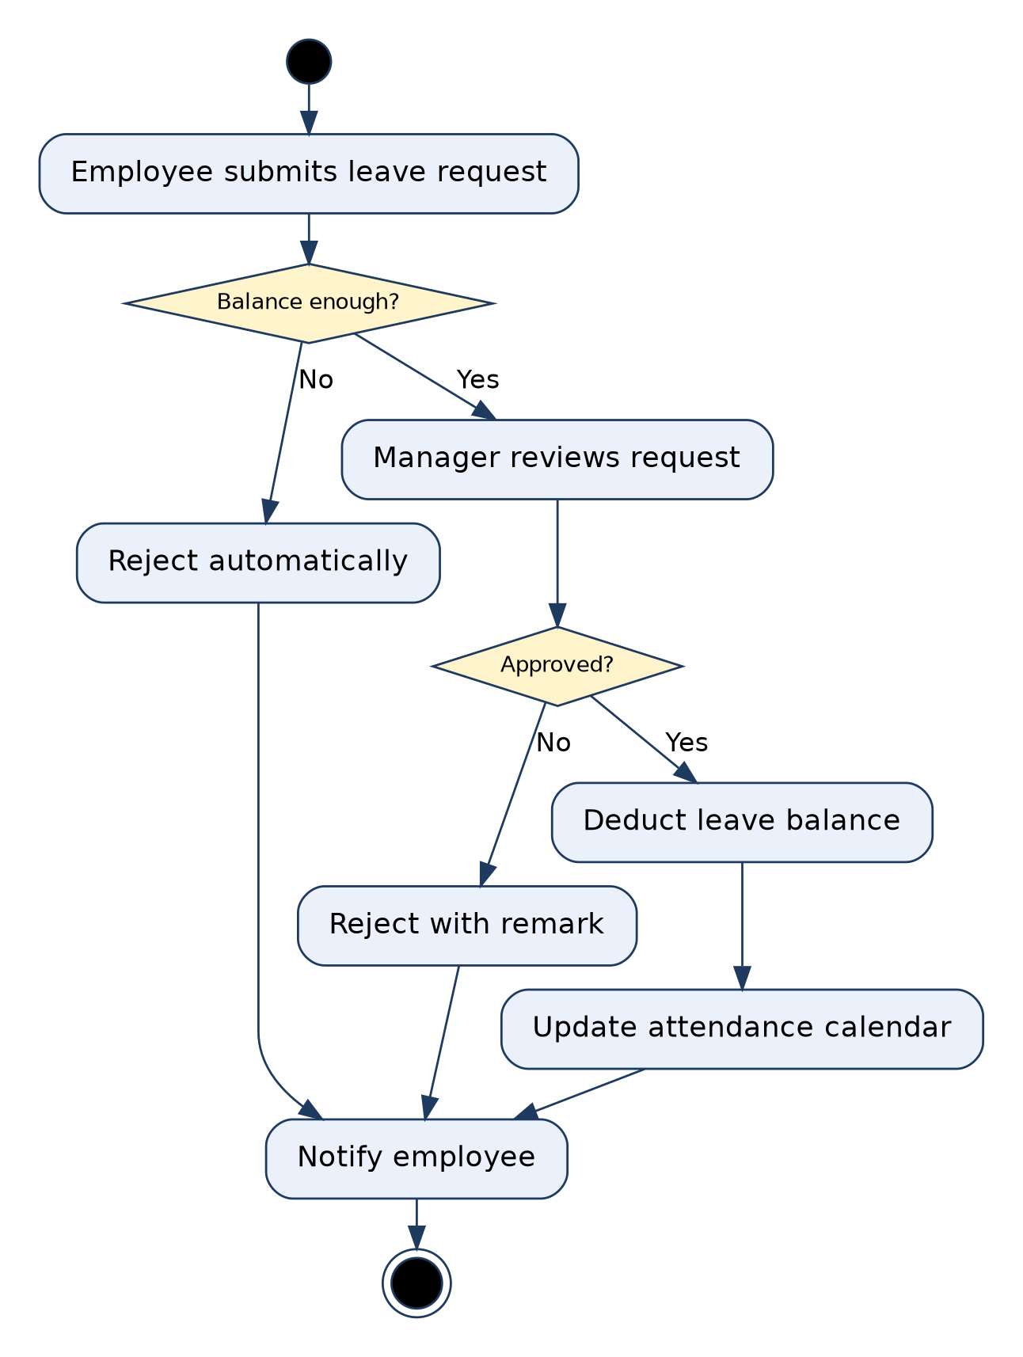
5. Software Personnel Management System: Activity Diagram
Rule / limitation: Shows flow of control: one initial node, guards on decisions must be mutually exclusive, every fork needs a matching join. Weak at showing which object owns an action.
Notes:
5. Software Personnel Management System: Activity Diagram. Shows flow of control: one initial node, guards on decisions must be mutually exclusive, every fork needs a matching join. Weak at showing which object owns an action.

Slide 33
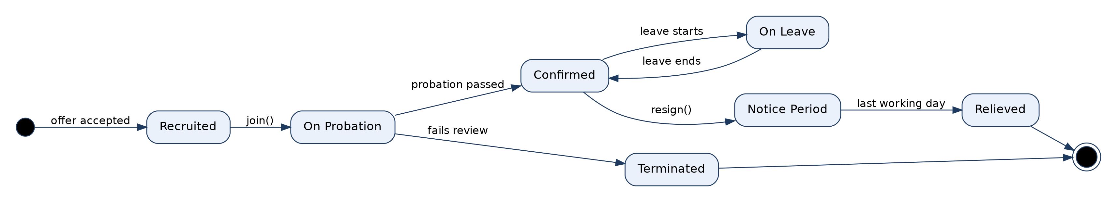
5. Software Personnel Management System: State Diagram (Employee)
Rule / limitation: Models the lifecycle of ONE object only. Every transition needs an event, guards must not overlap, and it suits reactive objects, not every class.
Notes:
5. Software Personnel Management System: State Diagram (Employee). Models the lifecycle of ONE object only. Every transition needs an event, guards must not overlap, and it suits reactive objects, not every class.

Slide 34
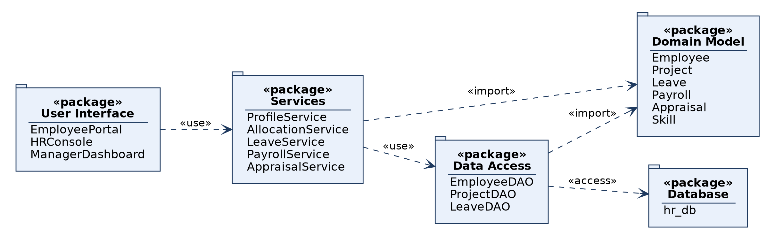
5. Software Personnel Management System: Package Diagram
Rule / limitation: Groups elements into namespaces and shows dependencies between groups; dependencies should not form cycles; internal detail is hidden.
Notes:
5. Software Personnel Management System: Package Diagram. Groups elements into namespaces and shows dependencies between groups; dependencies should not form cycles; internal detail is hidden.

Slide 35
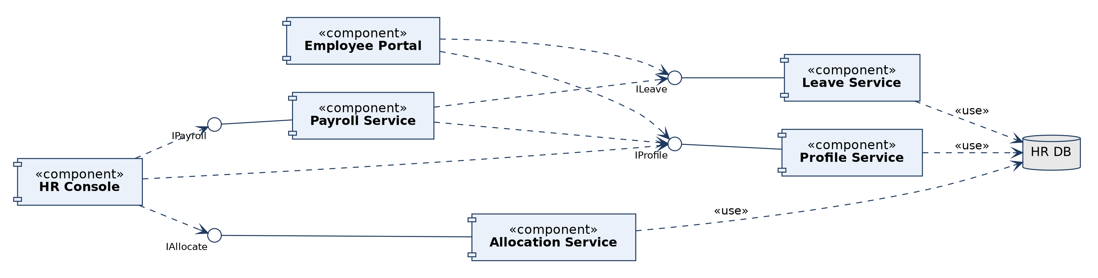
5. Software Personnel Management System: Component Diagram
Rule / limitation: Physical, modular view with provided (lollipop) and required (dashed) interfaces; shows no run-time behaviour and hides internal classes.
Notes:
5. Software Personnel Management System: Component Diagram. Physical, modular view with provided (lollipop) and required (dashed) interfaces; shows no run-time behaviour and hides internal classes.

Slide 36
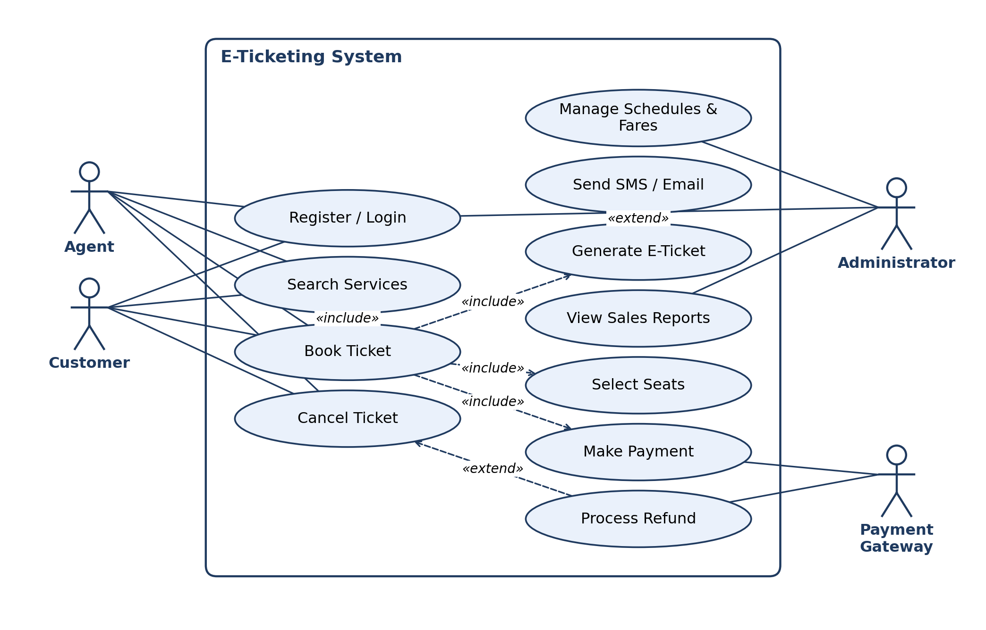
6. E-Ticketing: Use Case Diagram
Rule / limitation: Shows WHAT the system does for its actors, not HOW. Actors stay outside the boundary; no ordering or data detail; «include» is mandatory, «extend» is conditional.
Notes:
6. E-Ticketing: Use Case Diagram. Shows WHAT the system does for its actors, not HOW. Actors stay outside the boundary; no ordering or data detail; «include» is mandatory, «extend» is conditional.

Slide 37
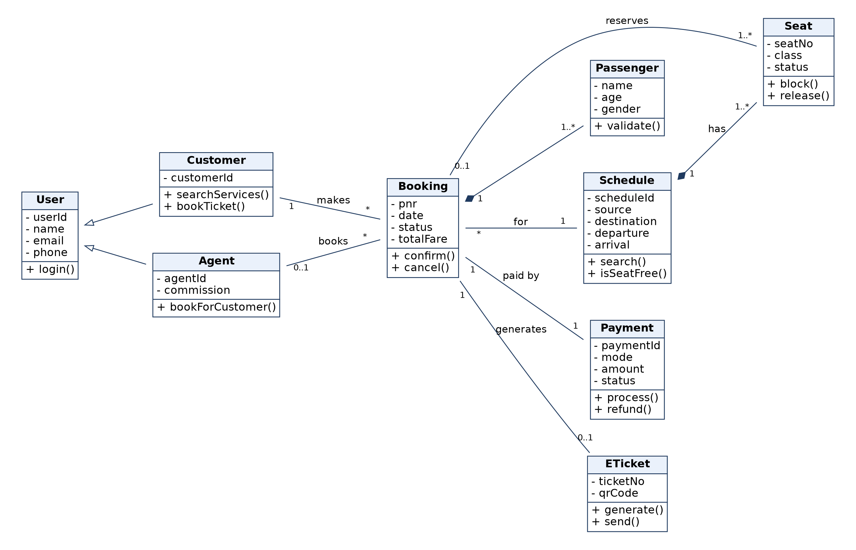
6. E-Ticketing: Class Diagram
Rule / limitation: Static structure only; behaviour over time is not shown. Show multiplicity on associations; composition parts are not shared; generalization must not be circular.
Notes:
6. E-Ticketing: Class Diagram. Static structure only; behaviour over time is not shown. Show multiplicity on associations; composition parts are not shared; generalization must not be circular.

Slide 38
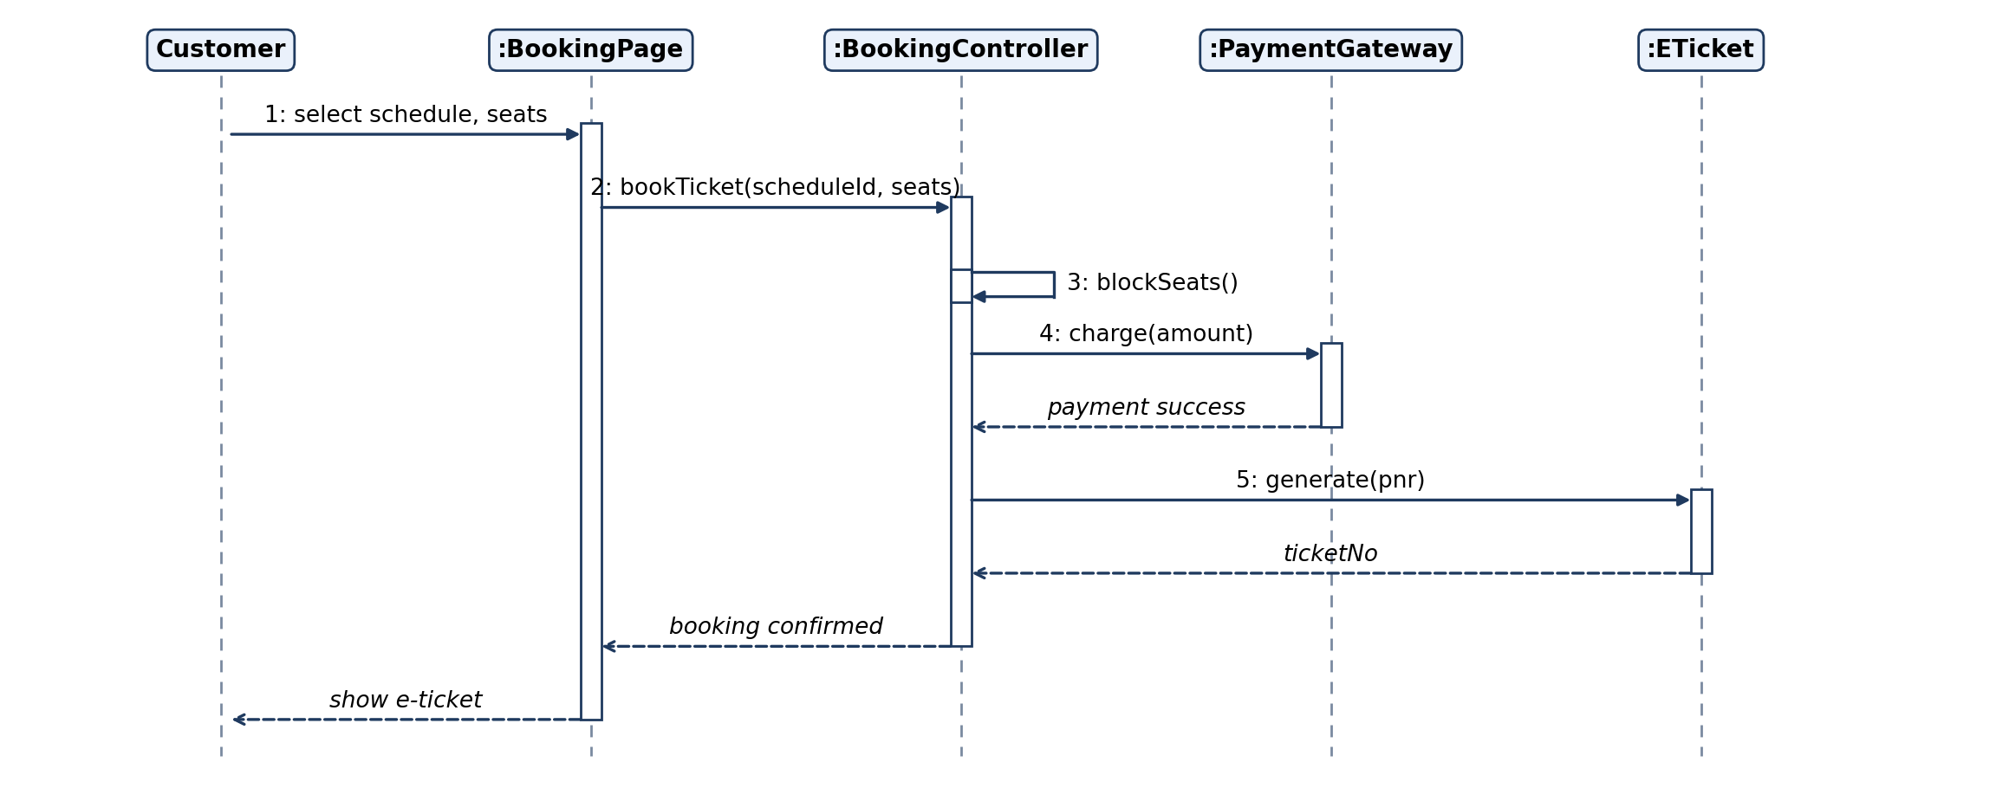
6. E-Ticketing: Sequence Diagram
Rule / limitation: Shows ONE scenario in time order (top to bottom). Poor for loops and many branches; use alt/loop frames or an activity diagram instead.
Notes:
6. E-Ticketing: Sequence Diagram. Shows ONE scenario in time order (top to bottom). Poor for loops and many branches; use alt/loop frames or an activity diagram instead.

Slide 39
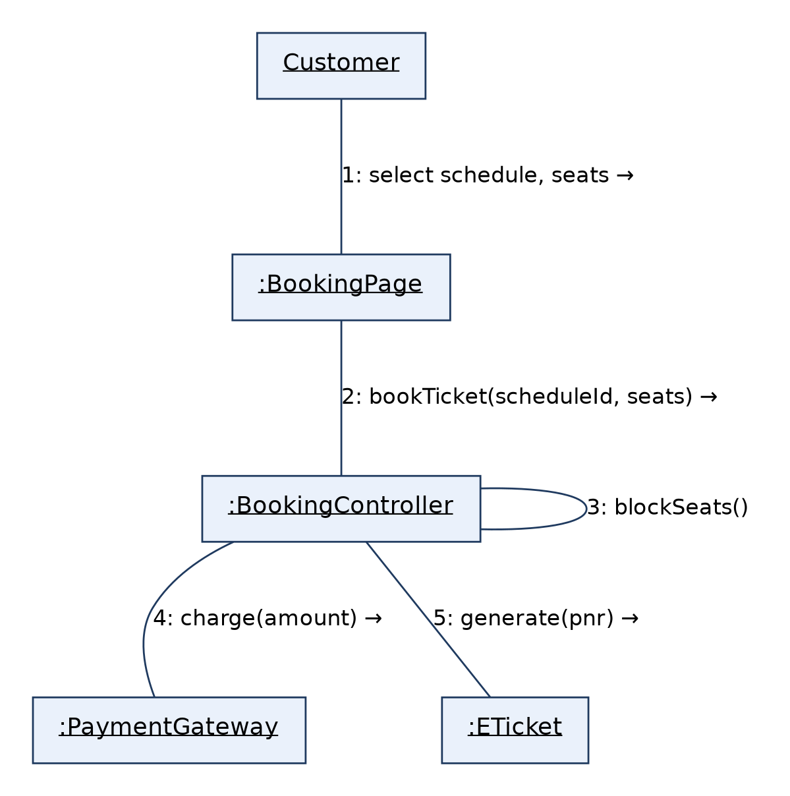
6. E-Ticketing: Collaboration Diagram
Rule / limitation: Same information as the sequence diagram, but emphasises object links; message order is shown only by numbers, and it gets cluttered with many objects.
Notes:
6. E-Ticketing: Collaboration Diagram. Same information as the sequence diagram, but emphasises object links; message order is shown only by numbers, and it gets cluttered with many objects.

Slide 40
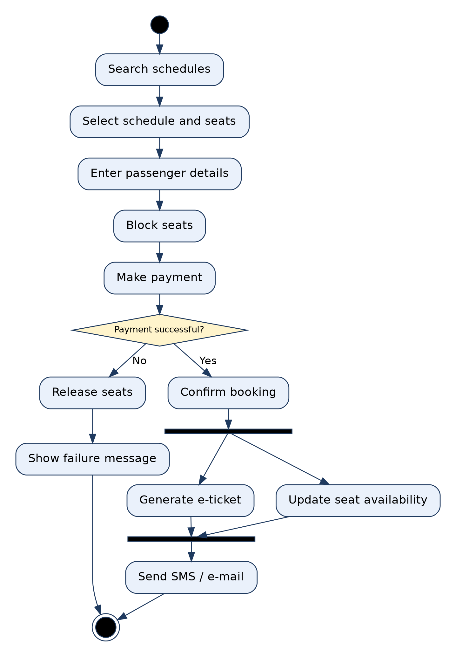
6. E-Ticketing: Activity Diagram
Rule / limitation: Shows flow of control: one initial node, guards on decisions must be mutually exclusive, every fork needs a matching join. Weak at showing which object owns an action.
Notes:
6. E-Ticketing: Activity Diagram. Shows flow of control: one initial node, guards on decisions must be mutually exclusive, every fork needs a matching join. Weak at showing which object owns an action.

Slide 41
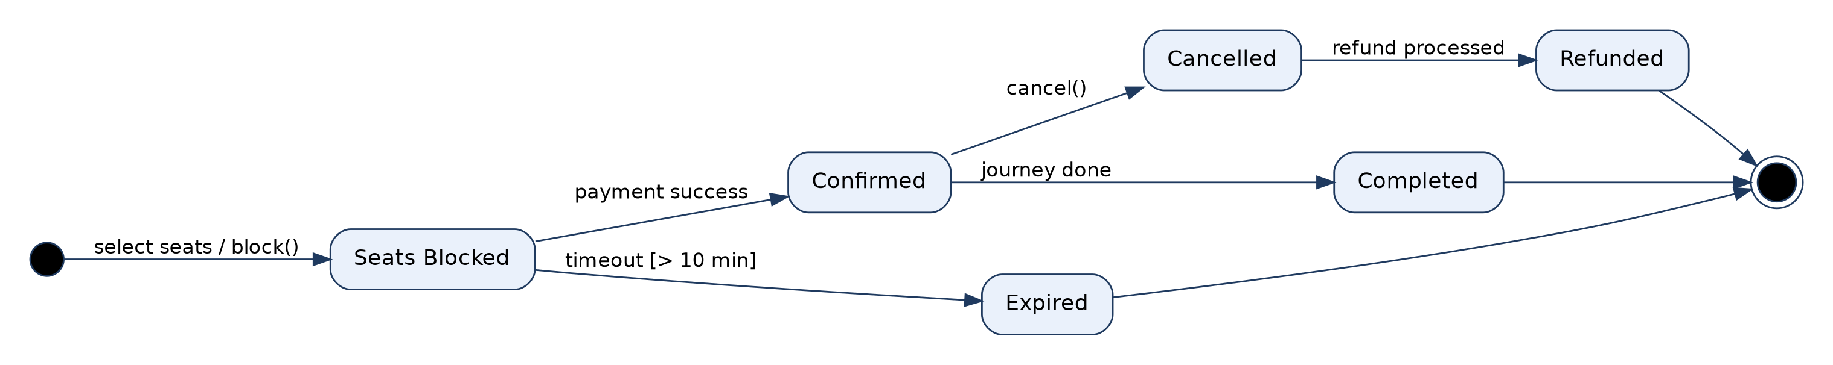
6. E-Ticketing: State Diagram (Booking)
Rule / limitation: Models the lifecycle of ONE object only. Every transition needs an event, guards must not overlap, and it suits reactive objects, not every class.
Notes:
6. E-Ticketing: State Diagram (Booking). Models the lifecycle of ONE object only. Every transition needs an event, guards must not overlap, and it suits reactive objects, not every class.

Slide 42
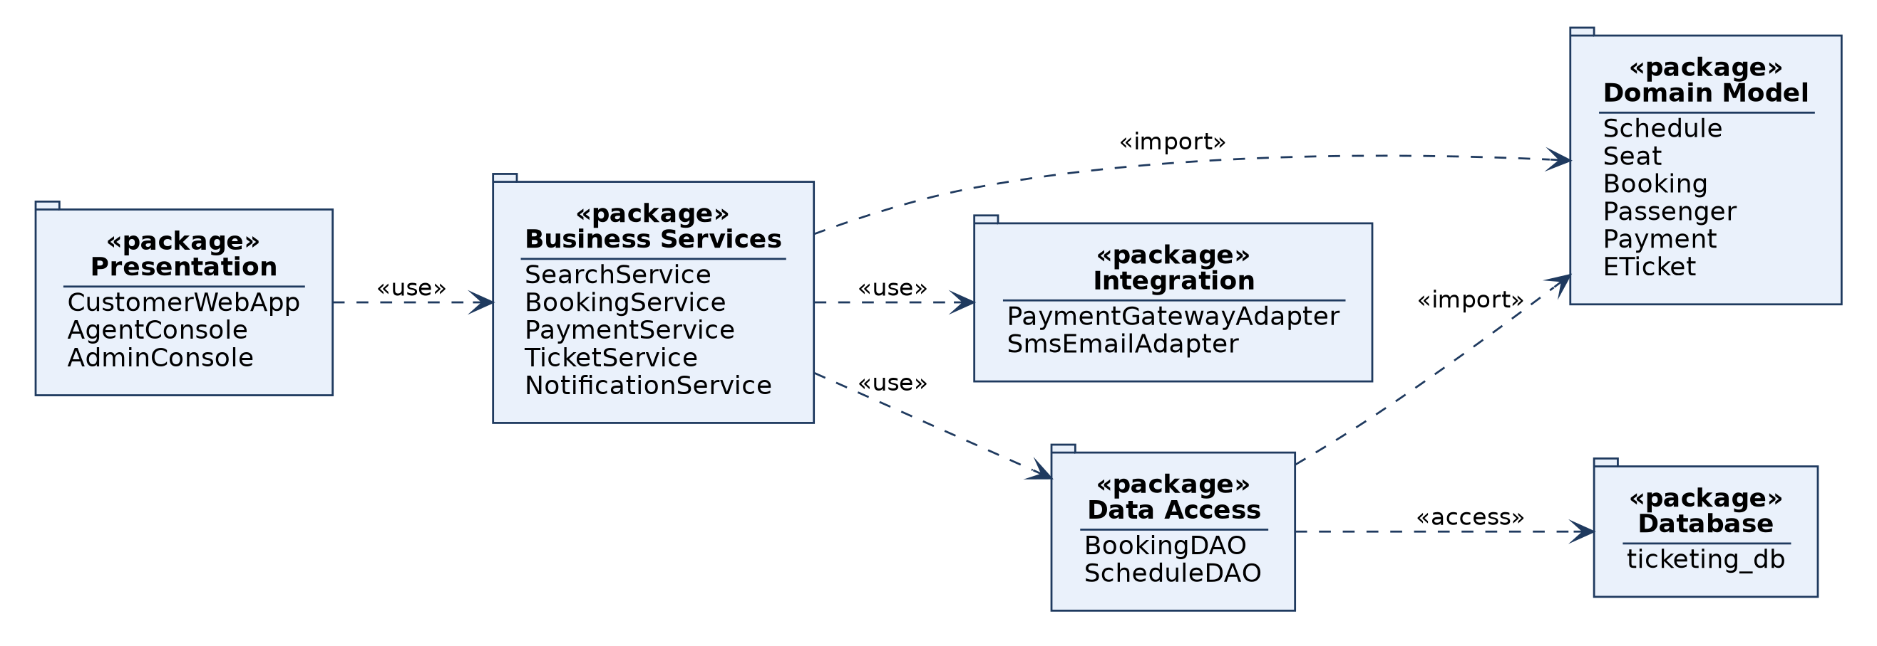
6. E-Ticketing: Package Diagram
Rule / limitation: Groups elements into namespaces and shows dependencies between groups; dependencies should not form cycles; internal detail is hidden.
Notes:
6. E-Ticketing: Package Diagram. Groups elements into namespaces and shows dependencies between groups; dependencies should not form cycles; internal detail is hidden.

Slide 43
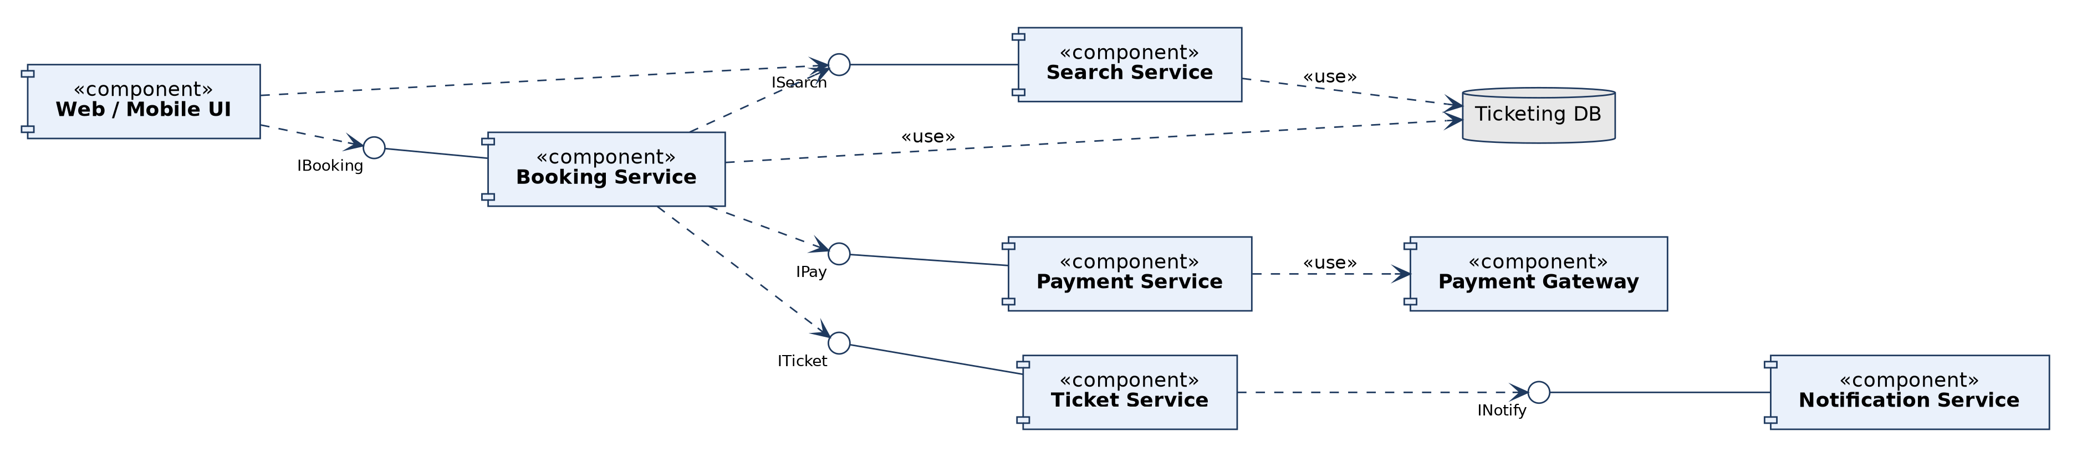
6. E-Ticketing: Component Diagram
Rule / limitation: Physical, modular view with provided (lollipop) and required (dashed) interfaces; shows no run-time behaviour and hides internal classes.
Notes:
6. E-Ticketing: Component Diagram. Physical, modular view with provided (lollipop) and required (dashed) interfaces; shows no run-time behaviour and hides internal classes.

Slide 44
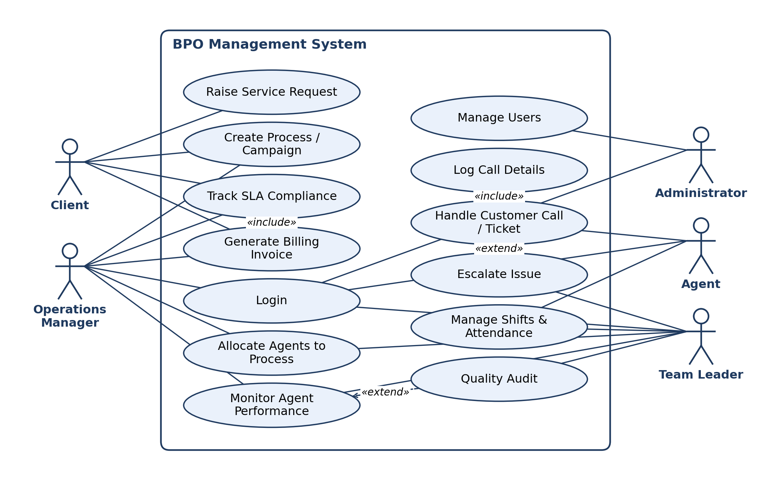
7. BPO Management System: Use Case Diagram
Rule / limitation: Shows WHAT the system does for its actors, not HOW. Actors stay outside the boundary; no ordering or data detail; «include» is mandatory, «extend» is conditional.
Notes:
7. BPO Management System: Use Case Diagram. Shows WHAT the system does for its actors, not HOW. Actors stay outside the boundary; no ordering or data detail; «include» is mandatory, «extend» is conditional.

Slide 45
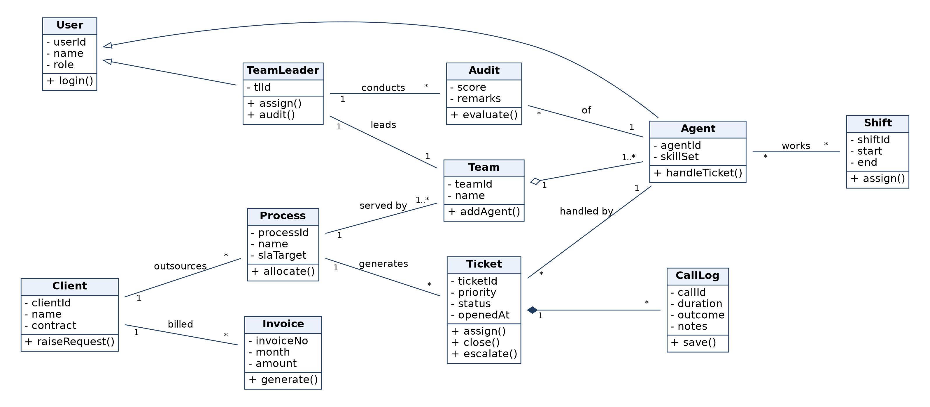
7. BPO Management System: Class Diagram
Rule / limitation: Static structure only; behaviour over time is not shown. Show multiplicity on associations; composition parts are not shared; generalization must not be circular.
Notes:
7. BPO Management System: Class Diagram. Static structure only; behaviour over time is not shown. Show multiplicity on associations; composition parts are not shared; generalization must not be circular.

Slide 46
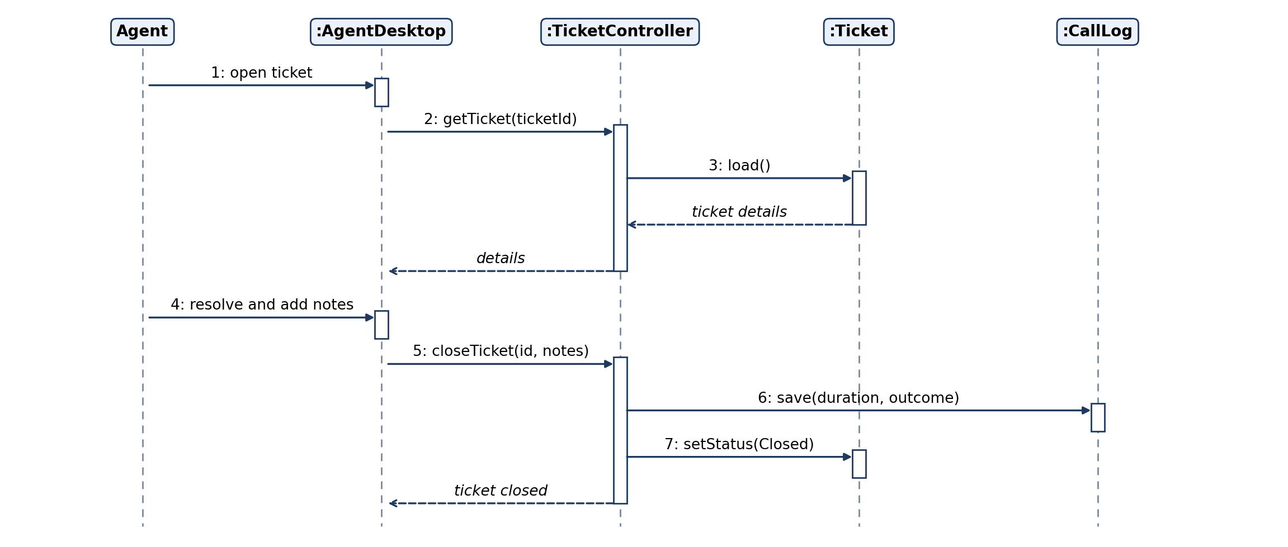
7. BPO Management System: Sequence Diagram
Rule / limitation: Shows ONE scenario in time order (top to bottom). Poor for loops and many branches; use alt/loop frames or an activity diagram instead.
Notes:
7. BPO Management System: Sequence Diagram. Shows ONE scenario in time order (top to bottom). Poor for loops and many branches; use alt/loop frames or an activity diagram instead.

Slide 47
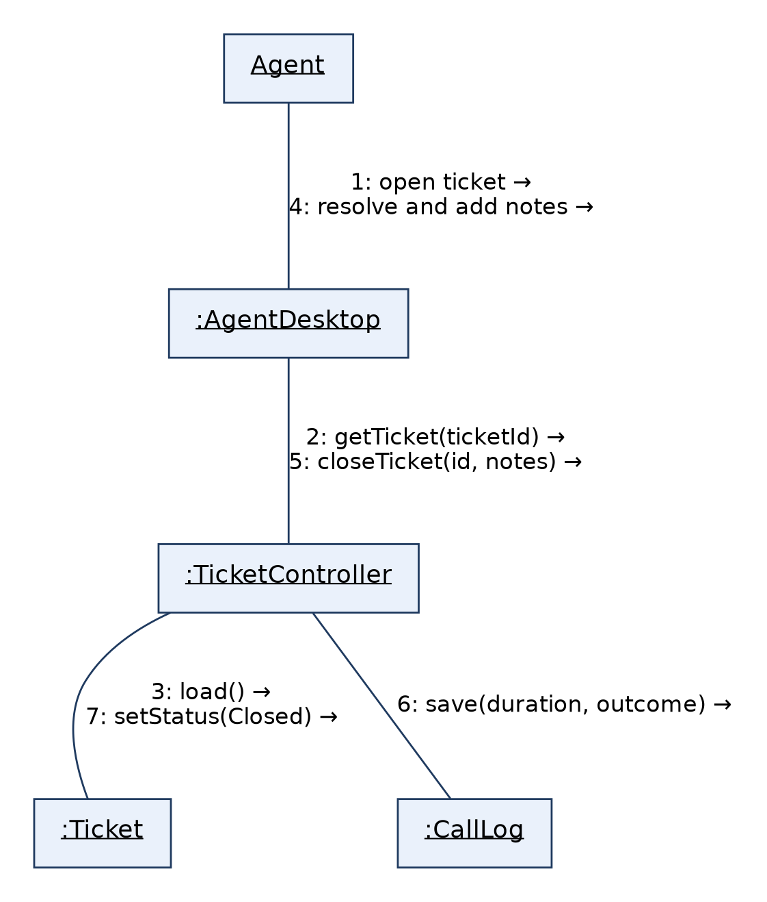
7. BPO Management System: Collaboration Diagram
Rule / limitation: Same information as the sequence diagram, but emphasises object links; message order is shown only by numbers, and it gets cluttered with many objects.
Notes:
7. BPO Management System: Collaboration Diagram. Same information as the sequence diagram, but emphasises object links; message order is shown only by numbers, and it gets cluttered with many objects.

Slide 48
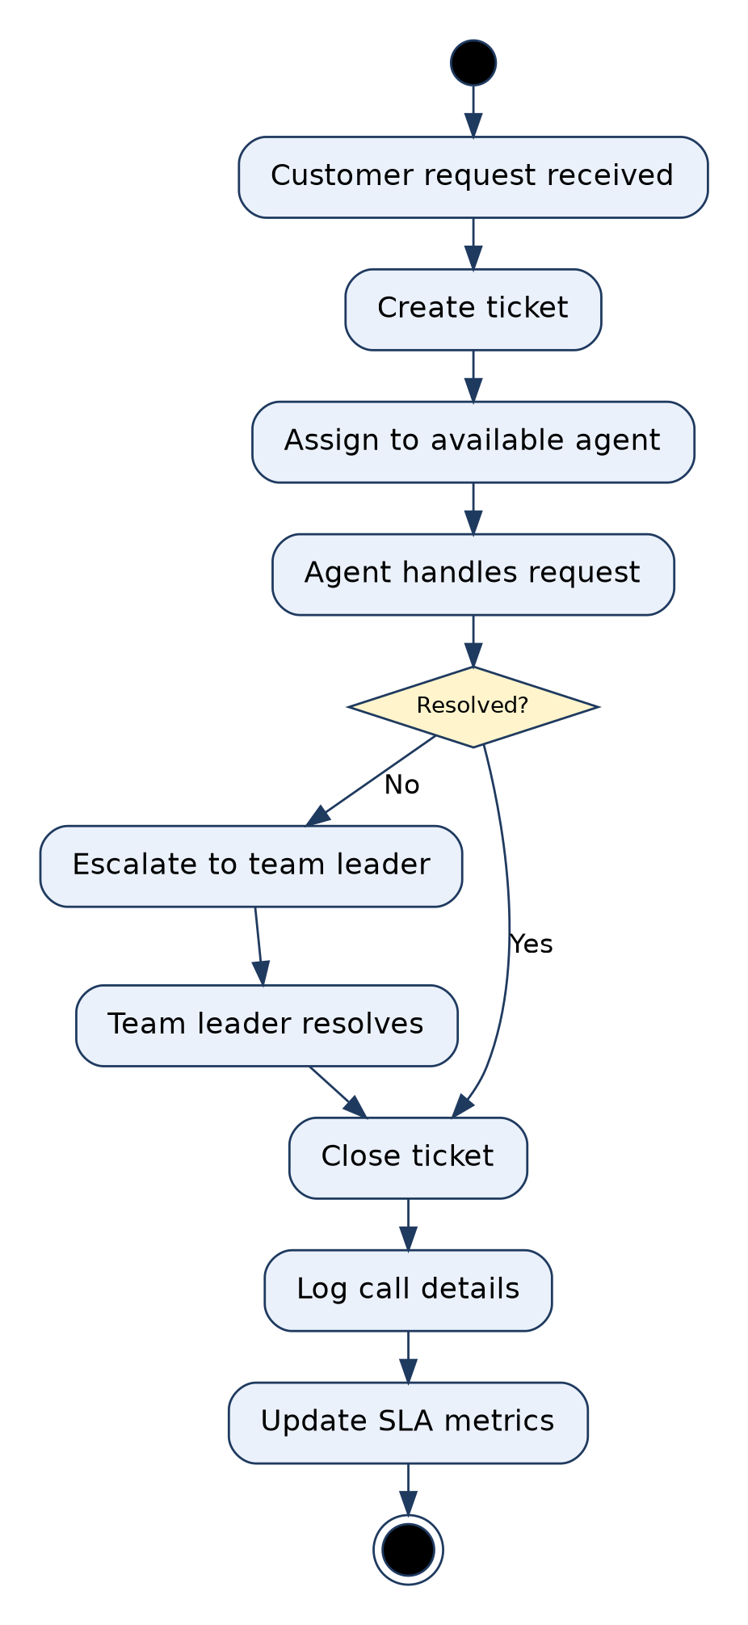
7. BPO Management System: Activity Diagram
Rule / limitation: Shows flow of control: one initial node, guards on decisions must be mutually exclusive, every fork needs a matching join. Weak at showing which object owns an action.
Notes:
7. BPO Management System: Activity Diagram. Shows flow of control: one initial node, guards on decisions must be mutually exclusive, every fork needs a matching join. Weak at showing which object owns an action.

Slide 49
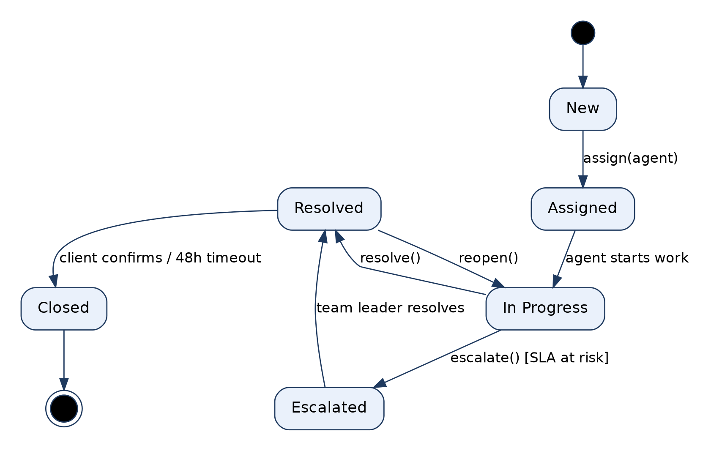
7. BPO Management System: State Diagram (Ticket)
Rule / limitation: Models the lifecycle of ONE object only. Every transition needs an event, guards must not overlap, and it suits reactive objects, not every class.
Notes:
7. BPO Management System: State Diagram (Ticket). Models the lifecycle of ONE object only. Every transition needs an event, guards must not overlap, and it suits reactive objects, not every class.

Slide 50
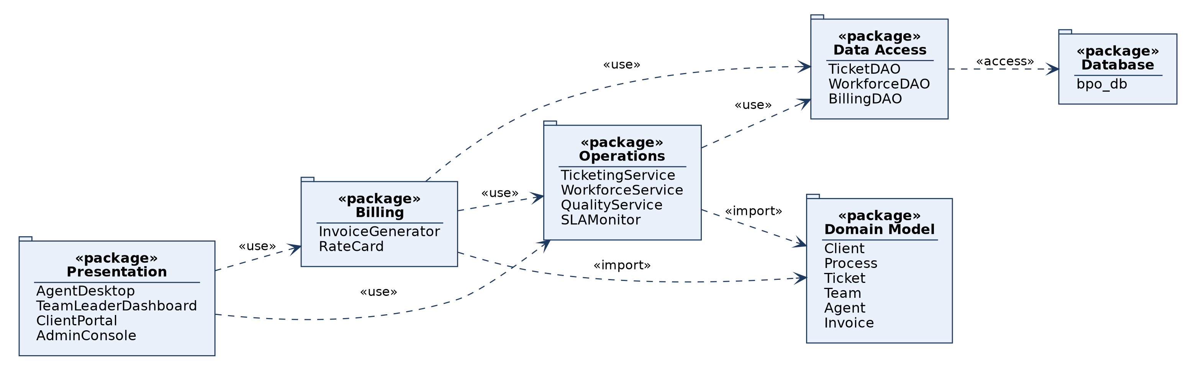
7. BPO Management System: Package Diagram
Rule / limitation: Groups elements into namespaces and shows dependencies between groups; dependencies should not form cycles; internal detail is hidden.
Notes:
7. BPO Management System: Package Diagram. Groups elements into namespaces and shows dependencies between groups; dependencies should not form cycles; internal detail is hidden.

Slide 51
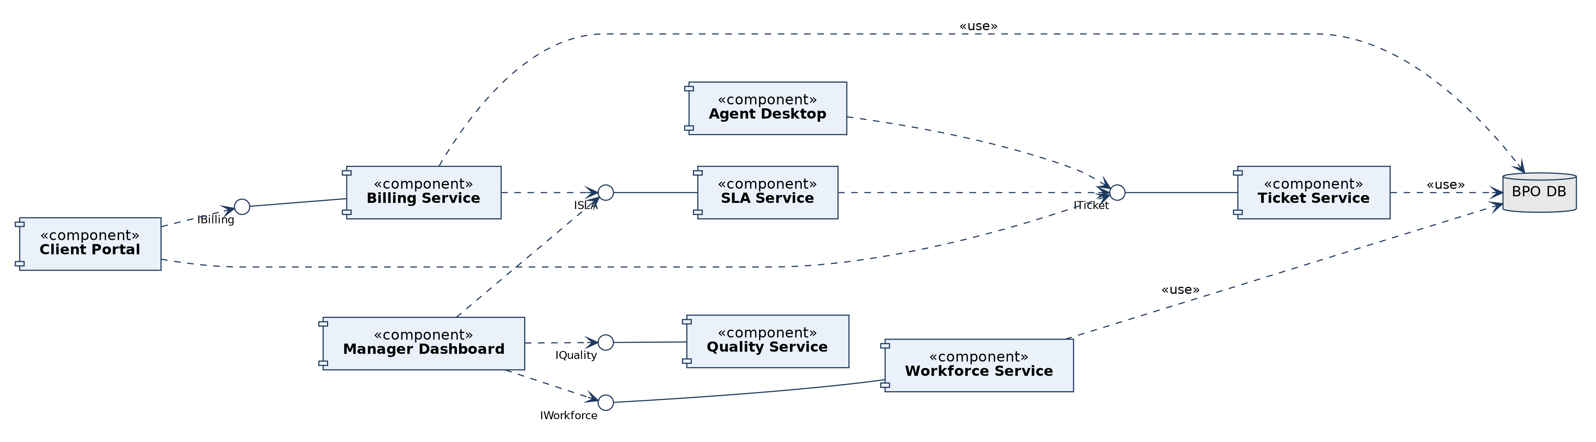
7. BPO Management System: Component Diagram
Rule / limitation: Physical, modular view with provided (lollipop) and required (dashed) interfaces; shows no run-time behaviour and hides internal classes.
Notes:
7. BPO Management System: Component Diagram. Physical, modular view with provided (lollipop) and required (dashed) interfaces; shows no run-time behaviour and hides internal classes.

Slide 52
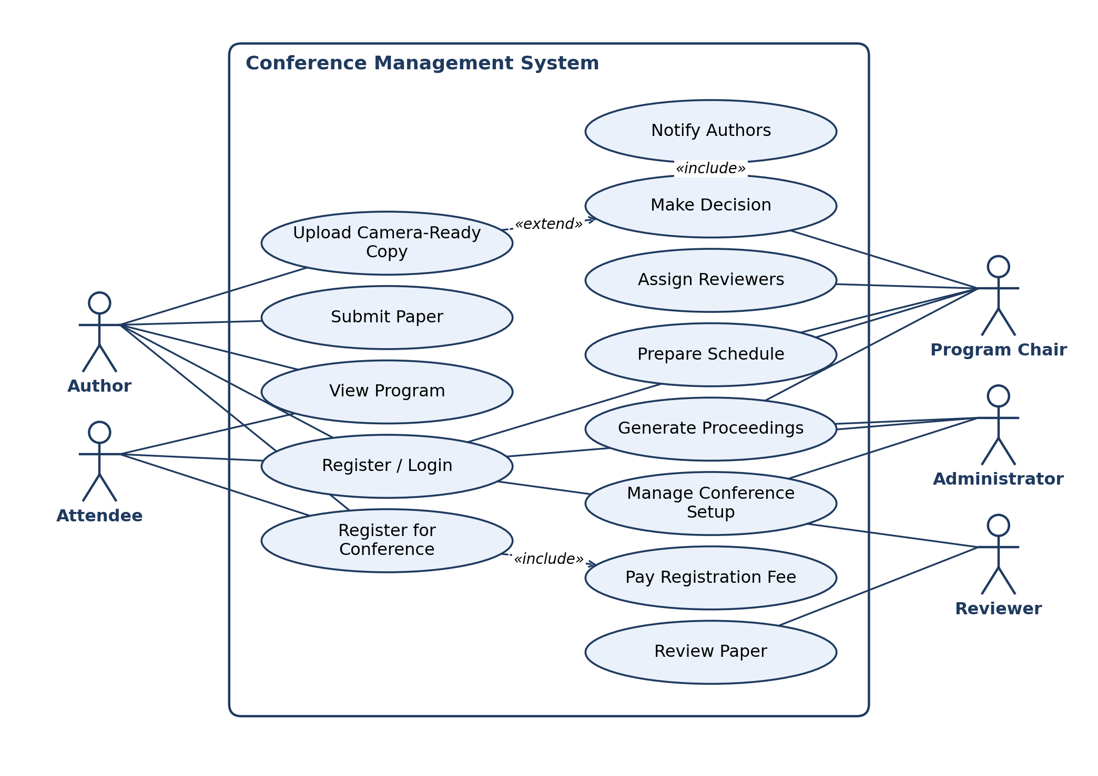
8. Conference Management System: Use Case Diagram
Rule / limitation: Shows WHAT the system does for its actors, not HOW. Actors stay outside the boundary; no ordering or data detail; «include» is mandatory, «extend» is conditional.
Notes:
8. Conference Management System: Use Case Diagram. Shows WHAT the system does for its actors, not HOW. Actors stay outside the boundary; no ordering or data detail; «include» is mandatory, «extend» is conditional.

Slide 53

8. Conference Management System: Class Diagram
Rule / limitation: Static structure only; behaviour over time is not shown. Show multiplicity on associations; composition parts are not shared; generalization must not be circular.
Notes:
8. Conference Management System: Class Diagram. Static structure only; behaviour over time is not shown. Show multiplicity on associations; composition parts are not shared; generalization must not be circular.

Slide 54

8. Conference Management System: Sequence Diagram
Rule / limitation: Shows ONE scenario in time order (top to bottom). Poor for loops and many branches; use alt/loop frames or an activity diagram instead.
Notes:
8. Conference Management System: Sequence Diagram. Shows ONE scenario in time order (top to bottom). Poor for loops and many branches; use alt/loop frames or an activity diagram instead.

Slide 55

8. Conference Management System: Collaboration Diagram
Rule / limitation: Same information as the sequence diagram, but emphasises object links; message order is shown only by numbers, and it gets cluttered with many objects.
Notes:
8. Conference Management System: Collaboration Diagram. Same information as the sequence diagram, but emphasises object links; message order is shown only by numbers, and it gets cluttered with many objects.

Slide 56

8. Conference Management System: Activity Diagram
Rule / limitation: Shows flow of control: one initial node, guards on decisions must be mutually exclusive, every fork needs a matching join. Weak at showing which object owns an action.
Notes:
8. Conference Management System: Activity Diagram. Shows flow of control: one initial node, guards on decisions must be mutually exclusive, every fork needs a matching join. Weak at showing which object owns an action.

Slide 57

8. Conference Management System: State Diagram (Paper)
Rule / limitation: Models the lifecycle of ONE object only. Every transition needs an event, guards must not overlap, and it suits reactive objects, not every class.
Notes:
8. Conference Management System: State Diagram (Paper). Models the lifecycle of ONE object only. Every transition needs an event, guards must not overlap, and it suits reactive objects, not every class.

Slide 58

8. Conference Management System: Package Diagram
Rule / limitation: Groups elements into namespaces and shows dependencies between groups; dependencies should not form cycles; internal detail is hidden.
Notes:
8. Conference Management System: Package Diagram. Groups elements into namespaces and shows dependencies between groups; dependencies should not form cycles; internal detail is hidden.

Slide 59

8. Conference Management System: Component Diagram
Rule / limitation: Physical, modular view with provided (lollipop) and required (dashed) interfaces; shows no run-time behaviour and hides internal classes.
Notes:
8. Conference Management System: Component Diagram. Physical, modular view with provided (lollipop) and required (dashed) interfaces; shows no run-time behaviour and hides internal classes.

