Slide 1
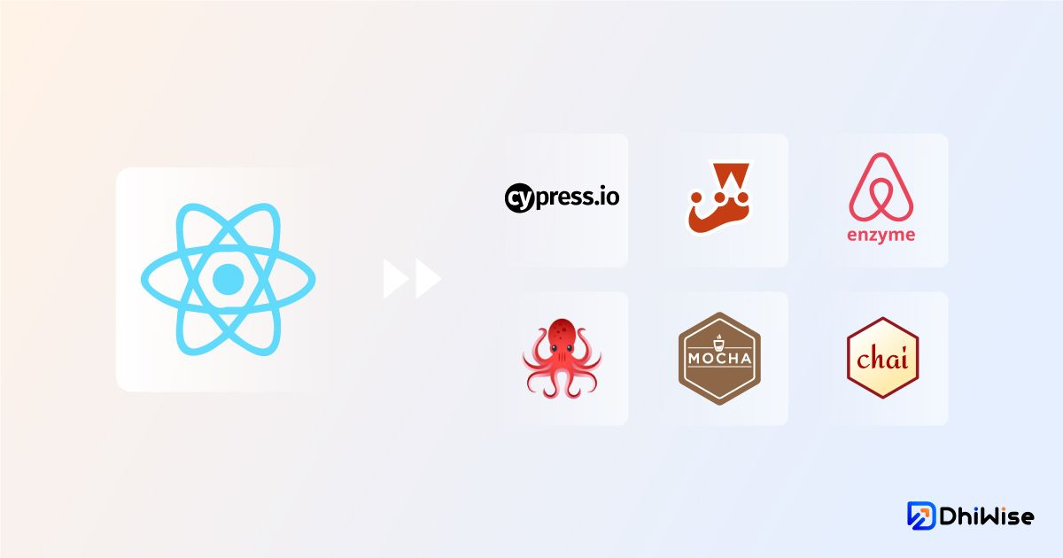
⚛️ React Testing Tools – From Basics to Brilliance 🚀
💡 "Turning Bugs into Brilliance – Testing Your React Apps the Smart Way"
🛠 Build with confidence. Ship with pride.

Slide 2
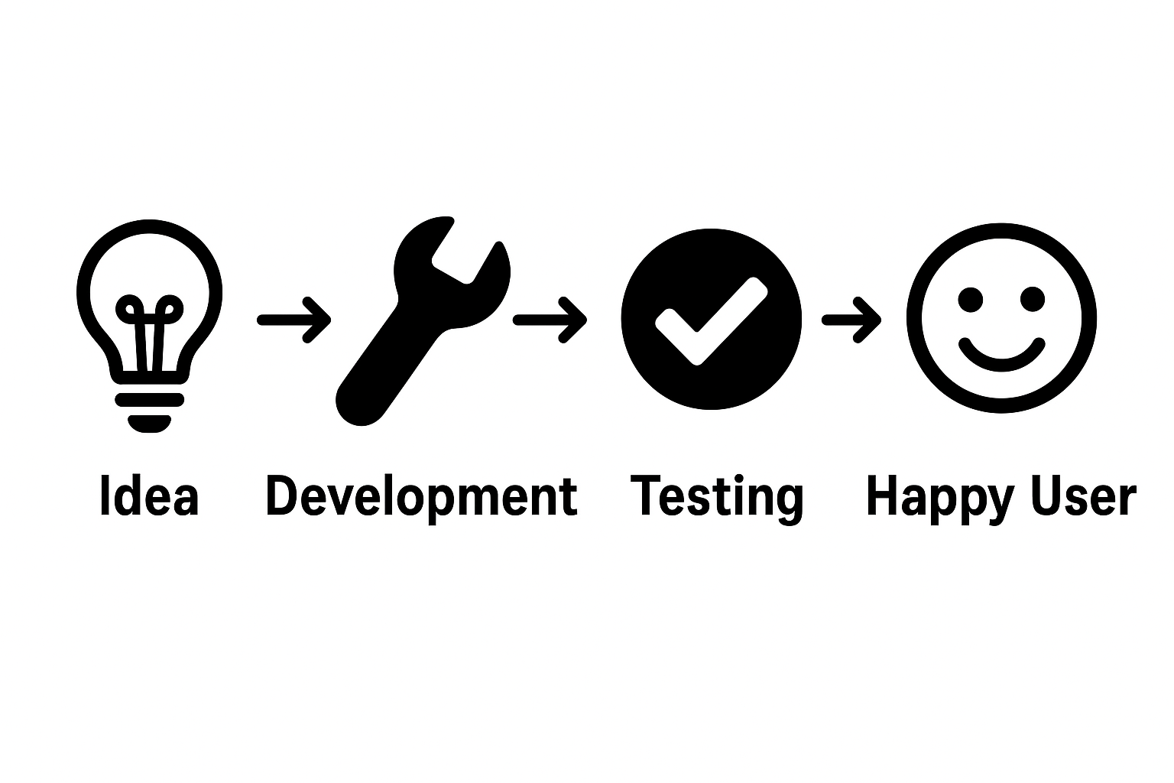
🛠 Why Testing is the Secret Ingredient to Stable React Apps
Early Bug Detection 🐛
→ Faster, cheaper fixes
Regression Prevention 🔄
→ Preserve existing functionality
Developer Confidence 💪
→ Safer code changes
Better UX 😊
→ Smooth, reliable user journeys
Team Alignment 🤝
→ Clear expectations, less rework

Slide 3
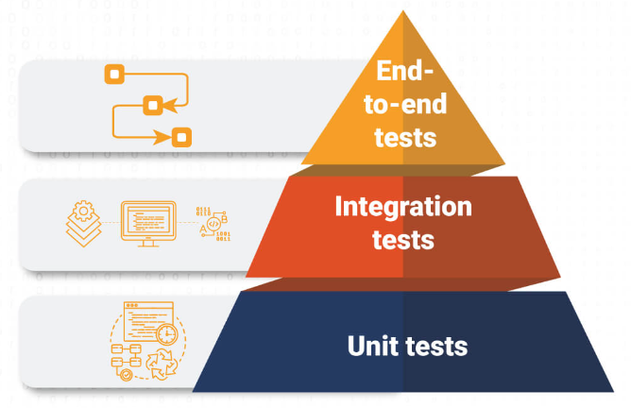
Types of Testing in React
🧩 Unit Testing
Test individual components/functions in isolation.
(e.g., <Button>shows correct label)
🔗 Integration Testing
Test how components work together.
(e.g., Button click updates parent state)
🌐 E2E Testing
Simulate full user flows in browser.
(e.g., Login → Add to cart → Checkout)
📸 Snapshot Testing
Compare current UI to stored snapshot to detect unwanted changes.
Testing pyramid

Slide 4
⚙️ Popular React Testing Tools (Extended)
Jest – Fast, zero-config framework for unit/integration tests. ✨ Snapshot testing, mocks, parallel runs.
Mocha – Flexible framework for async & modular testing. 🔌 Works with Chai/Sinon, customizable hooks.
Enzyme – React component testing utility. 🔍 Shallow/full rendering, state & lifecycle testing.
TestCafe – E2E & cross-browser testing made simple. 🌐 No plugins, parallel runs, CI/CD friendly.
Jasmine – BDD-style all-in-one test framework. 📝 Built-in spies/mocks, runs anywhere.

Slide 5
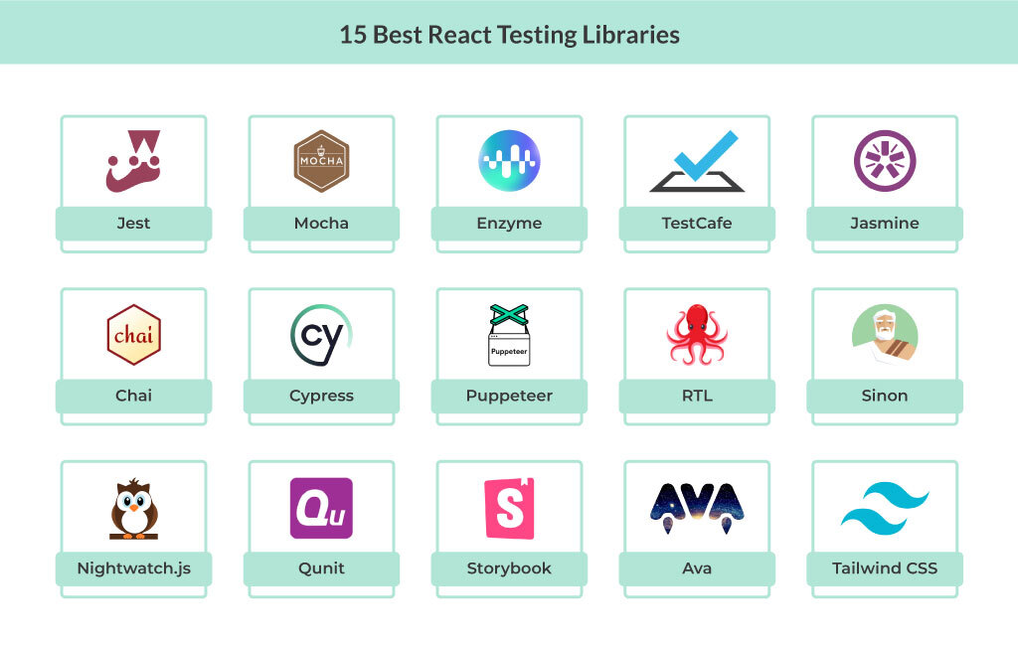
A Glance At The Best React Testing Libraries

Slide 6
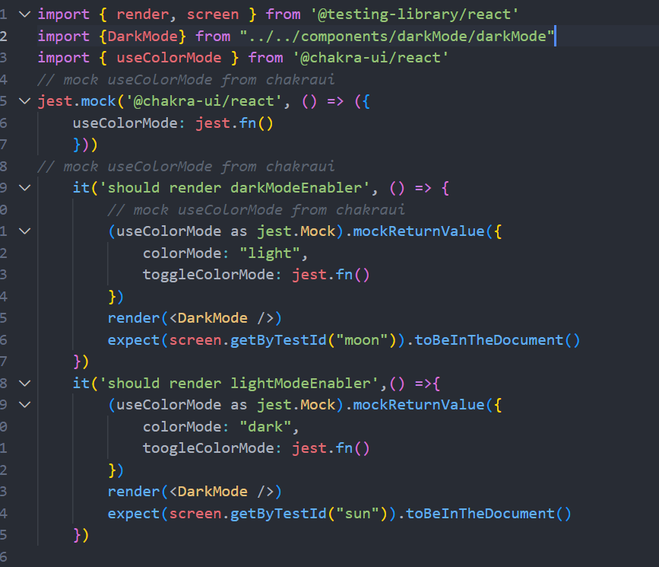
Jest: The All-in-One Test Runner
Purpose:
JavaScript testing framework for unit, integration, and snapshot tests.
Zero Config:
Works out-of-the-box with most React setups.
Snapshot Testing:
Captures UI output to ensure it doesn’t change unexpectedly.
Built-in Mocks:
Easy mocking for functions, modules, and timers.
Fast Execution:
Runs tests in parallel for speed.
Watch Mode:
Re-runs relevant tests on file changes.
Rich Assertions:
Built on top of expect() for expressive tests.

Slide 7
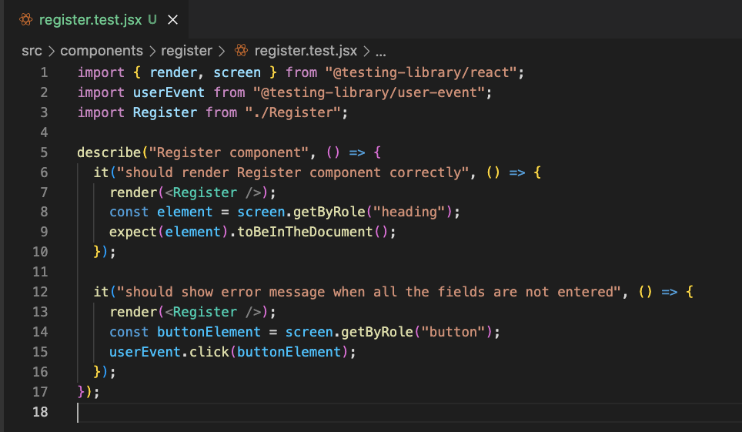
🎯 React Testing Library – Testing Like a User
Purpose: Test React components from the end-user’s perspective.
User-Focused Queries: Use getByText, getByRole, getByLabelText for real-world interactions.
Supports Async Testing: findBy and waitFor handle asynchronous UI updates.

Slide 8
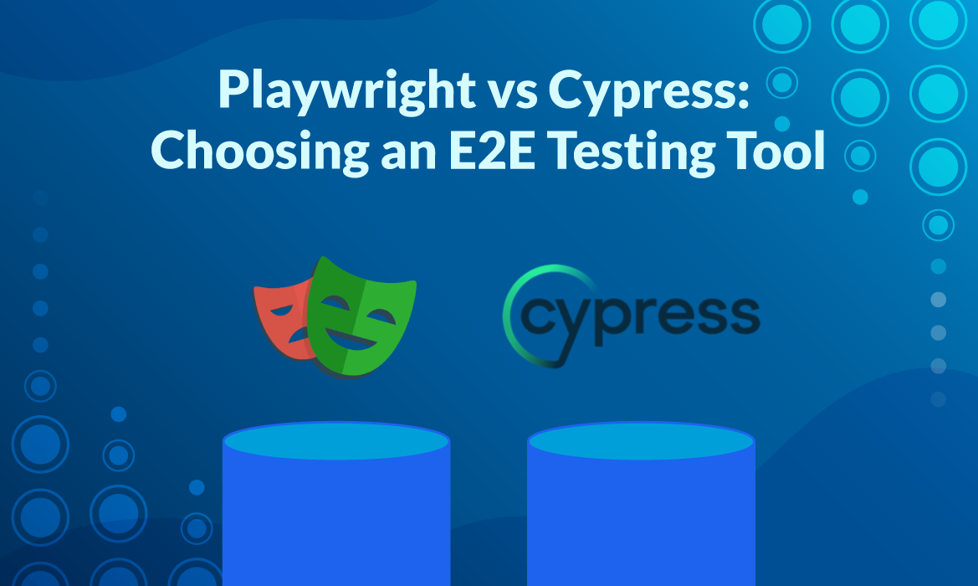
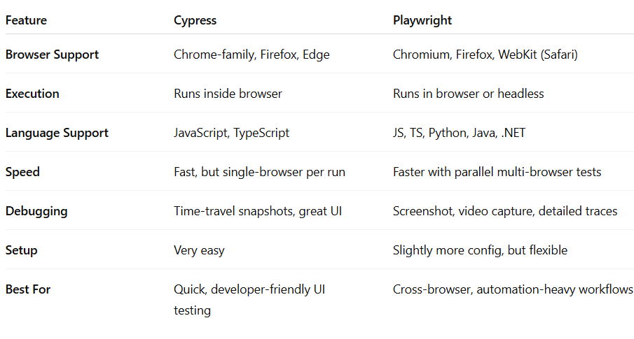
E2E Testing with Cypress & Playwright

Slide 9
🧩 Advanced Testing Concepts
Test Pyramid – Unit → Integration → E2E (balanced approach)
Mocking & Stubbing – Simulate APIs & dependencies for isolated tests
Data-Driven Testing – Run same test with multiple data sets
Cross-Browser Testing – Validate UI in different browsers/devices
Visual Regression Testing – Detect unintended UI changes via snapshots
Parallel Testing – Speed up execution by running tests concurrently
Continuous Testing – Integrate with CI/CD for automated builds
Performance Testing – Measure speed, load handling, and responsiveness

Slide 10
✅ Best Practices
Write clear, maintainable test cases
Follow the Test Pyramid for balanced coverage
Keep tests independent & repeatable
Use mocking/stubbing for external dependencies
Run tests in CI/CD pipelines
Regularly review & refactor test suites
💡 Key Takeaways
Testing ensures quality & reliability before release
Choose tools based on project needs & scope
Combine unit, integration, and E2E for full coverage
Automate for speed but keep critical manual checks

Slide 11


