Slide 1
VOICE OF THE FLYERS
Topic Modeling and Sentiment Analysis of British Airways Reviews
Task 1: Web scraping to gain company insights
DHARSHINI M

Slide 2
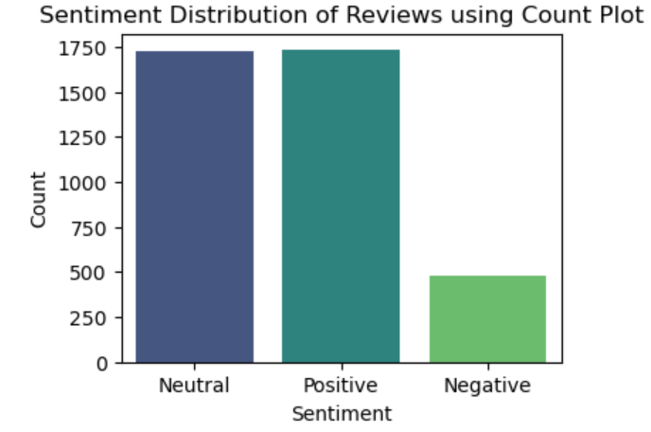

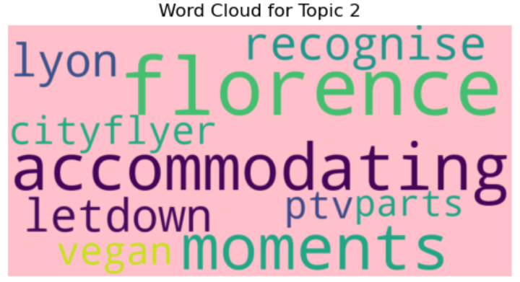
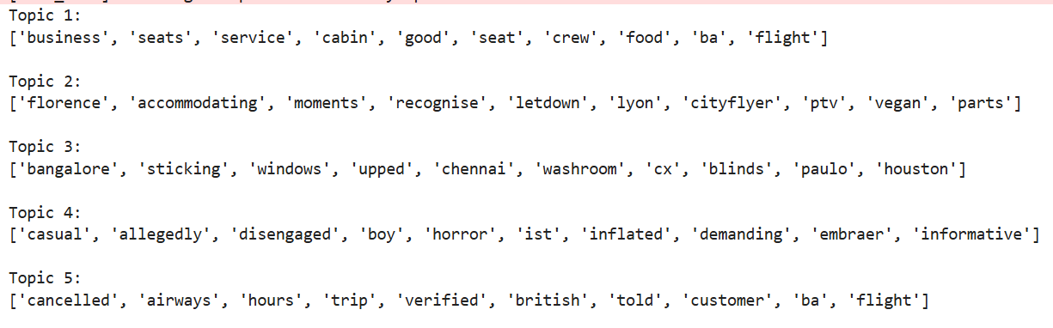
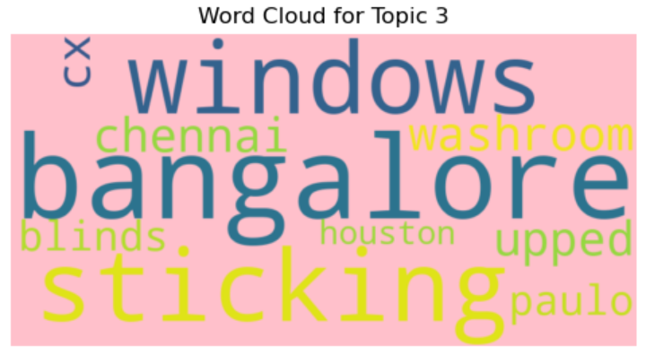
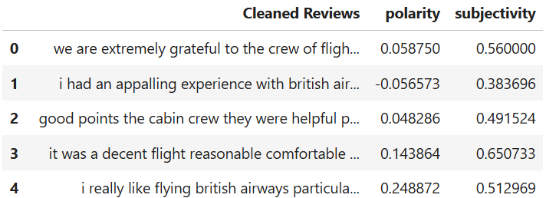
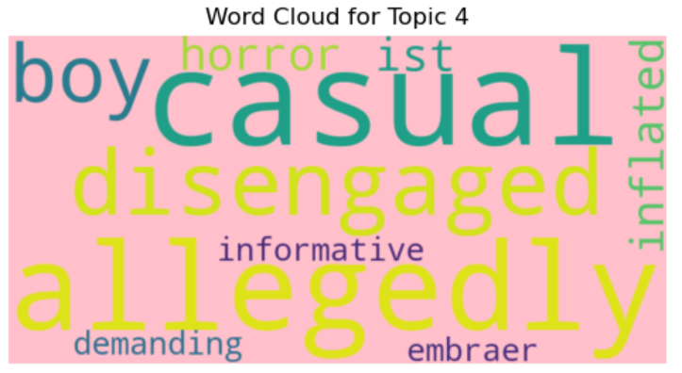
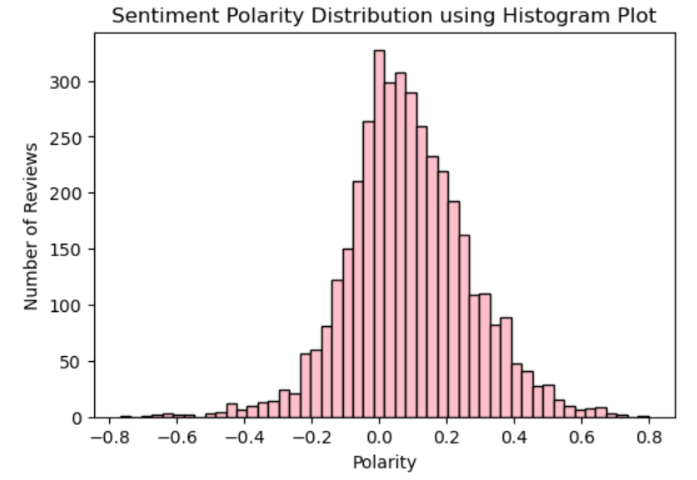
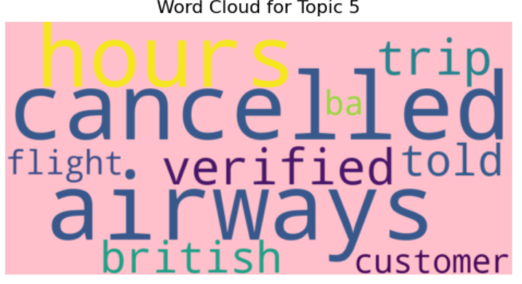
Final Insights derived
Data Collection Summary:
Source: Reviews from British Airways on AirlineQuality
Total Reviews Collected: 3,938 (Scraped from 40 pages, 100 reviews per page)
Key Insight: Dataset ready for analysis after automated scraping. Topic modelling and Sentimental analysis are done
Sentiment Analysis Summary:
Polarity Distribution: Most reviews are neutral, with a symmetric distribution, fewer strong negative sentiments.
Sentiment Breakdown:
Positive: Over 1,700 reviews (most frequent sentiment)
Neutral: Large number of reviews
Negative: Least frequent sentiment
Subjectivity: Reviews show varying levels of personal opinions (subjectivity scores: 0.297 to 0.863).
Tools Used: BeautifulSoup, Pandas, Matplotlib, WordCloud, TextBlob, NLTK.

