Slide 1
VOICE OF THE FLYERS
Predictive Analysis of British Airways Reviews
Task 2: Predicting customer buying behaviour
DHARSHINI M

Slide 2
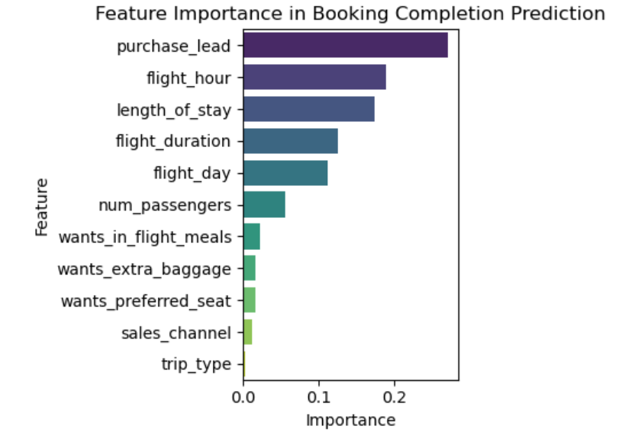
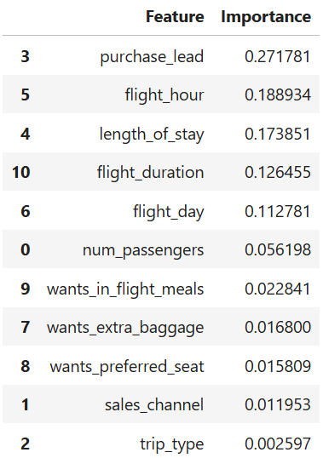
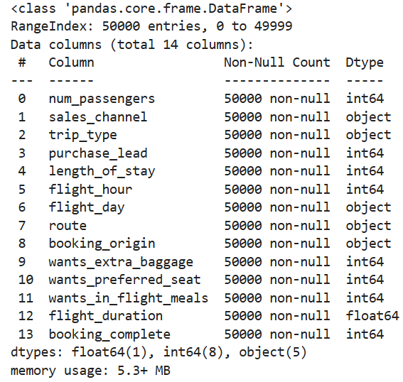
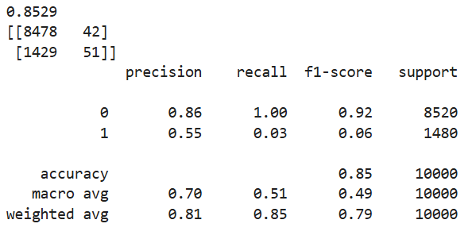
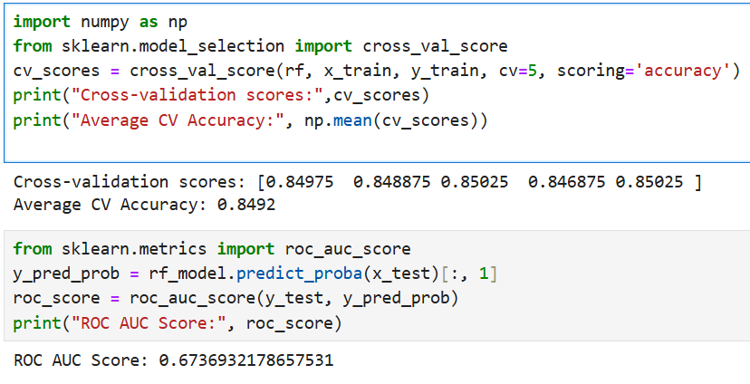
Final Insights derived
Booking Prediction Summary:
Dataset: 50,000 airline bookings
Model: Random Forest Classifier
Test Accuracy: 85.24%
Cross-Validation Accuracy: 84.92%
ROC AUC Score: 0.674
Top Contributing Features:
purchase_lead – 27.2%
flight_hour – 18.9%
length_of_stay – 17.4%
flight_duration – 12.6%
flight_day – 11.3%
Class-wise Performance:
Class 0 (Not Booked): Precision 0.86 | Recall 0.99 | F1-score 0.92
Class 1 (Booked): Precision 0.52 | Recall 0.03 | F1-score 0.06

