Slide 1

HEART DISEASE PREDICTION USING PYSPARK
TECHZEE TEAM
BIG DATA PROJECT

Slide 2
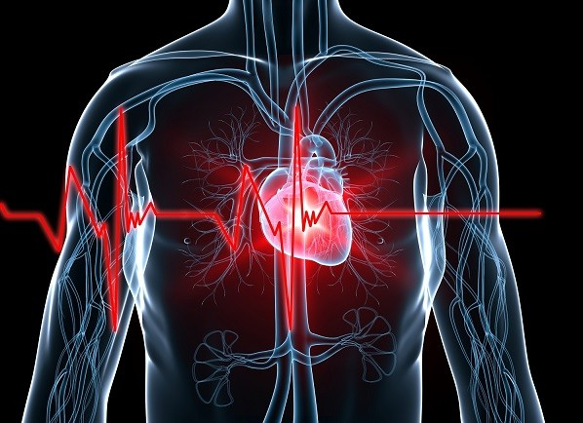

Problem Statement
Objective: Develop machine learning models to classify the presence or absence of heart disease from clinical features such as age, cholesterol levels, blood pressure, and maximum heart rate.
Models: Train and compare three classification models: Logistic Regression, Random Forest, Support Vector Machine (SVM)
Data: Use a dataset from the UCI Machine Learning Repository with 14 clinical attributes, along with a target attribute signifying whether a patient is suffering from heart disease.
Evaluation: Assess model performance based on measures such as accuracy, precision, recall, F1-score, and Auc. Choose the top-performing model for making predictions.
Prediction: Allow predictions on new patient data where the user selects a trained model and enters the clinical features and gets a prediction of the presence of heart disease.

Slide 3
Literature Review
Study Title | Authors | Techniques Used | Best Accuracy (%) | Dataset | Inspiration for Our Work
Heart Disease Prediction using Machine Learning Algorithms | M. Anbarasi et al. | Decision Tree, Naïve Bayes, SVM | 83.2 | UCI Heart Disease | Model selection approach and performance benchmarking
Comparative Study of Classification Algorithms for Heart Disease | J. D. Kaur & M. Kaur | KNN, Logistic Regression, Random Forest | 81.5 | UCI Repository | Inclusion of multiple ML algorithms for comparison
Heart Disease Prediction using Hybrid Ensemble Learning | S. Sharma et al. | Random Forest, XGBoost (Ensemble) | 85.0 | Cleveland Heart Dataset | Use of ensemble techniques for better accuracy
Prediction of Heart Disease using Deep Learning | R. Gupta et al. | ANN, CNN | 78.6 | UCI Heart Dataset | Inclusion of ANN in model experimentation
Predictive Analysis on Heart Disease using Data Mining Techniques | K. Srinivas et al. | Naïve Bayes, Decision Tree | 75.2 | Public Health Records | Focus on simplicity and interpretability of models

Slide 4
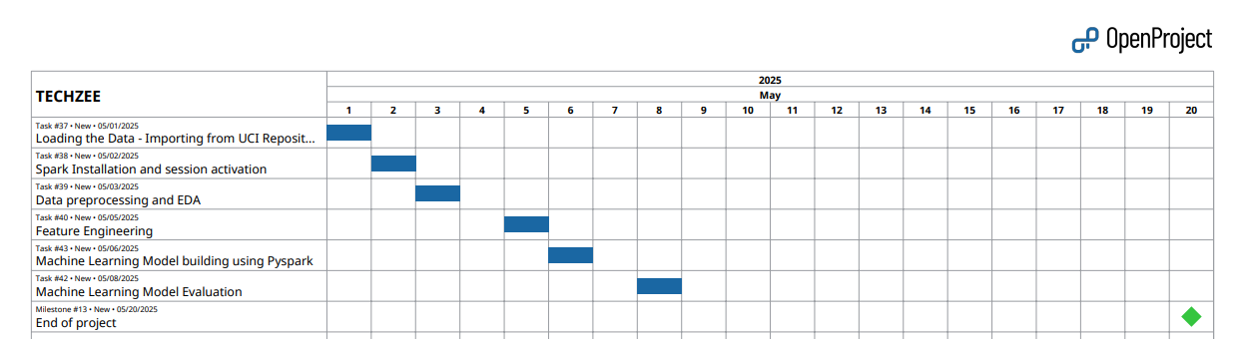
Project Plan
Phase 1: Data Collection & Cleaning
Phase 2: Exploratory Data Analysis (EDA)
Phase 3: Feature Engineering
Phase 4: Model Training & Evaluation
Phase 5: Results Interpretation

Slide 5
Dataset Description - 14 clinical attributes
age: age in years
sex: sex (1 = male; 0 = female)
cp: chest pain type -Value 1: typical angina -Value 2: atypical angina -Value 3: non-anginal pain -Value 4: asymptomatic
trestbps: resting blood pressure (in mm Hg on admission to the hospital)
chol: serum cholestoral in mg/dl
fbs: (fasting blood sugar > 120 mg/dl) (1 = true; 0 = false)
restecg: resting electrocardiographic results - Value 0: normal
- Value 1: having ST-T wave abnormality (T wave inversions and/or ST elevation or depression of > 0.05 mV)
- Value 2: showing probable or definite left ventricular hypertrophy by Estes' criteria
8. thalach: maximum heart rate achieved
9. exang: exercise induced angina (1 = yes; 0 = no)
10. oldpeak : ST depression induced by exercise relative to rest
11. slope: the slope of the peak exercise ST segment -Value 1: upsloping,Value 2: flat, Value 3: downsloping
12. ca: number of major vessels (0-3) colored by flourosopy
13. thal: 3 = normal; 6 = fixed defect; 7 = reversable defect
14. num: diagnosis of heart disease (angiographic disease status)
- Value 0: < 50% diameter narrowing
- Value 1: > 50% diameter narrowing

Slide 6
Coding and Implementation
Phase 1: Data Collection & Cleaning
Data Import:
Loaded UCI Heart Disease dataset using ucimlrepo.
Data Cleaning:
Removed duplicate records.
Checked for nulls and schema consistency.
Data Splitting:
Performed train-test split (80% training, 20% testing).

Slide 7
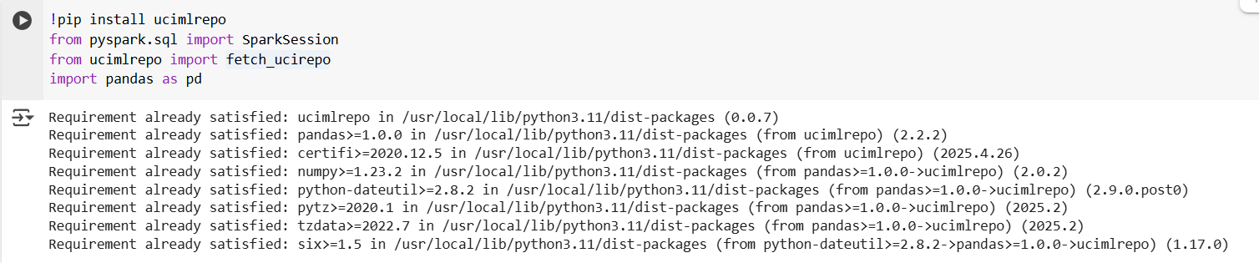
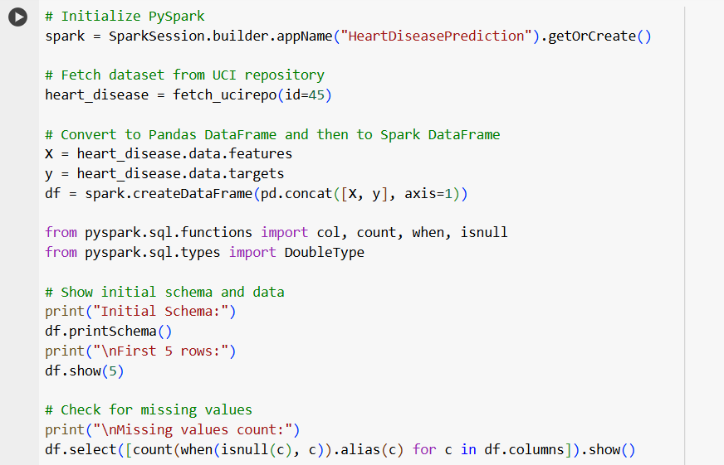
Coding and Implementation
Phase 1: Data Collection & Cleaning

Slide 8
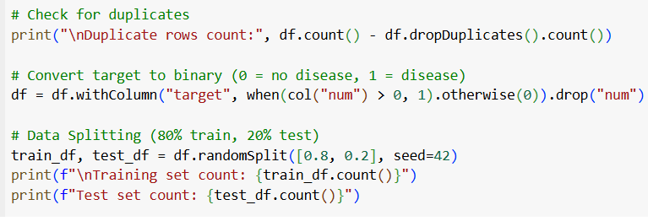
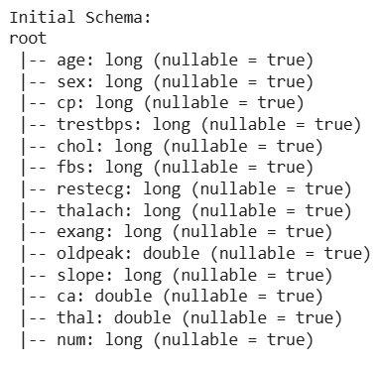
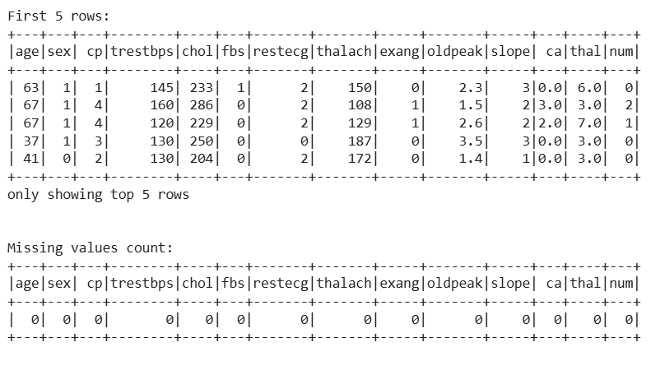

Coding and Implementation
Phase 1: Data Collection & Cleaning

Slide 9
Coding and Implementation
Phase 2: Exploratory Data Analysis (EDA)
Descriptive Statistics:
Computed summary statistics: mean, std, min, max, etc.
Target Variable Analysis:
Analyzed distribution of heart disease (target = 0 or 1).
correlation and statistical overview.

Slide 10
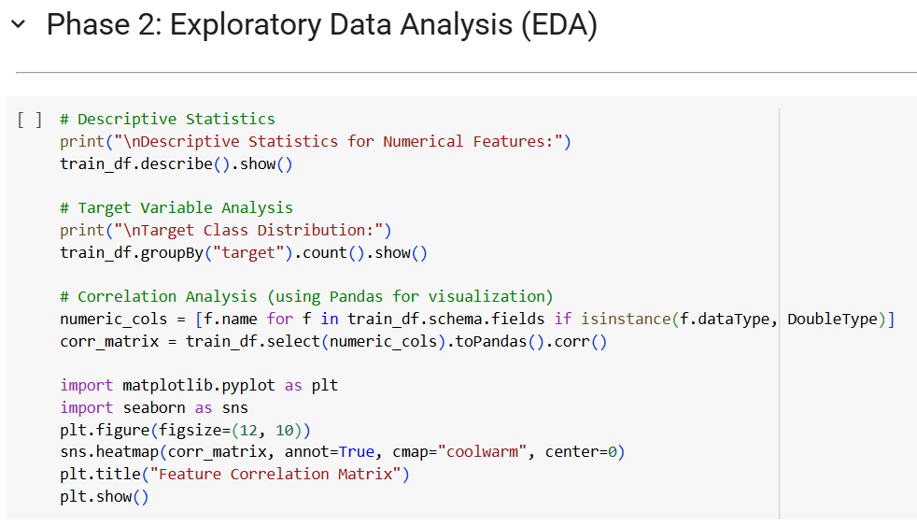
Coding and Implementation
Phase 2: Exploratory Data Analysis (EDA)

Slide 11
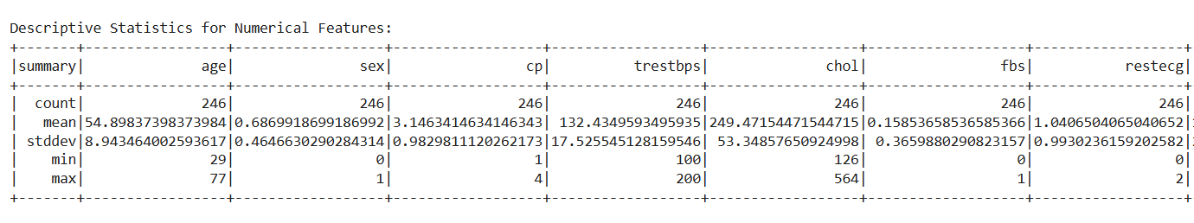
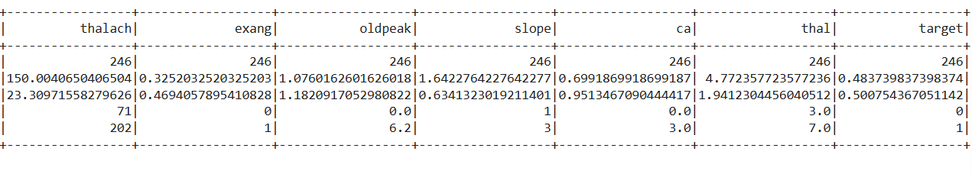
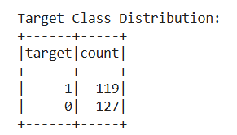
Coding and Implementation
Phase 2: Exploratory Data Analysis (EDA)

Slide 12
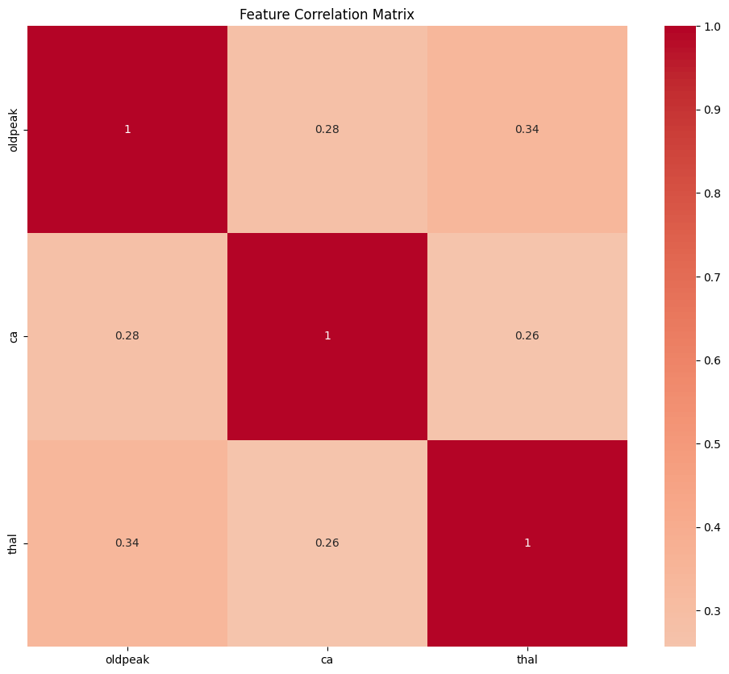
Coding and Implementation
Phase 2: Exploratory Data Analysis (EDA)

Slide 13
Coding and Implementation
Phase 3: Feature Engineering
Feature Selection:
Selected relevant features for model input (based on correlation and domain knowledge).
Feature Transformation:
Used VectorAssembler to combine features.
Applied StandardScaler to normalize numerical features.

Slide 14
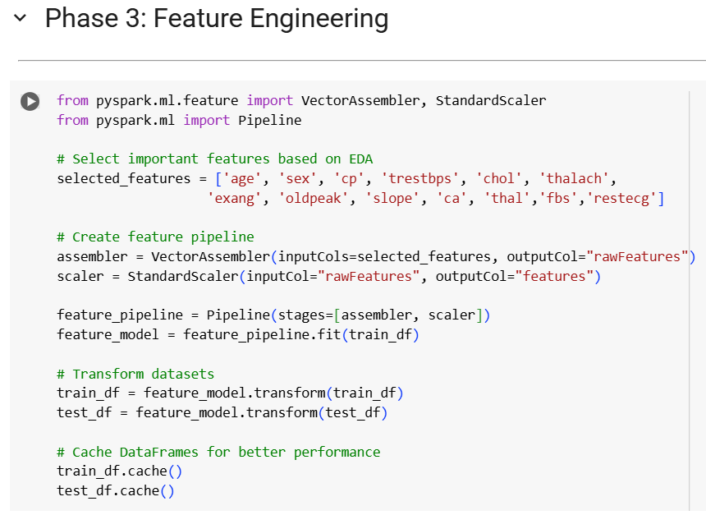
Coding and Implementation
Phase 3: Feature Engineering

Slide 15
Coding and Implementation
Phase 4: Model Training and Evaluation
Model Selection:
Trained the following classification models:
Logistic Regression
Random Forest
Support Vector Machine (SVM)
Model Training:
Built pipelines for each model using PySpark’s MLlib.
Model Evaluation:
Evaluated models using:
Accuracy
Precision
Recall
F1 Score
Area Under ROC Curve (AUC)
Model Comparison:
Compared model performance based on evaluation metrics.
Identified the best model.

Slide 16
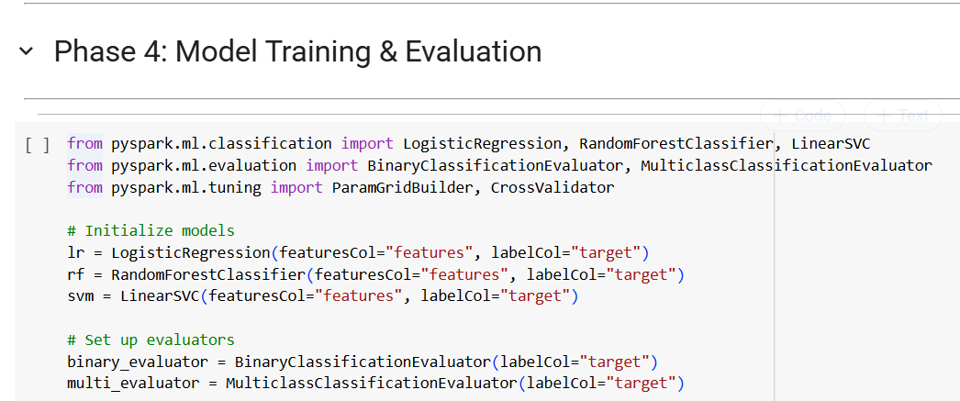
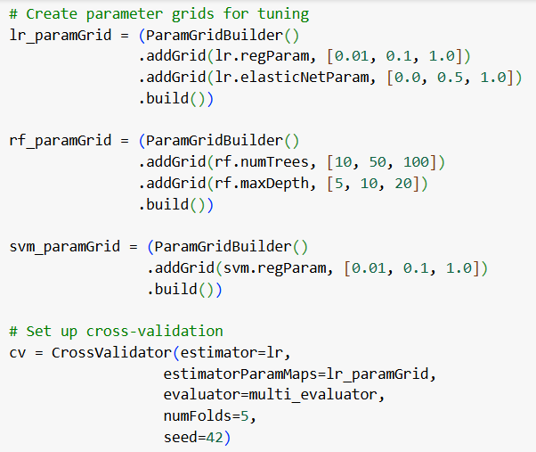
Coding and Implementation
Phase 4: Model Training and Evaluation

Slide 17
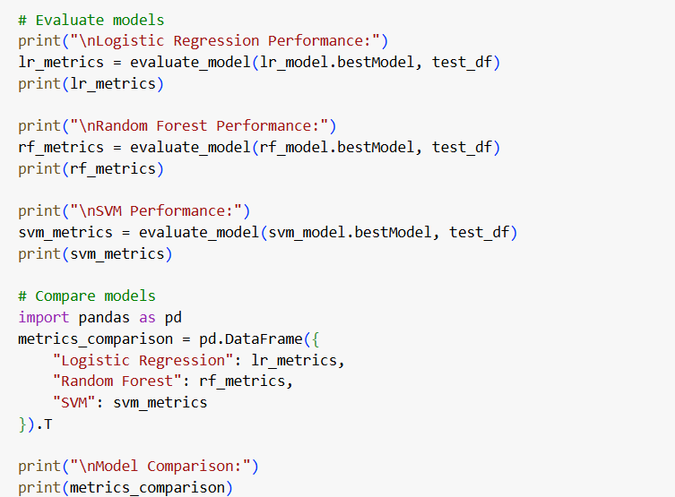
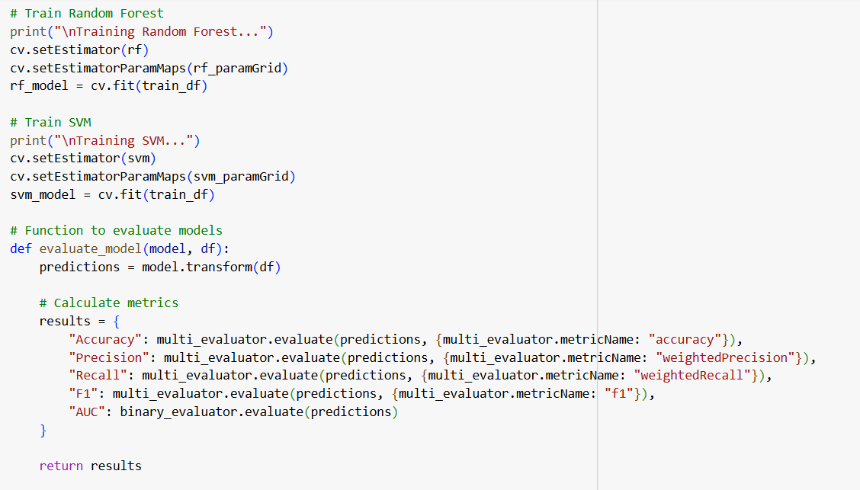
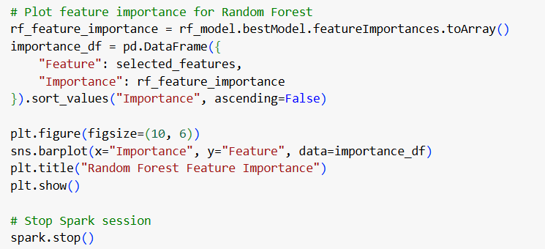
Coding and Implementation
Phase 4: Model Training and Evaluation

Slide 18
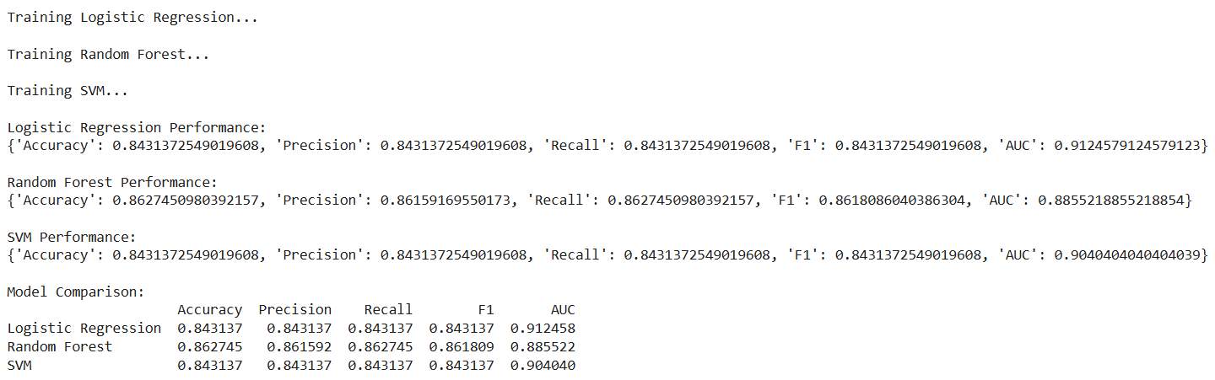
Coding and Implementation
Phase 5: Results Interpretation
RESULTS
Model Comparison Table
Model | Accuracy | Precision | Recall | F1 Score | AUC
Logistic Regression | 84.31% | 84.31% | 84.31% | 84.31% | 0.912
Random Forest | 86.27% | 86.16% | 86.27% | 86.18% | 0.885
SVM | 84.31% | 84.31% | 84.31% | 84.31% | 0.904

Slide 19
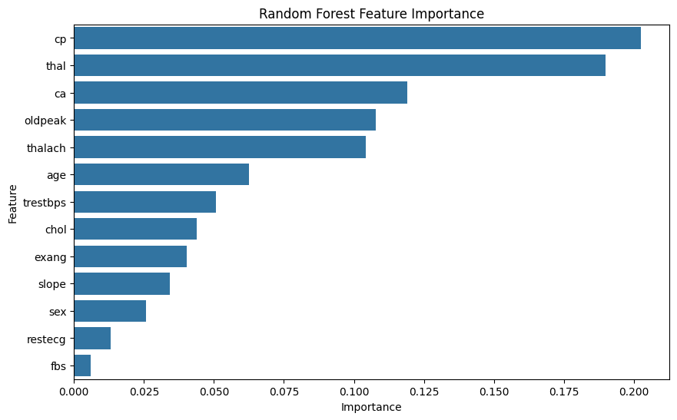
Coding and Implementation
Phase 5: Results Interpretation
RESULTS
Best Model Identified: Random Forest Classifier
Model | Accuracy | Precision | Recall | F1 Score | AUC
Random Forest | 86.27% | 86.16% | 86.27% | 86.18% | 0.885

Slide 20
Contribution of each Member
Team Member | Contribution
Member 1 | Data Collection & Cleaning (UCI Heart Disease Dataset)
 | Data Preprocessing (Handling missing values, encoding categorical features, scaling)
 | Exploratory Data Analysis (EDA) including descriptive statistics,
Member 2 | Model Training
 | Model Evaluation
 | Result Interpretation (Comparing models, deciding on the best-performing model)
 | Final Presentation Preparation

Slide 21
THANK YOU!
A PRESENTATION BY
DHARSHINI M 24MSP3070

