Slide 1
Salary and compensation analysis through Excel data modelling
STUDENT NAME: M.Dharshini
REGISTER NO:312216830
DEPARTMENT:III B.com Bank Management
COLLEGE: Shri krishnaswamy college for women

Slide 2
PROJECT TITLE
Salary and compensation analysis through Excel data modelling

Slide 3


AGENDA
Problem Statement
Project Overview
End Users
Our Solution and Proposition
Dataset Description
Modelling Approach
Results and Discussion
Conclusion
3/21/2024 Annual Review

Slide 4

PROBLEM STATEMENT
Salary Distribution:What is the distribution of salaries across different job roles, departments, and locations?Are there any significant outliers or anomalies in the salary data?Gender Pay
Gap:Is there a gender pay gap within the organization?How does the average salary differ between male and female employees within the same roles and departments?Salary
Growth Trends:How has the average salary changed over the past few years?Are there specific departments or job roles that have seen significant salary increases or decreases?

Slide 5

PROJECT OVERVIEW
Data Collection and Preparation:
Collect relevant data, including employee demographic information, job roles, salary details, bonuses, stock options, and performance ratings.
Clean and prepare the data for analysis by addressing any inconsistencies, missing values, and formatting issues.
Descriptive Analysis:
Use Excel tools like pivot tables, charts, and summary statistics to analyze the distribution of salaries across various dimensions such as job role, department, location, and gender.Explore historical salary trends and growth rates over time.
Comparative Analysis:
Compare the organization's salary data against industry benchmarks to assess market competitiveness.Analyze the relationship between employee performance ratings and compensation levels.
.

Slide 6

WHO ARE THE END USERS?
Human Resources (HR) Department:
HR professionals will use the analysis to review and adjust compensation structures, ensure equity and fairness, and address any disparities such as gender pay gaps. They may also use the data to inform recruitment, retention, and employee satisfaction strategies.
Finance Department:
Key Stakeholders: Finance teams will use the analysis to assess the financial impact of proposed salary adjustments and compensation strategies. They need to ensure that any changes are within the organization’s budget and align with overall financial goals.
Leadership and Executive Team:
Senior leaders and executives will use the insights to make strategic decisions related to talent management, employee retention, and organizational competitiveness. They are interested in ensuring that the compensation structure aligns with the company’s long-term objectives.

Slide 7

OUR SOLUTION AND ITS VALUE PROPOSITION
Solution :
The solution is a comprehensive Excel-based salary and compensation analysis tool designed to help organizations optimize their compensation strategies. This tool collects, cleans, and analyzes employee salary
Value proposition:
The value proposition of this solution is to empower organizations with data-driven insights that enable fair, competitive, and strategic compensation practices.

Slide 8
Dataset Description
Accuracy: Ensure that all data entries are accurate and up to date, particularly with respect to salary figures and performance ratings.
Consistency: Standardize data formats (e.g., dates, currency) and ensure consistent labeling across the dataset.
Completeness: Address any missing data points, particularly in critical fields like salary and performance data.Anonymity: If required, anonymize sensitive information to protect employee privacy.

Slide 9

THE "WOW" IN OUR SOLUTION
Dynamic Dashboards:
Create interactive dashboards that automatically update as new data is added, providing real-time
insights.
Customizable Reports:
Enable users to generate personalized reports tailored to specific departments, roles, or time periods, with just a few clicks.
Predictive Modeling:
Salary Forecasting: Use historical data to predict future salary trends, helping organizations plan for budget allocation and salary adjustments.
3/21/2024 Annual Review
9

Slide 10
MODELLING
Data Collection and Structuring:
Data Import: Gather data from various sources such as payroll systems, HR databases, and market salary surveys.Data Cleaning: Use Excel functions like TEXT, TRIM, CLEAN, and REMOVE DUPLICATES to ensure the data is clean and consistent.
Data Structuring:
Organize data in a way that supports easy analysis—using tables, named ranges, and consistent formats.
3. Pivot Tables:
Utilize PivotTables to summarize and analyze large datasets, allowing for quick insights into salary distributions, averages, and medians by department, role, or location.
4. Formulas and Functions:
Leverage Excel’s formulas such as VLOOKUP, INDEX/MATCH, SUMIF, AVERAGEIF, and array functions to perform detailed calculations and data lookups.
10

Slide 11
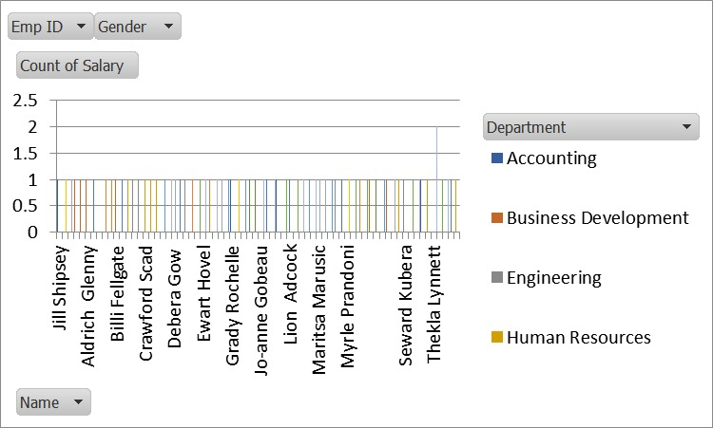
RESULTS
Average Salary:
The mean salary across the organization or within specific departments or job titles.
Median Salary:
The midpoint salary, which is less affected by outliers and gives a better sense of typical compensation.
Salary Range:
The difference between the highest and lowest salaries, indicating the spread of compensation.
11

Slide 12
conclusion
• The analysis reveals significant trends and disparities in compensation within the organization.
• Key findings include variations in salary by department and role, disparities in compensation compared to industry benchmarks, and inconsistencies in internal equity.
• To address these issues, it is recommended to adjust salary structures, update compensation policies, and implement ongoing monitoring to ensure alignment with market trends and organizational objectives.

