Slide 1

SignBridge AI
Indian Sign Language Translation System
Presented By
Dharshini K
Department of Computer Science and Engineering

Slide 2


Problem Statement & Objectives
Problem Statement
Objectives
Communication barrier between hearing-impaired individuals and the general public.
Recognize Indian Sign Language gestures.
Lack of real-time Indian Sign Language translation systems.
Convert gestures into text and speech.
Develop a secure web-based application.
Existing systems are expensive and hardware-dependent.
Store translation history.
SignBridge AI
2

Slide 3




Existing System vs Proposed System
Existing System
Proposed System
SignBridge AI
Sensor gloves required
Webcam-based recognition
Limited gesture recognition
AI-powered detection
High cost
Real-time text & speech
No speech output
Translation history
No user authentication
Secure login
SignBridge AI
3

Slide 4








System Architecture
User
Webcam
OpenCV
MediaPipe
Machine Learning Model
Gesture Prediction
Text + Speech
MySQL Database
Video captured by the webcam is processed through OpenCV and MediaPipe for hand-landmark detection, then classified by the ML model to produce text and speech output, with results logged to MySQL.
SignBridge AI
4

Slide 5





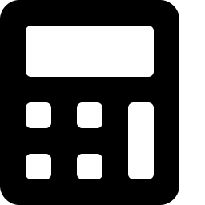
Technology Stack
Frontend
Backend
AI & Computer Vision
Database
HTML5
Python
MediaPipe
MySQL
CSS3
Flask (Web Framework)
OpenCV
JavaScript
TensorFlow
NumPy
SignBridge AI
5

Slide 6








Modules
Core pages and features of the SignBridge AI web application
Home
About
User Registration
Login
Dashboard
AI Camera
Translation History
Profile
Logout
SignBridge AI
6

Slide 7


Workflow
1
2
3
4
Login
Open Camera
Capture Hand Gesture
MediaPipe Detection
5
6
7
8
ML Prediction
Convert to Text
Generate Speech
Save in Database
SignBridge AI
7

Slide 8
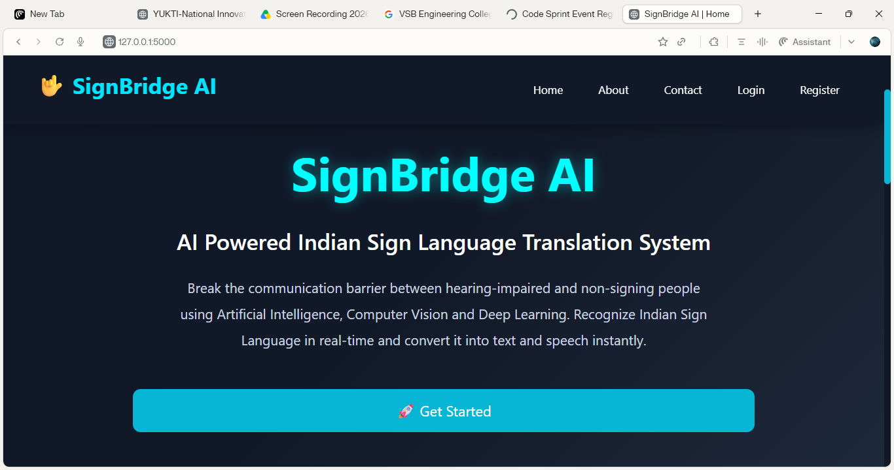
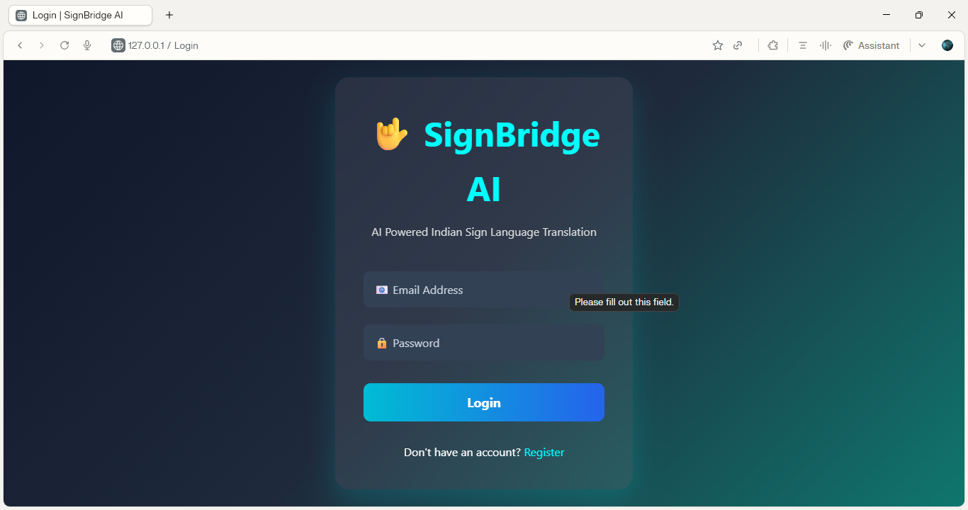
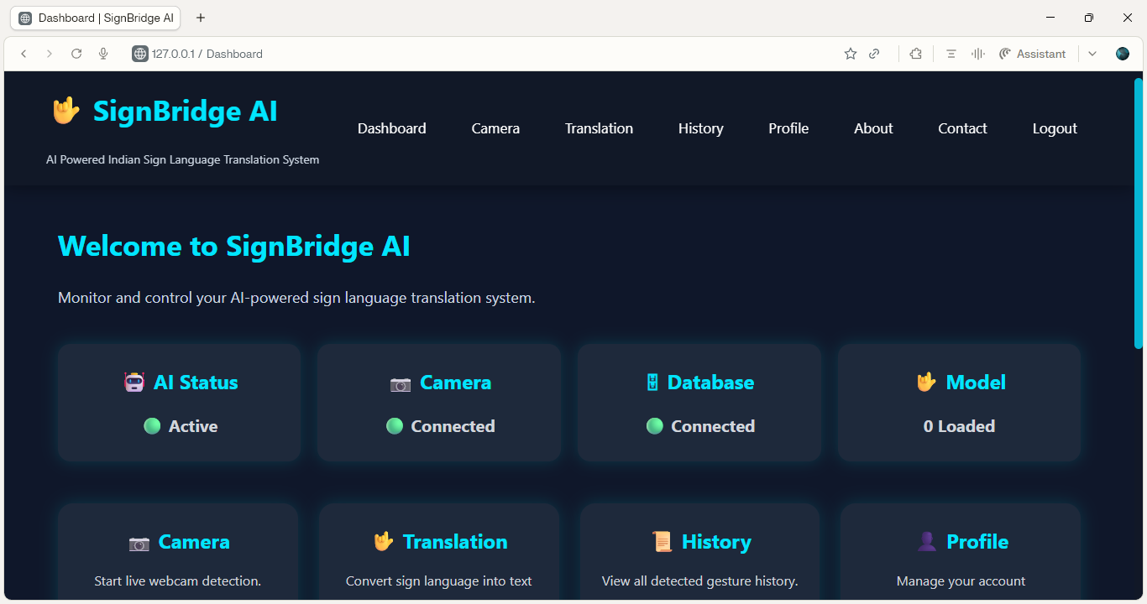
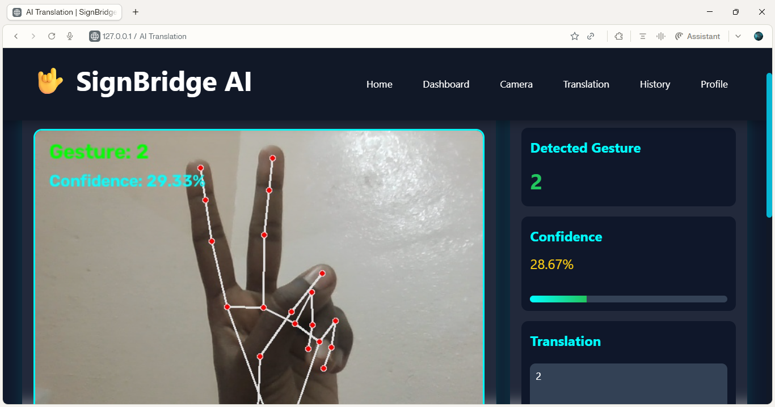
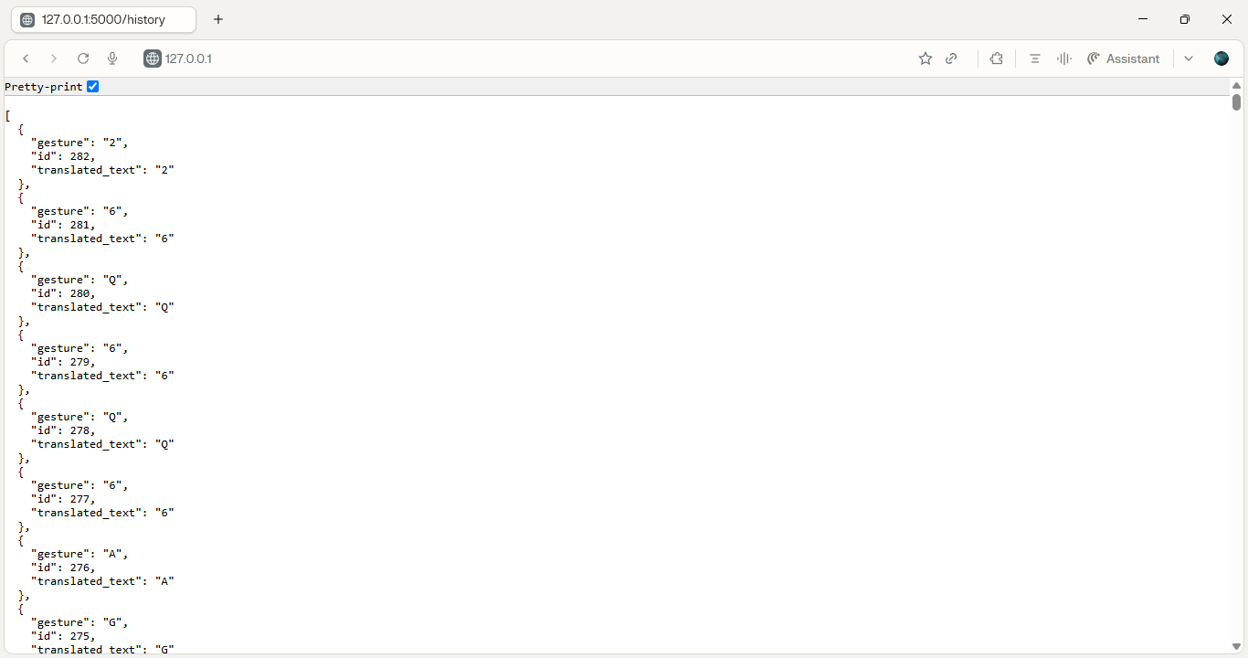
Implementation & Results
Screenshots
Results
Real-time gesture recognition
Home Page
Login
Instant text conversion
Voice output
Dashboard
AI Camera
Translation history saved
Translation History
SignBridge AI
8

Slide 9










Advantages & Applications
Advantages
Applications
Real-time recognition
Schools
User-friendly interface
Hospitals
Cost-effective
Government Offices
Secure authentication
Banks
Database integration
Public Service Centers
SignBridge AI
9

Slide 10




Conclusion & Future Scope
Conclusion
Future Scope
AI-based Indian Sign Language translation.
Mobile application
Real-time gesture recognition using Computer Vision.
Sentence recognition
Multilingual support
Improves communication accessibility.
Cloud deployment
Higher recognition accuracy
SignBridge AI
10

