Slide 1
Crime Rate Prediction
Based On Lunar Cycle
Group #2 - Team Lunatics
TEAM
IDEA
PROCESS
GOAL
PUBLISH

Slide 2
Meet Our Team
Arvind
Moorthy
Dharshini
Anandakumar
Ipsita
Panda
Sreenivas
Parthasarathy
Oracle Hyperion Technology Specialist
15 Years
ETL Developer
5 Years
Quality Assurance
6.5 Years
Principal SAP Consultant 15 Years

Slide 3

^{An} Idea _{Can Change The World}
1
3
Several thesis have been written in the past 20 years that explores the relationship between criminal behaviour and the full moon.
This phenomenon can be observed visibly from the ocean waves during the full moon nights.
2
4
This impact of full moon on human minds is due to the increase in intensity of the electro magnetic waves caused by the increase in gravitational force of the moon.
Assuming this relationship is true, we are predicting the Crime Count for a specific location on & around full moon days.

Slide 4
Applications
The Crime Rate Predictor when incorporated to google maps, can be useful to public in avoiding the routes and areas with high estimated crime rate.
1
2
Law Enforcement agencies will be able to better allocate their resources for high crime prone areas.
Psychologists will be able to predict extreme behaviour of their patients from specific areas on specific days.
3
City Development agencies will be able to identify crime hot zones to improve the infrastructure of those areas and thereby improving general population’s lifestyle.
4

Slide 5
Cities in Scope
1
New York
New York is a city in the state of New York.
Population as of 2019: 19849399
Crime Rate: 18.71
2
Raleigh
Raleigh is a city in North Carolina.
Population as of 2019: 463492
Crime Rate: 38.19
3
Atlanta
Atlanta is a city in Georgia.
Population as of 2019: 486290
Crime Rate: 61.17
Number of crimes in area
Crime Rate (CR) = ------------------------------------------ x 100,000
Population of the area
The Crime Rate specified here is per 1000 people in the population.

Slide 6
Project Steps
FINISH
Data Gathering
Data
Pre-processing
Model
Training
Testing &
Prediction
1
3
5
7
2
4
6
8
Data Preparation
Model Selection
Hyper Parameter Optimization
Evaluation
START

Slide 7
Data Collection
Atlanta – Crime Report
Collected the crime report of Atlanta City for the years 2009 to 2018 from Atlanta Police Department’s official web page http://www.atlantapd.org/
Lunar Calendar
The Lunar Calendar was built from the lunar data scraped from the web page https://www.timeanddate.com/moon/phases/ using 2 web crawler and scraper frameworks Scrapy and BeautifulSoup4.
New York – Crime Report
The crime report of New York City for the years 2000 to 2018 was gathered from New York Police Department’s official webpage https://www1.nyc.gov/
Population
The Normalized Population Census data is collected for all 3 cities for the fiscal years of 2000 to 2018 using the web scrapping framework, Scrapy from the webpage https://www.google.com/publicdata/explore?ds=kf7tgg1uo9ude_
Raleigh – Crime Report
We collected the crime report of Raleigh City for the years 2009 to 2018 from North Carolina Police Department’s official web page https://www.raleighnc.gov/police

Slide 8
Web Crawling & Scraping
Use Scrapy, a web-crawling python framework
Feed region, country and year to program for which lunar day information is needed
Build url from above input, open and crawl through the web page looking for specific key words.
Find a match, scrap the data and save as a csv file, in required format.
01
Use BeautifulSoup4, a web-scraping library to collect lunar data.
Build url to fetch lunar data for cities & years.
Leverage BS4 functions to the parse the required html tags.
Format the lunar date.
02

Slide 9
City-wise Crime Count Visualization
1
For ease of access, only 6 months’ data has been used to extrapolate the line graph.
2
All the crime counts are for the period of January to June, 2018
3
New York being a major city has the highest crime rate.
Atlanta has the lowest crime count during this period.

Slide 10
Data Selection
Why Atlanta?
1
Atlanta has the highest Crime Rate and lowest Crime Index.
Crime Index: 100 being safest
2
Atlanta City Crime Report data is spread across 2009 to 2018, with wide range of features.
Crimes on and around full moon day are selected to train the model to avoid the crime count fluctuations [outliers] on non-full moon days, which could be due to any number of external factors.
3

Slide 11
Data Cleansing Check List
Eye Ball the data to identity and remove the blatantly irrelevant features viz. Report Number etc.
Round up the Longitude & Latitude features, zip them together and convert them to categorical values for Unique Location-Group Identification.
Remove the duplicated features viz. UCR Literal which is the description of UCR Code.
Convert Categorical Features from text to numerical categories.
Remove Report Date and Possible Date as we are concentrating on Occur Date alone.
Standardize features containing Date and Time to suitable formats.

Slide 12
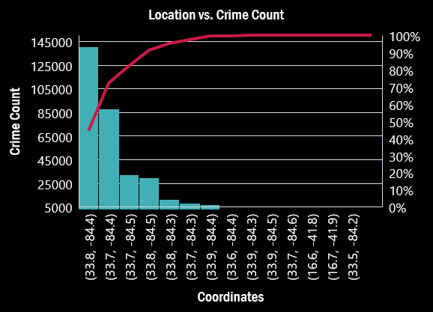
Atlanta Crime Visualization
Observations:
Crime count is high on and around Full Moon days (1, 2, 3, 27, 28 & 29)
The peaks in crime count during non-full moon days (between 5 & 25) are outliers, because they could have been influenced by ‘n’ number of factor like carnivals, concerts, natural calamities, recession etc.
The outliers will be omitted while building the model.
Specific locations have very high crime count whereas certain locations have very low crime count.
Both are highly possible occurrences and must be included to build the model.

Slide 13
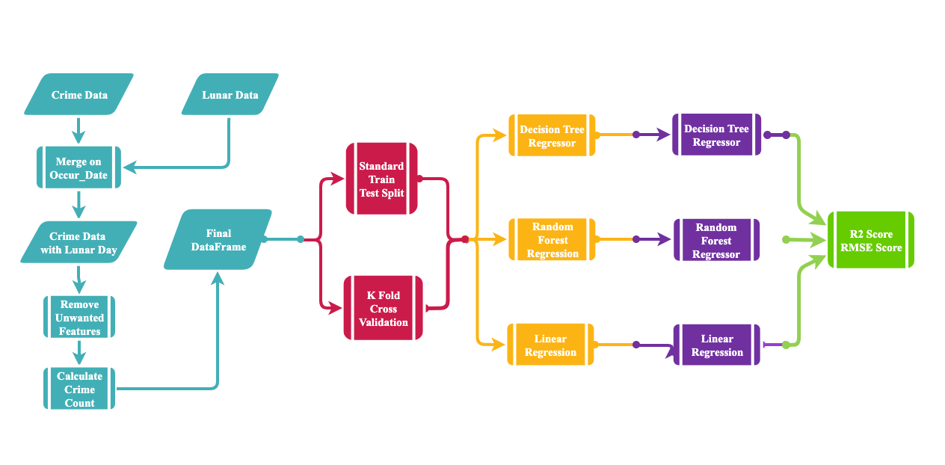
Workflow

Slide 14
Model Selection
01
Decision Tree Regressor
02
Random Forest Regressor
03
Linear Regressor
04
SVM Regressor

Slide 15
Model Tuning
Perform K fold Cross Validations
Perform Grid Search
Optimizing Cycle
Perform PCA
Perform Stacking & Ensembles

Slide 16
Model Evaluation
03
Decision Tree Regressor
with Grid Search
RMSE: 2.79
R2 Score: 0.55
01
RMSE: 0.042
R2 Score: 0.778
Decision Tree
Regressor
02
RMSE: 0.647
R2 Score: 0.811
Random Forest
Regressor

Slide 17
Model SWOT Analysis
Strengths
S
W
Weaknesses
Optimal prediction of Crime count achieved.
Test errors are considerably low.
Better prediction can be achieved with more relevant features and data.
Opportunities
O
T
Threats
Can be expanded to further cities.
Integration with Google maps.
Neural Network algorithm and Clustering – Supervised Combo Algorithms can be used to improve prediction.
Data sanity of the web sites is assumed to be high and any lacks may impact prediction.
Huge data warrants adequate infrastructure.

Slide 18
Limitations
Model is able to predict crime count for Full Moon day +/- 5days accurately
Data related to Victims and Criminals involved are not available for all cities
Population information across all cities day wise not readily available

Slide 19
Learning Curve
04
Model Tuning methods.
Inferring from Regression metrics.
Optimizing metrics by model tuning.
03
Model Selection criteria.
Scaling using Z-score & Min-Max.
02
Web scrapping via Scrappy & Beautiful Soup.
Data research and accumulation.
Feature Engineering by Uni & Bi-variate analysing techniques.
Visualizations using Seaborn & Matplotlib.
01

Slide 20
Thank you

