Slide 1


DEPARTMENT OF COMPUTER SCIENCE AND ENGINEERING
WEB PROGRAMMING COURSE PROJECT
SMART HOSTEL COMPLAINT MANAGEMENT SYSTEM
[DHARSHINI G] | [240701121]
III YEAR – COMPUTER SCIENCE & ENGINEERING

Slide 2
AIM
To develop a Smart Hostel Complaint Management System that provides a simple and efficient platform for students to submit hostel complaints online. The system aims to help students track their complaints and receive status updates. It also helps administrators manage, prioritize, and resolve complaints through a centralized dashboard. The system uses modern web technologies and MySQL to securely store and manage student and complaint information.

Slide 3
OBJECTIVE
To develop a simple and user-friendly hostel complaint management system.
To allow students to submit and track complaints online.
To help admins manage, prioritize, and resolve complaints efficiently.
To securely store student and complaint details using MySQL.
To provide dashboards, charts, and reports for better complaint management.
To reduce manual work and improve the complaint resolution process.

Slide 4
ABSTRACT
The Smart Hostel Complaint Management System is a web application developed using different web technologies to manage hostel complaints digitally.
HTML5 is used to create the structure of web pages and forms. CSS3 is used to design the user interface and make the application responsive on different screen sizes. Vanilla JavaScript is used for client-side validation, DOM manipulation, events, search, filters, pagination, and dynamic user interactions.
EJS is used for creating dynamic server-side web pages.
Node.js is used as the server-side runtime environment, while Express.js is used to handle server requests, routing, controllers, and application logic. MySQL is used to store student, admin, complaint, and complaint history data. The mysql2 module is used to connect the Node.js application with the MySQL database.
Express Session is used to manage user login sessions and protect different user roles.
bcryptjs is used to securely hash passwords before storing them in the database.
Chart.js is used to display complaint statistics and dashboard charts.
These technologies work together to create a responsive, secure, and database-connected web application for hostel complaint management.

Slide 5
PROJECT OBJECTIVES
1. Build an interactive web application
2. Support multiple user roles
3. Apply Web Programming concepts
Create a responsive interface using HTML5, CSS3 and vanilla JavaScript.
Provide dedicated portals for students, admins and the super admin.
Use forms, DOM manipulation, events, validation and responsive CSS.
4. Centralize complaint workflows
5. Demonstrate a complete system
Submit, track, prioritise and resolve hostel complaints with remarks.
Connect the frontend to Node.js/Express and a MySQL database.

Slide 6
PROBLEM STATEMENT
Hostel complaint handling is manual and scattered
Students rely on paper registers, verbal requests or messages to report issues like water, electricity, cleaning and Wi-Fi.
Wardens and admins have no single place to view, prioritise and assign complaints.
Students cannot easily track the status of their complaint or see the admin's remarks.
Reports and statistics on complaint trends are hard to produce.
No accountability or transparency: there is no record of who handled a complaint or how long it took, so students often have to follow up repeatedly.
No priority system: urgent problems such as water leakage, electrical faults or safety issues get mixed in with minor ones, so critical complaints are delayed.
Delays and lost complaints: paper registers and verbal requests are easily misplaced, forgotten or never reach the warden, so issues stay unresolved for days.
Lack of data for decisions: without digital records, administrators cannot see repeated issues or find which hostel blocks or complaint types need attention.

Slide 7
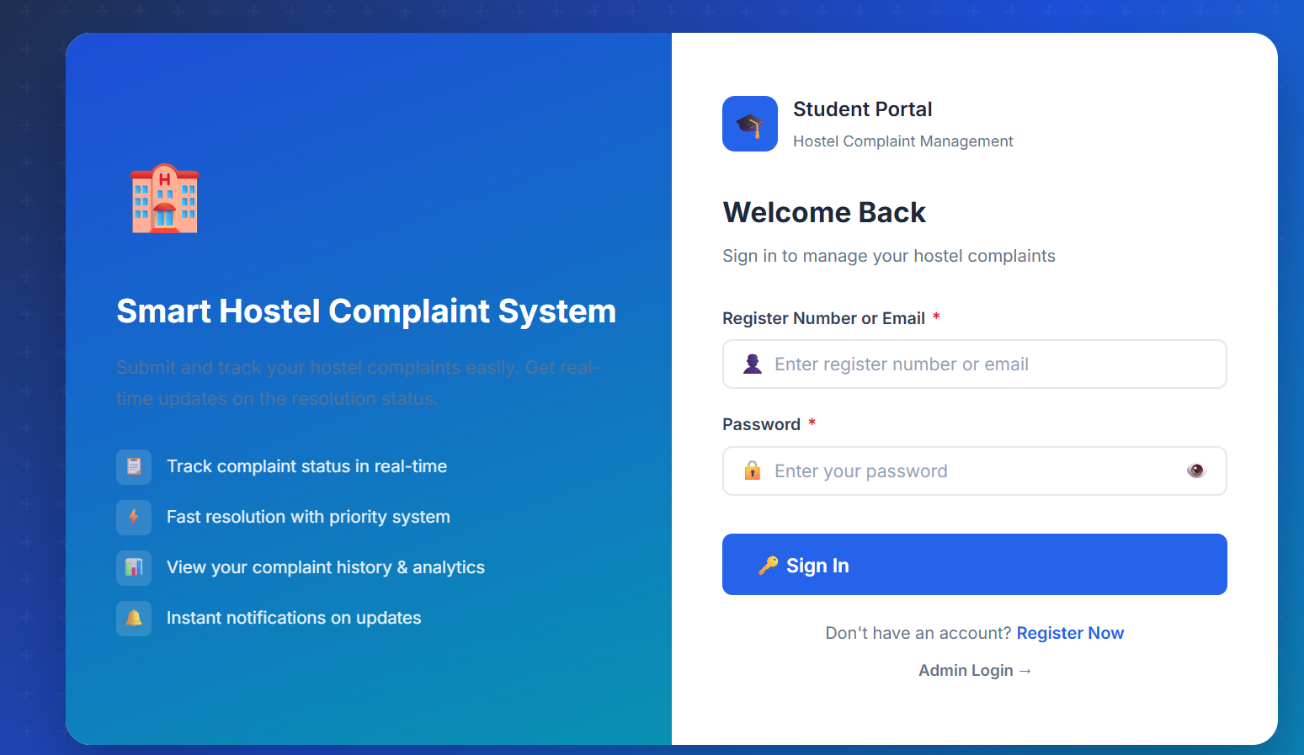
HTML & CSS IMPLEMENTATION
HTML5 provides the structure
PASTE IMAGE HERE
Login / Register page screenshot
Semantic sections and EJS partials for shared layout
Forms for login, registration and complaint submission
Inputs, selects, tables and dynamic containers
Labels and required fields for accessibility
HTML FORM EXAMPLE
<form action="/login" method="POST">
<label>Username
<input type="text" name="username" required>
</label>
<label>Password
<input type="password" name="password" required>
</label>
<button type="submit">Login</button>
</form>

Slide 8
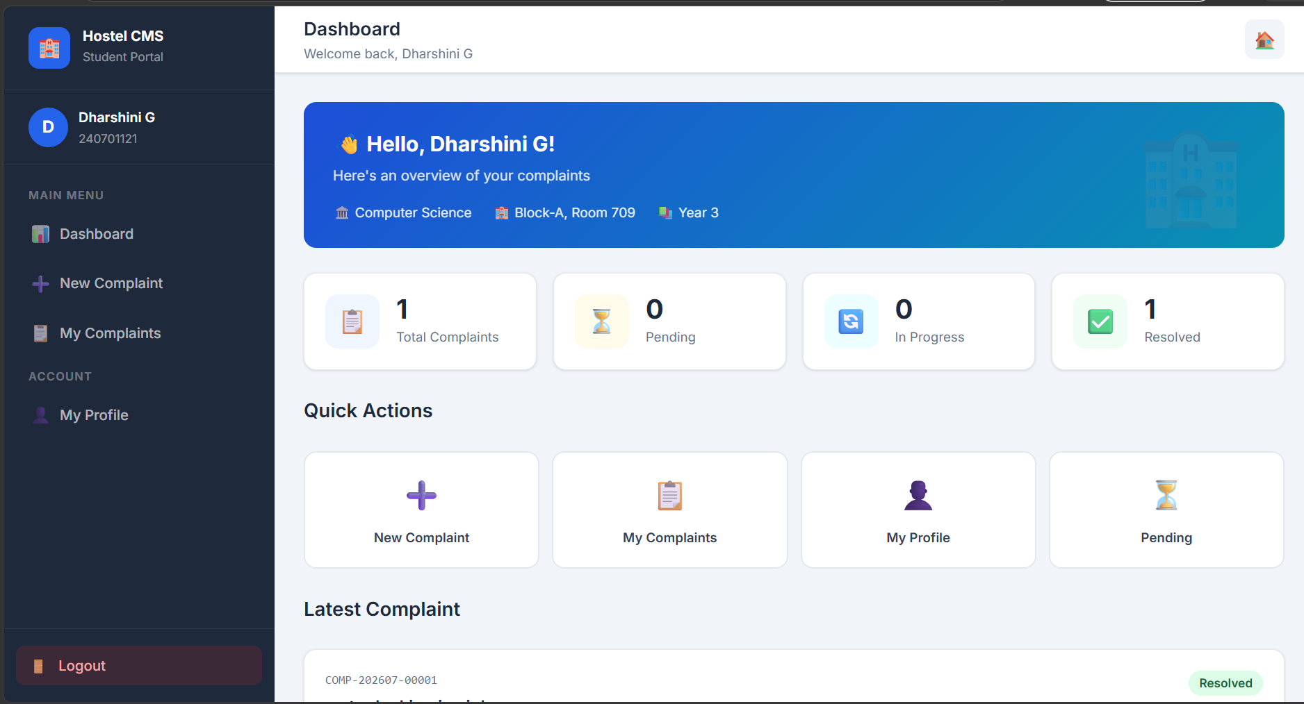
JAVASCRIPT – DOM, EVENTS & DYNAMIC UI
Client-side interaction in the portal
PASTE IMAGE HERE
Dashboard / complaints page screenshot
Event listeners handle click, change and submit actions.
DOM updates drive toast notifications, filters and loading indicators.
Search, filters and pagination keep long complaint lists easy to use.
Chart.js renders dashboard charts for admins.
JAVASCRIPT EVENT EXAMPLE
form.addEventListener('submit', (e) => {
if (!form.checkValidity()) {
e.preventDefault();
showToast('Please fill all fields', 'error');
}
});
setTimeout(() => toast.remove(), 3000);

Slide 9
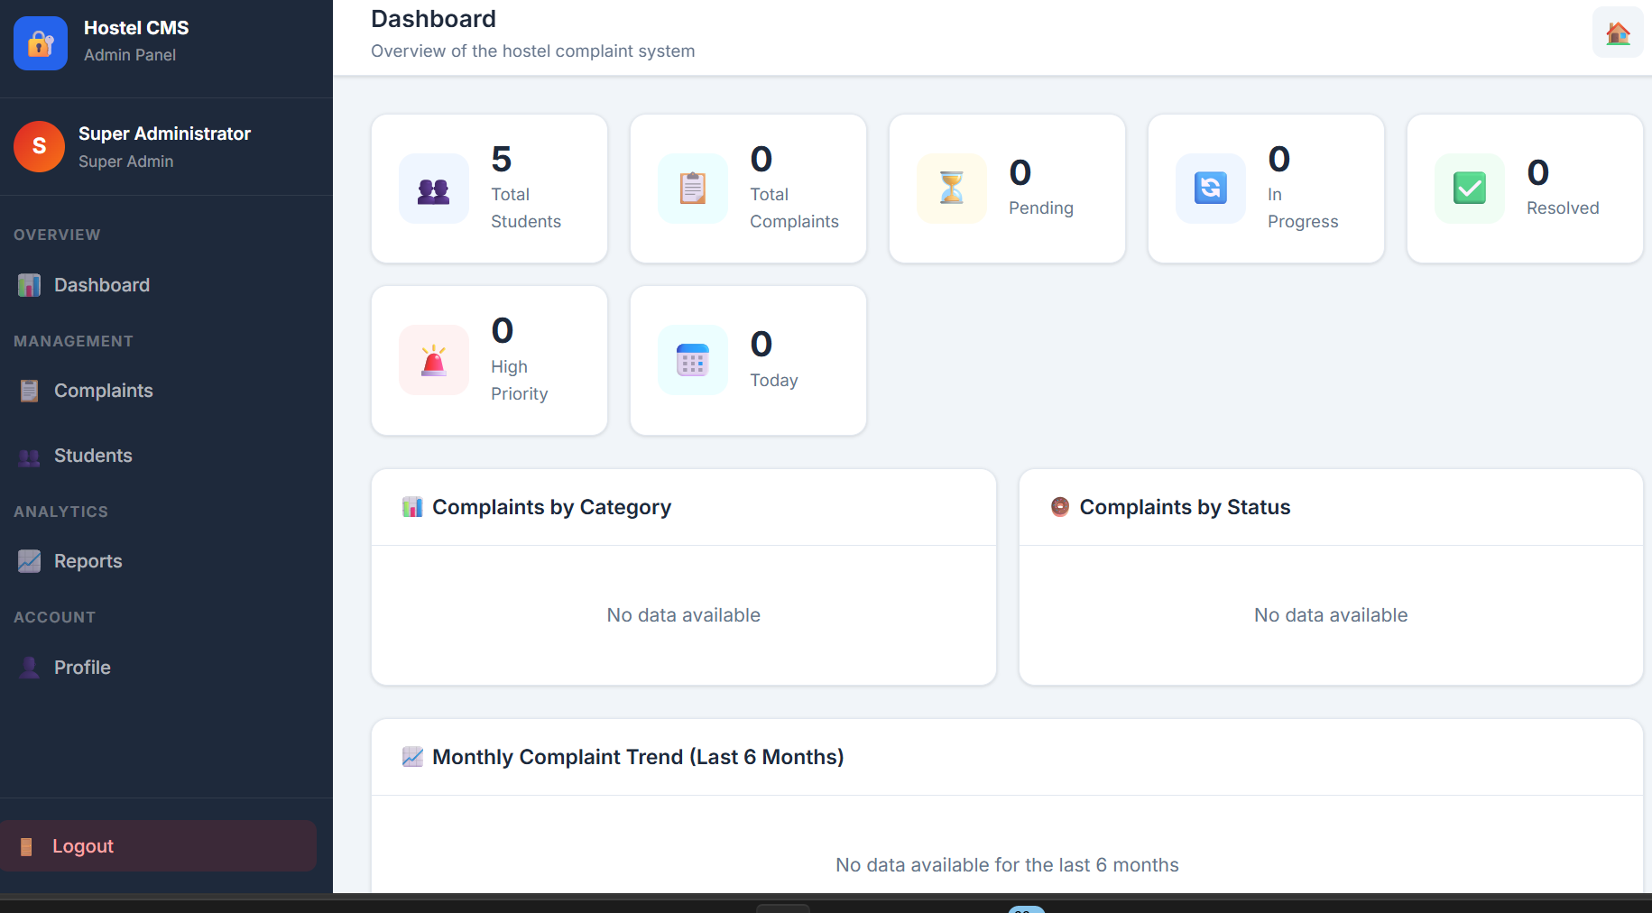
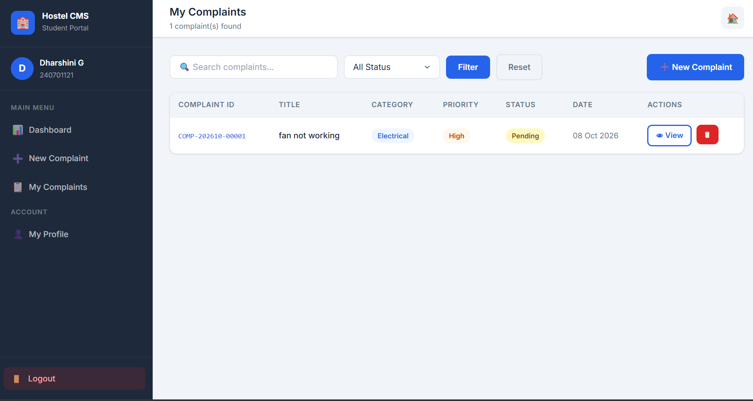
USER MODULES & INTERFACES
PASTE IMAGE HERE
Student dashboard screenshot
PASTE IMAGE HERE
Admin dashboard screenshot
PASTE IMAGE HERE
Reports page screenshot
STUDENT PORTAL
ADMIN PANEL
REPORTS & STUDENTS
Submit complaints • Track status • Profile • Change password
Dashboard charts • Manage complaints • Status, priority & remarks
Student management • Complaint reports • Search & filters

Slide 10
METHODOLOGY
How the web application works
1
2
3
4
5
6
User Interface
Interaction
Communication
Server Logic
Data Layer
Security
HTML + CSS + EJS
JavaScript + DOM + Events
HTTP Forms + Routes
Node.js + Express.js
MySQL (mysql2)
Sessions + bcryptjs
Development approach: design the interface → implement client-side behavior → connect routes and controllers → persist data in MySQL → add role-based security → test the complete flow.

Slide 11
SYSTEM ARCHITECTURE
CLIENT / FRONTEND
HTML5 • CSS3 • Vanilla JavaScript • EJS views
APPLICATION / ROUTES
Node.js • Express.js • Routes → Controllers → Models
DATA LAYER
MySQL • mysql2 connection pool • parameterized queries
SECURITY
Express Session • bcryptjs hashing • route guards • input validation
Role-based access: Student | Admin | Super Admin

Slide 12
TECHNOLOGIES USED
HTML5
CSS3
Page structure & forms
Responsive UI & visual design
Vanilla JavaScript
EJS
DOM, events & validation
Server-side view templates
Node.js + Express
MySQL (mysql2)
Server & routing
Persistent data storage
Express Session + bcryptjs
Chart.js
Authentication & password security
Dashboard charts (CDN)
Run locally: http://localhost:3000 (npm install → npm start)

Slide 13
SMART HOSTEL COMPLAINT MANAGEMENT SYSTEM
THANK YOU

