Slide 1

PROJECT REVIEW | LOW-CODE APPLICATION DEVELOPMENT
CALIBTRACK
Laboratory Equipment Calibration & Certification Management System
Developed using Zoho Creator
Dharshini G
Register Number: 240701121
B.E. Computer Science and Engineering
Rajalakshmi Engineering College, Chennai
Guide: Aswana Lal | Academic Year: 2026–2027
Notes:
Good morning. I am Dharshini G. My project is CALIBTRACK, a Laboratory Equipment Calibration and Certification Management System built using Zoho Creator.

Slide 2



Introduction
What is this project?
Equipment
A centralised laboratory management application
Built on the Zoho Creator low-code platform
Manages equipment, calibration, certificates, inspections and maintenance
Forms capture data, reports show it, Deluge automates
Dashboard gives a quick overview
Register and track lab equipment details
Calibration
Schedule, record results and parameters
Certificates
Keep certificates and expiry dates
Notes:
CALIBTRACK is a centralised low-code application for managing laboratory equipment, calibration schedules, results, certificates, inspections and maintenance.

Slide 3




Problem Statement
Scattered records
Missed calibration dates
Equipment, calibration results and history sit in separate registers and files.
Upcoming and overdue schedules are tracked by hand.
Delayed maintenance
Slow reporting
Requests and inspection issues are not followed up on time.
Preparing equipment and calibration reports takes extra effort.
Notes:
Manual registers and spreadsheets make it hard to find records, track due dates, follow up maintenance and prepare reports.

Slide 4

Objectives
1
Centralised equipment and calibration management
2
Eight forms for lab, equipment and records
3
Automate status updates and notifications
One organised, centralised calibration system
4
Reports for history and certificate expiry
5
Dashboard with KPIs and charts
6
Test forms, reports, workflows, dashboard
Notes:
Six main objectives: centralise records, build the eight forms, automate with workflows and Deluge, provide reports, build a dashboard and test everything.

Slide 5
Existing System vs Proposed System
Existing System
Proposed System (CALIBTRACK)
Registers and spreadsheets
Separate record files
Manual schedule tracking
Certificates stored separately
Manual maintenance follow-up
One application, 8 linked forms
Lookups connect related records
Auto next date and overdue status
Email alerts for key events
Dashboard with KPIs and charts
Notes:
The existing system relies on registers and spreadsheets. CALIBTRACK keeps everything in one application with automation and a dashboard.

Slide 6





Technology Used
Zoho Creator
Forms
Workflows
Deluge
Reports & Dashboard
Low-code platform to build the app
Capture and store records
Automate actions on form events
Scripting for dates and emails
Lists, KPIs and charts
All components run together on the Zoho Creator cloud platform
Notes:
Zoho Creator provides forms, workflows, Deluge scripting, reports and the dashboard, all hosted on the Zoho cloud.

Slide 7
System Architecture
Users / Access Layer
Equipment Manager, Technician, Supervisor, Auditor
Application Layer
Forms, reports, dashboard, workflows and Deluge scripts
Data Layer
Eight forms and one subform of application records
Services Layer
Zoho Creator email notifications
Notes:
Four layers: users reach the app through a browser, the application layer holds forms, reports, workflows and Deluge, the data layer stores records, and email notifications are the only service used. No external APIs are integrated.

Slide 8




Modules and Features
Laboratory
Equipment
Technician
Calibration Schedule
Lab details and in-charge
Details, interval, next date
Specialisation and contact
Dates, priority, status
Calibration Record
Certificate
Maintenance Request
Equipment Inspection
Result and parameters
Validity and expiry
Problems and repairs
Condition and result
Notes:
Eight forms, linked with lookup fields. The Calibration Record form also contains a Calibration Parameters subform.

Slide 9
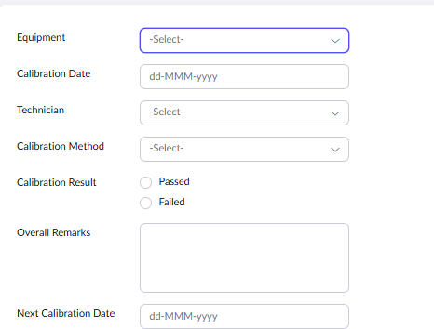
Calibration Record Form
Fields collected
Equipment, technician and date
Method and result (Passed / Failed)
Overall remarks and next calibration date
Calibration Parameters subform: name, standard, actual, tolerance, unit, result
Notes:
The Calibration Record form uses lookups for equipment and technician, and a subform to record each measured parameter.

Slide 10
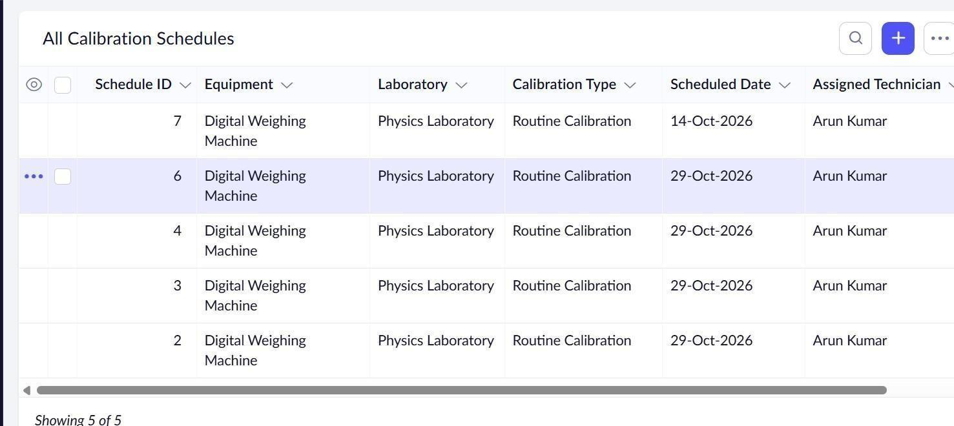
Reports
15
list reports
Group by status
Sort by date or name
Expiry and workload views
All Calibration Schedules report: ID, equipment, laboratory, type, date, technician, priority
Notes:
Fifteen list reports cover laboratories, equipment, technicians, schedules, records, certificates, maintenance, inspections, calibration history, status, certificate expiry and technician workload.

Slide 11
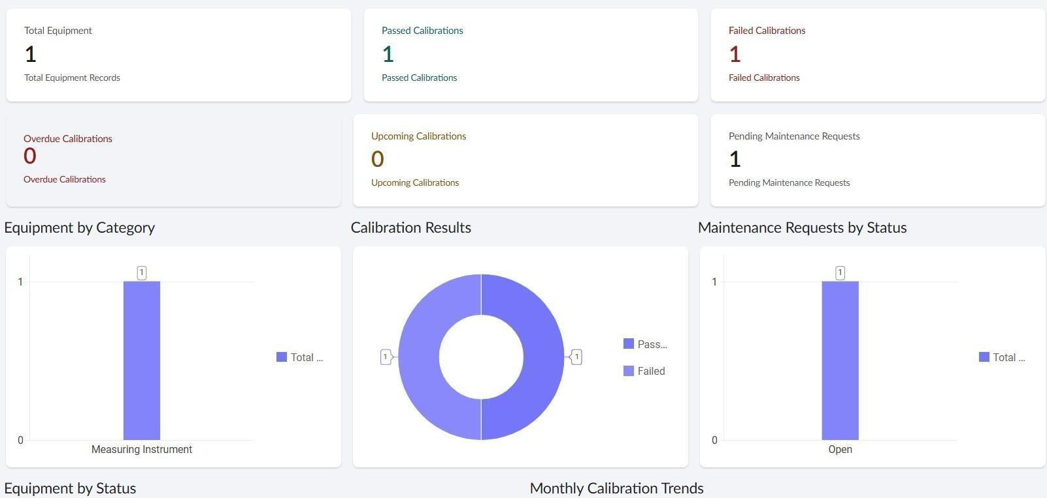
Calibration Dashboard
6
KPI cards
5
Charts: equipment category, calibration results, maintenance status, monthly trend
charts
Notes:
The dashboard shows KPI cards for total equipment, passed, failed, overdue, upcoming calibrations and pending maintenance, plus charts for equipment category, calibration results, maintenance status, equipment status and monthly trends.

Slide 12
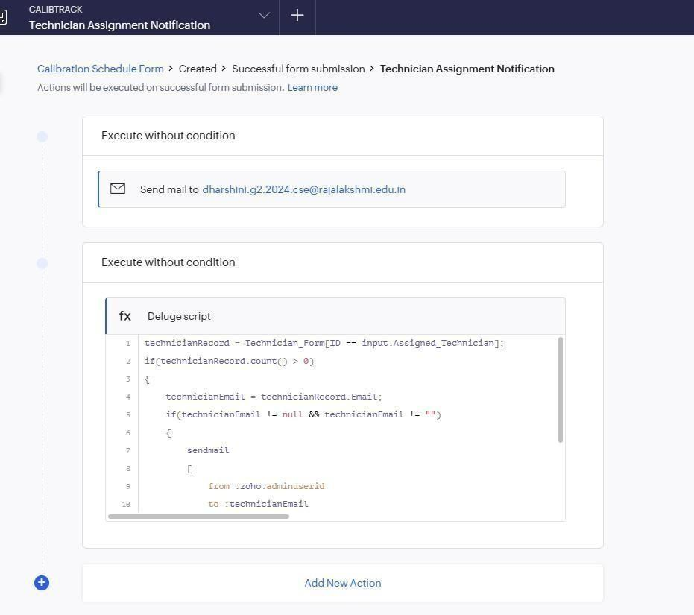


Workflow and Automation
Next date
Overdue status
Adds 6 months to the calibration date
Past scheduled date becomes Overdue
Technician email
Failed alert
Mails the assigned technician
Email alert on a Failed result
11 workflows: 10 form workflows and 1 scheduled
Notes:
Workflows calculate the next calibration date, mark overdue schedules, email technicians on assignment and alert on failed calibration. The same pattern covers certificate expiry, maintenance and inspection alerts.

Slide 13
Deluge Script Logic
DS-01 Next calibration date
DS-03 Technician email (abridged)
if(input.Calibration_Date != null)
{
input.Next_Calibration_Date =
input.Calibration_Date.addMonth(6);
}
tech = Technician_Form[ID ==
input.Assigned_Technician];
if(tech.count() > 0)
{
sendmail
[
from :zoho.adminuserid
to :tech.Email
subject :"New Calibration Task
Assigned - CALIBTRACK"
]
}
DS-02 Overdue status
if(input.Scheduled_Date < zoho.currentdate)
{
input.Schedule_Status = "Overdue";
}
Scripts run on form events: date calculation, overdue marking and technician email
Notes:
Three of the four Deluge scripts: the next calibration date adds six months, the status check marks past schedules as Overdue, and the notification script fetches the technician record and sends an email.

Slide 14
Testing and Validation
Test | Expected result
Form entry | Records save with valid data
Lookup | Equipment linked to laboratory
Subform | Parameters stored with record
Overdue status | Past dates marked Overdue
Failed alert | Alert workflow configured
Reports & dashboard | KPIs, charts, reports load
15
test cases, all passed
Notes:
Fifteen test cases cover every functional requirement and all passed. Full multi-user role testing and complete email delivery testing are listed as future work.

Slide 15
Limitations and Future Enhancements
Current limitations
Future enhancements
No external API integration
Tested in Development only
Multi-user role testing pending
Mobile and portal not configured
AI predictive analytics
REST API integration
Mobile access for technicians
Approval workflows
Downloadable PDF certificates
Notes:
Limitations: no external APIs, development environment only, role testing with multiple users still pending, and no mobile or portal configuration.

Slide 16
Conclusion
Brings equipment, calibration, certificates and maintenance into one application
Built with 8 forms, 15 reports, a dashboard, workflows and Deluge scripts
Automates next date, overdue status and email notifications
A strong base that can grow with more features
Low-code makes practical laboratory management applications quick to build.
Notes:
CALIBTRACK shows how Zoho Creator can organise laboratory calibration activities in a single application. Thank you.

