Slide 1
Employee Data Analysis using Excel
STUDENT NAME: DHARSHINI G
REGISTER NO 312204567,B72935DC3C5E7E68DAC45E21B2FF3A79 DEPARTMENT : COMMERCE
COLLEGE: K.C.S.KASI NADAR COLLEGE OF ARTS & SCIENCE

Slide 2
PROJECT TITLE
Employee Rating Card Analysis Using Excel

Slide 3

AGENDA
Problem Statement
Project Overview
End Users
Our Solution and Proposition
Dataset Description
Modelling Approach
Results and Discussion
Conclusion
3/21/2024 Annual Review

Slide 4

PROBLEM STATEMENT
The Problem is to determine the rating of each employee’s total score by using their scores on several factors that affects their work.
Such factors are Problem solving, Punctuality, communication, Teamwork, technical knowledge and Meeting deadlines.

Slide 5

PROJECT OVERVIEW
The following slides shows the procedures to determining the rating of each employee’s total score Using Excel by Utilising The tools listed below.
Tables
Slicers
Pivot table formulae
Pivot table
Pie chart
Line chart

Slide 6

WHO ARE THE END USERS?
Civil Engineering
Computer Engineering
Electrical Engineering
Electronics Engineering

Slide 7

OUR SOLUTION AND ITS VALUE PROPOSITION
Advanced Analytical Tools: Formulas and Functions PivotTables User-Friendly Interface: Accessibility Ease of Use Scenario Analysis:
Used to analyse different situation Comprehensive Data Management: Data Organization
Data Integration
Visual Representation:
Charts and Graphs
7

Slide 8
DATASET DESCRIPTION
DATA OVERVIEW:
The dataset holds Information regarding Employees within the organization consists their scores on Punctuality and Teamwork. This data is used to determine the total score of each employees.
DATA FIELDS:
Problem solving
Punctuality
Communication
Technical knowledge
Teamwork
Meeting deadline

Slide 9
MODELLING
Data cleaning.
Creating table.
Creating pivot chart.
Creating dashboard.
Inserting pivot chart in dashboard.
Inserting formulas in dashboard to make interaction.
Creating interactive dashboard by putting all together elements.

Slide 10
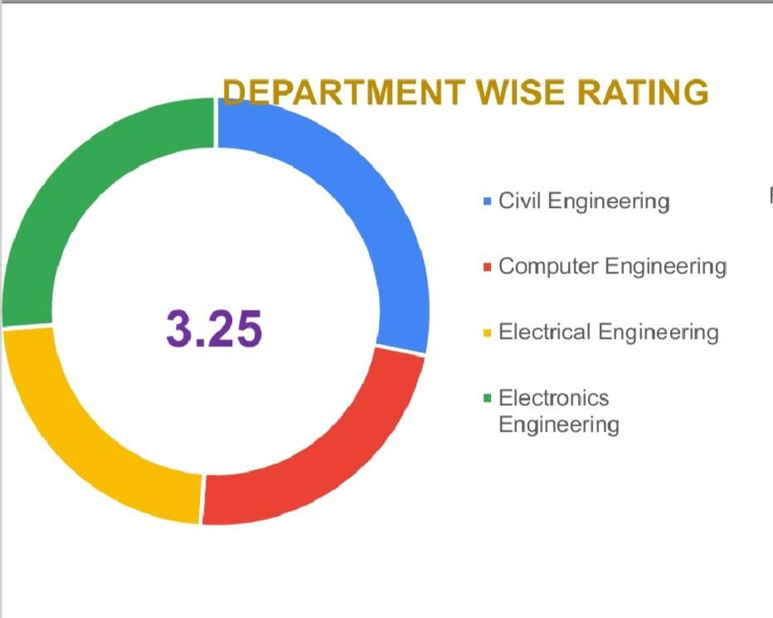
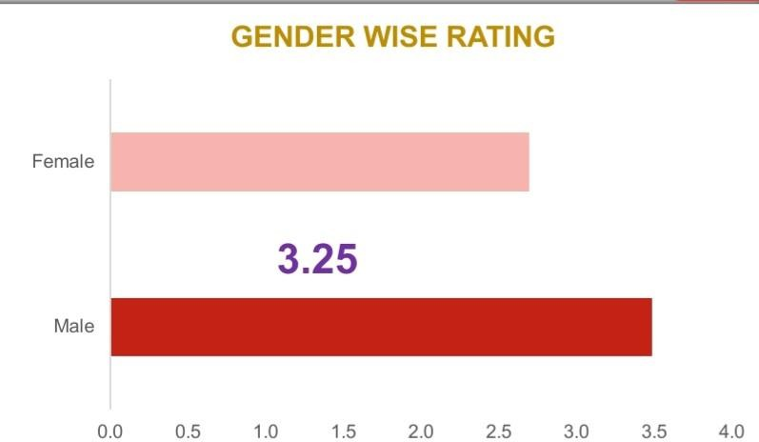
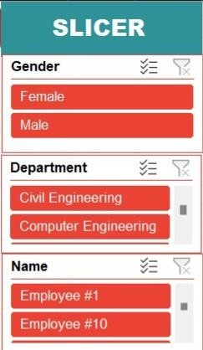
RESULTS
(click to open file)

Slide 11
CONCLUSION
Employees Rating Analysis using Excel help optimize employee performance in the future. This can lead to better outcomes for your team members and your organization.It enables organisations to understand who their top performers are for talent planning purposes. It can provide supporting evidence when taking action against poor performers (e.g. In dismissal cases). It lets employees know where they stand in relation to their peers.

