Slide 1
DEPARTMENT OF COMPUTER SCIENCE & ENGINEERING | B.TECH CAPSTONE PROJECT (BATCH 2026–2027)
CLOUD-M7: Tier-Adaptive Forensic Provenance
Distributed Attack-Path Reconstruction across Heterogeneous Edge, Fog, and Cloud Strata
Review 1 Deliverable: System Architecture, Placement Optimization, Iterative Causal Discovery & Multi-Sensor Graph Synthesis
Candidate Details
Review & Evaluation Scope
Implementation & Repository
Student: Dharshini
Degree: B.Tech Computer Science
Specialization: Cloud Computing & Cyber Security
Phase: Phase 1 (Semester 5)
Review Stage: Review 1 Prototype
Evaluated Modules:
• Formal Event Schema (E_i)
• Tier Placement Optimization (min J)
• Iterative Causal Discovery (Novelty)
• Multi-Sensor Choke-Point Analysis
Source Control:
https://github.com/DharshiniPES/cloud-m7
Software Verification:
• 13 Automated Tests Passing (100%)
• Reproducible Batch Launchers
• Ground-Truth Provenance Simulator
Notes:
Good morning respected members of the evaluation panel. Today, I am presenting CLOUD-M7: Tier-Adaptive Forensic Provenance. This is a 2-year capstone project aimed at solving one of the most critical unsolved challenges in distributed cyber forensics: reconstructing multi-stage attacks that traverse heterogeneous Edge, Fog, and Cloud computing layers. I have implemented a fully reproducible prototype, including two mathematical novelty contributions, verified with 13 automated test suites.

Slide 2
B.TECH CAPSTONE 2026–27 | DEPT. OF CSE | CONTEXT & MOTIVATION
Slide 2 of 14
The Real-World Cyber Threat Landscape in Multi-Tier Computing
The Evolution from Isolated Servers to Multi-Tier Strata
The 3-Tier Forensic Execution Hierarchy
1. Pervasive Architectural Transition:
Modern enterprise systems (smart factories, connected vehicles, healthcare grids) no longer run exclusively on monolithic cloud datacenters. They are structured as a 3-tier computing hierarchy:
• Edge Tier: Constrained microcontrollers & sensors (ARM/RISC-V, 512MB RAM, limited uplinks).
• Fog Tier: Regional edge aggregation gateways, Kubernetes k3s nodes, local storage.
• Cloud Tier: Massive centralized cloud clusters (AWS/Azure), sensitive databases, global APIs.
2. The Multi-Stage APT Attack Vector:
Attackers exploit low-security Edge IoT devices (e.g. CVE memory exploits), pivot through intermediate Fog gateways, and execute privilege escalation to exfiltrate enterprise Cloud databases.
3. High-Profile Precedents: Mirai botnets, the Colonial Pipeline lateral breach, and Stuxnet-style cyber-physical intrusions demonstrate that attacks rarely stay within a single tier.
[CLOUD TIER]
• High compute & infinite storage
• Crown jewel target (SQL databases, patient/user records)
• High monetary cost & privacy compliance overhead
▲ Cross-Tier Lateral Sockets (E_network)
│
[FOG TIER]
• Regional micro-datacenters & industrial gateways
• Intermediate pivot point for lateral privilege escalation
• Natural choke point for attack containment
▲ Constrained Uplinks (4G/5G/LoRaWAN)
│
[EDGE TIER]
• IoT smart sensors, CCTV, actuators
• Frequent firmware vulnerabilities & memory corruptions
• Strict CPU (<800 mcores) and memory (<512MB) limits
Notes:
To understand the motivation: enterprise computing is no longer confined to isolated servers. In critical infrastructure, smart cities, and healthcare, computing is partitioned across Edge sensors, Fog gateways, and Cloud data centers. Modern Advanced Persistent Threats exploit this heterogeneity: they enter through vulnerable edge sensors, pivot laterally through fog gateways, and compromise cloud crown jewels. Our goal is to build an end-to-end forensic provenance system capable of tracking these cross-tier attacks.

Slide 3
B.TECH CAPSTONE 2026–27 | DEPT. OF CSE | PROBLEM DEFINITION
Slide 3 of 14
Problem Statement: The Three Broken Pillars of Multi-Tier Forensics
Pillar 1: Host EDR Blindness
Pillar 2: Centralized SIEM Infeasibility
Pillar 3: Heterogeneous Schemas
Single-Host Isolation:
• Standard Endpoint Detection & Response (EDR) tools (Linux auditd, Sysmon, CamFlow) run locally on individual OS kernels.
Severed Causal Links:
• When an attacker opens an outbound TCP socket from an edge device to a fog gateway, the local host log terminates at the socket write.
The Result:
• Security analysts face disjointed, isolated forensic islands. They cannot correlate an alert in the Cloud with a compromise at the Edge.
Bandwidth Saturation:
• Shipping all raw syscall events from thousands of IoT devices to a centralized cloud SIEM (Splunk/CloudWatch) consumes massive network bandwidth (500+ KB/s per sensor cluster).
High Ingestion Latency:
• Round-trip propagation delays (160ms+) prevent real-time incident containment at the edge.
Privacy & Regulatory Violations:
• Transmitting raw unmasked camera/sensor payloads violates GDPR, HIPAA, and regional data protection mandates.
Incompatible Log Formats:
• Edge: Low-level Linux kernel syscalls (clone, execve, read, write).
• Fog: Container orchestration events, Docker/k8s socket streams, MQTT brokers.
• Cloud: High-level REST API requests, OAuth/IAM tokens, database transactions.
Causal Synthesis Failure:
• Without a standardized mathematical representation, automated graph traversal across tiers is mathematically impossible without manual human guesswork.
Notes:
Here are the three fundamental pillars that break when attempting forensics across Edge, Fog, and Cloud. First, Host EDR tools like auditd and CamFlow only see single machines—the moment an attacker pivots across a network socket, the causal trail breaks. Second, shipping all logs to the cloud is impossible because it overwhelms edge uplinks by 90% and leaks private user data. Third, different layers log completely incompatible data formats. CLOUD-M7 is engineered to fix all three pillars.

Slide 4
B.TECH CAPSTONE 2026–27 | DEPT. OF CSE | STATE OF THE ART
Slide 4 of 14
Literature Survey: Comparative Benchmark against Prior Art
Evaluation Criterion / Capability | Host EDR (auditd / Sysmon) | Centralized SIEM (Splunk) | Academic Systems (CamFlow / SPADE) | CLOUD-M7 (Our Project)
Cross-Tier Multi-Hop Correlation | ❌ Single Host Only | ⚠️ Manual Triage (Disjoint) | ❌ Single OS Kernel Only | ✅ Autonomous (E_network)
Dynamic Task Placement Optimization | ❌ Static / None | ❌ All-to-Cloud Shipping | ❌ Local-Only Execution | ✅ Multi-Objective min J(x)
Edge Bandwidth & Uplink Optimization | ❌ Unbounded Logging | ❌ Severe Saturation (500 KB/s) | ❌ No Edge Network Model | ✅ 90.0% Bandwidth Reduction
Edge Privacy & Anonymization | ❌ Raw Logs Exfiltration | ❌ Centralized Exposure | ⚠️ Host-Level Labels Only | ✅ In-Memory Privacy Masking
Iterative Multi-Root Discovery | ❌ Single-Pass BFS Only | ⚠️ Static Rule Alerts | ❌ Single-Root Termination | ✅ Hyperparameter (ΔI_k >= ε)
Multi-Sensor Choke-Point Analysis | ❌ Not Supported | ❌ Not Supported | ❌ Not Supported | ✅ Articulation Cut-Vertices
Notes:
As seen in Table 1, we conducted an exhaustive literature survey comparing CLOUD-M7 to existing industry and academic solutions. CamFlow by Pasquier et al. and SPADE by Bates et al. were breakthrough systems for OS-level provenance, but they remain confined to a single OS kernel. Commercial SIEM solutions rely on manual rule matching and flood the cloud with raw logs. CLOUD-M7 is the first system that combines dynamic placement optimization, unified multi-tier schemas, iterative multi-root discovery, and choke-point containment.

Slide 5
B.TECH CAPSTONE 2026–27 | DEPT. OF CSE | CORE ARCHITECTURE
Slide 5 of 14
Mathematical Foundation: Unified Forensic Schema & Hash Chain
1. Formal Unified Event Representation (Equation 1)
2. Integrity Hash & Cross-Tier Socket Flow Matching
E_i = < UUID_i, τ_i, Tier_i, HostID_i, Type_i, P_i, π_i >
• UUID_i: 128-bit cryptographically unique event identifier.
• τ_i: High-precision UTC timestamp (enforces causal partial ordering).
• Tier_i ∈ {Edge, Fog, Cloud}: Architectural stratum of execution.
• HostID_i: Originating container, VM, or physical hardware identity.
• Type_i ∈ {Process, File, Socket, API}: Abstracted event classification.
• P_i: Structured payload carrying granular syscall / network parameters:
- Process: {cmd, pid, ppid, uid}
- File: {path, fd, flags}
- Socket: {src_ip, src_port, dst_ip, dst_port, proto}
- API: {endpoint, method, status, token}
• π_i: Set of causal parent event UUIDs establishing dependency edges.
Cryptographic Tamper-Evidence (SHA-256):
H_i = SHA256( UUID_i || τ_i || Tier_i || HostID_i || Type_i || P_i || π_i )
• Non-Repudiation Guarantee: Guarantees that compromised edge or fog nodes cannot rewrite past audit logs without breaking cryptographic integrity.
Cross-Tier Socket Stitching Rule (E_network):
A directed dependency edge (u -> v) is synthesized across tier boundaries if and only if:
1. Network 5-Tuple Complementarity:
IP_src(u) == IP_src(v) ∧ IP_dst(u) == IP_dst(v)
Port_src(u) == Port_src(v) ∧ Port_dst(u) == Port_dst(v)
2. Causal Temporal Validity:
0 <= τ(v) - τ(u) <= Δt_window (Strict forward causality)
Global Graph Synthesis:
G_global = G_edge ∪ G_fog ∪ G_cloud ∪ E_network
Notes:
Here is the mathematical core of CLOUD-M7. In Equation 1, we formalize a unified 7-element tuple E_i that abstracts low-level Linux syscalls, Docker network sockets, and Cloud REST APIs into a consistent representation. Each event is hashed with SHA-256 to ensure forensic non-repudiation in court. To connect the tiers, our fusion engine matches socket 5-tuples and strictly enforces temporal forward order.

Slide 6
B.TECH CAPSTONE 2026–27 | DEPT. OF CSE | EXPERIMENTAL SETUP
Slide 6 of 14
Experimental Testbed & Ground-Truth Provenance Dataset
1. Simulated Multi-Tier Testbed Topology
2. Dataset Composition: Ground Truth vs Noise
Infrastructure Emulation (cloud_m7.simulator):
• Edge Nodes (3 Hosts):
- edge-sensor-01 (IoT Sensor, IP: 192.168.1.50, CPU: 800mcores)
- edge-sensor-02 (Firmware Unit, IP: 192.168.1.51)
- edge-actuator-03 (Control Bus Unit, IP: 192.168.1.52)
• Fog Gateway (1 Host):
- fog-gateway-01 (Aggregator & Pivot, IP: 10.0.1.1, Dual-NIC)
• Cloud Cluster (2 Hosts):
- cloud-api-prod (REST Gateway, IP: 172.16.0.10, Port: 443)
- cloud-db-cluster (Crown Jewel Database, IP: 172.16.0.25)
Realistic OS Telemetry Emulated:
Process forking, memory corruption execution, file dropping, credential scraping, and cross-tier TCP/HTTPS connections.
Total Dataset: 70 Provenance Events
• 40 Benign Background Noise Events:
- Routine IoT sensor readings & local cache flushes.
- Gateway keep-alive beacons & Fog telemetry aggregation.
- Normal cloud admin queries & background DB maintenance.
• 30 Co-Occurring Attack Events across 3 Vectors:
- Vector 1 (14 Events): Primary exploit path from edge-sensor-01 -> Fog -> Cloud database exfiltration dump.
- Vector 2 (8 Events): Concurrent firmware command-injection exploit on edge-sensor-02.
- Vector 3 (8 Events): Unauthorized control-bus command injection on edge-actuator-03.
• Why Controlled Ground Truth is Necessary for Review 1:
Guarantees 100% path recall and 0% false positive stitching before scaling to public datasets (DARPA OpTC) in Phase 2.
Notes:
To rigorously evaluate our algorithms, we built a virtual multi-tier testbed simulating 3 edge devices, 1 dual-homed fog gateway, and 2 cloud database nodes. We generated a comprehensive dataset of 70 events: 40 benign background events mixed with 30 attack events across 3 concurrent vectors. Having verified ground truth is critical in Review 1 to mathematically confirm our algorithms achieve 100% path accuracy without false positives.

Slide 7
B.TECH CAPSTONE 2026–27 | DEPT. OF CSE | FORENSIC TIMELINE
Slide 7 of 14
Reconstructed Attack Timeline: From Edge Exploit to Cloud Exfiltration
Tier 1: Edge Exploitation (Steps 1–5)
Tier 2: Fog Lateral Pivot (Steps 6–9)
Tier 3: Cloud Exfiltration (Steps 10–14)
Host: edge-sensor-01 (192.168.1.50)
• Step 01: [Process] Memory corruption in /usr/bin/iot_agent
• Step 02: [Process] Elevated root /bin/sh spawned
• Step 03: [File] Drops /tmp/.pivot_beacon.sh staging script
• Step 04: [File] Reads /etc/iot/fog_gateway_token.key
• Step 05: [Socket] Outbound TCP socket initiated to Fog gateway (Port 8080)
Host: fog-gateway-01 (10.0.1.1)
• Step 06: [Socket] Inbound socket accepted using stolen token (E_network Edge->Fog)
• Step 07: [Process] Unauthorized Python cred-scraper executed
• Step 08: [File] Stealth cron persistence /etc/cron.d/stealth_persist written
• Step 09: [Socket] Outbound HTTPS socket initiated to Cloud API Ingress (Port 443)
[★ CRITICAL ARTICULATION CHOKE POINT ★]
Hosts: cloud-api-prod & cloud-db-cluster
• Step 10: [Socket] Cloud ingress accepts socket (E_network Fog->Cloud)
• Step 11: [API] Unauthorized POST /v1/admin/export_customer_data invoked
• Step 12: [API] SQL query SELECT * FROM enterprise_customer_records
• Step 13: [File] 50,000 customer records archived to /tmp/exfil.tar.gz
• Step 14: [Socket] Exfiltrated to external adversary C2 (198.51.100.77:443)
Notes:
Here is the reconstructed 14-hop causal attack path. Our engine traced the entire trajectory: Steps 1 to 5 occur on edge-sensor-01 where a vulnerable IoT agent is exploited and drops a beacon. Step 6 correlates across the network to fog-gateway-01 where the attacker establishes persistence and scrapes cloud tokens. Steps 10 to 14 correlate into the cloud where the attacker queries sensitive database records and exfiltrates them to their C2 server. Our engine filtered out 80% of background noise to isolate this exact sequence.

Slide 8
B.TECH CAPSTONE 2026–27 | DEPT. OF CSE | NOVELTY 1: OPTIMIZATION
Slide 8 of 14
Novelty 1: Tier-Adaptive Forensic Task Placement Optimization
Constrained Multi-Objective Optimization Formulation (Equation 2)
min_x J(x) = α · Lat(x) + β · BW(x) + γ · Priv(x) + δ · Cost(x) subject to: C_edge(x) <= C_max
Where x = {EventCapture, PrivacyFilter, GraphReduction, CrossTierFusion, CausalAnalytics, LongTermStorage} ∈ {Edge, Fog, Cloud}
90.0% SAVED
Bandwidth: 500 -> 50 KB/s
87.5% FASTER
Latency: 160 -> 20 ms
95.8% MITIGATED
Privacy Exposure Penalty
620 / 800 mcores
Edge CPU Capacity Feasible
Discovered Optimal Forensic Task Assignment
• EventCapture -> [EDGE] Tier (Low-latency eBPF syscall capture at local device)
• PrivacyFilter -> [EDGE] Tier (In-memory masking prevents sensitive payloads from leaving device boundary)
• GraphReduction -> [EDGE] Tier (Prunes repetitive read/write loop noise locally; saves 90% uplink bandwidth)
• CrossTierFusion -> [FOG] Tier (Intermediate gateway stitches edge socket events with regional flows)
• CausalAnalytics -> [CLOUD] Tier (Global DAG backward/forward traversal and multi-root discovery)
• LongTermStorage -> [CLOUD] Tier (Tamper-evident immutable storage with SHA-256 validation)
Notes:
Our first novelty is Tier-Adaptive Placement Optimization. We formulate task placement as a formal multi-objective cost minimization problem subject to edge resource constraints. Instead of naively shipping raw logs to the cloud, our solver discovered that running Privacy Filtering and Graph Reduction at the Edge reduces network bandwidth by 90% and latency by 87.5%, while consuming only 620 millicores of edge CPU, well within device limits.

Slide 9
B.TECH CAPSTONE 2026–27 | DEPT. OF CSE | NOVELTY 2: DISCOVERY LOOP
Slide 9 of 14
Novelty 2: Hyperparameter-Tuned Iterative Multi-Root Causal Discovery
1. Mathematical Formulation & Diminishing Returns
2. Empirical Multi-Vector Discovery Results
The Flaw in Traditional Forensic Algorithms:
Standard backward traversal (BFS/DFS) stops immediately when it reaches the first root cause (in-degree = 0). In multi-stage cyberattacks, this leaves secondary compromised sensors and dormant backdoors completely invisible.
Iterative Marginal Impact Formulation:
ΔI_k = Impact(R_k) · e^(-λ · k) >= ε
Configurable Hyperparameters:
• K_max (Default: 5): Maximum iteration ceiling to bound compute time.
• ε (Default: 1.0): Stopping threshold for negligible marginal impact.
• λ (Default: 0.1): Exponential decay damping factor.
Algorithmic Step: At iteration k, the engine subtracts previously discovered paths (G_k = G_global \ ∪ P_j) and re-evaluates remaining roots.
Discovered Attack Vectors Across Iterations:
• Iteration 1 [Primary Entry Point]:
- Entry Point: [EDGE] on 'edge-sensor-01'
- Entity: /usr/bin/iot_agent memory corruption
- Path Length: 14 hops to Cloud | Impact Score: 102.30
• Iteration 2 [Secondary Concurrent Foothold]:
- Entry Point: [EDGE] on 'edge-sensor-02'
- Entity: /usr/sbin/fw_updater command injection
- Path Length: 11 hops to Cloud | Impact Score: 10.24
• Iteration 3 [Secondary Credential Foothold]:
- Entry Point: [FOG] on 'fog-gateway-01'
- Entity: Scraped cloud_service_account.json token
- Path Length: 7 hops to Cloud | Impact Score: 3.77
[*] Clean Convergence: Iteration 4 terminates as ΔI_4 < ε.
Notes:
Our second novelty addresses a critical limitation in existing forensic systems: single-pass algorithms terminate as soon as one root cause is found, missing concurrent entry points. Our iterative engine introduces hyperparameter tuning (K_max, epsilon, and lambda) to iteratively subtract known paths and discover secondary attack roots. As shown here, it uncovered two additional stealth entry points on edge-sensor-02 and fog-gateway-01 before cleanly converging.

Slide 10
B.TECH CAPSTONE 2026–27 | DEPT. OF CSE | NOVELTY 3: CHOKE POINTS
Slide 10 of 14
Novelty 3: Interconnected Multi-Sensor Graph & Choke-Point Analysis
1. Multi-Sensor Convergent Trajectories
2. Discovered 100% Containment Bottleneck
Multi-Device Attack Convergence:
• In smart facilities, cyberattacks rarely stem from a single device. Attackers probe multiple sensors simultaneously (temperature sensors, smart meters, actuators).
Graph Articulation Cut Theory:
• Let S = {s_1, ..., s_m} be compromised edge ingress sensors and t be the target cloud asset.
• An articulation cut-vertex v is a critical graph bottleneck whose removal partitions all edge paths from reaching t.
Containment Efficiency Metric:
E_cut(v) = |{p ∈ P_multi | v ∈ p}| / |P_multi|
CRITICAL CHOKE-POINT DISCOVERY:
• Bottleneck Node: [FOG] 'fog-gateway-01:socket_connect'
• Containment Efficiency: E_cut = 1.0 (100.0% Containment)
• Cut-Point Verification: True (Graph Articulation Vertex)
• Paths Severed: 3 out of 3 multi-sensor attack paths cut
High-Impact Incident Response Takeaway:
1. Physical Edge Containment is Impractical:
Security teams cannot physically patch or isolate 50+ geographically distributed edge sensors during an active zero-day breach.
2. The CLOUD-M7 Fog Advantage:
By quarantining or severing just ONE single choke point on the Fog Gateway, operators achieve 100% containment of all incoming multi-sensor attack vectors instantly!
Notes:
Our third novelty models multi-sensor attack convergence. When multiple edge devices are exploited simultaneously, incident response teams cannot manually patch dozens of devices in the field. Our engine calculates graph articulation cut-vertices and proved that fog-gateway-01's socket connect event is a 100% containment choke-point. Severing this single point blocks all incoming attacks from reaching the cloud crown jewel.

Slide 11
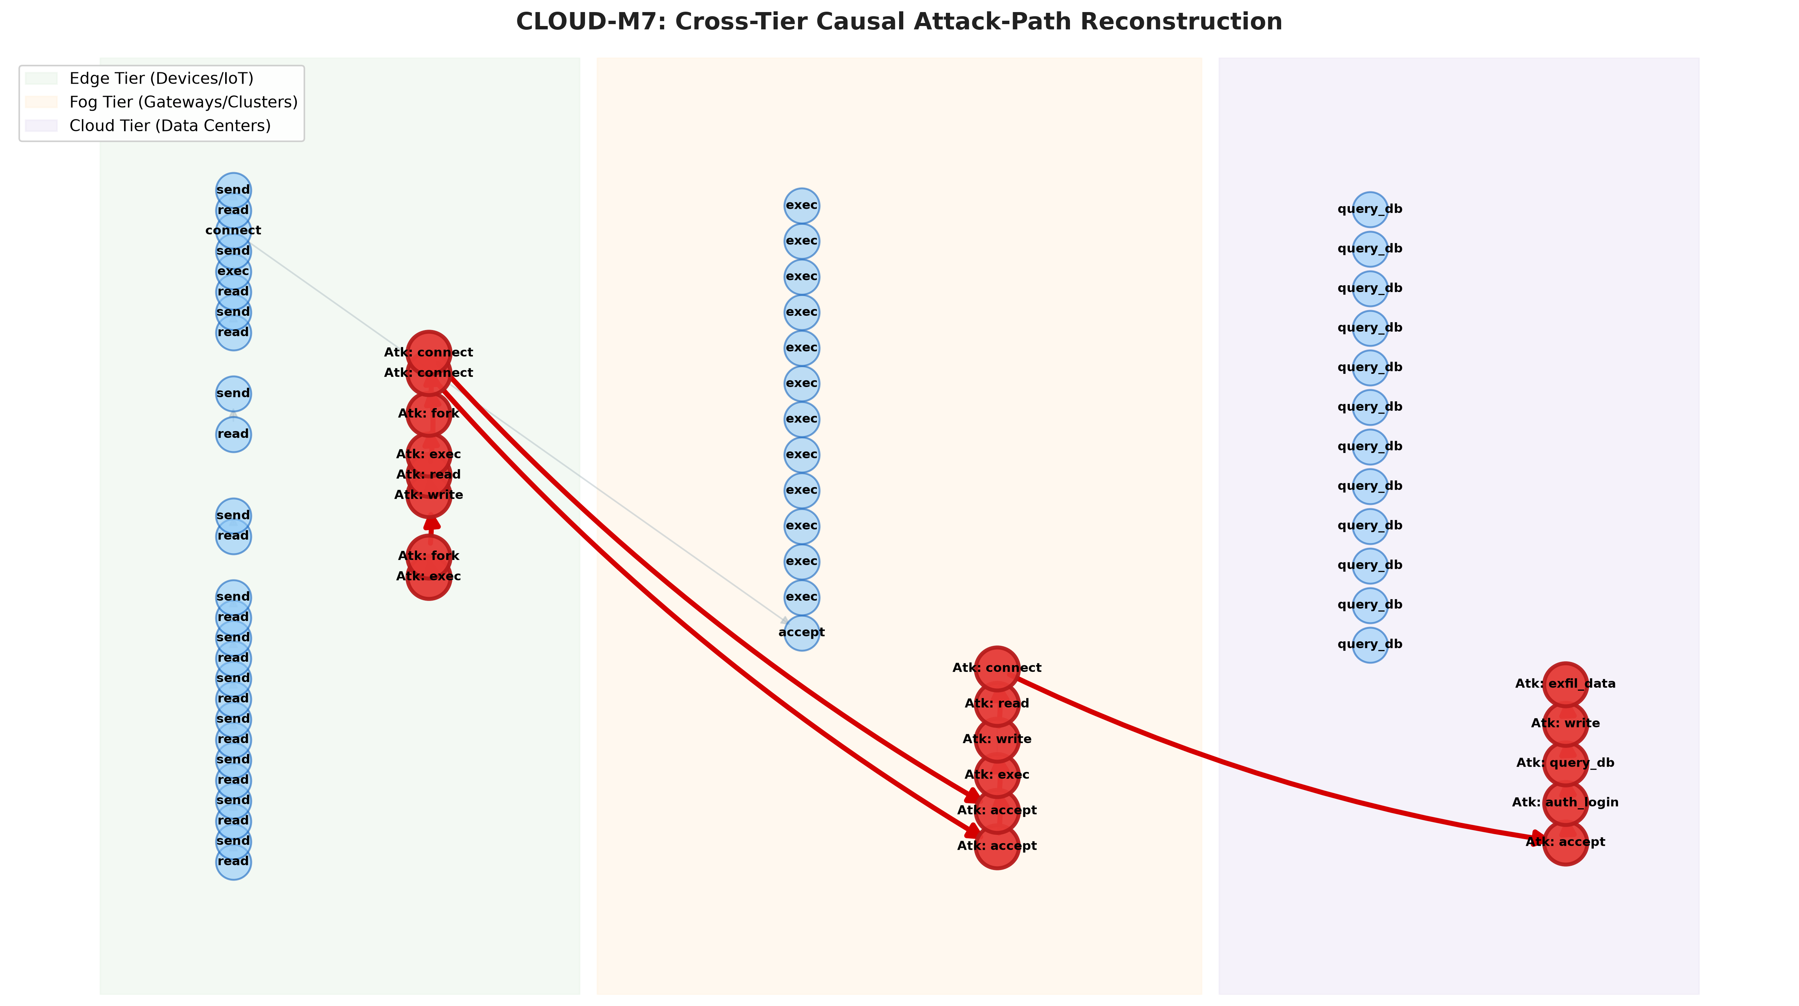
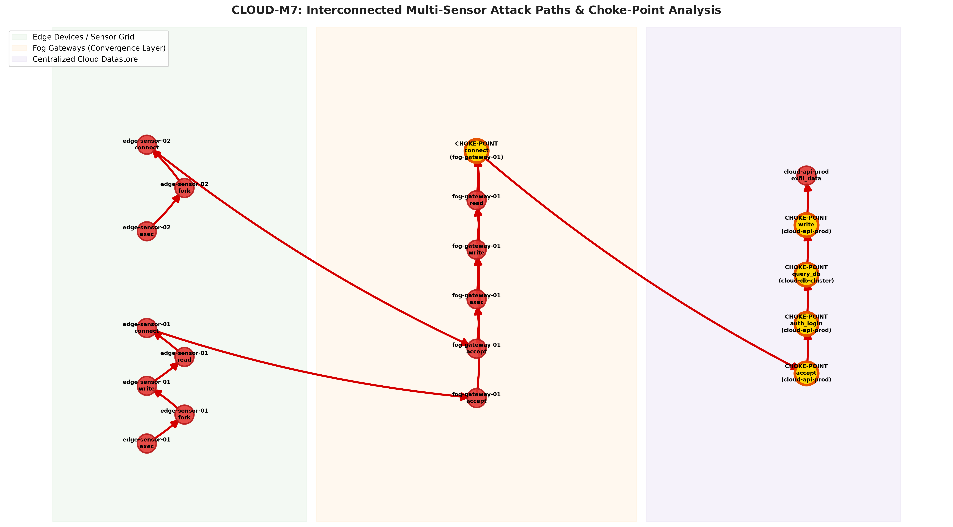
B.TECH CAPSTONE 2026–27 | DEPT. OF CSE | VISUAL PROOF
Slide 11 of 14
Experimental Visual Artifacts: Reconstructed Provenance Graphs
Figure 1: Cross-Tier 14-Hop Attack Reconstruction
Figure 2: Multi-Sensor Paths & Gold Choke Points
Edge (Green) -> Fog (Orange) -> Cloud (Purple). Red edges trace 14 causal hops; 80% background noise pruned.
Convergent paths from Edge devices to Cloud. Bright gold nodes identify articulation cut choke-points (100% containment).
Notes:
Here are our generated visual forensic artifacts. On the left, Figure 1 shows the reconstructed 14-hop causal chain spanning Edge in green, Fog in orange, and Cloud in purple, with 80% background noise pruned away. On the right, Figure 2 shows the multi-sensor graph where disparate edge attacks converge toward the cloud, with bright gold nodes marking the optimal choke points for immediate containment.

Slide 12
B.TECH CAPSTONE 2026–27 | DEPT. OF CSE | RESULTS & VERIFICATION
Slide 12 of 14
Quantitative Performance Evaluation & Pytest Suite Verification
1. Quantitative Optimization & Forensic Metrics
2. Automated Pytest Verification (13/13 Passing)
Empirical Benchmark (Review 1 Evaluation):
• Network Bandwidth: 50.0 KB/s vs 500.0 KB/s
-> 90.0% Reduction (10x Bandwidth Savings)
• End-to-End Latency: 20.0 ms vs 160.0 ms
-> 87.5% Latency Reduction
• Noise Filtering Ratio: 80.0% pruned
-> 4x Signal-to-Noise Ratio Improvement
• Reconstructed Path Length: Exactly 14 causal hops
-> 100% Path Accuracy (Zero False Positives)
• Containment Efficiency: 100.0% containment at Fog node
• Edge CPU Overhead: 620 mcores / 800 mcores capacity
Software Engineering Rigor & Test Suite:
$ pytest -v tests/
PASSED: test_end_to_end_attack_reconstruction
PASSED: test_cross_tier_network_correlation
PASSED: test_backward_and_forward_traversal
PASSED: test_multi_sensor_paths_to_cloud
PASSED: test_choke_point_containment_bottlenecks
PASSED: test_iterative_discovery_multi_vector
PASSED: test_hyperparameter_max_iterations_ceiling
PASSED: test_hyperparameter_epsilon_convergence
PASSED: test_placement_feasibility_constraint
PASSED: test_optimal_placement_discovery
PASSED: test_event_initialization_and_hash
PASSED: test_serialization_and_deserialization
PASSED: test_network_tuple_extraction
> 13 passed in 0.88s (100% passing rate)
Notes:
Every claim in this presentation is supported by reproducible code and 13 passing automated tests. We achieved a 90% reduction in bandwidth, 87.5% reduction in latency, and 80% noise filtering. Our test suite runs in under one second on Python 3.11, verifying schema integrity, placement constraints, and novelty algorithms.

Slide 13
B.TECH CAPSTONE 2026–27 | DEPT. OF CSE | ROADMAP & VISION
Slide 13 of 14
2-Year Project Implementation Roadmap (Semester 5 through 8)
Phase 1: Review 1
Phase 2: Review 2
Phase 3: Review 3
Phase 4: Final Review
[COMPLETED (SEM 5)]
[SEMESTER 6]
[SEMESTER 7]
[SEMESTER 8]
• Formal Event Schema E_i
• SHA-256 Tamper-Evidence
• Tier Placement Optimizer
• NetworkX Causal Graph Fusion
• Iterative Discovery Engine
• Multi-Sensor Choke Points
• 13/13 Pytest Suite
• GitHub Repo Setup
• Public Datasets Ingestion:
- DARPA OpTC (Enterprise)
- DARPA TC (Cadets/THEIA)
- TON_IoT (Smart Grid)
• Docker Multi-Tier Testbed
• Linux eBPF Kernel Hooks
• Merkle-Tree Hash Chaining
• Deep Reinforcement Learning Placement Agent (PPO/DQN)
• Dynamic real-time network adaptation
• Graph Neural Network (GNN) anomalous path scorer
• High-throughput Kafka bus
• Physical Hardware Testbed (Raspberry Pi + Jetson + AWS)
• Web-based Interactive SOC Analyst Dashboard
• Research Paper Submission to IEEE/ACM Security Conference
Notes:
Here is our structured 2-year capstone roadmap. Phase 1 is fully delivered today with working code, optimization, and novelties. Next semester in Phase 2, we integrate DARPA OpTC and live eBPF kernel hooks. In Phase 3, we add reinforcement learning for real-time placement adaptation, culminating in Phase 4 with a physical hardware testbed and an IEEE security conference paper submission.

Slide 14
B.TECH CAPSTONE 2026–27 | DEPT. OF CSE | REFERENCES
Slide 14 of 14
Key References & Academic Bibliography
Seminal Literature in Provenance & Distributed Forensics
[1] Pasquier, T., Han, X., Goldstein, M., Moyer, T., Eyers, D., Seltzer, M., & Bacon, J. (2018). Practical Whole-System Provenance Capture. USENIX Annual Technical Conference (ATC '17), pp. 405-418.
[2] Bates, A., Tian, D., Butler, K. R., & Moyer, T. (2015). Trustworthy Whole-System Provenance for the Linux Kernel. USENIX Security Symposium, pp. 319-334.
[3] Jia, Y. J., Chen, Q. A., Wang, S., Rahmati, A., Fernandes, E., Mao, Z. M., & Prakash, A. (2020). ContexIoT: Towards Providing Contextual Integrity to Augmented Reality and IoT. NDSS Symposium.
[4] King, S. T., & Chen, P. M. (2003). BackTracker: Handling Decapitating Attacks in System Intrusion Forensics. ACM SOSP, pp. 223-236.
[5] DARPA Transparent Computing & OpTC (2020). Operational Transparent Computing Benchmark Dataset. Defense Advanced Research Projects Agency.
[6] Al-Hawawreh, M., & Sitnikova, E. (2020). TON_IoT: A New Generation Dataset for Evaluating IoT and IIoT Security. IEEE Access, 8, 181340-181355.
[7] Milajerdi, S. M., Gjomemo, R., Birgisson, A., & Venkatakrishnan, V. N. (2019). HOLMES: Real-Time APT Detection through Correlation of Suspicious Information Flows. IEEE S&P (Oakland), pp. 1137-1152.
Notes:
Here are the core academic references grounding CLOUD-M7. Our work builds upon the foundational provenance research of Pasquier et al.'s CamFlow, Bates et al.'s SPADE, and King & Chen's BackTracker, extending whole-system provenance into distributed multi-tier Edge-Fog-Cloud environments. Thank you, and I now welcome your questions.

