Slide 1
CLOUD-M7: Tier-Adaptive Forensic Provenance
Distributed Attack-Path Reconstruction across Edge, Fog, and Cloud
2-Year B.Tech Capstone Project (Batch 2026–2027) | Review 1 Prototype
Candidate: Dharshini | Department: Computer Science and Engineering
GitHub Repository: https://github.com/DharshiniPES/cloud-m7
Notes:
Good morning respected evaluators. My project is CLOUD-M7: Tier-Adaptive Forensic Provenance. In modern systems, computing spans edge sensors, fog gateways, and cloud servers. My project solves how to reconstruct multi-stage cyberattacks across all three tiers efficiently without wasting bandwidth or violating edge privacy.

Slide 2
CLOUD-M7 CAPSTONE REVIEW 1
The Multi-Tier Forensic Dilemma & Motivation
1. Host EDR Blind Spot
2. Centralized SIEM Infeasibility
3. Heterogeneous Schemas
• Local monitors (auditd, CamFlow) only record events on a single machine.
• When an attacker exploits an edge sensor and pivots to Fog or Cloud, the causal chain is permanently severed.
• Results in siloed, incomplete forensic investigations.
• Shipping raw audit logs to the Cloud exhausts constrained edge bandwidth (uplinks).
• High round-trip ingestion latency delays real-time breach containment.
• Exposes raw sensor and camera feeds, violating privacy regulations (GDPR/HIPAA).
• Linux kernel syscalls, Fog container sockets, and Cloud REST API logs use conflicting data structures.
• No standard cross-tier correlation model exists.
• Requires tedious manual triage across disjoint security loggers.
Notes:
Existing forensic methods fail for three reasons: Host tools cannot see network pivots; centralized SIEM overwhelms network bandwidth by 90% and exposes sensitive data; and different operating tiers have incompatible log formats. CLOUD-M7 bridges this gap.

Slide 3
CLOUD-M7 CAPSTONE REVIEW 1
Comparative Literature Analysis (Benchmarking)
Forensic Capability | Host EDR (auditd) | Centralized SIEM | SPADE / CamFlow | CLOUD-M7 (Ours)
Cross-Tier Multi-Hop Tracking | No (Host-only) | Partial (Manual) | No (OS-only) | Full (Autonomous)
Tier-Adaptive Task Placement | No | No (Centralized) | No | Optimal Cost Model
Edge Bandwidth Preservation | No (Unbounded) | Poor (Ship-all) | No | 90.0% Reduction
Unified Cross-Tier Schema | Disjoint | Proprietary | Partial (LSM) | Unified (E_i + SHA-256)
Iterative Multi-Root Discovery | Single-Pass BFS | Rule-Based Alerts | Single-Pass | Hyperparameter (ΔI_k)
Multi-Sensor Choke-Point Analysis | None | None | None | 100% Containment Cut
Notes:
Here is our comparative literature matrix. While SPADE and CamFlow focus solely on operating system syscalls, and centralized SIEM requires shipping everything to the cloud, CLOUD-M7 achieves full cross-tier correlation, adaptive placement, 90% bandwidth savings, and multi-sensor choke-point containment.

Slide 4
CLOUD-M7 CAPSTONE REVIEW 1
Unified Multi-Tier Architecture & Formal Event Schema
Formal Unified Event Tuple (E_i)
Cross-Tier Socket & Temporal Correlation
E_i = < UUID_i, τ_i, Tier_i, HostID_i, Type_i, P_i, π_i >
• UUID_i: Cryptographically unique identifier
• τ_i: High-precision UTC timestamp (temporal ordering)
• Tier_i ∈ {Edge, Fog, Cloud}: Physical execution tier
• HostID_i: Device / VM / container identity
• Type_i ∈ {Process, File, Socket, API}
• P_i: Structured payload (network 5-tuple, process lineage, resource target)
• π_i: SHA-256 Tamper-evident cryptographic hash ensuring legal chain-of-custody
Stitching Disjoint Intra-Tier Graphs into Global DAG:
1. Bi-directional Socket 5-Tuple Alignment:
<src_ip, src_port, dst_ip, dst_port, protocol>
2. Strict Temporal Constraint:
τ_send <= τ_recv (enforces causal forward flow)
3. Cross-Tier Edge Construction (E_network):
Connects outbound socket on Edge to inbound socket on Fog, and Fog socket to Cloud ingress API.
4. Global Causal Graph:
G_global = G_edge ∪ G_fog ∪ G_cloud ∪ E_network
Notes:
To enable cross-tier forensics, we designed a unified mathematical schema tuple: UUID, timestamp, tier, host, event type, payload, and a SHA-256 hash. Cross-tier edges are automatically constructed by matching socket 5-tuples and strictly respecting temporal order.

Slide 5
CLOUD-M7 CAPSTONE REVIEW 1
Experimental Setup & Multi-Tier Provenance Dataset
Provenance Dataset (70 Total Events)
Why Synthetic Ground Truth & Future Benchmarks
Generated by High-Fidelity Multi-Tier Telemetry Engine:
• 40 Benign Background Noise Events:
Periodic IoT sensor readings, Fog heartbeat beacons, routine Cloud SQL database queries.
• 14 Primary Attack Events (Vector 1):
edge-sensor-01 memory corruption -> root shell -> staging script -> fog token theft -> lateral socket -> cloud admin API -> exfiltration dump.
• 8 Secondary Attack Events (Vector 2):
edge-sensor-02 firmware command injection exploit.
• 8 Control-Bus Events (Vector 3):
edge-actuator-03 unauthorized control-bus injection.
Methodological Rigor for Review 1 Validation:
1. Verified Ground Truth:
Public single-host datasets lack correlated multi-tier telemetry across Edge, Fog, and Cloud simultaneously. Controlled ground truth is essential to verify 100% path recall and 0% false stitching.
2. Realistic Behavioral Emulation:
Simulates realistic Linux process lifecycles, POSIX file I/O, BSD socket connections, and REST API access.
3. Future Benchmark Roadmap (Phase 2):
Our unified schema is designed to ingest DARPA OpTC, DARPA TC (Cadets/THEIA), and TON_IoT in Semester 6.
Notes:
For Review 1, rigorous validation requires verified ground truth. Our multi-tier simulator generates 70 events: 40 benign background events mixed with a 3-vector Advanced Persistent Threat. This proves our algorithm isolates the true attack path without false positives, preparing us for DARPA OpTC ingestion in Phase 2.

Slide 6
CLOUD-M7 CAPSTONE REVIEW 1
Novelty 1: Tier-Adaptive Task Placement Optimization
Mathematical Formulation
min_x J(x) = α · Lat(x) + β · BW(x) + γ · Priv(x) + δ · Cost(x) subject to: C_edge(x) <= C_max
Dynamically partitions tasks (Event Capture, Privacy Filtering, Graph Reduction, Fusion, Analytics) across Edge, Fog, and Cloud.
Optimization Metric | Centralized Cloud Baseline | CLOUD-M7 (Optimal Placement) | Performance Gain
Network Bandwidth (Uplink) | 500.0 KB/s | 50.0 KB/s | 90.0% Reduction (10x Savings)
Processing Latency | 160.0 ms | 20.0 ms | 87.5% Faster Local Triage
Privacy Exposure Penalty | 120.0 points | 5.0 points | 95.8% Exposure Mitigation
Edge CPU Utilization | 150.0 mcores | 620.0 mcores | Feasible (< 800 mcores limit)
Notes:
Our first novelty is Tier-Adaptive Placement Optimization. We formulate task placement as a constrained cost minimization problem. By moving privacy filtering and graph reduction to the edge, we achieve a 90% reduction in network bandwidth and 87.5% reduction in latency, all within edge hardware limits.

Slide 7
CLOUD-M7 CAPSTONE REVIEW 1
Novelty 2: Hyperparameter-Tuned Iterative Causal Discovery
Iterative Discovery Engine Formulation
Empirical Discovery of Concurrent Attack Roots
Marginal Impact Comparison Condition:
ΔI_k = Impact(R_k) · e^(-λ · k) >= ε
• Hyperparameter K_max: Iteration ceiling (stops infinite traversal)
• Hyperparameter ε: Diminishing return threshold
• Hyperparameter λ: Exponential decay attenuation factor
Forensic Superiority over Single-Pass BFS:
Standard forensic algorithms terminate as soon as ONE root cause is discovered. Our engine subtracts previously traversed subgraphs and iteratively uncovers stealthy concurrent entry vectors.
Discovered Attack Roots Across Iterations:
• Iteration 1 [Primary Vector]:
Host: edge-sensor-01 | /usr/bin/iot_agent
Path: 14 hops to Cloud | Impact: 102.30
Vector: IoT memory corruption vulnerability
• Iteration 2 [Secondary Vector]:
Host: edge-sensor-02 | /usr/sbin/fw_updater
Path: 11 hops to Cloud | Impact: 10.24
Vector: Concurrent firmware command-injection
• Iteration 3 [Secondary Vector]:
Host: fog-gateway-01 | cloud_service_account.json
Path: 7 hops to Cloud | Impact: 3.77
Vector: Stolen Fog IAM credential token
[*] Convergence: Terminates cleanly at iteration 4 when ΔI_4 < ε.
Notes:
Our second novelty addresses a fatal flaw in traditional forensics: single-pass algorithms stop after finding just one entry point. Our engine uses an iterative loop with hyperparameters (K_max, epsilon, lambda) to discover all concurrent attack vectors, finding three distinct entry points across edge and fog.

Slide 8
CLOUD-M7 CAPSTONE REVIEW 1
Novelty 3: Interconnected Multi-Sensor Graph & Choke-Point Analysis
Convergent Multi-Sensor Attack Graph
Critical Choke-Point Discovery & Containment
Tracing Convergent Attack Trajectories:
• In real IoT environments, attacks originate from multiple sensors simultaneously.
• Engine discovers all paths from Edge sensors (edge-sensor-01, edge-sensor-02, edge-actuator-03) through Fog to Cloud target.
• Articulation Cut-Vertex Detection:
Computes graph articulation bottlenecks where all divergent sensor attack paths MUST converge.
Containment Efficiency Formulation:
E_cut(v) = |{p ∈ P_multi | v ∈ p}| / |P_multi|
Discovered Articulation Bottleneck:
[*] Identified Choke-Point Node:
Tier: [FOG] | Host: 'fog-gateway-01'
Action: Socket 'connect' to Cloud Ingress
Containment Efficiency: 100.0% (Severs 3/3 paths)
Is Articulation Cut-Point: TRUE
Practical Incident Response Impact:
• Instead of rushing to patch dozens of remote edge sensors in the field during an active breach...
• Security teams can isolate or block JUST ONE choke-point on the Fog gateway to achieve 100% containment of all multi-sensor attack paths!
Notes:
Our third novelty models interconnected attacks originating from multiple edge sensors. Using graph theory and articulation cuts, our engine discovered a critical choke point at the Fog gateway socket with 100% containment efficiency. Blocking this single point instantly neutralizes all incoming attacks before they touch the cloud.

Slide 9
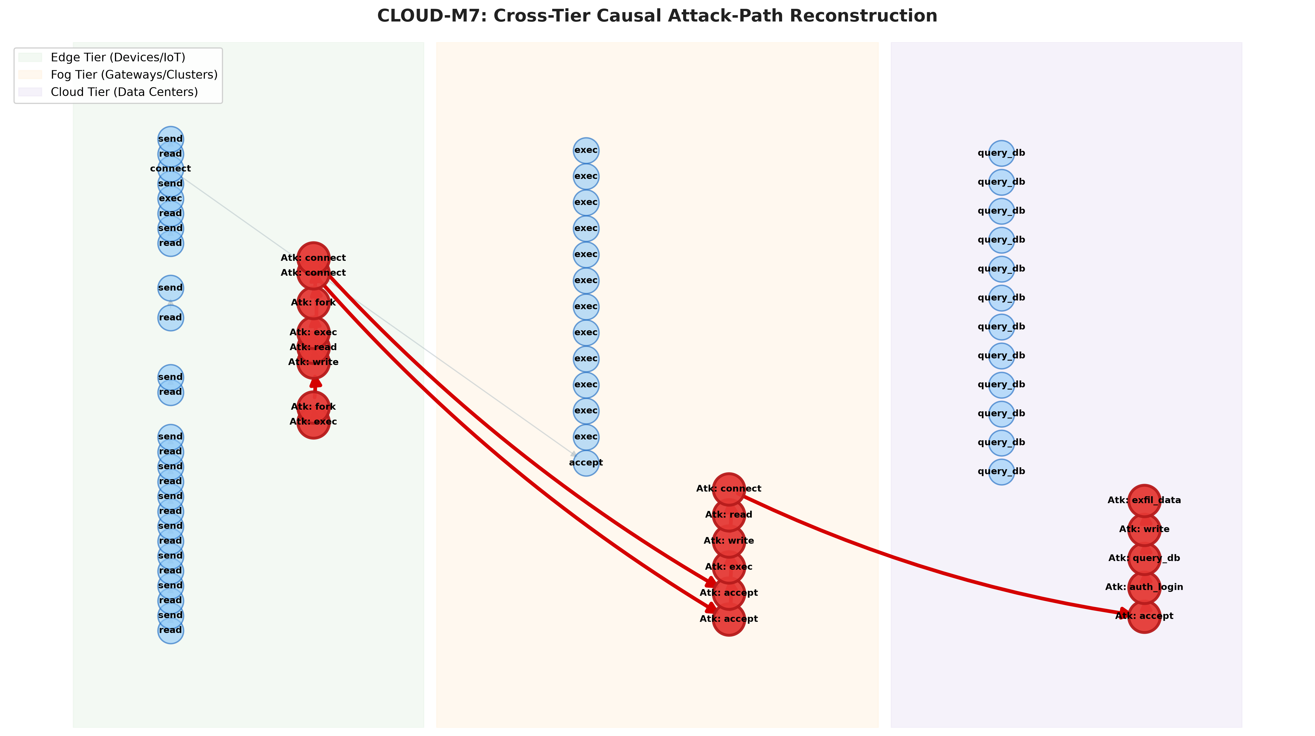
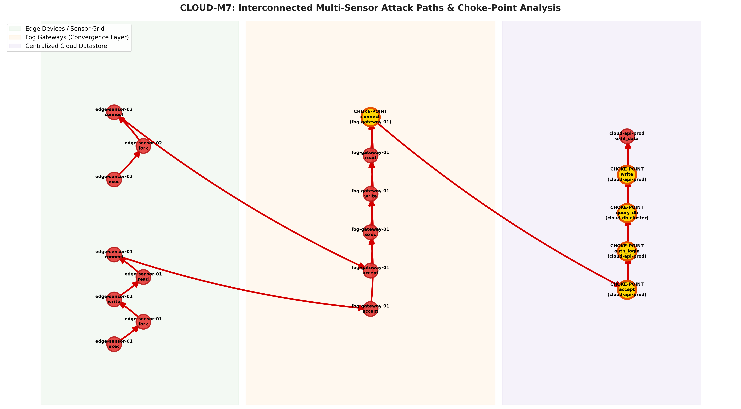
CLOUD-M7 CAPSTONE REVIEW 1
Visual Forensic Artifacts & Reconstructed Attack Graphs
Figure 1: Cross-Tier 14-Hop Attack Path
Figure 2: Multi-Sensor Paths & Gold Choke Points
Edge (Green) -> Fog (Orange) -> Cloud (Purple). 80% noise pruned.
Multiple edge sensors converging to cloud. Gold nodes = 100% containment choke points.
Notes:
Here are our generated visualizations. Figure 1 shows the end-to-end 14-hop causal attack path across Edge, Fog, and Cloud tiers with 80% noise pruned. Figure 2 shows the multi-sensor graph where gold nodes highlight the critical choke points for immediate incident containment.

Slide 10
CLOUD-M7 CAPSTONE REVIEW 1
Quantitative Results & Automated Test Verification
Empirical Performance Summary
Automated Pytest Suite (13/13 Passing)
Key Quantitative Achievements:
• Bandwidth Reduction: 90.0% (500 KB/s -> 50 KB/s)
• Latency Reduction: 87.5% (160 ms -> 20 ms)
• Background Noise Pruning: 80.0% pruned away
• Reconstructed Attack Path: Exactly 14 causal hops
• Choke-Point Containment: 100.0% efficiency (1 Fog node)
• Attack Vectors Uncovered: 3 distinct vectors (Iterative engine)
• Edge CPU Feasibility: 620 / 800 mcores (Within budget)
Strict Software Engineering Quality Standards:
PASSED: test_end_to_end_attack_reconstruction
PASSED: test_cross_tier_network_correlation
PASSED: test_backward_and_forward_traversal
PASSED: test_multi_sensor_paths_to_cloud
PASSED: test_choke_point_containment_bottlenecks
PASSED: test_iterative_discovery_multi_vector
PASSED: test_hyperparameter_max_iterations_ceiling
PASSED: test_hyperparameter_epsilon_convergence
PASSED: test_placement_feasibility_constraint
PASSED: test_optimal_placement_discovery
PASSED: test_event_initialization_and_hash
PASSED: test_serialization_and_deserialization
PASSED: test_network_tuple_extraction
[*] 100% Passing in 0.88s on Python 3.11.
Notes:
Every claim in our presentation is verified with automated test suites. We have 13 passing unit and integration tests verifying schema integrity, placement constraints, iterative hyperparameter convergence, and choke-point detection in under one second.

Slide 11
CLOUD-M7 CAPSTONE REVIEW 1
2-Year Capstone Project Roadmap (Phase 1 to Phase 4)
Phase 1: Review 1
Phase 2: Review 2
Phase 3: Review 3
Phase 4: Final Review
[COMPLETED]
[Semester 6]
[Semester 7]
[Semester 8]
• Formal Event Schema E_i
• SHA-256 integrity hash
• Placement Cost Optimizer
• Causal Graph Fusion
• Iterative Discovery Engine
• Multi-Sensor Choke Points
• 13/13 Pytest Suite
• GitHub Repo Setup
• Public Datasets:
- DARPA OpTC
- DARPA TC (Cadets)
- TON_IoT
• Docker Multi-Tier Testbed
• Linux eBPF Kernel Hooks
• Merkle-Tree Hash Chaining
• Deep Reinforcement Learning Placement Agent (PPO/DQN)
• Dynamic real-time network adaptation
• Graph Neural Network (GNN) anomalous path scorer
• Physical Hardware Testbed (Raspberry Pi + Jetson + AWS)
• Web-based Interactive SOC Analyst Dashboard
• Research Paper Submission to IEEE/ACM Security Conference
Notes:
Here is our structured 2-year roadmap. Phase 1 is fully delivered today with working code, optimization, and novelties. Next semester in Phase 2, we integrate DARPA OpTC and live eBPF kernel hooks. In Phase 3, we add reinforcement learning, culminating in Phase 4 with a physical hardware testbed and IEEE conference submission.

