Slide 1



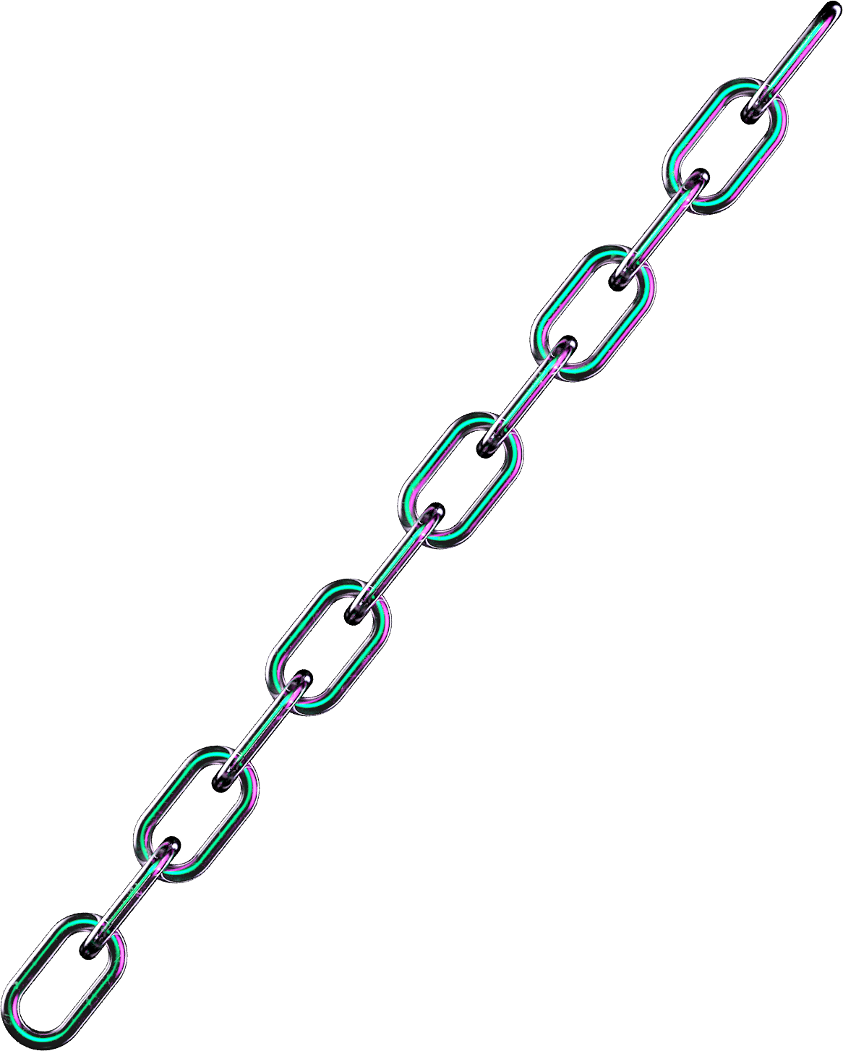

Department of Computer Science and Engineering
(Cyber Security)
Phase I – Project Presentation
2026-2027
QUANTUMSHIELD: QUANTUM-RESISTANT BLOCKCHAIN FRAMEWORK WITH AI-BASED THREAT DETECTION FOR ENTERPRISE IT ORGANIZATIONS
Dr.Tamilselvi P
HOD and Professor
Dharshna U 231901008

Slide 2
Problem Statement and Motivation
Problem Statement and Motivation
Problem Statement
Modern enterprise IT environments generate large volumes of security events from applications, containers and Kubernetes infrastructure. Traditional monitoring often requires manual analysis and separate tools for detection, cryptographic protection, auditing and response.
Existing systems may also rely on conventional cryptography that faces long-term risks from quantum computing.
Motivation
Need for AI-assisted security incident analysis.
Need to secure modern Kubernetes-based environments.
Need for post-quantum cryptographic protection.
Need for tamper-evident security auditing.
Need for controlled response with human approval.
2

Slide 3
Objectives
PRIMARY OBJECTIVE :
To develop an integrated security framework that detects, analyzes, protects and responds to enterprise security incidents while providing post-quantum security and auditable operations.
Key Objectives :
Monitor Kubernetes security conditions.
Detect, correlate and deduplicate security incidents.
Perform AI-based incident classification and analysis.
Generate severity and recommended security actions.
Protect incident integrity using SHA-256.
Provide post-quantum security using ML-DSA and ML-KEM.
Maintain tamper-evident blockchain audit records.
Enforce human approval for sensitive responses.
Verify response outcomes and maintain an audit trail.
3

Slide 4
Abstract
QuantumSHIELD is a security framework designed to protect enterprise IT environments against evolving cyber threats and future quantum-computing risks. The system integrates Kubernetes security monitoring, AI-based incident analysis, post-quantum cryptography, blockchain-based auditing, role-based access control, and controlled incident response into a unified workflow. Security observations are converted into incidents and analyzed using AI to determine their classification, confidence, severity, and recommended actions. SHA-256 provides data integrity, while ML-DSA-65 supports post-quantum digital signatures and ML-KEM-768 provides post-quantum key establishment for protected evidence. Blockchain-based auditing maintains tamper-evident security records, while human approval and policy-based controls ensure safe responses. The system was validated through a local demonstration environment covering incident detection, AI analysis, PQC protection, controlled response, verification, and audit recording.
4

Slide 5
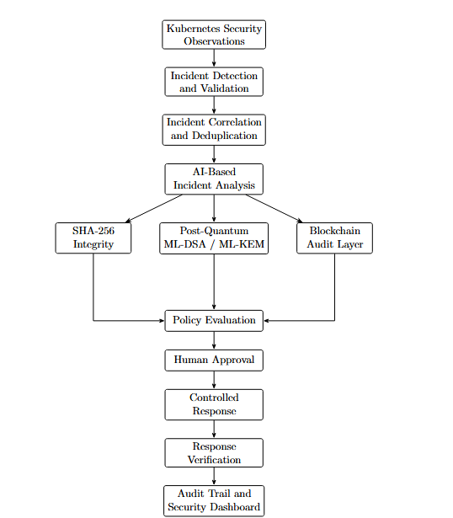
System Architecture
5

Slide 6
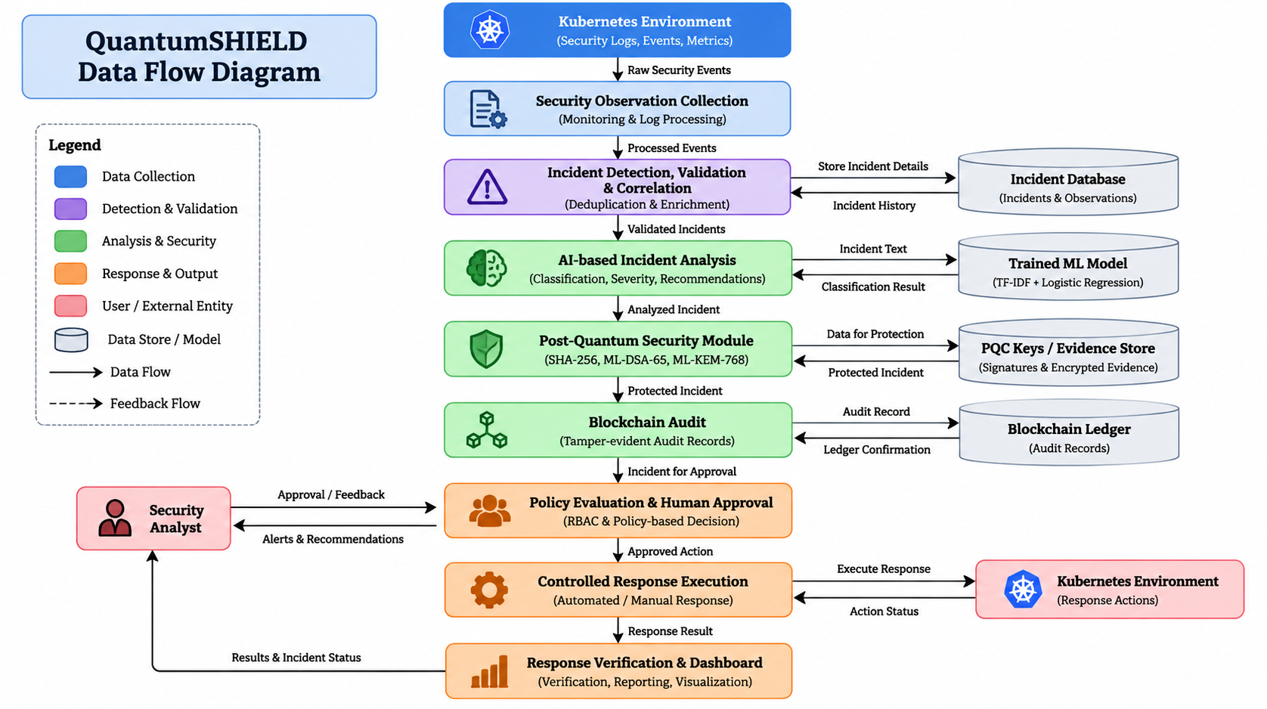
UML/DFD Diagram
6

Slide 7
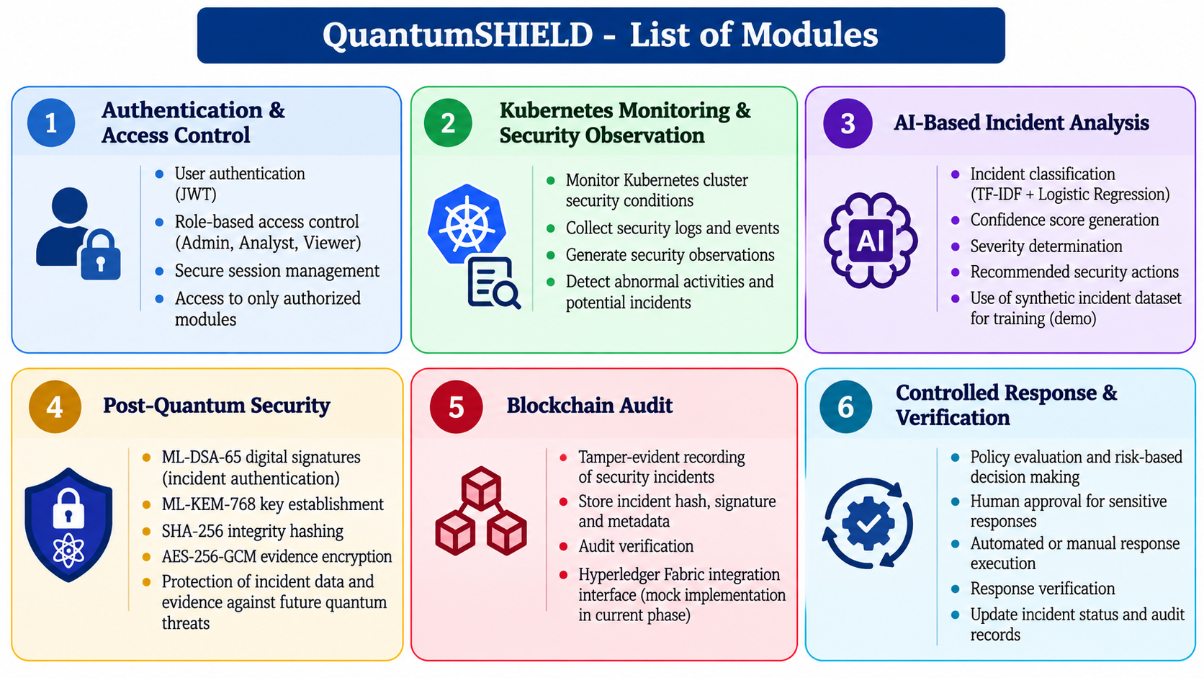
List of Modules
7

Slide 8
Module Description
CURRENT IMPLEMENTATION
Stage | Current Implementation
Data Collection | Collects security incident data from Kubernetes security observations and the synthetic demo_incidents.csv dataset for AI training.
Data Preprocessing | Validates and structures incident text and labels before passing the data to the AI pipeline.
AI Model Training | Uses TF-IDF to convert incident text into numerical features and Logistic Regression to classify incidents.
Model Evaluation | Splits the dataset into 75% training and 25% testing, then evaluates the model using accuracy, precision, recall and F1-score.
AI Model Storage | The trained model is saved as incident_classifier.joblib using Joblib.
Incident Processing | New incident data is sent to the AI service, where the saved model predicts its classification and confidence.
Database Storage | Processed incident details, AI analysis and related security information are stored in the application database.
8

Slide 9
Phase I - Results & Discussion
FUTURE IMPLEMENTATION
Area | Future Enhancement
Real-Time Monitoring | Integrate with live Kubernetes clusters and enterprise security data sources.
AI Enhancement | Use larger real-world cybersecurity datasets and improve model accuracy and confidence calibration.
Post-Quantum Security | Implement production-grade PQC key management and secure key storage.
Blockchain | Deploy the audit layer using a live Hyperledger Fabric network.
Automated Response | Enable secure real-world remediation with additional policy and safety controls.
Scalability | Extend the framework for large-scale enterprise and cloud environments.
9

Slide 10
Conclusion
CONCLUSION
  QuantumSHIELD provides an integrated framework for enterprise security by combining AI-based incident analysis, Kubernetes security monitoring, post-quantum cryptography, blockchain auditing, and controlled response. The current implementation demonstrates the complete workflow from incident processing and AI classification to cryptographic protection, database storage, approval, and audit verification. The system provides a foundation for strengthening enterprise security against current cyber threats and future quantum-related risks.Improve classification performance.
  FUTURE WORKS
Integrate real-time Kubernetes monitoring and enterprise security data sources.
Use larger real-world cybersecurity datasets to improve AI performance.
Implement calibrated AI confidence and advanced threat detection.
Deploy Hyperledger Fabric as a live blockchain network.
Implement production-grade PQC key management and secure key storage.
Extend controlled response for secure real-world remediation.
Improve scalability for large enterprise environments.
10

Slide 11
References
Bagheri, S., Kermabon-Bobinnec, H., Kabir, M. E., Majumdar, S., Wang, L., Jarraya, Y., Nour, B., and Pourzandi, M., “ACE-WARP: A Cost-Effective Approach to Proactive and Non-Disruptive Incident Response in Kubernetes Clusters,” IEEE Transactions on Information Forensics and Security, vol. 19, pp. 8204–8219, 2024.
Chaudhary, D., Durgarao, M. S. P., Mishra, D., and Kumari, S., “A Module Lattice Based Construction of Post Quantum Secure Blockchain Architecture,” Transactions on Emerging Telecommunications Technologies, vol. 35, no. 4, 2024.
Choi, D., Seo, H., Kim, K., You, M., Shin, S., and Kim, J., “Uncovering Threats in Container Systems: A Study on Misconfigured Container Components in the Wild,” IEEE Access, vol. 12, pp. 192931–192945, 2024.
Hamdi, A., Fourati, L., and Ayed, S., “Vulnerabilities and Attacks Assessments in Blockchain 1.0, 2.0 and 3.0: Tools, Analysis and Countermeasures,” International Journal of Information Security, vol. 23, pp. 713–757, 2024.
Ji, I. H., Lee, J. H., Kang, M. J., Park, W. J., Jeon, S. H., and Seo, J. T., “Artificial Intelligence-Based Anomaly Detection Technology over Encrypted Traffic: A Systematic Literature Review,” Sensors, vol. 24, no. 3, p. 898, 2024.
Luo, X., Chen, X., Chen, X., and Cheng, Q., “A Survey on the Application of Blockchain in Cryptographic Protocols,” Cybersecurity, vol. 7, no. 1, 2024.
Ruffo, V. G. da Silva, Lent, D. M. B., Komarchesqui, M., Schiavon, V. F., Assis, M. V. O. de, Carvalho, L. F., and Proença Jr., M. L., “Anomaly and Intrusion Detection Using Deep Learning for Software-Defined Networks: A Survey,” Expert Systems with Applications, vol. 256, 2024.
Salem, A. H., Azzam, S. M., Emam, O. E., and Abohany, A. A., “Advancing Cybersecurity: A Comprehensive Review of AI-Driven Detection Techniques,” Journal of Big Data, vol. 11, no. 105, 2024.
11

Slide 12
Paper Status
Activity | Status
Literature Survey | Completed
Problem Statement & Objectives | Completed
System Design & Architecture | Completed
Data Collection & Preprocessing | Completed
AI Model Training | Completed
Testing & Validation | To be Done
Paper Writing & Submission | In Progress

Slide 13
Thank You
13

