Slide 1
Employee Data Analysis using Excel
STUDENT NAME: P. DHARSSHNI
REGISTER NO: 122202277
DEPARTMENT: BACHELOR OF CORPORATE SECRETARYSHIP
COLLEGE: Valliammal College for Women

Slide 2
PROJECT TITLE
Employee Performance Analysis using Excel

Slide 3


AGENDA
Problem Statement
Project Overview
End Users
Our Solution and Proposition
Dataset Description
Modelling Approach
Results and Discussion
Conclusion
3/21/2024 Annual Review

Slide 4

PROBLEM STATEMENT - Develop a standardized performance evaluation framework - Identify key performance indicators (KPIs) and metrics - Analyze relationships between performance, engagement, and retention. -

Slide 5

PROJECT OVERVIEW - Develop a data-driven approach to analyze and improve employee performance - Enhance talent management decisions through actionable insights - Increase employee engagement, retention, and overall business performance
.

Slide 6

WHO ARE THE END USERS? HR business partners, Line Managers, Employees, Senior Leadership, Talent Management Team, Analytics Team, IT Department, Training and Development Team.

Slide 7

OUR SOLUTION AND ITS VALUE PROPOSITION Develop a consistent evaluation process to ensure fairness and accuracy. Create a centralised platform for data integration, analysis, and visualization.

Slide 8
Dataset Description This dataset contains employee performance data, including demographic information, performance ratings, and talent management metrics.

Slide 9

THE "WOW" IN OUR SOLUTION Assess progress towards goals, objectives, and key performance indicators Determine areas of excellence and areas for improvement. Provide data-driven insights for strategic decisions.
3/21/2024 Annual Review
9

Slide 10
MODELLING
Examine relationships between performance metrics and demographic variables.Identify significant predictors of employee performance.Test hypotheses about differences in performance across groups.
10

Slide 11
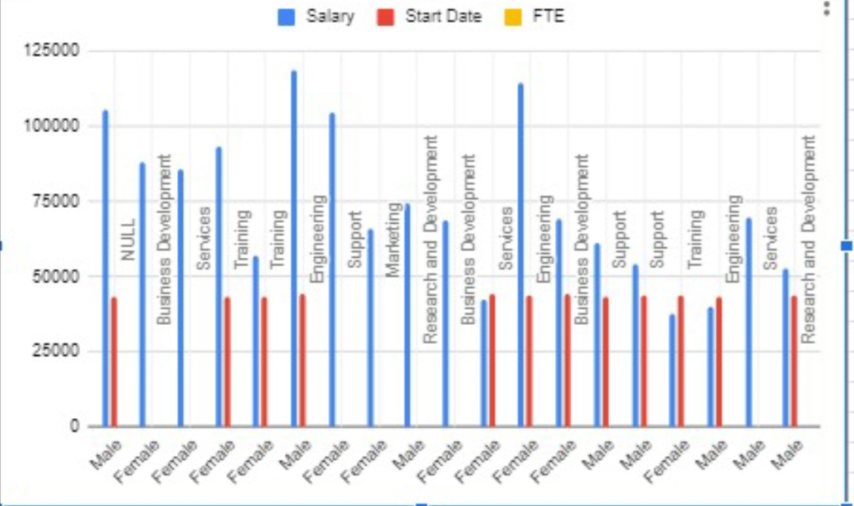
RESULTS
‹#›

Slide 12
Conclusion The employee performance analysis project aimed to develop a data-driven approach to understanding and improving employee performance.

