Slide 1
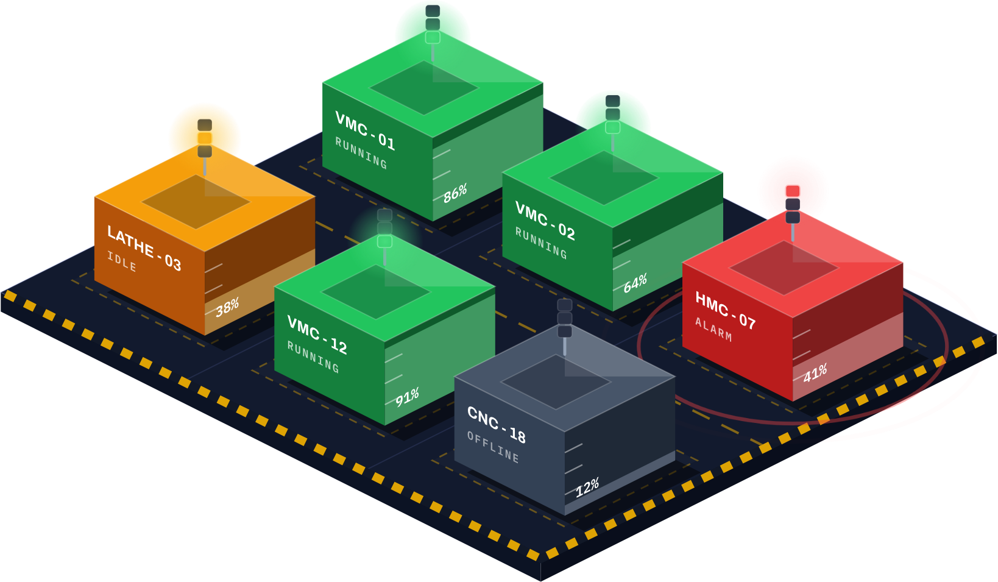

See every machine.
Act on every minute.
EXECUTIVE BRIEFING · OCTOBER 2026
Dharstec Smart Factory shows every CNC machine on your floor live, on screen and on your phone, and answers your questions with AI.
NEW: DHARSTEC AI ASSISTANT
Dharstec Solutions Pvt Ltd · Chennai, India · dharstec.com
Notes:
Thank you for your time. In the next fifteen minutes I will show what Dharstec Smart Factory does for your plant, what you can expect from it and when, and what it costs. The picture is the live view of a shop floor; every screen in this deck shows sample data. New this year: Dharstec AI, an assistant you can simply ask about your plant.

Slide 2



Hidden idle time costs you every shift
THE CHALLENGE
Idle time nobody sees
A SIMPLE EXAMPLE
3,000
Machines wait for material, a program or an operator, and nobody is told.
Alarms answered late
machine hours lost in a year
A stopped machine can wait an hour before the right person hears.
10 machines × 1 idle hour a day × 300 working days
Reports that come too late
Most plants only find out at the end of the shift, or the month.
Registers and spreadsheets arrive after the shift, and rarely agree.
Notes:
Start with a simple sum. If ten machines each stand idle for just one hour a day, that is three thousand machine hours a year, and most plants only find out when the shift report or the month-end figures arrive. Three gaps cause it: idle time nobody sees, alarms that are answered late, and reports that arrive after the fact and rarely agree.

Slide 3
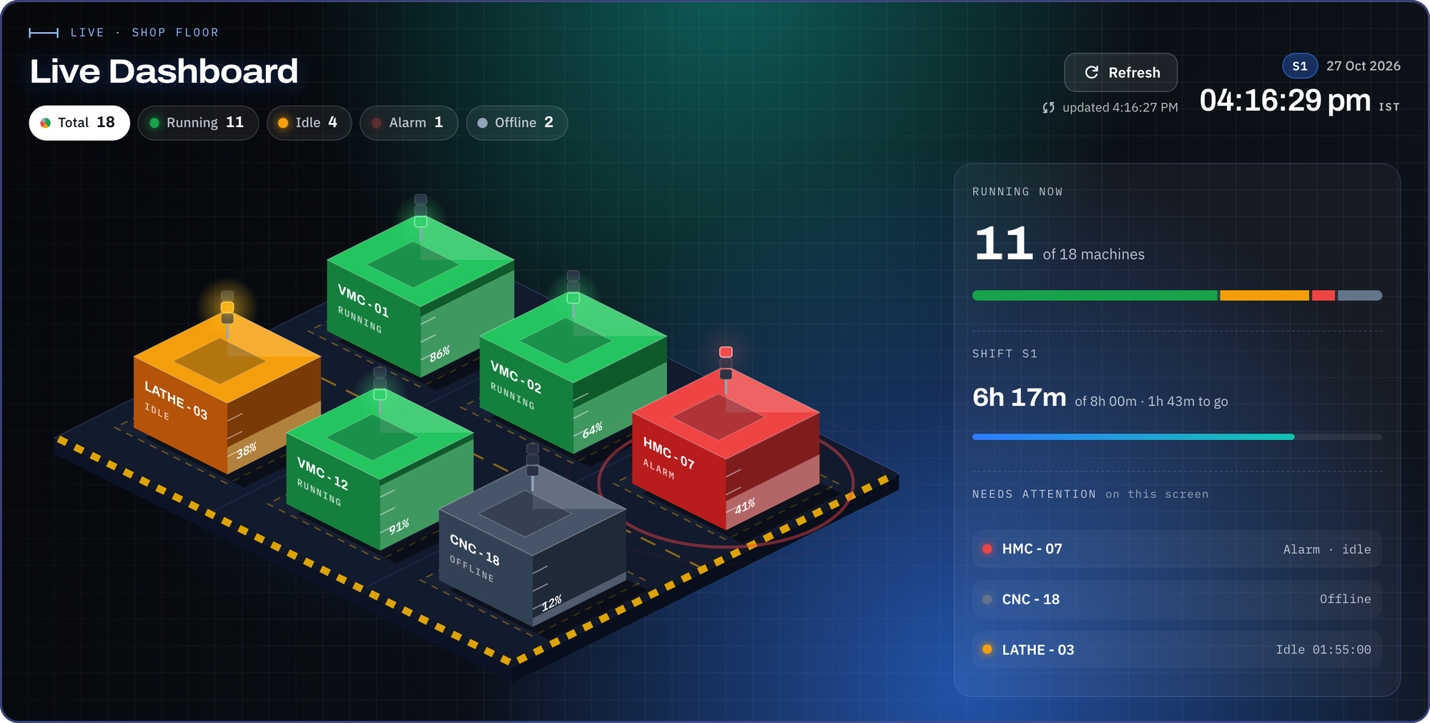
One live picture of your whole plant
LIVE DASHBOARD
1
Status in colour
Green running, amber idle, red alarm, grey offline, in one look.
1
2
2
Shift at a glance
How many machines are running, and how much of the shift is left.
3
What needs you
3
Machines in alarm or idle too long rise to the top of the list.
Notes:
This is the Live Dashboard. Every machine is a block on the floor plan, in the colour of its state: green running, amber idle, red alarm, grey offline. The panel on the right shows how many machines are running, how much of the shift is left, and which machines need attention first.

Slide 4
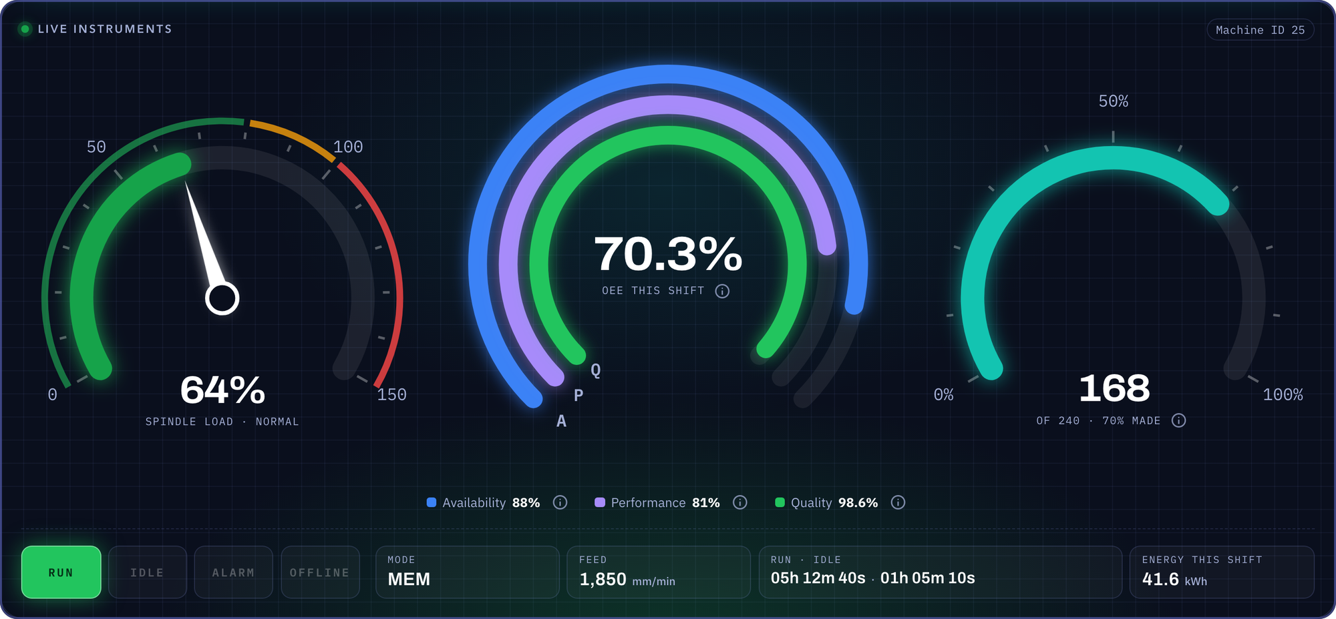




Every machine, read like a cockpit
MACHINE COCKPIT
Spindle load
Cutting well, or straining?
OEE
How well the shift is going, in one number.
Parts made
Output against the shift target.
Status lamps
Run, idle, alarm or offline, as on the machine.
Also on every machine: the shift timeline, hourly output, quality, operator and part.
Notes:
Open any machine and you get its cockpit. Spindle load shows whether it is cutting well or straining. OEE combines availability, performance and quality into one number for the shift. Parts made shows output against the target, and the lamps show the machine's state just as the stack light does on the floor.

Slide 5
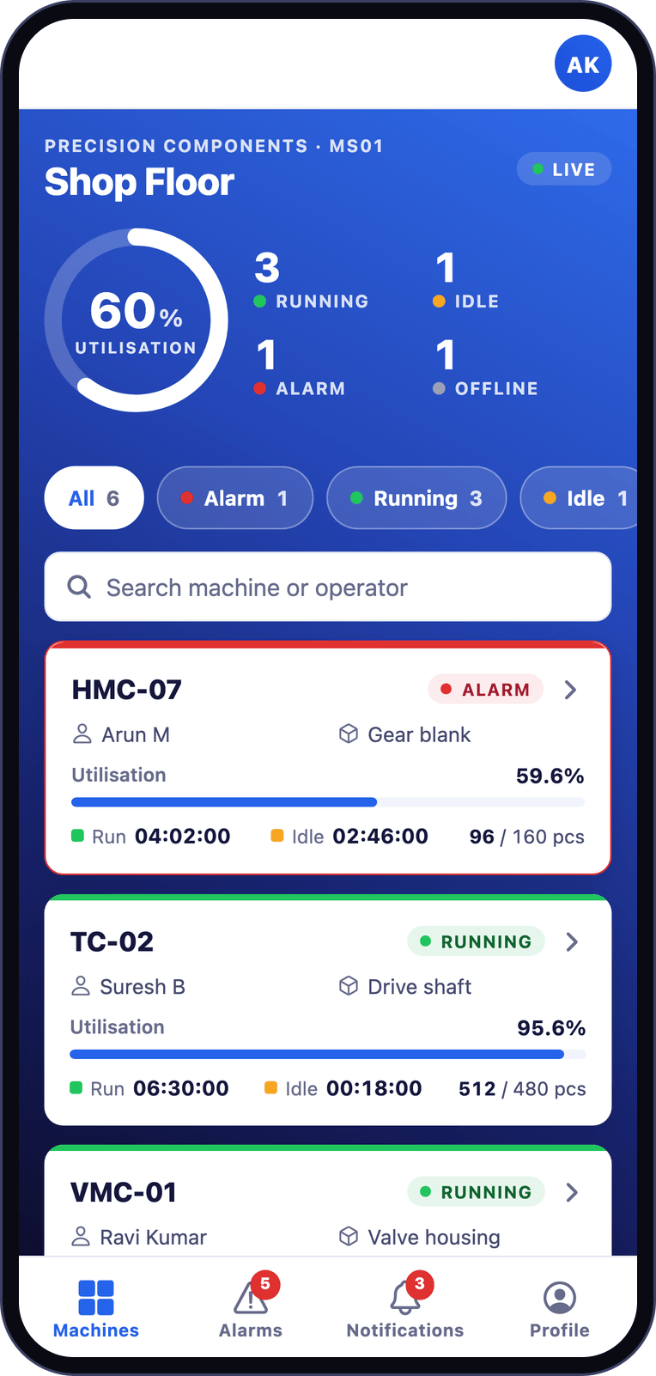
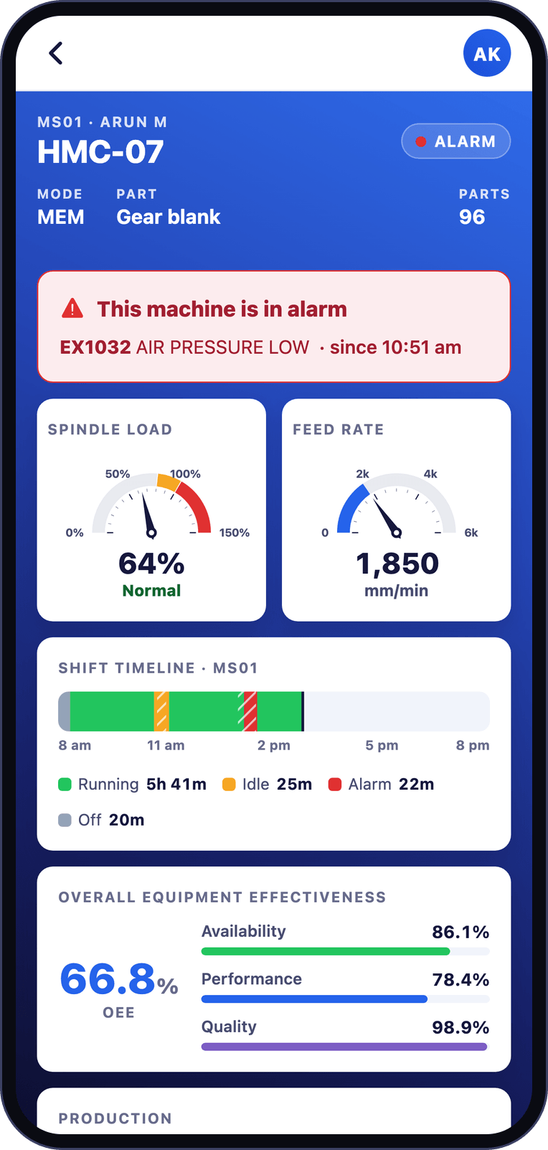
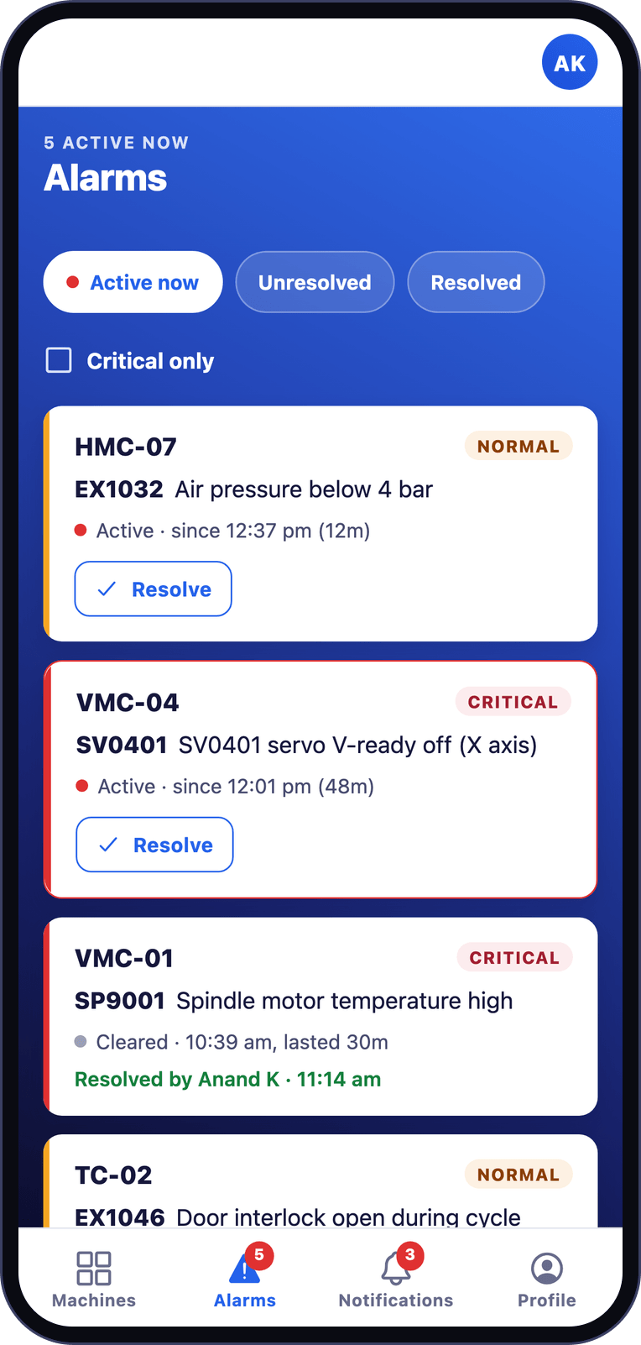


Your plant in your pocket
MOBILE APP
INCLUDED IN STANDARD AND PREMIUM
Every machine, live
Status and output, wherever you are.
Alarms as they happen
Critical alerts reach the right person at once.
Detail on demand
Spindle load, OEE and the shift timeline of each machine.
Notes:
The same picture travels with you. The mobile app shows every machine live, brings alarms and alerts the moment they happen, and opens the detail of any machine. It comes with the Standard and Premium plans.

Slide 6
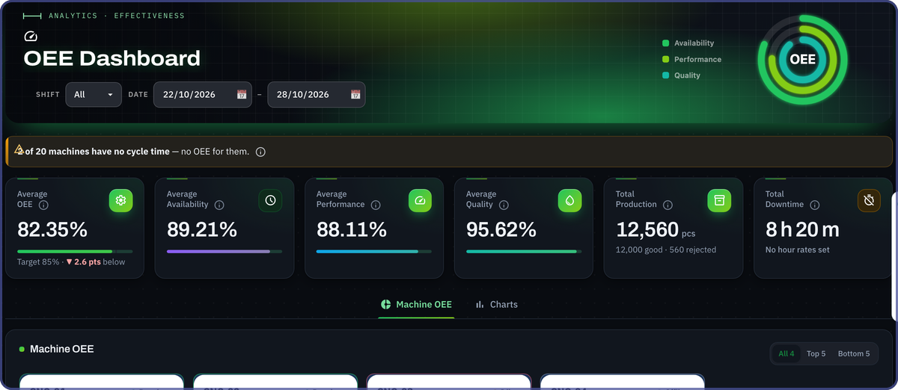
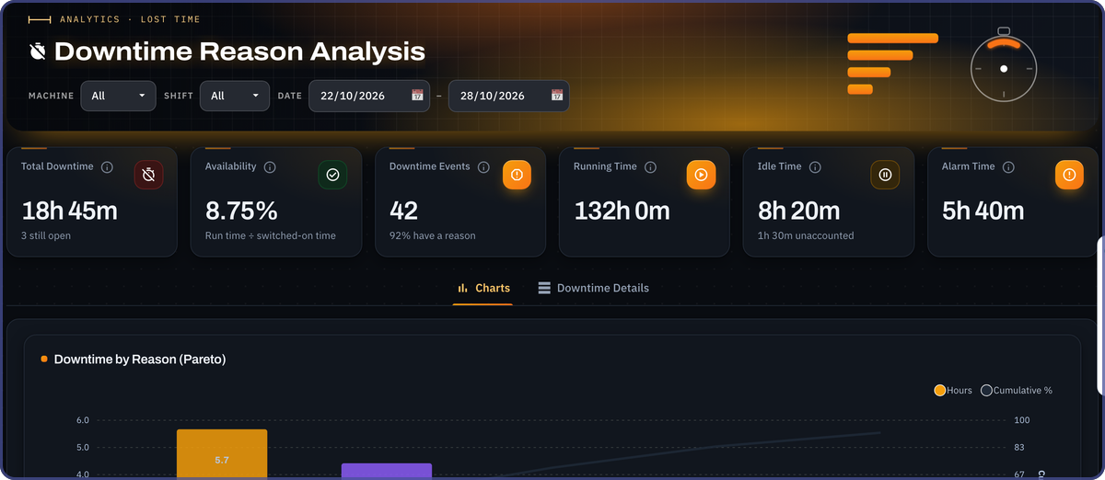
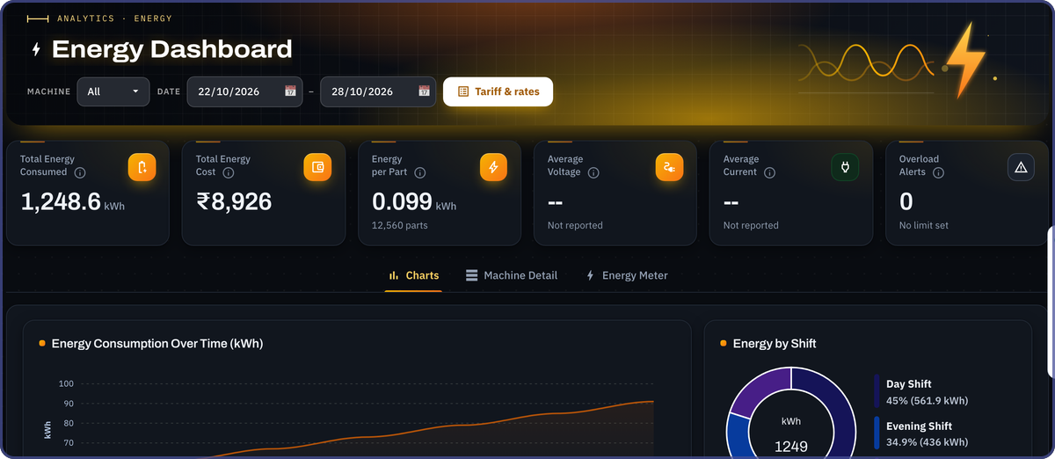
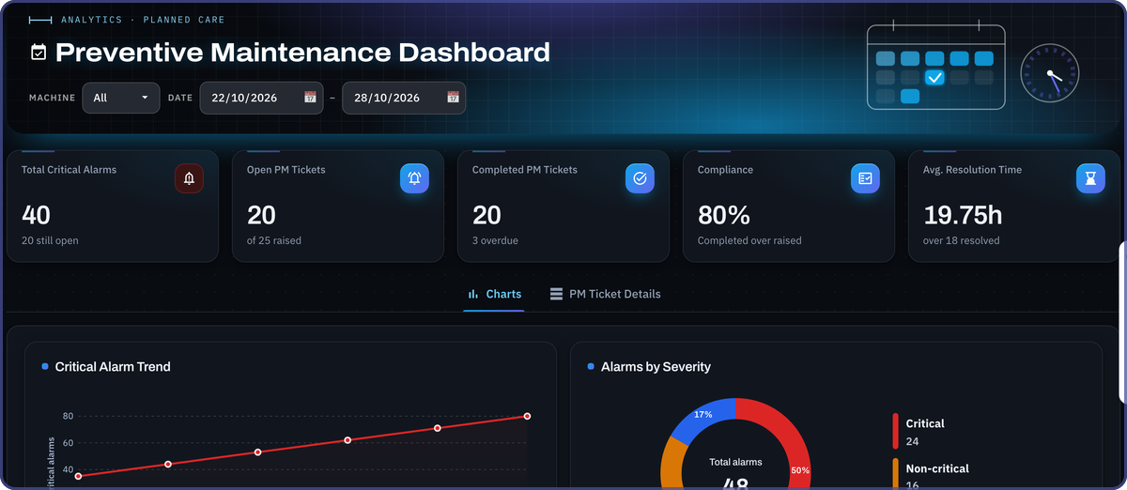
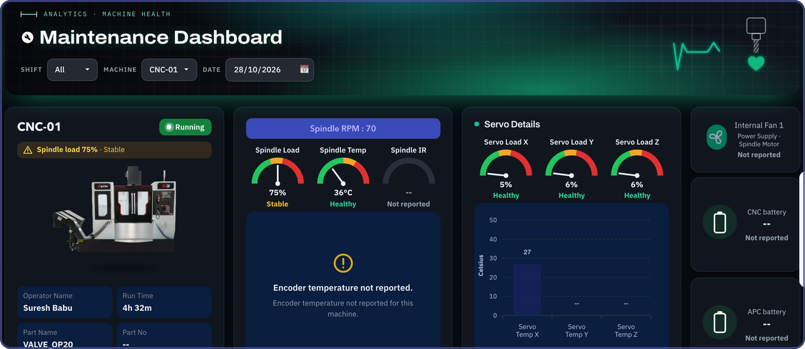
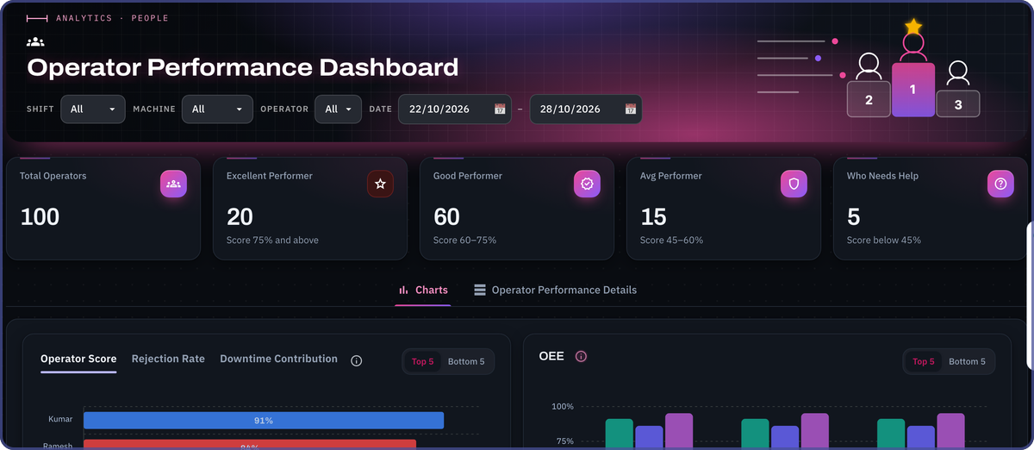
A dashboard for every question
ANALYTICS
OEE dashboard
Downtime analysis
Energy dashboard
Availability, performance and quality
Why machines stop, and what it costs
Power, cost and supply of each machine
Preventive maintenance
Machine health
Operator performance
Service planned before a breakdown
Spindle, servo, fans and batteries
Output and ranking of each operator
Notes:
Beyond the live view, every part of the plant has its own dashboard: OEE, downtime and what it costs, energy, preventive maintenance, machine health and operator performance. Each has date, shift and machine filters, and the figures download to Excel. These come with the Standard and Premium plans.

Slide 7
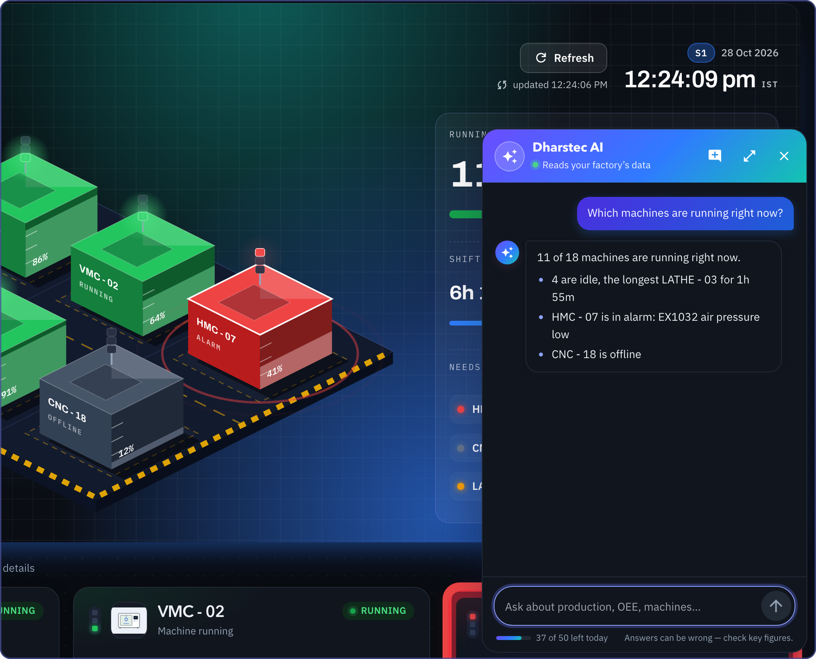
Ask your factory
anything
NEW · DHARSTEC AI
Dharstec AI reads your plant’s own data and answers in plain words, with the report to prove it.
ADD-ON FOR STANDARD AND PREMIUM
Notes:
This is what is new, and where the industry is heading. Dharstec AI is an assistant built into the platform: anyone can ask it about the plant in plain words and get an answer in seconds, here open on top of the Live Dashboard. It works from your own plant data, not from the internet. It is an add-on for the Standard and Premium plans.

Slide 8
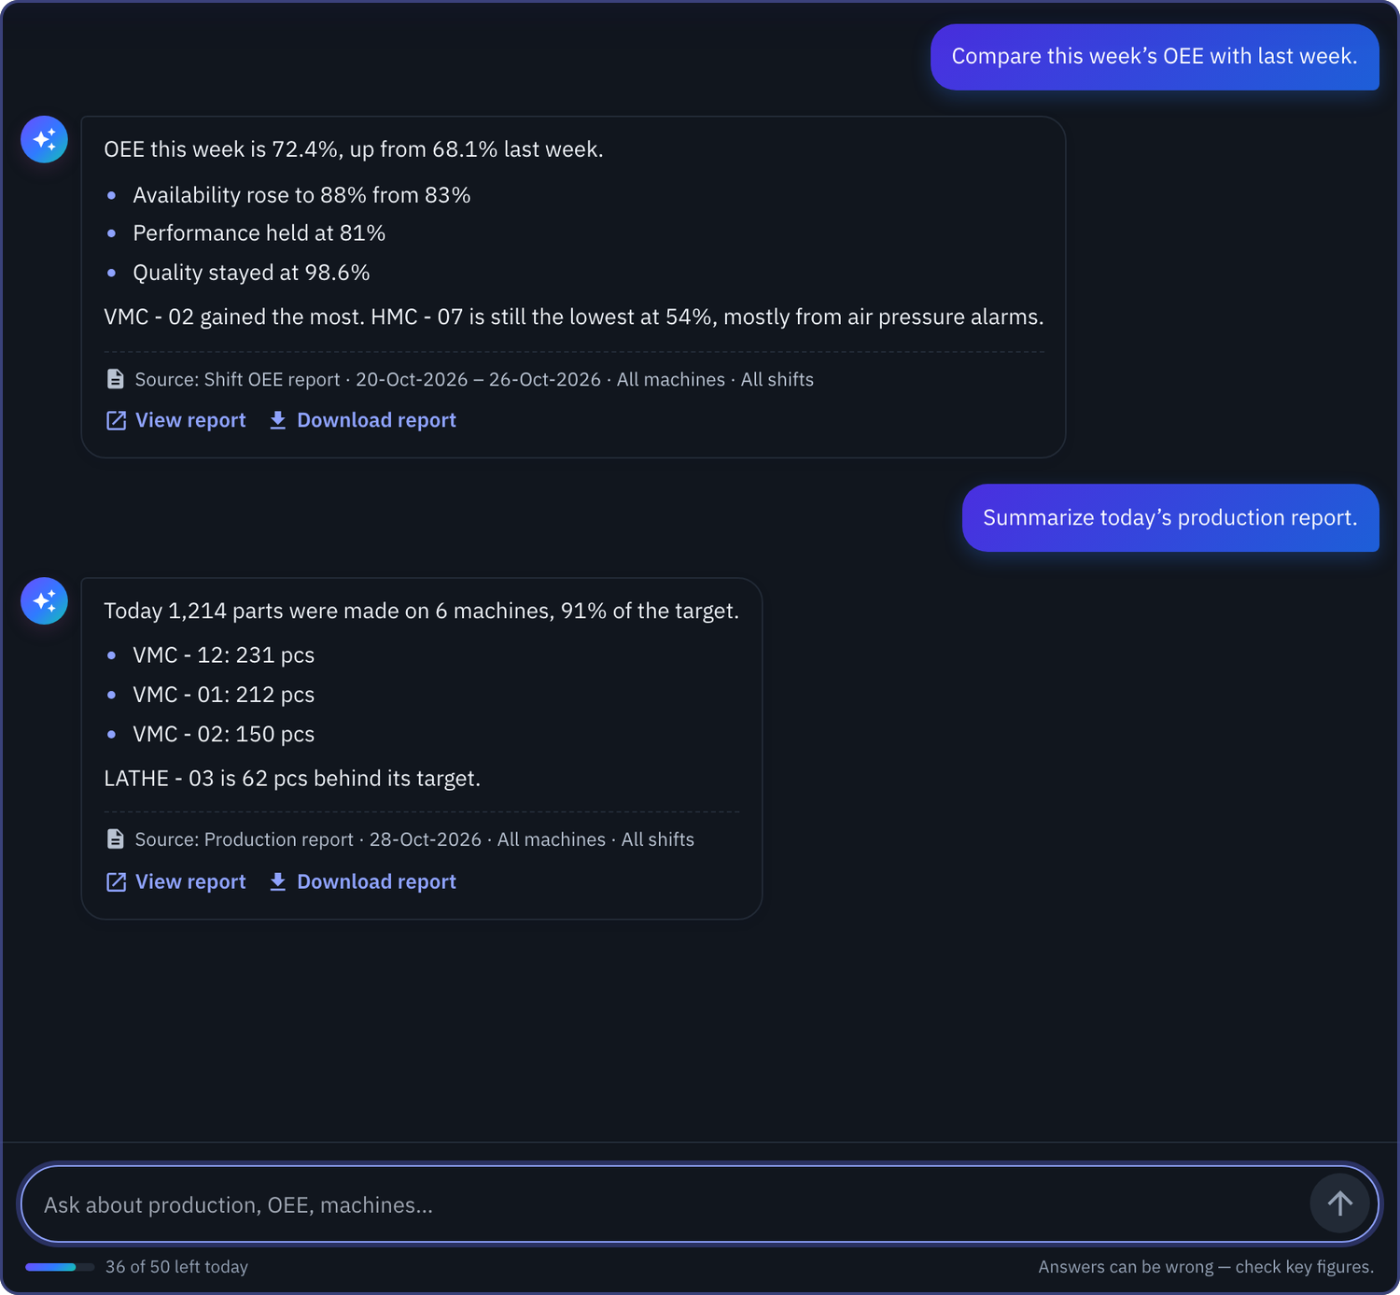






Answers from your own data
DHARSTEC AI
Ask in plain words
Production, OEE, alarms, downtime, maintenance or energy.
Every answer shows its source
Report, dates and filters, so figures can be checked.
One click to the full report
View it, or download it in Excel.
Knows what you are looking at
On a report page it uses that page’s filters.
Follows your roles
People get answers only about what they may see.
Private by design
Cleared at sign-out; the server stores none of it.
Notes:
Every answer comes from your own data and names its source: the report, the dates and the filters it used, with one click to view the report or download it in Excel. On a report page it uses that page's filters. It follows each person's role, so people only get answers about what they are allowed to see. The conversation is cleared when someone signs out, and the server stores none of it. Daily use is capped per company, so the cost stays predictable.

Slide 9
Your team asks, Dharstec AI answers
DHARSTEC AI
AI
Which machines are running right now?
Compare this week’s OEE with last week.
Which machine lost the most time yesterday?
How many parts did Shift 2 make?
Why is HMC - 07 below target?
Summarize today’s production report.
Show the top alarms of the month.
What did energy cost us this month?
Which maintenance is due this week?
How do I download a report?
Add-on for Standard and Premium · On web and mobile
Notes:
Anyone on the team can ask questions like these, from the shop floor to the boardroom, and get the answer in seconds instead of waiting for a report. It also answers how-to questions about the software itself, so new people find their way quickly.

Slide 10




Answers in seconds, not at month-end
WHAT YOU CAN ANSWER
LIVE DASHBOARD
OEE
DOWNTIME COST
Are my machines running?
How did today’s shift go?
What did downtime cost us?
Live status, parts and run time, machine by machine.
Availability, performance and quality against target.
Why machines stopped, and what the idle hours cost.
ALARMS
MACHINE HEALTH
ENERGY
What needs attention now?
Is a breakdown coming?
What is our power cost?
Live alarms and critical alerts, on web and phone.
Health readings, vibration and maintenance by usage.
Power use and the electricity bill, machine by machine.
Basic covers live monitoring and records. OEE, downtime cost, alarms, machine health and energy come with Standard and Premium; vibration with Premium.
Notes:
These are the questions a plant head asks every day. Each now has an answer on screen in seconds instead of at month-end. Basic covers live monitoring and production records; the rest comes with Standard and Premium, and vibration with Premium. Energy needs an energy meter, and vibration a vibration sensor.

Slide 11



What to expect, and when
THE JOURNEY
FROM DAY ONE
AFTER THE FIRST MONTH
AS YOU GROW
See it live
Know your numbers
Decide on facts
Every machine live, on any screen
Alarms reach the right people
Shift output counted for you
Your true OEE, machine by machine
The top reasons for downtime
What idle hours really cost
Maintenance planned by usage
Energy cost of every machine
Add more machines and plants
Notes:
What to expect, and when. From day one, every connected machine is live and alarms reach the right people. After the first month you have real numbers: your true OEE, the top reasons for downtime and what idle hours cost. As you grow, maintenance is planned by machine usage, energy cost is visible for every machine, and more machines and plants join the same system.

Slide 12





Everything in one platform
THE COMPLETE PLATFORM
SEE
ANALYSE
MAINTAIN
RUN
MANAGE
Live Dashboard
OEE dashboard
Machine health
Program transfer
Roles and permissions
Machine cockpit
Downtime and its cost
Preventive maintenance
Jobs and components
Every figure explained
Factory overview
Operator ranking
Periodic service
Shifts and lines
Any screen, light or dark
Mobile app
Reports in Excel or CSV
Repair tickets and report
Multi-plant
Your server or our cloud
Alarms and alerts
Quality and rework
Vibration monitoring
Energy and tariff
Dharstec AI assistant
All plans
Standard and Premium
Premium
Add-on
Notes:
This is the whole platform on one page, grouped by what it helps you do: see, analyse, maintain, run and manage. The dots show the plan: Basic covers live monitoring and records, Standard adds every dashboard and the mobile app, Premium adds vibration monitoring, and Dharstec AI is an add-on.

Slide 13





Runs on your server or our cloud
WHERE IT RUNS
YOUR OWN SERVER
HOSTED FOR YOU
On-premise
Dharstec cloud
No yearly fee
BASIC
STANDARD
PREMIUM
₹8,000
₹10,000
₹12,000
The software is paid once per machine
Per machine, per year
All data stays inside your network
Access from anywhere, at any time
Keeps working without the internet
Secure storage with regular backups
You provide the server at your site
A gateway at your factory sends the data
Both connect to your machines over a standard Ethernet network. The gateway is quoted with your order.
Notes:
It runs wherever you prefer. On your own server there is no yearly fee: your data stays inside your network and it keeps working without the internet. On the Dharstec cloud you can see it from anywhere, with storage and backups handled for you, for a yearly fee per machine. A gateway at your factory sends the data to the cloud, and is quoted with the order.

Slide 14


Simple plans, paid once per machine
INVESTMENT
Basic
Standard
RECOMMENDED
Premium
₹10,000
₹20,000
₹25,000
per machine, one-time
per machine, one-time
per machine, one-time
Live monitoring and records
All dashboards, plus mobile app
Standard, plus vibration monitoring
Live Dashboard
Everything in Basic
Everything in Standard
Machine details
Mobile app
Vibration monitoring
Reports in Excel or CSV
OEE, alarms, maintenance
Early warning of wear
Quality, shifts, team access
AI assistant add-on
AI assistant add-on
Cloud: ₹8,000 per machine a year
Cloud: ₹10,000 per machine a year
Cloud: ₹12,000 per machine a year
Energy meters, vibration sensors, the gateway and the AI assistant are quoted with your order. Customised plans are available.
Notes:
Pricing is simple: the software is paid once per machine. Basic is ten thousand rupees; Standard is twenty thousand, and it is the one we recommend for most plants because it has every dashboard and the mobile app; Premium is twenty-five thousand and adds vibration monitoring. On our cloud there is a yearly fee per machine; on your own server there is none. Sensors, the gateway and the AI assistant are quoted with the order, and we can tailor a plan.

Slide 15


From first meeting to a live shop floor
HOW WE DELIVER
1
2
3
4
Discover
Connect
Configure
Go live and grow
We learn your machines, shifts and goals, and agree what success means.
Your machines join the network and data starts to flow.
Dashboards, targets, shifts and alerts set up your way.
Your team is trained, and we stay with you as you grow.
What we need from your side
Power points near the machines and the server or gateway
An Ethernet connection to each machine
Machine access and a site contact during installation
Notes:
Delivery follows four steps: we learn your plant, connect the machines, set up dashboards, targets and alerts around how you work, and go live with training for your team. From your side we need power points, an Ethernet connection to each machine, and access to the machines with a contact person at the site during installation.

Slide 16



Let’s see your
shop floor live
NEXT STEP
1
Your plan
Basic, Standard, Premium or a customised plan
2
Your machines
How many machines to connect first
Tell us three things,
and we will send your final quotation.
3
Where it runs
Your own server or the Dharstec cloud
info@dharstec.com
dharstec.com
Chennai, India
Notes:
To move ahead we need three things: your plan, how many machines to connect first, and whether it runs on your own server or our cloud. We will then send the final quotation. Thank you.

