Slide 1

Git & Git hub

Slide 2
Version Control System
A version control system is software.
Version Control is the management of changes to documents, computer programs, large websites, and other collections of information.
A version control system tracks changes to a file or set of files over time so that you can recall specific versions later.
It also allows you to work together with other programmers.
The version control system is a collection of software tools that help a team to manage changes in a source code. It uses a special kind of database to keep track of every modification to the code.
Developers can compare earlier versions of the code with an older version to fix the mistakes.

Slide 3
Benefits of the Version Control System
Complete change history of the file
Simultaneously working
Branching and merging
Traceability
Types of Version Control System
Localized version Control System
Centralized version control systems
Distributed version control systems

Slide 4
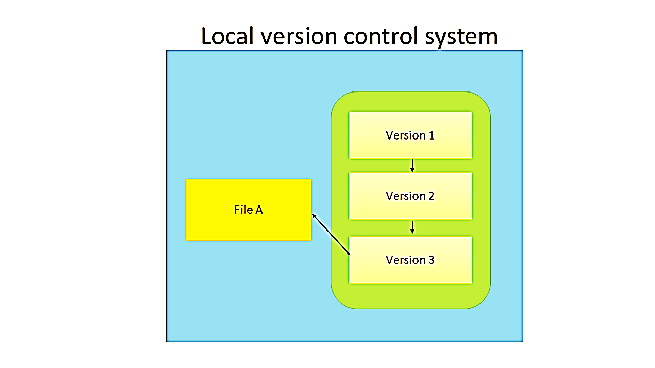
This control
system uses
within a single
machine.
Copying of
files from one
directory to
another.

Slide 5
Advantages
· It is easy to setup
· Less efficiency in running
Disadvantages
· It can easily make an error
· Not suitable for a group project
· Unsafe
Due to high disadvantages, the developer moved to the next version control called centralized version control system.

Slide 6
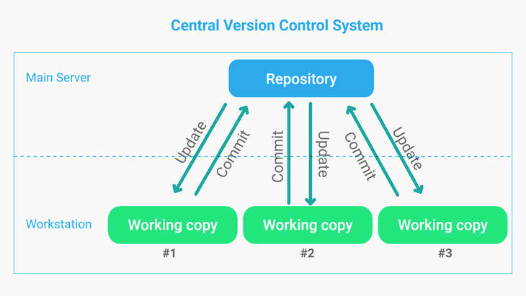
Centralized Version Control System (CVCS)
A centralized version control system (CVCS) uses a central server to store all files and enables team collaboration. It works on a single repository to which users can directly access a central server.
Please refer to the diagram below to get a better idea of CVCS:

Slide 7
Centralized Version Control System (CVCS)
The repository in the above diagram indicates a central server that could be main or remote which is directly connected to each of the programmer’s workstations.
Every programmer can extract or update their workstations with the data present in the repository or can make changes to the data or commit in the repository. Every operation is performed directly on the repository.
Even though it seems pretty convenient to maintain a single repository, it has some major drawbacks. Some of them are:
1. It is not locally available; meaning you always need to be connected to a network to
perform any action
Since everything is centralized, in any case, the central server getting crashed will result
in losing the entire data of the project.

Slide 8
Centralized Version Control System (CVCS)
Benefits of CVCS
1. Easy to learn and manage
2. Works well with binary files
3. More control over users and their access.
CVS and SVN are some conventional Central Version Control systems.

Slide 9
Distributed Version Control System (CVCS)
These systems do not necessarily rely on a central server to store all the versions of a project file.
In Distributed VCS, every contributor has a local copy of the main repository i.e. everyone maintains a local repository of their own which contains all the files and metadata present in the main repository.
You will understand it better by referring to the diagram below:

Slide 10
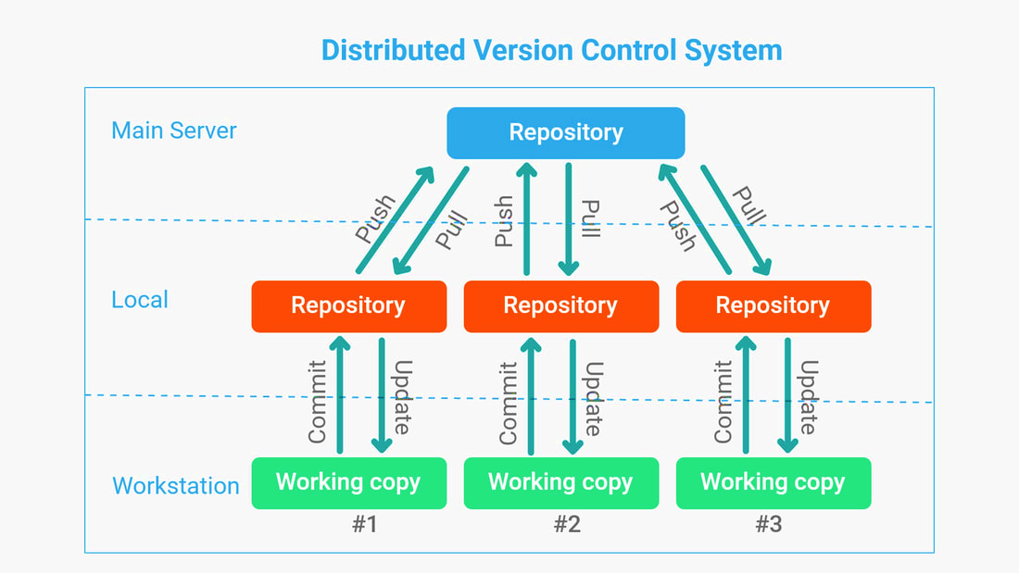

Slide 11
Distributed Version Control System (DVCS)
As you can see in the above diagram, every programmer maintains a local repository on its own. They can commit and update their local repository without any interference.
They can update their local repositories with new data from the central server by an operation called “pull” and affect changes to the main repository by an operation called “push” from their local repository.
Benefits of DVCS
1. Except for pushing and pulling the code, the user can work offline in DVCS.
2. DVCS is fast compared to CVCS because you don't have to contact the central server
for every command.
3. Merging and branching the changes in DVCS is very easy.
4. Performance of DVCS is better.
5. Even if the main server crashes, code will be stored in the local systems.

Slide 12
Distributed Version Control System (DVCS)
Git and Mercurial are standard distributed version central systems.
If we don’t want a DVCS on our server, we can use either GitHub or BitBucket to store our central repository, and we can get the clone of the central repository to our local systems.
GitHub and BitBucket are the most popular companies that provide cloud hosting for software development version control using Git.

Slide 13
Centralized Version Control System | Distributed Version Control System
In CVCS, The repository is placed at one place and delivers information to many clients. | In DVCS, Every user has a local copy of the repository in place of the central repository on the server-side.
It is based on the client-server approach. | It is based on the client-server approach.
It is the most straightforward system based on the concept of the central repository. | It is flexible and has emerged with the concept that everyone has their repository.
In CVCS, the server provides the latest code to all the clients across the globe. | In DVCS, every user can check out the snapshot of the code, and they can fully mirror the central repository.
CVCS is easy to administrate and has additional control over users and access by its server from one place. | DVCS is fast comparing to CVCS as you don't have to interact with the central server for every command.
The popular tools of CVCS are SVN (Subversion) and CVS. | The popular tools of DVCS are Git and Mercurial.
CVCS is easy to understand for beginners. | DVCS has some complex process for beginners.
If the server fails, No system can access data from another system. | if any server fails and other systems were collaborating via it, that server can restore any of the client repositories

Slide 14
What is Git?
Git is an open-source distributed version control system.
It is designed to handle minor to major projects with high speed and efficiency.
It is developed to coordinate the work among the developers.
The version control allows us to track and work together with our team members in the same workspace.
Git is the foundation of many services like GitHub and GitLab, but we can use Git without using any other Git services. Git can be used privately and publicly.
Git was created by Linus Torvalds in 2005 to develop Linux Kernel. It is also used as an important distributed version-control tool for DevOps.
Git is easy to learn and has fast performance. It is superior to other SCM tools like Subversion, CVS, Perforce, and ClearCase.

Slide 15
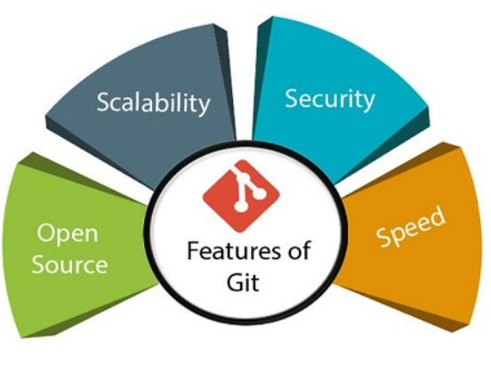
Features of Git
Open Source
Scalability
Distributed
Security
Speed
Supports non-linear development
Branching and Merging
Data Assurance
Staging Area

Slide 16
Open Source
Git is an open-source tool. It is released under the GPL (General Public License) license.
Scalable
Git is scalable, which means when the number of users increases.
Git can easily handle such situations.
3. Distributed
One of Git's great features is that it is distributed.
Git gives each developer a local copy of the entire development history, and changes are copied from one such repository to another. These changes are imported as additional development branches and can be merged in the same way as a locally developed branch.

Slide 17
4. Security
Git is secure. It uses the SHA1 (Secure Hash Function) to name and identify objects within its repository. Files and commits are checked and retrieved by its checksum at the time of checkout. It stores its history in such a way that the ID of particular commits depends upon the complete development history leading up to that commit. Once it is published, one cannot make changes to its old version.
5. Speed
Git is very fast, so it can complete all the tasks in a while.
Most of the git operations are done on the local repository, so it provides a huge speed.
Also, a centralized version control system continually communicates with a server somewhere.
Performance tests conducted by Mozilla showed that it was extremely fast compared to other VCSs.
Fetching version history from a locally stored repository is much faster than fetching it from the remote server.

Slide 18
6. Supports non-linear development
Git supports seamless branching and merging, which helps in visualizing and navigating a non-linear development. A branch in Git represents a single commit. We can construct the full branch structure with the help of its parental commit.
7. Branching and Merging
Branching and merging are the great features of Git, which makes it different from the other SCM tools.
Git allows the creation of multiple branches without affecting each other. We can perform tasks like creation, deletion, and merging on branches, and these tasks take a few seconds only.
Below is some features that can be achieved by branching:
1. Create a separate branch for a new module of the project, commit and delete it whenever we want.
2. Production branch, which always has what goes into production and can be merged for testing in the test branch.
3. Demo branch for the experiment and check if it is working. We can also remove it if needed.
4. The core benefit of branching is if we want to push something to a remote repository, we do not have to push all of our branches. We can select a few of our branches, or all of them together.

Slide 19
8. Data Assurance
The Git data model ensures the cryptographic integrity of every unit of our project.
It provides a unique commit ID to every commit through an SHA algorithm.
We can retrieve and update the commit by commit ID.
Most of the centralized version control systems do not provide such integrity by default.
9. Staging Area
The Staging area is also a unique functionality of Git.
It can be considered as a preview of our next commit, moreover, an intermediate area where commits can be formatted and reviewed before completion.
When you make a commit, Git takes changes that are in the staging area and makes them as a new commit.
We are allowed to add and remove changes from the staging area.
The staging area can be considered as a place where Git stores the changes.
Git doesn't have a dedicated staging directory where it can store some objects representing file changes (blobs). Instead of this, it uses a file called index.

Slide 20
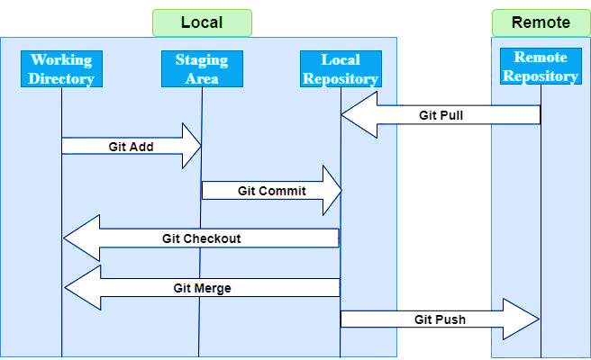
Git Workflow

Slide 21
Few Commands Used In Git
Git config - Configure the email address and username.
Git init - Initialization of an empty Git repository.
Git diff - presents changes made to the file.
Git add - Add files to the staging area.
Git commit - Commit head adjustments but not to the remote repository.
Git push - push the content in a local repository to the remote repository.
Git pull - merge and fetch changes from the remote repository to the local repository.

Slide 22
Benefits of Git
Everyone has their own local copy of the code
Work on your own branch
Work offline
Faster since you don’t have to communicate with the server
Everyone has a backup of the entire project
Everyone maintains the full history of the project
Everyone can experiment with new additions before committing to master

Slide 23
Disadvantages of Git
Not suitable for binary files:
It fails with the presence of files having binary data. It starts processing every work slowly.
Any file which doesn’t support textual data is not compatible with this technology.
No sub-trees checkout possible:
In this system, it is not supported to check the sub-trees.
For checking each particular project, the need to create multiple repositories with pre-package arise.

Slide 24
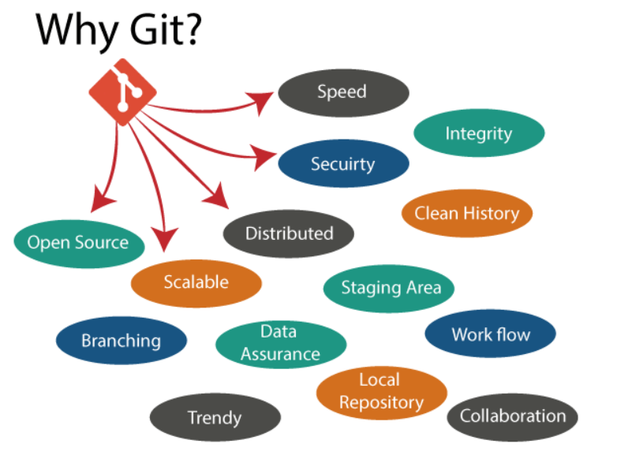

Slide 25
What Is GitHub?
GitHub is a cloud service that helps developers store and manage their source code as well as track and control all the changes to the source code.
In simple terms, GitHub is meant for developers wherein they can manage the project, host the source code and review them too. We will explore all of these in this series.
GitHub is an American company. It hosts source code of your project in the form of different programming languages and keeps track of the various changes made by programmers.
It offers both distributed version control and source code management (SCM) functionality of Git. It also facilitates with some collaboration features such as bug tracking, feature requests, task management for every project.

Slide 26
Some of its significant features are as follows.
Collaboration
Integrated issue and bug tracking
Graphical representation of branches
Git repositories hosting
Project management
Team management
Code hosting
Track and assign tasks
Conversations

Slide 27
Benefits of GitHub
GitHub can be separated as the Git and the Hub. GitHub service includes access controls as well as collaboration features like task management, repository hosting, and team management.
The key benefits of GitHub are as follows.
It is easy to contribute to open source projects via GitHub.
It helps to create an excellent document.
You can attract recruiter by showing off your work. If you have a profile on GitHub, you will have a higher chance of being recruited.
It allows your work to get out there in front of the public.
You can track changes in your code across versions.

Slide 28
Git | GitHub
It is a tool for distributed version control. | It is a web hosting service for git repositories.
It is installed locally. | It is hosted on the cloud.
Code changes like commit, merge are done using commands from the command line. | Everything is done through a web-based interface.
It does not have a user management system. | It has an inbuilt user management system.
There is no GUI. | It provides an easy to use GUI.
Git can be used offline and does not need an internet connection for use. | GitHub cannot be used offline and needs an internet connection.
Git can be used without GitHub. | GitHub cannot be used without Git.
Provides integration with limited 3rd party tools using Hooks. | Provides easy integration with a vast number of 3rd party tools.

