Slide 1

AI-Powered Skin Lesion Recognition System
DHARUN PRASATH M
24MCA19
Under the Guidance of
Mr. Alwin Pinakas James M.Sc., M.Phil., (Ph.D).
Head of the Department.

Slide 2
Presentation Outline
• Existing System
• Proposed System
• Objectives & Scope
• System Architecture
• Dataset Information
• Machine Learning Models
• Technology Stack
• Features & Functionality
• Results & Performance
• Demo & Future Enhancements
• Conclusion

Slide 3
01
Introduction

Slide 4
Existing System
• Skin cancer is one of the most common cancers globally
• Over 5 million cases diagnosed annually in the US alone
• Early detection crucial: 99% survival rate vs 27% for late-stage
• Limited access to dermatologists in many regions
• Long wait times delay critical diagnoses
• Professional screenings can be expensive and inaccessible
• Different skin conditions appear similar to untrained eyes

Slide 5
Proposed System
• AI-powered preliminary screening tool for skin lesions
• Instant analysis using deep learning models
• Classification into 8 different skin condition categories
• Confidence scoring for prediction reliability
• Educational information about detected conditions
• Analysis history tracking for monitoring changes
• Professional PDF reports for medical consultations
• AI chatbot (DermaGenie) for skin health guidance

Slide 6
02
Objectives

Slide 7
Project Objectives
Primary Objectives
Secondary Objectives
• Develop accurate deep learning model for skin lesion classification
• Create user-friendly web interface for image upload
• Implement secure user authentication
• Provide educational information about conditions
• Generate professional reports for consultations
• Implement analytics dashboard for trends
• Develop AI chatbot for skin health guidance
• Enable comparison of multiple analyses
• Ensure mobile responsiveness
• Maintain legal compliance with disclaimers

Slide 8
03
System Architecture

Slide 9
System Requirements
Software Requirements
Hardware Requirements
• Operating System: Windows / Linux
• Programming Language: Python 3.10+
• Web Framework: Django
• ML Frameworks: TensorFlow, Keras
• Database: SQLite (development)
• Frontend: HTML, CSS, JavaScript
• Development Tools: VS Code
• RAM: 8 GB
• Storage: 10 GB free space
• Internet connection
• Processor: Intel Core i5
• RAM: 8 GB
• Storage: 10 GB free space
• Internet connection

Slide 10
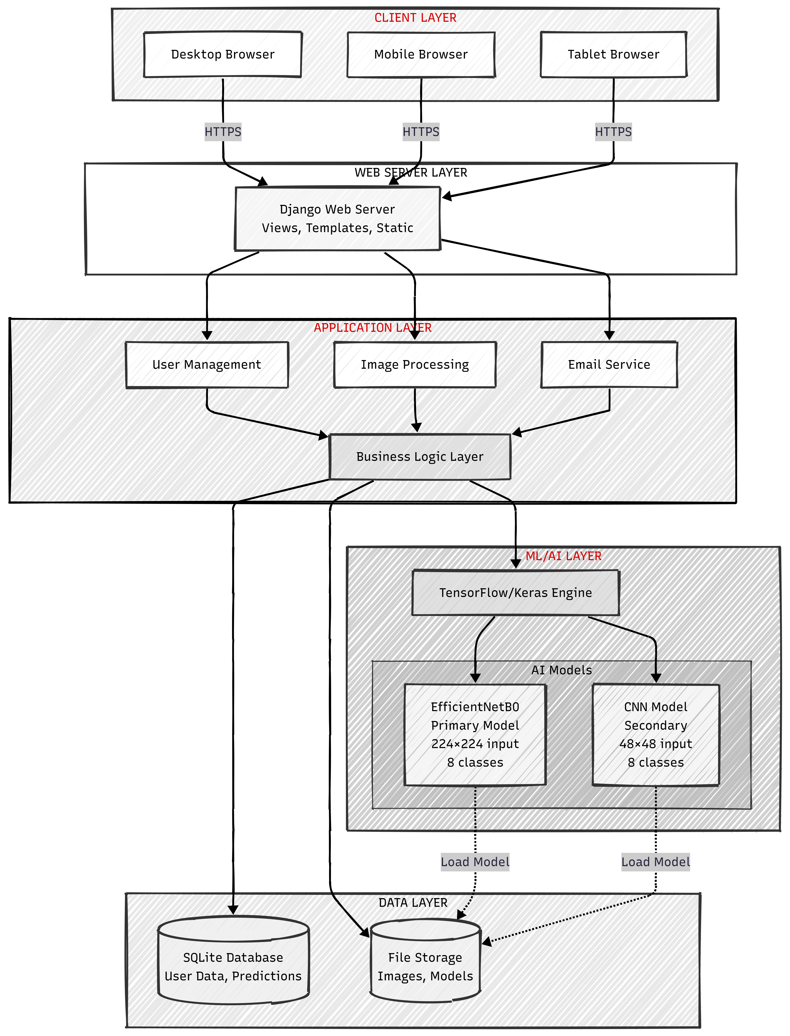
Architectural Diagram

Slide 11
System Architecture
• Client Layer: Browser-based access (Desktop, Mobile, Tablet)
• Web Server Layer: Django Web Server with Views & Templates
• Application Layer: User Management, Image Processing, Email Service
• ML/AI Layer: TensorFlow/Keras with Dual Model System
• Data Layer: SQLite Database + File Storage for images/models
• External Services: Resend (Email), Perplexity AI (Chatbot)

Slide 12
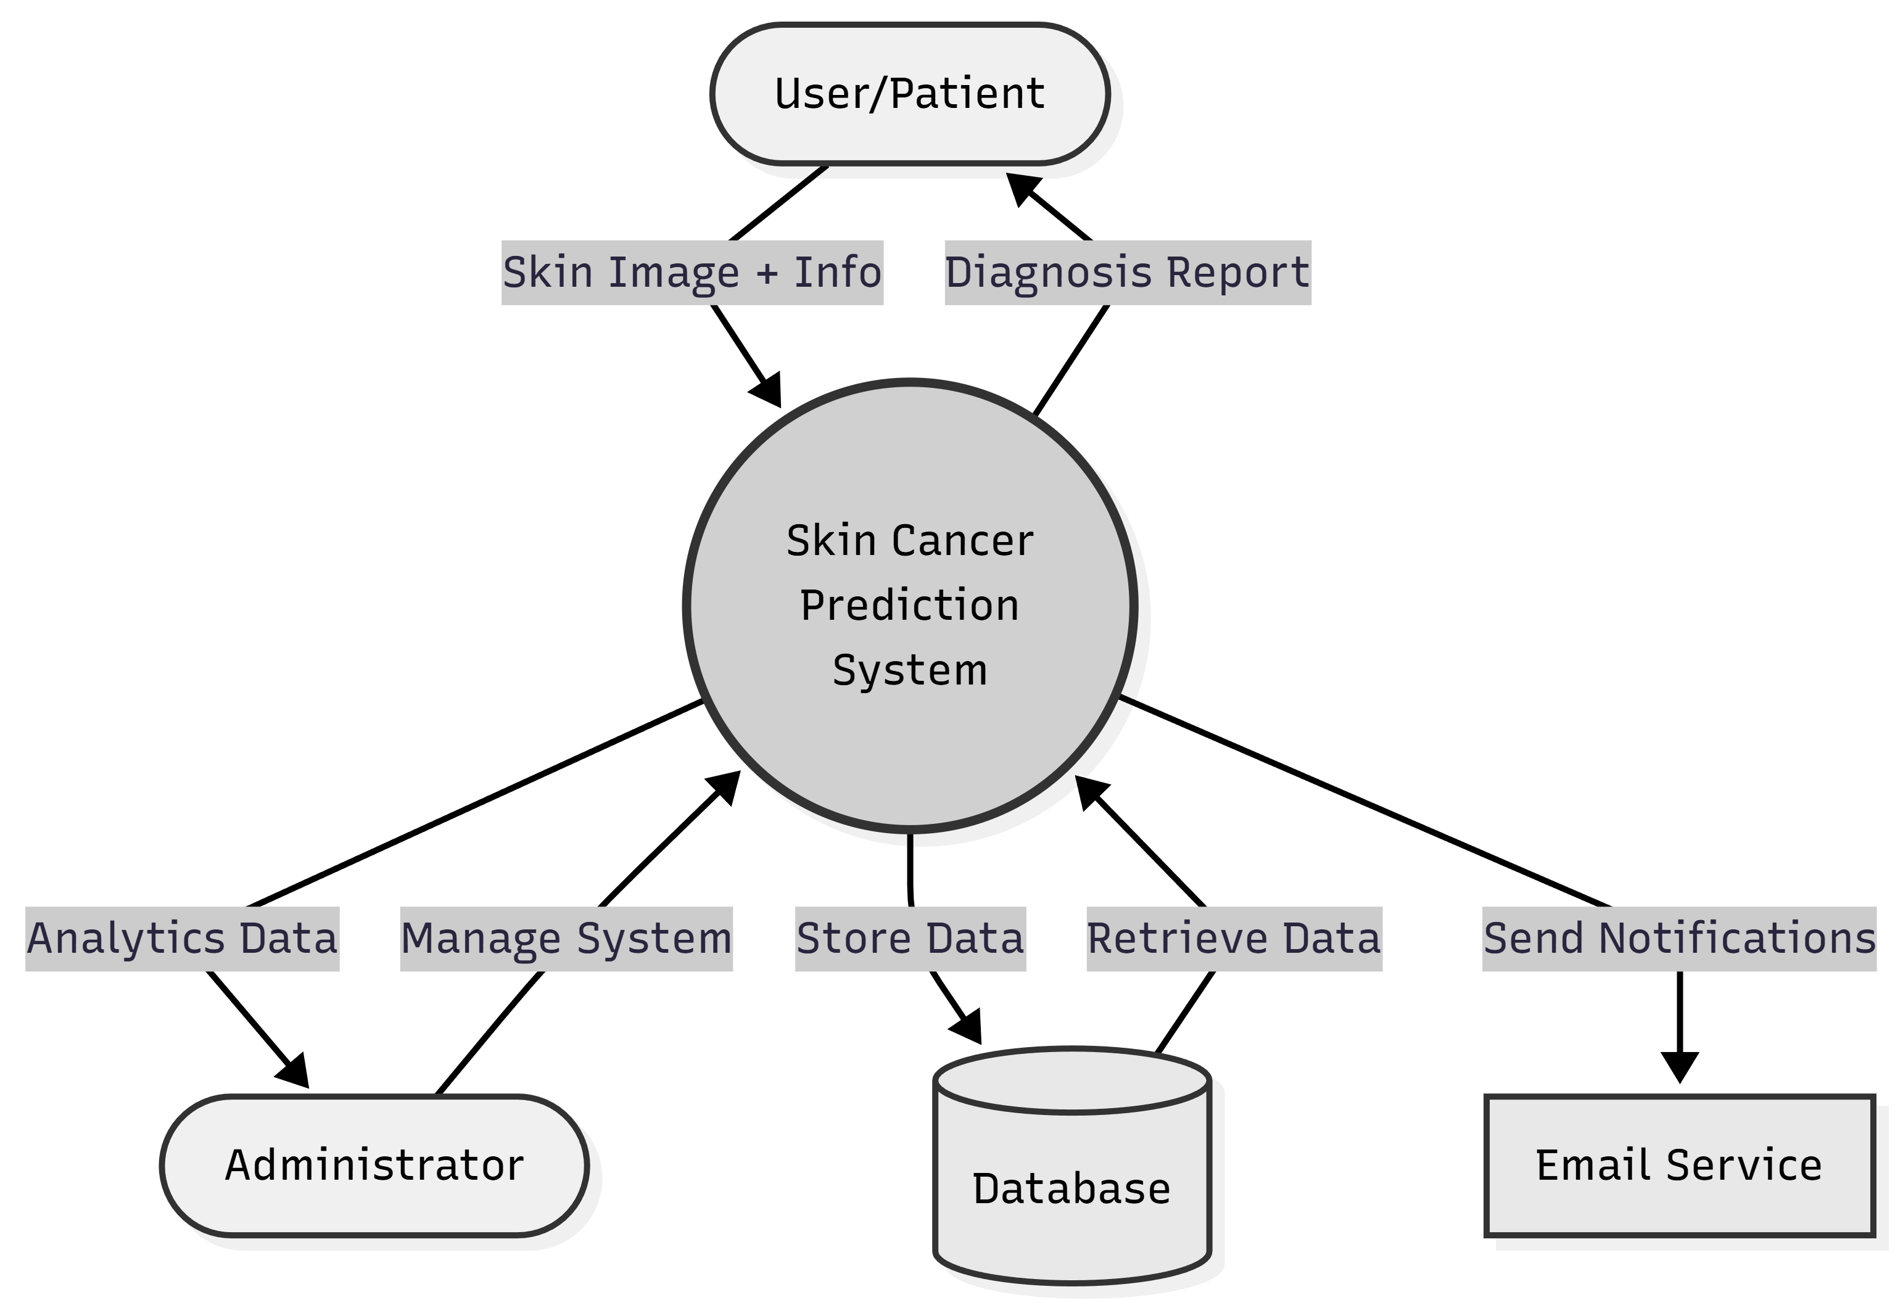
DFD LEVEL 0

Slide 13
Data Flow Pipeline
• 1. User uploads skin lesion image through web interface
• 2. Image preprocessing: Resizing, Normalization
• 3. Model selection based on user preference or auto mode
• 4. Primary Model (EfficientNetB0) processes image
• 5. Confidence check - if low, fallback to Secondary Model (CNN)
• 6. Result formatting with legal compliance checks
• 7. Display results with condition info and recommendations
• 8. Store prediction in database and send notification

Slide 14
04
Dataset Information

Slide 15
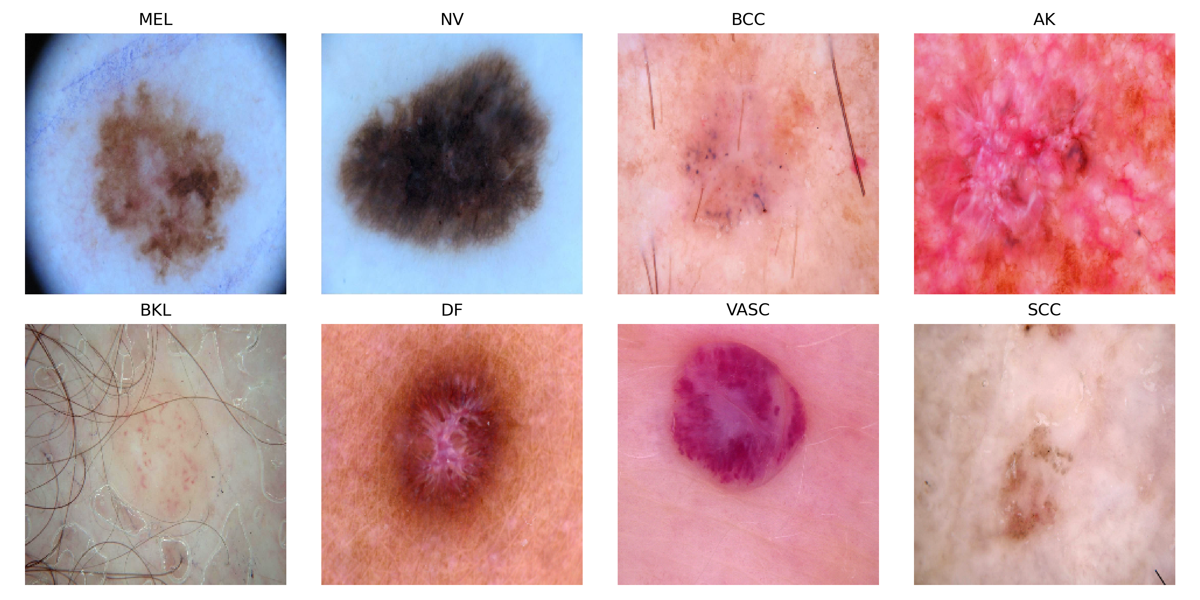
Primary Dataset: ISIC 2019 Sample images

Slide 16
Primary Dataset: ISIC 2019
Class | Full Name | Images | Percentage
NV | Melanocytic Nevi | 12,875 | 50.8%
MEL | Melanoma | 4,522 | 17.9%
BCC | Basal Cell Carcinoma | 3,323 | 13.1%
BKL | Benign Keratosis | 2,624 | 10.4%
AK | Actinic Keratoses | 867 | 3.4%
SCC | Squamous Cell Carcinoma | 628 | 2.5%
VASC | Vascular Lesions | 253 | 1.0%
DF | Dermatofibroma | 239 | 0.9%

Slide 17
Secondary Dataset: HAM10000 Subset
• Base Source: HAM10000 (Human Against Machine with 10000 images)
• Total Images: 5,906 dermoscopic images
• License: CC BY-NC 4.0 (Open Source for Academic Use)
• 8 Classes: akiec, bcc, bkl, df, mel, nv, vasc + not_skin_cancer
• Citation: Tschandl et al., Scientific Data, 2018
• Preprocessing: Resizing, Normalization, Data Augmentation
• Split: 70% Training / 15% Validation / 15% Testing

Slide 18
05
Machine Learning Models

Slide 19
Primary Model: EfficientNetB0
Parameter | Value
Architecture | EfficientNetB0 (Transfer Learning)
Input Shape | 224 × 224 × 3
Output Classes | 8
Total Parameters | ~5.3 Million
Test Accuracy | 71.32%
Training Epochs | 50
Optimizer | Adam (LR: 0.0001)
Pre-trained On | ImageNet

Slide 20
Secondary Model: Custom CNN
Parameter | Value
Architecture | Custom Convolutional Neural Network
Input Shape | 48 × 48 × 3
Output Classes | 8
Total Parameters | ~1.2 Million
Test Accuracy | 94.1%
Training Epochs | 100
Optimizer | Adam (LR: 0.001)
Conv Layers | 3 Blocks (32→64→128 filters)

Slide 21
Intelligent Model Selection
• User can choose: EfficientNetB0, CNN, or Auto Mode
• Auto Mode Logic:
• → First, try EfficientNetB0 (larger, more robust)
• → Check confidence score of prediction
• → If confidence > 50%, use EfficientNetB0 result
• → If confidence ≤ 50%, fallback to CNN model
• Benefits: Combines strengths of both models
• Result: More reliable predictions across diverse images

Slide 22
06
Technology Stack

Slide 23
Technology Stack
Backend
Frontend & Services
• Python 3.10+ (Primary Language)
• Django 4.2.1 (Web Framework)
• TensorFlow 2.13.0 (Deep Learning)
• Keras 2.13.1 (Neural Network API)
• SQLite (Database)
• Pillow & OpenCV (Image Processing)
• HTML5, CSS3, JavaScript (Frontend)
• Chart.js (Data Visualization)
• Resend API (Email Service)
• Perplexity AI (Chatbot)
• Git (Version Control)
• Font Awesome (Icons)

Slide 24
07
Features & Functionality

Slide 25
Core Features
• Skin Lesion Analysis: AI-powered classification of skin images
• 8 Condition Detection: Identifies 8 different skin conditions
• Dual Model System: EfficientNetB0 + CNN for robust predictions
• Confidence Scoring: Displays prediction confidence percentage
• User Authentication: Secure registration with email verification
• Password Reset: OTP-based secure password recovery
• Analysis History: Track and review all past analyses

Slide 26
Advanced Features
• User Profiles: Personal info, profile pictures, statistics
• PDF Export: Generate professional reports for doctors
• Comparison Tool: Compare multiple analyses side-by-side
• Analytics Dashboard: Charts and trend analysis
• DermaGenie AI: AI chatbot for skin health guidance
• Admin Dashboard: System monitoring (staff only)
• Email Notifications: Automated alerts and updates
• Mobile Responsive: Works on all devices

Slide 27
08
Results & Performance

Slide 28
Model Performance Summary
Metric | EfficientNetB0 | Custom CNN
Test Accuracy | 71.32% | 94.1%
Input Size | 224×224 | 48×48
Parameters | 5.3M | 1.2M
Inference Time | ~200ms | ~50ms
Training Dataset | 25,331 images | 5,906 images
Best For | Complex cases | Quick screening

Slide 29
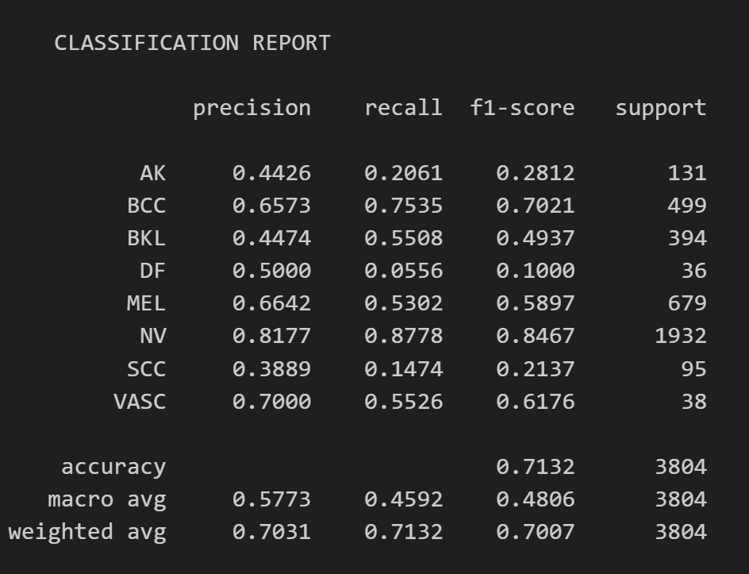
Model Classification

Slide 30
Key Achievements
• Successfully deployed dual-model AI classification system
• Achieved 94.1% accuracy on CNN model
• Implemented secure OTP-based authentication
• Created comprehensive analytics dashboard
• Developed AI-powered chatbot (DermaGenie)
• Built responsive UI with modern dark theme
• Integrated professional PDF report generation
• Ensured legal compliance with medical disclaimers

Slide 31
09
Future Enhancements

Slide 32
Future Enhancements
Short-term (6 months)
Long-term (12+ months)
• Mobile Application (iOS/Android)
• Multi-language Support
• Enhanced Analytics
• RESTful API Access
• Batch Image Processing
• Real-time Webcam Analysis
• Telemedicine Integration
• 3D Skin Mapping
• Predictive Risk Assessment
• Clinical EHR Integration

Slide 33
Conclusion
• SkinCare AI provides accessible AI-powered skin cancer screening
• Dual-model architecture ensures robust and reliable predictions
• User-friendly interface makes technology accessible to everyone
• Comprehensive features: History, Analytics, Reports, AI Chat
• Encourages early detection and professional medical consultation
• Built with modern technologies and best practices
• Potential to save lives through early skin cancer detection

Slide 34
References
• ISIC Archive - International Skin Imaging Collaboration
• HAM10000 Dataset - Tschandl et al., Scientific Data, 2018
• EfficientNet: Rethinking Model Scaling for CNNs (Tan & Le, 2019)
• Django Documentation - docs.djangoproject.com
• TensorFlow Documentation - tensorflow.org
• Skin Cancer Foundation - skincancer.org
• Kaggle - Skin Cancer MNIST: HAM10000 Dataset

Slide 35
Thank You
Questions & Discussion

