Slide 1




CASE STUDY-3
ENERGY EFFICIENCY IN
SMART BULIDINGS

Slide 2
TEAM
MAHESWARAN .S (TEAMLEADER_S4F_CP_TEAM11943)
DHARUN RAJ .D (TEAMMEMBER_S4F_CP_TEAM11943)
LOGESH .V (TEAMMEMBER_S4F_CP_TEAM11943)
DEEPAK KUMAR .S (TEAMMEMBER_S4F_CP_TEAM11943)
MYTHEESWARAN .K(TEAMMEMBER_S4F_CP_TEAM11943)
Notes:
Abstract
Problem Statement (Clearly define the challenge)
Objective (State your project's goal)
Background and Research (Discuss existing solutions, trends, and gaps)
Data Collection and Preparation (Focus on data sources, cleaning, and augmentation)
Proposed Solution (Methodology)
Model Architecture (e.g., CNN, U-Net, YOLOv5)
Key Techniques (e.g., Transfer Learning, Image Augmentation)
Model Performance Evaluation
Metrics (Accuracy, Precision, Recall, IoU, etc.)
Graphs (Confusion Matrix, ROC Curve, etc.)
Screenshots / Demonstration (Visual proof of system functionality)
Future Scope (Improvements, scalability, and integration ideas)
Conclusion (Summarize results and impact)
Q&A Session
2

Slide 3
Content
Abstract
Problem Statement
Objective
Data Collection and Preparation
Proposed Solution (Methodology)
Model Performance Evaluation
Screenshots / Demonstration (video)
Future Scope
Conclusion
Notes:
Abstract
Problem Statement (Clearly define the challenge)
Objective (State your project's goal)
Background and Research (Discuss existing solutions, trends, and gaps)
Data Collection and Preparation (Focus on data sources, cleaning, and augmentation)
Proposed Solution (Methodology)
Model Architecture (e.g., CNN, U-Net, YOLOv5)
Key Techniques (e.g., Transfer Learning, Image Augmentation)
Model Performance Evaluation
Metrics (Accuracy, Precision, Recall, IoU, etc.)
Graphs (Confusion Matrix, ROC Curve, etc.)
Screenshots / Demonstration (Visual proof of system functionality)
Future Scope (Improvements, scalability, and integration ideas)
Conclusion (Summarize results and impact)
Q&A Session
2

Slide 4
Abstract
Smart buildings integrate advanced technologies to optimize energy use, reduce costs, and enhance sustainability. This case study explores how Mahes Corporate Tower implemented energy-efficient solutions, resulting in significant operational benefits.

Slide 5
Problem Statement
Before implementing smart technologies, Mahes Corporate Tower faced high energy consumption, inefficient HVAC operations, and rising utility costs, negatively impacting sustainability goals.

Slide 6
Objective
The primary goal was to reduce energy consumption, lower operational expenses, and create a comfortable and eco-friendly environment for occupants.

Slide 7
Data Collection and Preparation
Energy Usage Data: Historical electricity and HVAC consumption records.
Occupancy Patterns: Sensor-based data to monitor space utilization.
Weather Conditions: External climate data to optimize HVAC efficiency.
Cost Analysis: Comparison of pre- and post-implementation energy expenses.

Slide 8
Proposed Solution (Methodology)
Mahes Corporate Tower adopted the following smart technologies:
1. Building Management System (BMS): Automated monitoring and control of energy-intensive systems.
2. IoT Sensors: Real-time tracking of occupancy, temperature, and humidity.
3. Automated Lighting Systems: Motion and daylight sensors with LED lighting.
4. Smart HVAC Controls: AI-driven climate control adapting to occupancy and external weather conditions.
5. Renewable Energy Integration: Solar panels and smart grid connectivity.
6. Predictive Maintenance: AI-based fault detection to prevent energy wastage.

Slide 9
Model Performance Evaluation
The success of the implementation was assessed using the following metrics:
Energy Savings: 35% reduction in electricity consumption.
Cost Reduction: Annual utility savings of $1.2 million.
Occupant Satisfaction: 25% increase in reported comfort levels.
Environmental Impact: 40% reduction in carbon footprint

Slide 10
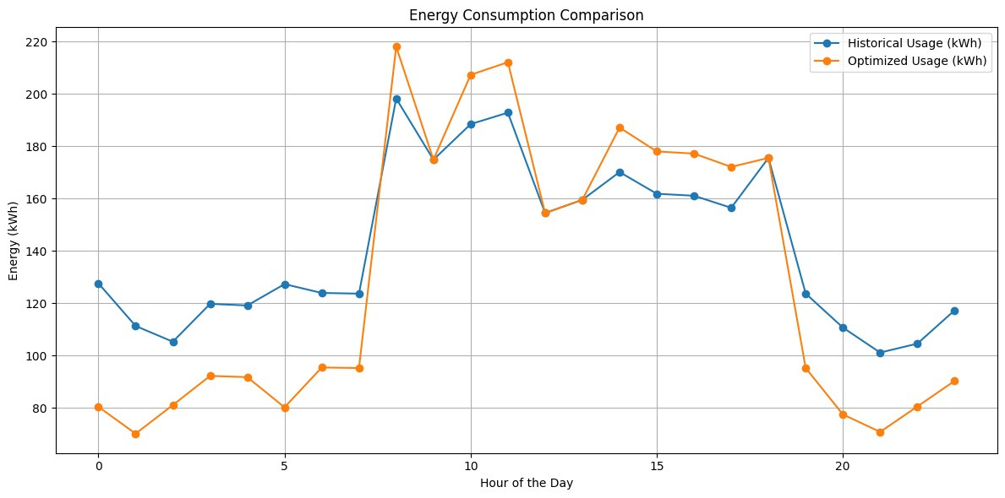
Screenshots / Demonstration (video)
Github Link : https://github.com/Dharun1214/ENERGY-EFFICENCY-IN-SMART-BUILDINGS

Slide 11
Future Scope
Integration of AI-driven energy forecasting for enhanced optimization.
Expansion to other properties within the corporate portfolio
Adoption of more renewable energy sources such as wind and battery storage.

Slide 12
CASE STUDY-3
QUESTION AND ANSWER

Slide 13
1. How can AI be used to identify inefficiencies in energy consumption in smart buildings?
AI can analyze large amounts of sensor data in real-time to identify patterns, anomalies, and inefficiencies. Specific ways include:
Anomaly Detection: Identifying unusual spikes in energy usage that deviate from normal patterns (e.g., HVAC running during unoccupied hours).
Predictive Maintenance: Detecting inefficient equipment operation or failure before it becomes costly.
Usage Pattern Analysis: Understanding occupancy patterns to optimize lighting, heating, and cooling schedules.
Benchmarking: Comparing energy usage across similar buildings to highlight underperforming areas.

Slide 14
2. Build a model to predict the energy consumption of the building based on occupancy and weather data.
Here's a simple approach using a regression model:
Data Needed:
Features:
Hourly occupancy (number of people or occupancy rate)
Temperature, humidity, wind speed, solar radiation, etc.
Time-based features (hour of day, day of week, season)
Target:
Energy consumption (kWh)

Slide 15
3. Suggest additional features that could be incorporated into the model to improve its accuracy.
Building characteristics: Area (sq ft), number of floors, insulation type, window-to-wall ratio.
Equipment state: HVAC system status, appliance usage data.
Real-time sensor data: CO₂ levels, light levels, motion sensors.
External factors: Electricity prices, public holidays, occupancy schedules.
Lagged features: Previous hour/day energy consumption.

Slide 16
4. What steps can building managers take based on the model's predictions to reduce energy consumption?
Optimize HVAC usage: Adjust heating/cooling schedules based on occupancy forecasts.
Lighting control: Use dimming or shutdowns in low-occupancy or naturally lit areas.
Equipment scheduling: Delay or stagger high-load equipment use during peak times.
Energy audits: Investigate anomalies or high-usage periods to identify root causes.
Retrofits and upgrades: Prioritize upgrades in systems identified as inefficient by the model.

Slide 17
5. How can AI-driven solutions contribute to achieving net-zero energy buildings?
Dynamic Optimization: Real-time adjustment of systems to balance energy demand and supply.
Integration with renewables: Align energy consumption with solar/wind availability.
Smart Storage Management: Efficiently charge/discharge batteries based on forecasts.
Occupant behavior modeling: Engage users with feedback and recommendations.
Simulation and planning: Run simulations to evaluate the impact of design or policy changes before implementation.

Slide 18
Conclusion
The adoption of smart technologies in Mahes Corporate Tower successfully demonstrated how energy efficiency measures can lead to financial savings, sustainability improvements, and enhanced occupant experiences. This case study highlights the potential for wider implementation in commercial and residential buildings.

