Slide 1

Dr. N.G.P. ARTS AND SCIENCE COLLEGE (An Autonomous Institution, Affiliated to Bharathiar University, Coimbatore) Approved by Government of Tamil Nadu & Accredited by NAAC with A++Grade (3rd Cycle- 3.64 CGPA) Dr. N.G.P.-Kalapatti Road, Coimbatore-641 048, Tamil Nadu, India. Website: www.drngpasc.ac.in | Email: info@drngpasc.ac.in. | Phone: +91-422-2369100
PROJECT REVIEW
College Project Submission And Review Portal
UNDER THE GUIDANCE OF
Mrs.Vanitha K M.Sc (CS), M.Ed., M.Phil., M.Sc.(App.Psy.).,NET
Assistant Professor
BY
NANDHANA R
(231CT127)

Slide 2
ABSTRACT
The College Project Submission And Review Portal is a web application developed to digitalize the workflow of academic project submission in college.
Projects are submitting as printed copies it create challenges like file misplacement, lack of timely feedback, and difficulty in tracking revisions.
Students can upload their project files and details, and Faculty members can review the student project details.
By centralizing all activities into a single platform, the portal enhances efficiency and make the evaluation process more organized.

Slide 3
No centralized tracking system
SYSTEM STUDY
Existing System
Project submission are handling by manual methods.
Students submit their project reports as physical copies.
Faculty members provide feedback verbally.
Project records are maintained without a centralized system.
Drawbacks for existing system:
No centralized tracking system
Difficulty in managing multiple project files
Risk of data loss or misplacement of project reports

Slide 4
Proposed System
Centralized platform for students, faculty, and admin
Students upload project documents and view review status
Faculty review submitted projects and provide feedback
Admin manages users and assigns students to faculty
Advantages:
Centralized platform for project submission and review
Easy tracking of project status
Role-based access for students, faculty, and admin
Time consuming for students and faculty

Slide 5
Database: MySQL
SOFTWARE AND HARDWARE REQUIREMENTS
Software Specifications:
Frontend: HTML, CSS, JavaScript
Backend: PHP
Database: MySQL
Server: Apache (XAMPP)
IDE: VS Code
Hardware Specifications:
Processor: Intel i3 or above
RAM: Minimum 4 GB
Hard Disk: 10 GB free space
Operating System: Windows 10 or above
Network: Internet Connection

Slide 6
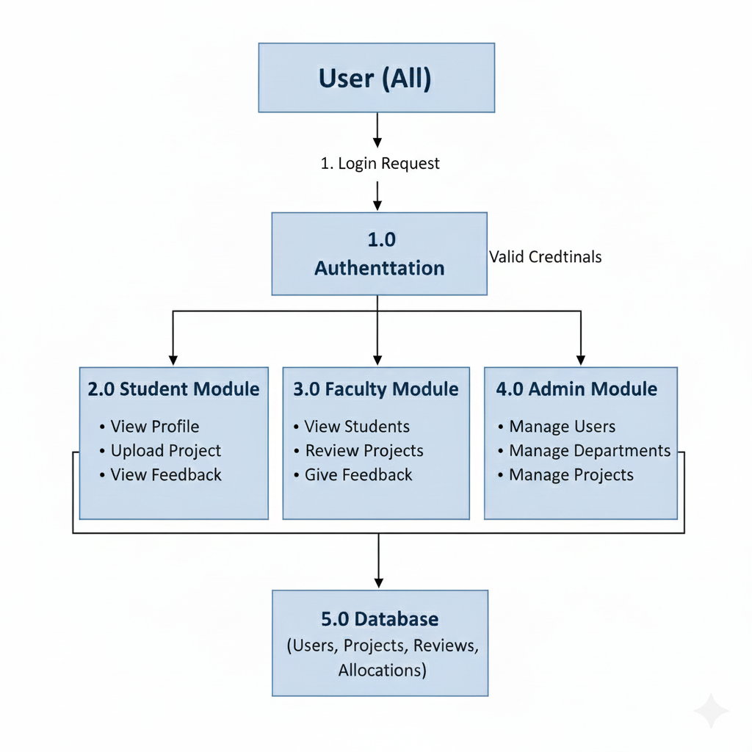
DATA FLOW DIAGRAM ( DFD )

Slide 7
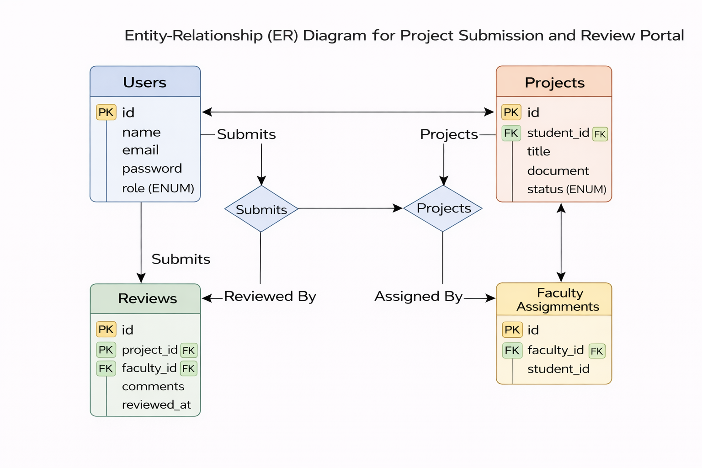
ENTITY RELATIONSHIP DIAGRAM

Slide 8
MODULES
Student Module
Student login
Upload project documents and details
View submission status
View faculty remarks
Revise and resubmit if required
Faculty Module
Faculty login
View assigned students
Download project files
Approve or request revision
Add remarks and comments
Admin Module
Admin login
Add students and faculties
Assign students to faculty
View Submitted Projects
Monitor project status

Slide 9
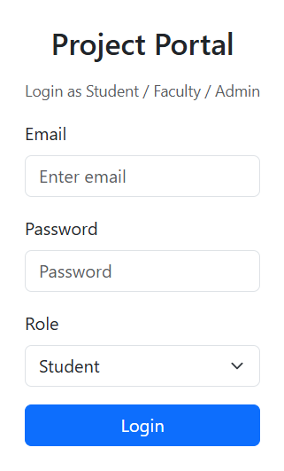
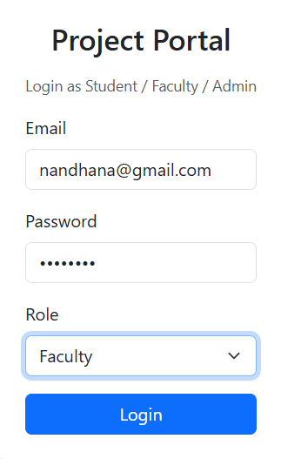
LOGIN PAGE

Slide 10
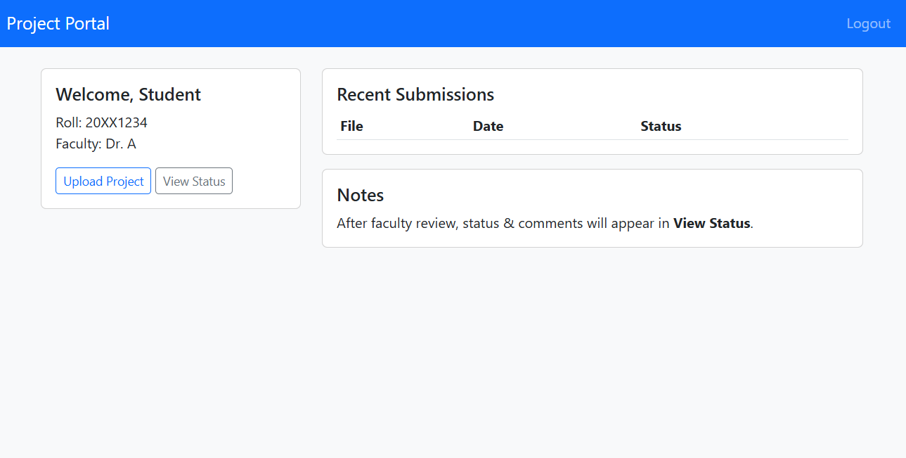
STUDENT DASHBOARD

Slide 11
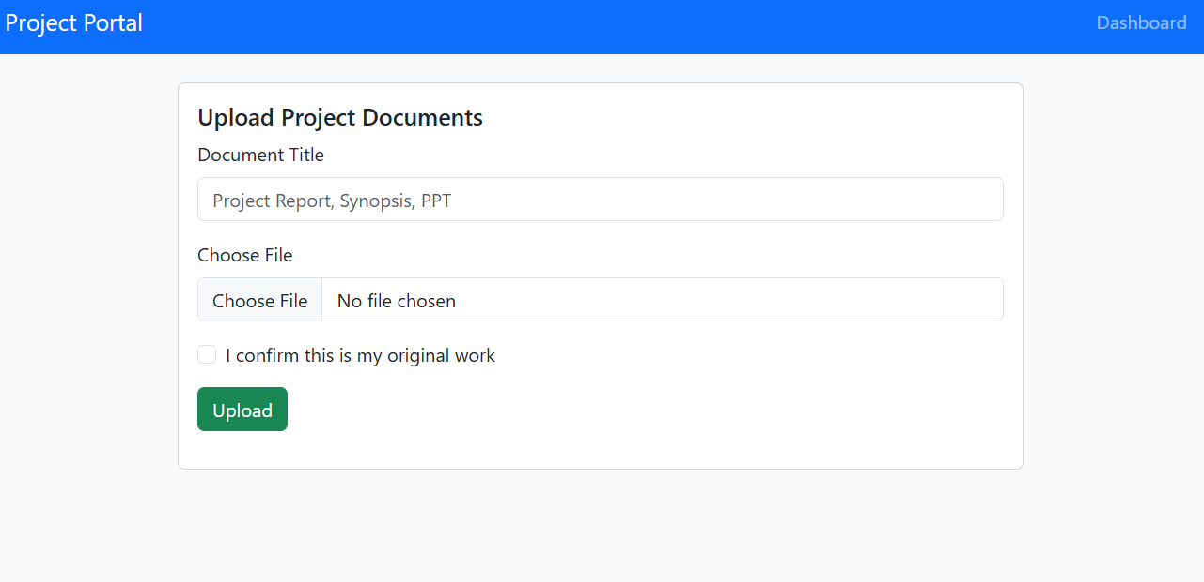

Slide 12
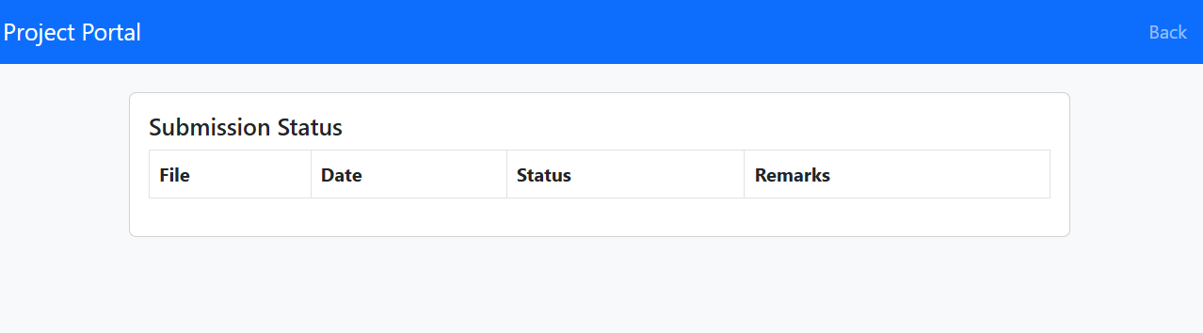

Slide 13
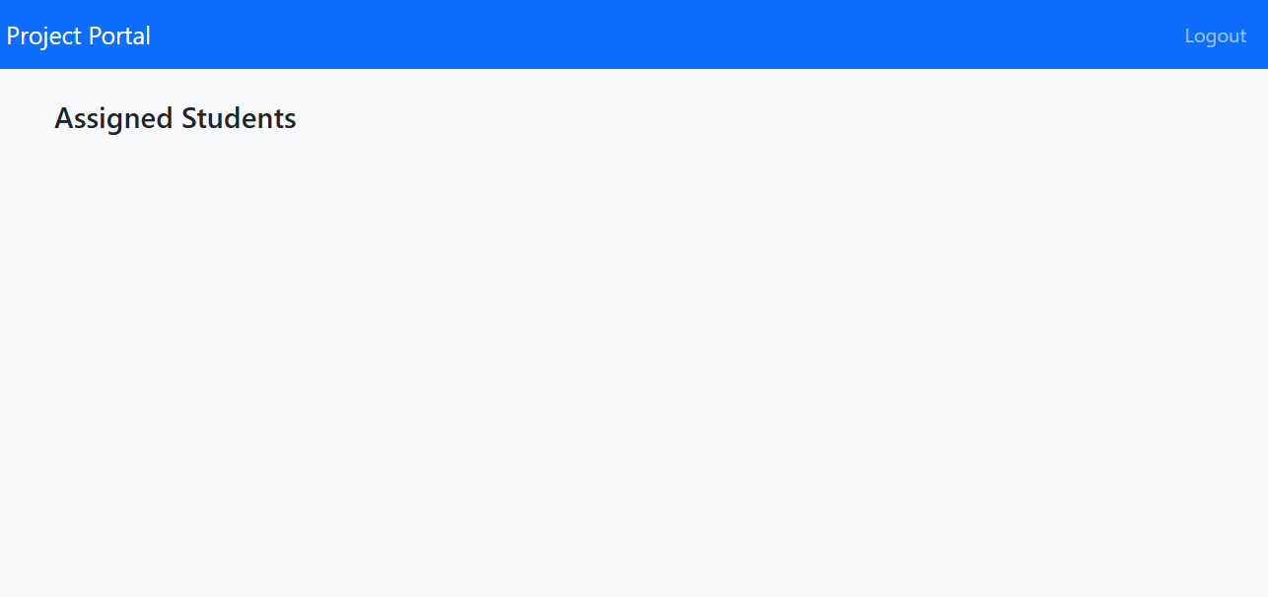
FACULTY DASHBOARD

Slide 14
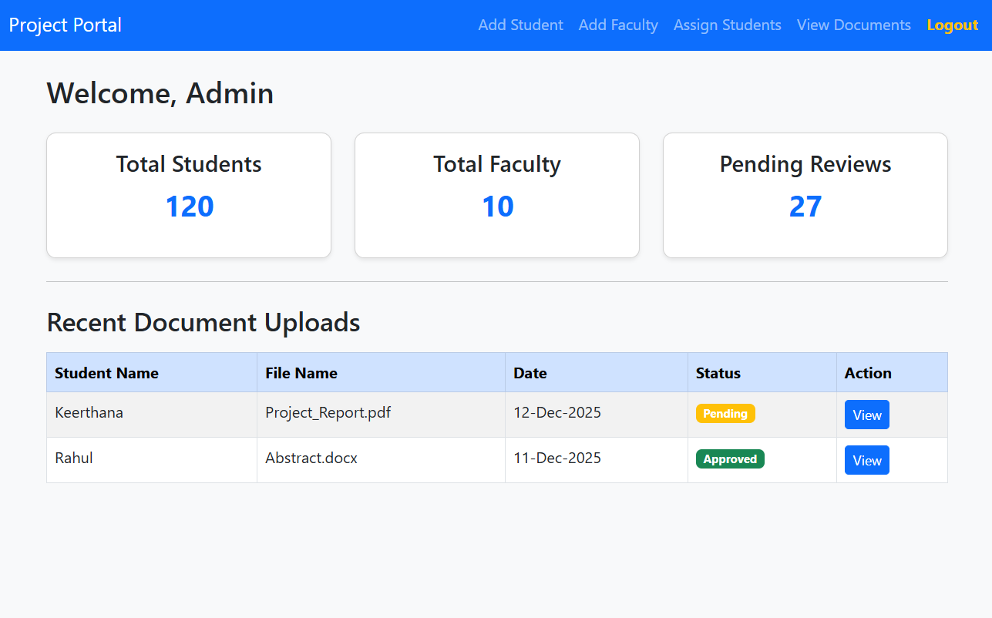
ADMIN DASHBOARD

Slide 15
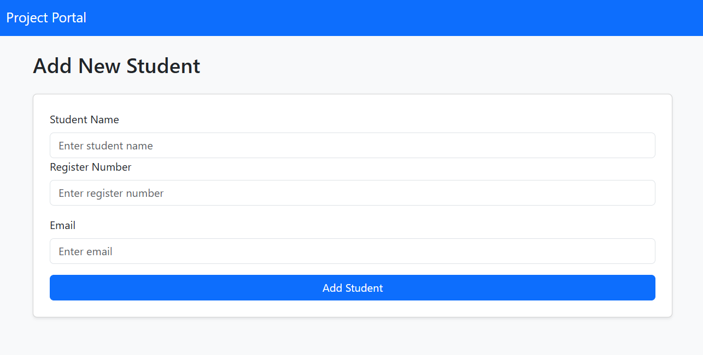

Slide 16
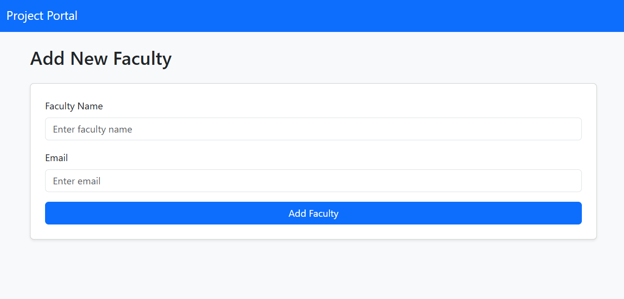

Slide 17
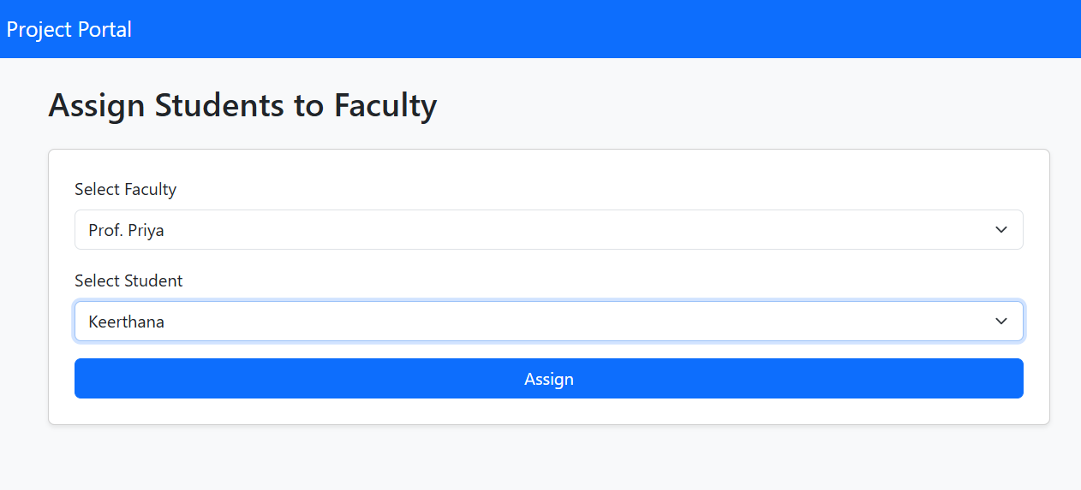

Slide 18
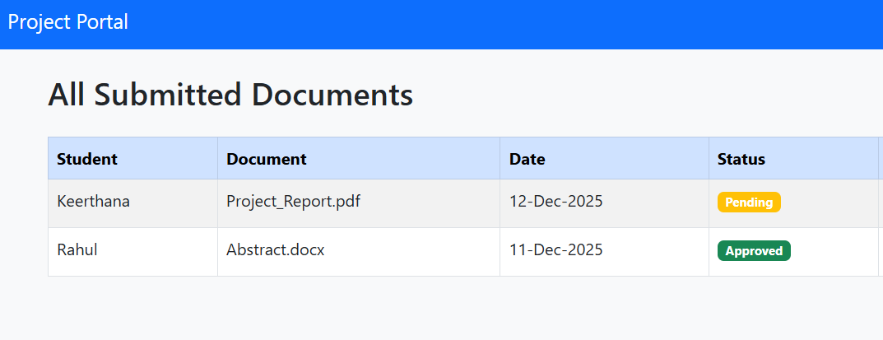

Slide 19



