Slide 1


Deepfakes: The New Frontier of Digital Deception
Deepfakes use AI to create realistic fake videos and audio. They raise urgent concerns about misinformation.
In 2023, $3 billion was spent combating online misinformation fueled by deepfakes.
by John Constantine

Slide 2

The Technology Behind Deepfakes
Deep learning & AI
Popular tools
Process
They power face swapping and video manipulation techniques.
DeepFaceLab, FaceSwap, and others enable creators to build deepfakes at about $500 each.
Involves training neural networks on target faces to create realistic videos.

Slide 3
Types of Deepfakes
Face-swapping
Lip-syncing
Puppet-master
Complete fabrication
Replacing one person's face with another's in videos.
Altering speech to match new audio content.
Manipulating facial expressions in real-time.
Creating fully synthetic characters, like Samsung's AI "Mona Lisa" animation.

Slide 4
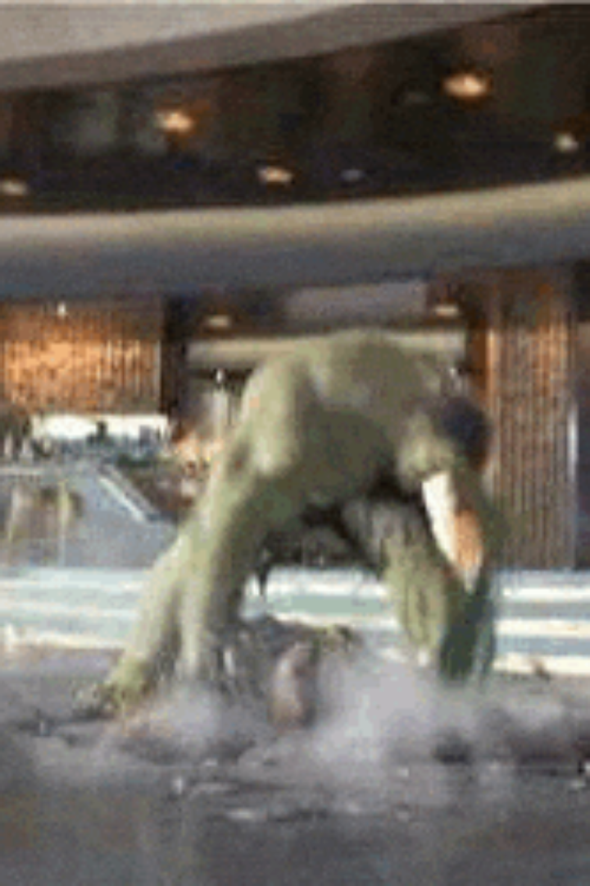
Deepfakes in Entertainment
Realistic characters
Resurrecting actors
Deepfakes create believable digital personas in films.
Tech brings deceased actors back, seen in "The Irishman" (2019).
Gaming enhancements
Improves graphics and player immersion via realistic avatars.
"The Irishman" de-aging technology cost $150 million, reflecting deepfake sophistication in entertainment.

Slide 5

Deepfakes and Politics
1
Misinformation
2
Election impact
Deepfakes spread false information and propaganda widely.
Attempts tripled during the 2020 U.S. election versus 2016.
3
Trust erosion
Undermines public confidence in media and institutions.

Slide 6




The Dangers of Deepfakes in Society
Reputation damage
Cyberbullying
1
2
False videos harm individuals emotionally and socially.
Used to harass and intimidate people online.
Legal risks
Fraud
Deepfakes challenge evidence integrity in courts.
Impersonation can enable financial and identity crimes.
4
3
67% of people struggle to differentiate deepfakes from real videos.

Slide 7

Detecting Deepfakes
Current methods
Visual and audio inconsistencies help spot fakes.
AI tools
Advanced algorithms analyze facial and speech patterns.
Detection challenges
Creators constantly improve fakes to evade detection.
The Deepfake Detection Challenge incentivized innovation with $1 million in prizes.

Slide 8





The Role of Legislation and Regulation
Existing laws
Some policies address deepfake misuse today.
New regulations
Needed to tackle evolving AI threats effectively.
Free speech
Balancing regulation with protection of expression.
EU AI Act
Aims to govern the use of deepfake technology.

Slide 9




The Future of Deepfake Technology
Advances in AI
1
New algorithms will create ultra-realistic deepfakes.
Undetectable fakes
2
Tech will make deception harder to spot.
Arms race
3
Ongoing battle between creators and detection tools.
Industry growth
4
Projected $100 billion market by 2030.

Slide 10

Ethical Considerations and Responsibilities
Transparency
Public education
Creators should disclose when content is synthetic.
Informing users about deepfake risks is vital.
Accountability
Responsible AI
Misuse must have consequences to deter harm.
Develop technology with ethical safeguards in place.
80% of people want platforms to label deepfakes transparently.

