Slide 1

User Access Management in Jira
This appendix provides a concise overview of user access management within Jira. It covers essential topics from roles and permissions to best practices. Our goal is to enhance security and streamline administrative processes.
DS
by Dharun Anand S

Slide 2


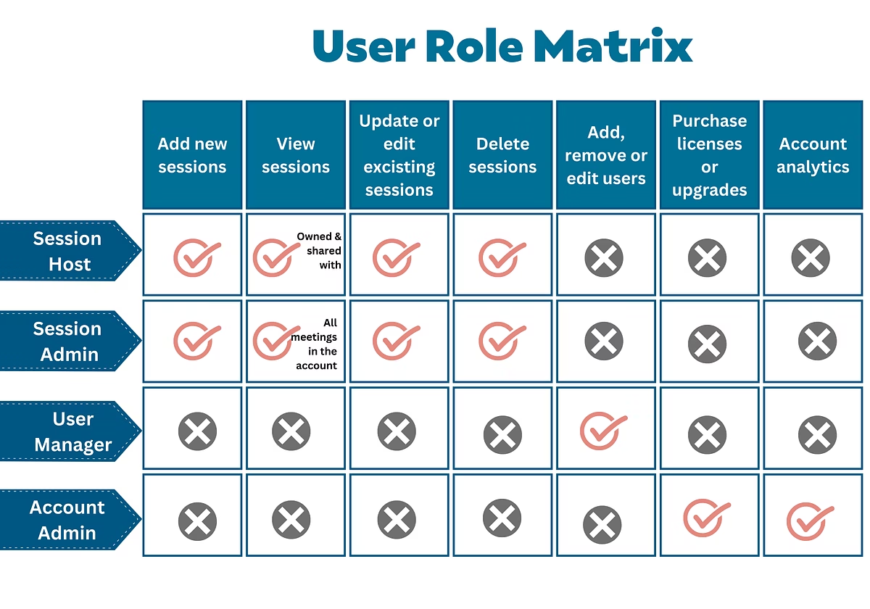



User Roles and Permissions
Roles
Define user responsibilities like Administrator or Reporter.
Permissions
Granular control over actions such as creating or editing issues.
RBAC
Role-Based Access Control simplifies administration.
Additive
Permissions are additive, not subtractive.

Slide 3
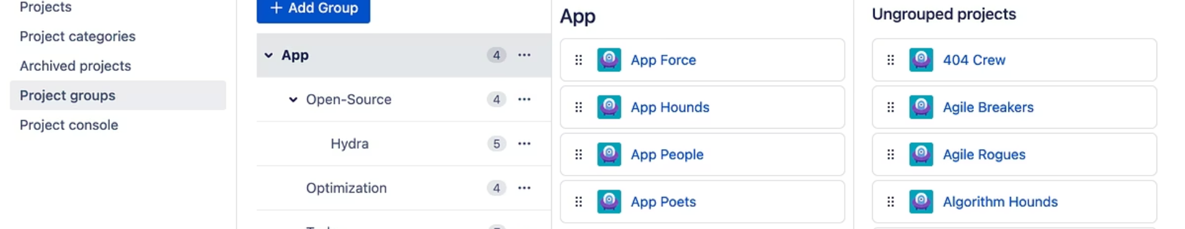




Jira Groups
Purpose
Examples
Efficiency
Structure
Aggregate users with similar access needs.
Common groups include jira-administrators and jira-developers.
Groups are linked to roles for efficient management.
Nested groups support complex organizational structures.

Slide 4
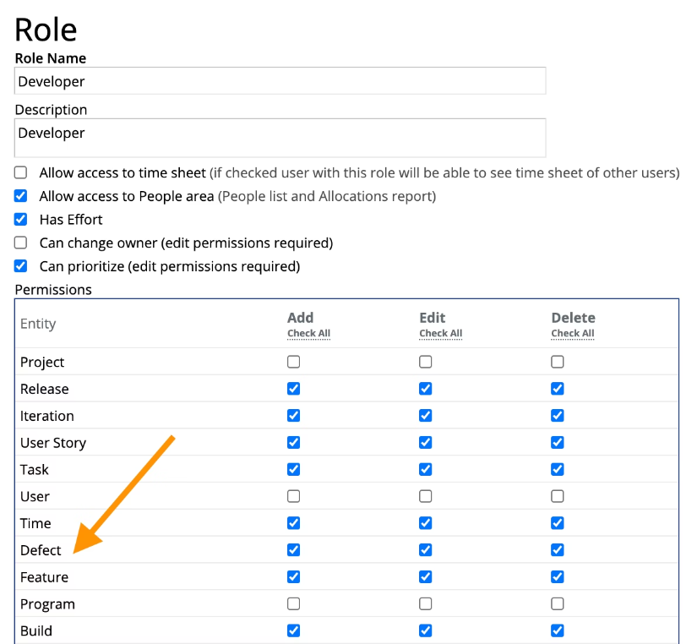
Project-Level Access
Access is granted at the project level, overriding global permissions. Roles are assigned within specific projects. Common project roles include Project Lead and Contributor. Project Administrators manage these permissions, ensuring tailored control for each project team.

Slide 5
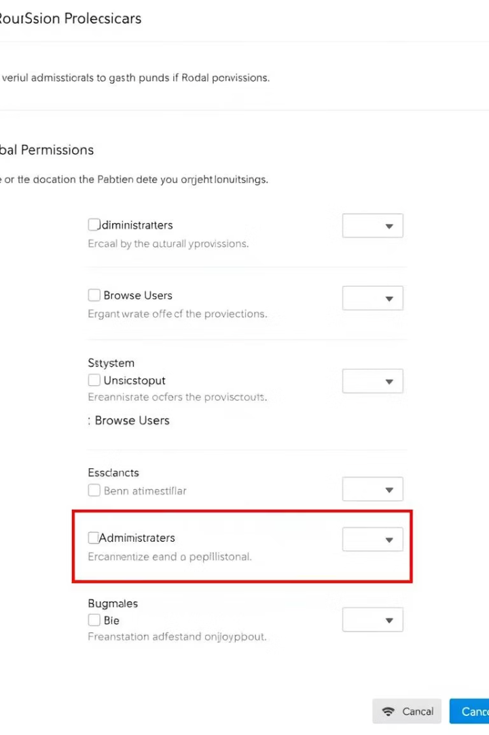
Global Permissions
Broad Scope
Sensitive
Applies across all Jira instances.
Limit access to authorized personnel only.
Review
Regularly review to prevent privilege creep.

Slide 6








Best Practices for Access Control
Least Privilege
Audit
Implement the principle of least privilege.
Regularly audit user permissions.
Security
Document
Use strong passwords and MFA; enforce password expiration.
Document access control procedures.

Slide 7
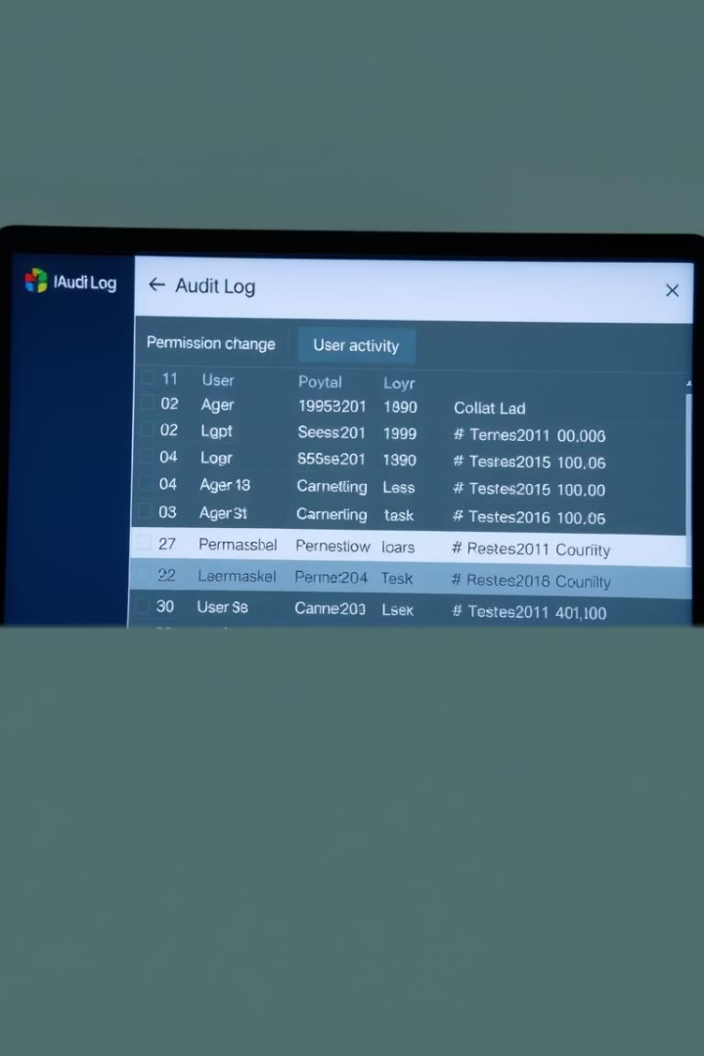
Audit Logs and Onboarding/Offboarding
1
Audit Logs
Track user access and modifications for compliance.
2
Onboarding
Provision access based on role upon joining.
3
Offboarding
Revoke access immediately upon departure (critical).
4
Automation
Use automated provisioning tools like Okta or Azure AD.

Slide 8
Common Issues & Troubleshooting
Over-permissioned Users
1
Limit access to necessary functions only.
2
Orphaned Accounts
Disable inactive accounts after 90 days.
Complex Schemes
3
Simplify by using groups/roles consistently.
4
Lack of Documentation
Maintain clear access control procedures.
Conflicting Permissions
5
Review user's group memberships.

