Slide 1
OFFICIAL PROJECT PITCH TEMPLATE
SymbioLink AI
A digital industrial-symbiosis platform that turns one factory's waste into another factory's cheap raw material.
DROP YOUR BEST
PROJECT VISUAL HERE
PROJECT SNAPSHOT
Product screen, prototype, photo or concept visual
SDG 12 · Responsible Consumption • MSME owners in industrial clusters • Working prototype (Flask + MySQL, 3 trained ML models)
TEAM
Team Chaos | R.M.D Engineering College
Vishwa R • Vineeth A • Naveen A M
01 / 08

Slide 2
02
DEFINE
The problem worth solving
Make the problem specific, evidence-based and human - not just a broad topic.
!
PROBLEM IN ONE SENTENCE
EVIDENCE
MSME owners inside a shared industrial cluster struggle to find buyers for their factory waste because no digital system exists to discover, verify and act on cross-unit matches, resulting in usable material going to landfill while nearby units pay full price for the same raw material.
11 exchanges / 60+ facilities
A Nanjangud (Mysore-area) cluster study of 42 facilities found 99.5% on-site waste recovery but only 11 verified inter-firm exchanges across 60+ facilities - recovery is high, formal cross-unit exchange is nearly absent.
U
WHO FEELS IT?
N
WHY NOW?
MSME owners in manufacturing clusters
Shared industrial clusters (e.g. Muzaffarnagar paper/sugar-mill belt, Mysore mixed-manufacturing)
Every time a waste stream is generated with no ready buyer nearby
Rising ESG/BRSR pressure pushes MSMEs toward provable waste cuts
SEBI BRSR reporting and carbon-credit markets maturing nationally
Matching still runs on personal networks, not a searchable system
SOURCE / VALIDATION
Nanjangud Industrial Area study, ScienceDirect / academia.edu (2010)
02 / 08

Slide 3
03
DEFINE
User insight + SDG alignment
Show that you understand the person behind the problem and the sustainable outcome you are targeting.
PRIMARY USER
SDG ALIGNMENT
Ramesh, MSME unit owner
SDG 12.5
Responsible Consumption & Production
USER
Mid-size manufacturing unit inside a shared industrial cluster
Turns one unit's waste into another's input material - directly supporting SDG 9.4 (industrial resource efficiency), 11.6 (cluster environmental footprint) and 13 (climate action via CO2e tracking).
JOB TO BE DONE
“When my unit generates offcut or byproduct waste, I need to find a nearby unit that can use it as raw material, so I can cut disposal cost and earn from what would otherwise be trash.”
TARGET OUTCOME
More verified inter-firm exchanges per cluster, less landfill waste, lower input costs for MSMEs
CURRENT WORKAROUND
Relies on personal contacts and word-of-mouth - most usable waste is simply missed and landfilled today.
SUCCESS SIGNAL
Completed exchanges and tonnes of waste diverted from landfill per cluster
03 / 08

Slide 4
04
DESIGN
The AI solution
Show what your product does, where AI adds real value and why the approach is different.
ONE-LINE SOLUTION
Our solution helps MSME owners in an industrial cluster find and complete waste-to-resource exchanges by using AI to rank multi-hop matches, forecast listings and read text/photo intake.
01
INPUT
AI
INTELLIGENCE
03
EXPERIENCE
04
OUTCOME
Waste/need listings via web form, WhatsApp/voice-note text or photo, plus posting history and unit trust data
4 trained models: TF-IDF + logistic-regression intake classifier, Ridge forecaster, logistic-regression match ranker, Random Forest photo classifier
Owner sees ranked match chains (direct + 2-3 hop) with a plain-language reason, posts via web/WhatsApp/photo, tracks orders and trust on one dashboard
Faster, verified matches; usable waste diverted from landfill instead of missed; lower raw-material cost
WHY AI?
Can't parse text/photos or learn saving-distance-trust interactions like AI does.
04 / 08

Slide 5
05
DESIGN
How it works
Keep the architecture understandable to both technical and non-technical judges.
1
2
AI
4
5
INPUT
PREPARE
AI CORE
DECIDE
OUTPUT
Web form listing, WhatsApp/voice message, uploaded photo, or simulated IoT bin sensor
Validate + structure the listing - parse text/Hinglish, extract material/quantity, or classify the photo
Forecast next listing (Ridge) → rank direct + 2-3 hop match chains (logistic regression) → group small loads for pooled transport
Rank matches by saving/distance/trust; flag at-risk orders (logistic regression) before they fail
Ranked match dashboard with plain-language reason, order lifecycle tracking, BRSR/carbon-credit reports
TECH STACK
SAFETY / RESPONSIBLE AI
Python / Flask + MySQL • scikit-learn • Google OR-Tools • Twilio WhatsApp • Google Maps API
Every score gets a plain-language reason, not a black box; models revert to a heuristic if accuracy drops.
05 / 08

Slide 6
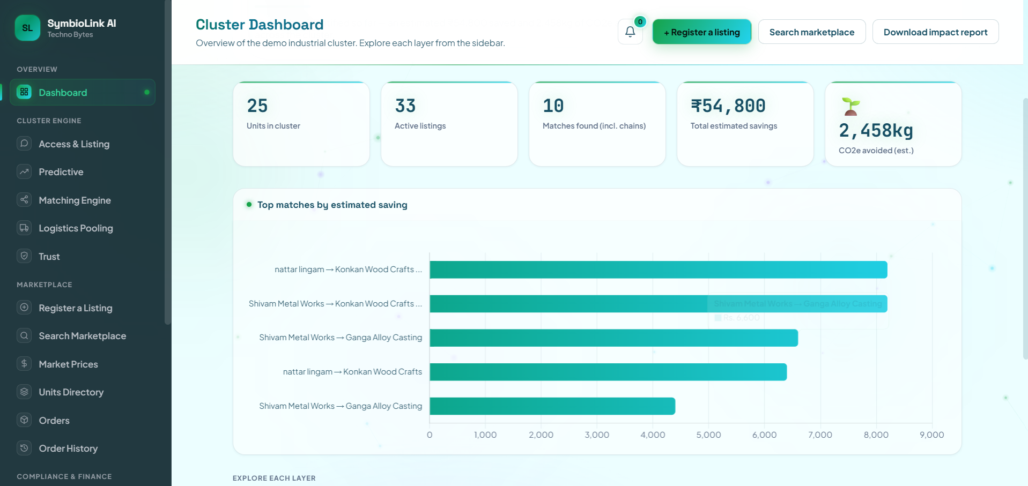
06
PROVE
Prototype + proof
Do not describe the product when you can show it. Use real screens, outputs, tests and evidence.
IOT SENSORS / CARBON CREDITS VIEW
ORDER LIFECYCLE & TRUST LEDGER
Replace this box with a readable screenshot / prototype image
Replace this box with a readable screenshot / prototype image
PROOF
A working Flask + MySQL dashboard with 9 live pages tying every layer together
• 3 trained ML models, held out: intake classifier 95.6% accuracy, match ranker 71.0% / 0.725 AUC, forecaster +14.2% MAE vs. baseline
• Built all 6 core layers + 12 added modules (matching, pooling, trust, IoT, BRSR, carbon credits, geofencing, OR-Tools) with an automated pytest suite
• Demo: localhost:5000 - repo at F:\symbiolink (add public link/QR if allowed)
06 / 08

Slide 7
07
PROVE
Impact + feasibility
Quantify the value, show what you validated and acknowledge what still needs to be solved.
95.6%
3 ML models
+14.2%
Real pilot partner
Intake classifier accuracy parsing free-text & Hinglish listings (held-out test set)
Trained and validated on a 12-unit, ~20-listing synthetic dataset modeled on real cluster data
Forecast-regressor MAE improvement vs. moving-average baseline (accuracy gain, not cost - pricing still an estimate)
Onboard one real cluster (10-20 units), replace synthetic data, turn on live WhatsApp intake
F
FEASIBILITY
S
SCALABILITY
R
RISKS + ETHICS
Phased 3-stage rollout: MVP (0-3mo, web-form intake + match ranker live) → Pilot (3-6mo, one real cluster partner, live Twilio WhatsApp, retrain on real data) → Scale (6-12mo, photo classification, carbon credits, IoT/GPS). Every layer is already built and tested end-to-end.
The rules-based graph engine + trained ML layer generalizes to any documented industrial cluster. Density modeling shows ~30% unit adoption (~18 of 60 units) is the threshold where 2-3 hop chains become reliably findable.
Reference prices/CO2e factors are estimates, not certified data • Synthetic training data could carry bias • Mitigation: plain-language reason on every score, auto-revert to heuristics below accuracy thresholds, photo results stay human-confirmed until validated
07 / 08

Slide 8
08
CLOSE
Why this project should win
End with evidence, not adjectives. Make the judges remember one clear reason to choose you.
OUR STRONGEST CASE
SymbioLink AI turns a documented 11-exchange gap across 60+ facilities into a searchable, trust-verified, multi-hop market.
NEXT 90 DAYS
01
Secure one real pilot cluster partner and define onboarding scope
02
Wire up live Twilio WhatsApp intake; retrain intake classifier + match ranker on real data
01
REAL PROBLEM
02
REAL PROOF
03
REAL IMPACT
Nanjangud cluster study: 99.5% on-site recovery, only 11 inter-firm exchanges across 60+ facilities - the gap is discovery, not willingness
Full 6-layer + 12-module architecture working end-to-end: 9 live dashboard pages, 3 trained ML models with held-out validation, automated test suite
Modeled adoption curve shows ~30% cluster adoption unlocks multi-hop matching's full value - a phased rollout keeps near-term execution realistic for a student team
03
Onboard 10-20 real units, replace synthetic data, track first exchanges
THANK YOU
SymbioLink AI · Team Chaos · Demo: localhost:5000 (repo: F:\symbiolink)
08 / 08

