Slide 1

NANDHA ENGINNERING COLLEGE
(AUTONOMOUS)
ADVENTURE EXPLORE BOT
PROJECT TITLE:
TEAM MEMBERS:
DHARUN KUMAR C
KAVIN M
SOUNDER G

Slide 2
PROJECT DOMAIN
Tourist Information Bot: Develop a bot that provides users with information about various tourist destinations, including popular attractions, historical sites, local cuisine, accommodations, weather updates, transportation options, and more. Users can query the bot for specific destinations or browse recommendations based on their preferences.
Interactive Travel Planner: Build a bot that helps users plan their trips by suggesting itineraries, activities, and points of interest based on their interests, budget, and travel dates. The bot can also assist with booking accommodations, flights, and tours, as well as providing real-time updates and notifications during the trip.

Slide 3
PROJECT DOMAIN
Virtual Tour Guide: Create a bot that offers virtual tours of famous landmarks and tourist attractions through multimedia content such as photos, videos, and audio guides. Users can explore different destinations from the comfort of their homes and interact with the bot to learn more about each location.
Local Recommendations Bot: Develop a bot that connects users with local residents or experts who can provide personalized recommendations and insider tips for exploring tourist destinations. Users can ask questions, seek advice, and receive recommendations tailored to their preferences and interests.

Slide 4
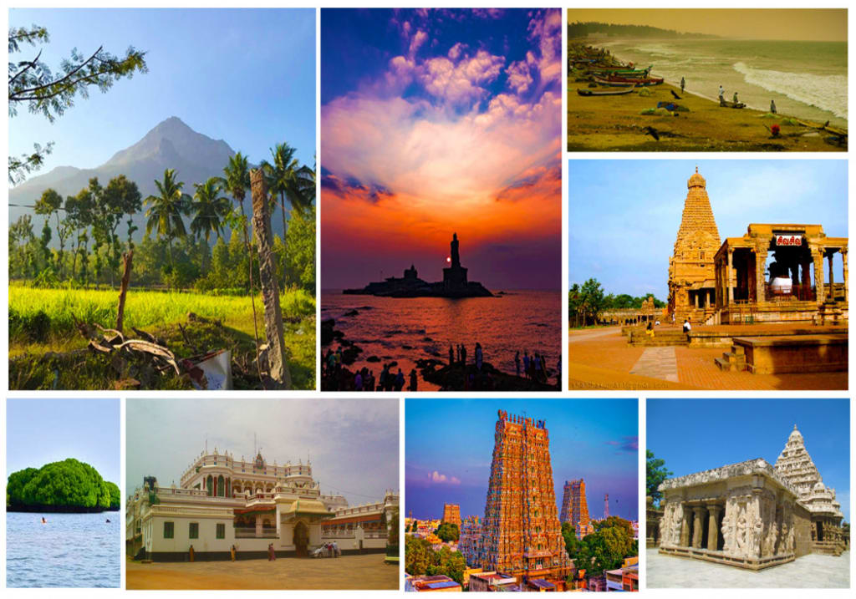
ABSTACT
This project proposes the development of a Telegram bot tailored for the exploration and discovery of tourist places. The bot aims to enhance the travel experience by providing users with comprehensive information, personalized recommendations, and interactive features. Key functionalities include tourist information retrieval, travel planning assistance, virtual tours. By leveraging the Telegram platform's messaging capabilities, multimedia support, and bot API, the project seeks to create a user-friendly and accessible tool for travelers worldwide. Through innovative features and seamless integration with Telegram, the bot aims to revolutionize the way users explore and interact with tourist destinations, making travel planning and exploration more convenient, enjoyable, and enriching.

Slide 5

Introduction
Personalized Recommendations:
Travelers input details about their trip, including whether they are traveling alone or with companions (such as a partner or family with kids), the purpose of their travel (business or leisure), and other relevant information.
Using this personal input, the deep learning-based recommendation system processes the data to suggest tourist activities and attractions that best match the traveler’s profile.
Real-Time Contextual Information:
When tourists are in the smart city, IoT devices collect real-time context-related information. This includes data on the tourist’s location, weather conditions, time of day, and attractions they have already visited.
Based on this dynamic information, the recommendation system can suggest additional activities or attractions in real time. For example, if you’re near a historical site, it might recommend visiting a nearby museum or cultural center.

Slide 6
Introduction
Performance Metrics:
The proposed multi-label deep learning classifier outperforms other models (such as decision trees, extra trees, k-nearest neighbors, and random forests).
It successfully recommends tourist attractions both when travelers search for activities before traveling (with impressive accuracy, precision, recall, and F1-score) and when they seek activities within the smart city.
Benefits:
Enhanced Tourist Experience: Travelers receive tailored recommendations based on their preferences and real-time context.
Efficient Exploration: The system helps tourists discover hidden gems and optimize their time.
Smart City Integration: By leveraging IoT data, cities can provide personalized services to visitors.

Slide 7
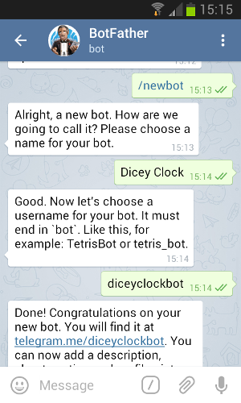
Overview
Getting Started with TeleBot:
Choose an API to interact with the Telegram Bot API. For this example, we’ll use TeleBot, a Python library.
Initiate a conversation with BotFather on Telegram to create and name your bot. Follow the prompts to receive an API token for your bot.
Setting Up Your Bot:
Install the telebot library (you can find it on PyPI).
Create a .env file and add your API key: API_KEY_TG=xxx (where xxx is your API token).
Initialize a connection to your bot using the API key.
Creating a Simple Bot:
Define a command (e.g., /hello) that triggers a response (e.g., “Hello there!”).
Your bot can watch for input and respond accordingly.

Slide 8
Overview
Example Code
import telebot
from decouple import config
API_KEY_TG = config("API_KEY_TG")
bot = telebot.TeleBot(API_KEY_TG)
@bot.message_handler(commands=["hello"])
def handle_hello(message):
bot.reply_to(message, "Hello there!")
bot.polling()
Expanding Functionality:
You can add more commands and responses to your bot.
Explore third-party APIs to enhance your bot’s capabilities

Slide 9
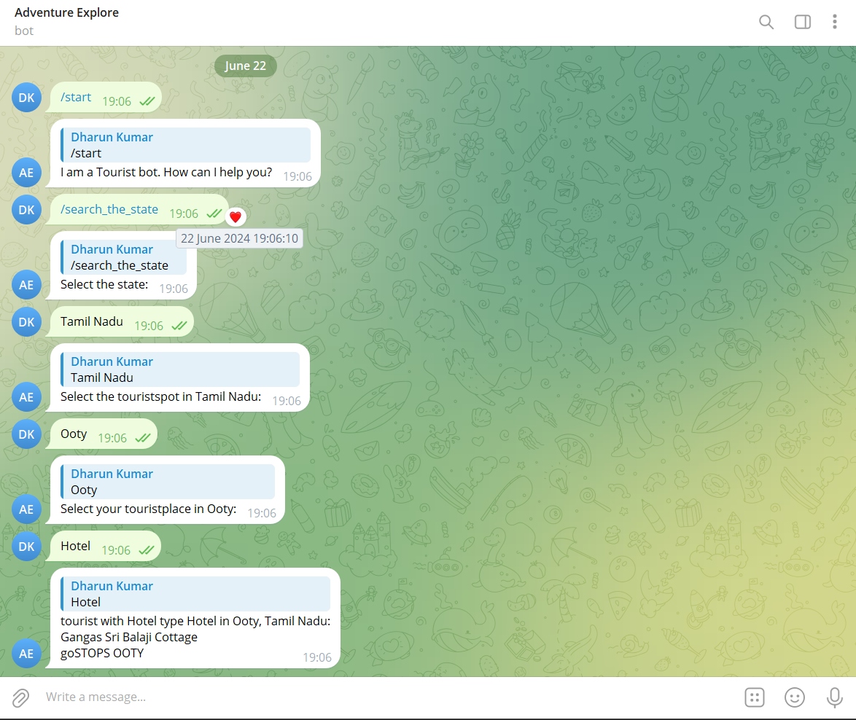
Challenges and Solutions
User Interaction and Commands:
Challenge: Designing an intuitive and user-friendly interaction flow.
Solution: Define clear commands and responses. Use buttons, inline keyboards, and menus to guide users through options.
Data Retrieval:
Challenge: Fetching relevant information about tourist spots (e.g., descriptions, opening hours, ratings).
Solution: Integrate with APIs or scrape data from reliable sources (e.g., TripAdvisor, Wikipedia). Cache data to reduce API calls.
Natural Language Understanding (NLU):
Challenge: Understanding user queries in natural language.
Solution: Use NLP libraries (e.g., spaCy, NLTK) to extract intent and entities. Train your bot to recognize common phrases related to tourist spots.

Slide 10
Challenges and Solutions
Security and Privacy:
Challenge: Protecting user data and preventing misuse.
Solution: Encrypt sensitive data (e.g., user preferences, location). Follow best practices for secure communication.
Error Handling:
Challenge: Handling unexpected inputs or errors gracefully.
Solution: Create fallback responses for unrecognized commands. Log errors for debugging.

Slide 11
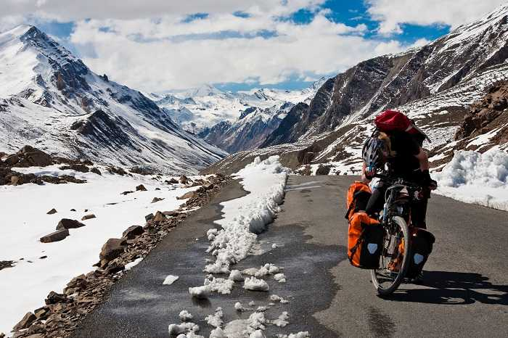
Conclution
Concluding a tourist places telebot project involves several critical steps. First, ensure all features, such as destination information, maps, recommendations, and booking options, are fully developed and thoroughly tested for accuracy and usability. Conduct extensive debugging to resolve any issues. Next, gather user feedback through beta testing, refine the bot based on this feedback, and make necessary adjustments to improve the user experience. Ensure all tourist information is accurate, up-to-date, and relevant. Prepare comprehensive documentation, including user guides and setup instructions, to aid both users and future developers. Deploy the bot in a stable environment and set up monitoring tools to track performance and user interactions. Provide user support through FAQs, support tickets, or a dedicated team, and continuously evaluate the bot's performance using analytics and user feedback to identify areas for improvement. Finally, promote the bot to attract users and increase engagement, ensuring it becomes a valuable tool for tourists seeking information and assistance.

Slide 12
REFERENCE
Data Source for Tourist Places: You’ll need a dataset containing information about tourist spots. For example, you can extract data from websites like Trawell that list tourist places in specific cities. The dataset could include details like title, category, distance from the railway station, duration, nearby places, and ratings1.
Telegram Bot Framework: To create a Telegram bot, you’ll need to use the Telegram Bot API. You can start by creating a bot using the @BotFather on Telegram. Install the pyTelegramBotAPI library, which provides a Python implementation for the Telegram Bot API2.
Bot Functionality: Decide what functionality your bot will offer. For a tourist places bot, consider features like
Search for Places: Allow users to search for tourist spots based on keywords or location..
Bot Example: Eddy Travels: One of the best Telegram bots for travelers is Eddy Travels (@EddyTravels_bot). It’s powered by Skyscanner and helps users find deals on flights, accommodations, and places to visit.

