Slide 1
NUTRIVISION AI POWERED NUTRITION ANALYSER
PROJECT PPT
DHARUN PRASANTH S (210701056)
BHUVANESHWARI S (210701043)
3RD YEAR CSE A

Slide 2
ABSTRACT
Seamlessly tracks dietary intake, offering personalized insights to support users in achieving their health and fitness objectives effectively.
Delivers immediate feedback on dietary choices, empowering individuals to make informed decisions about their nutrition for better health outcomes.
Utilizes advanced data analysis techniques to generate tailored recommendations, ensuring that users receive personalized advice aligned with their unique goals and preferences.
Enhances user engagement and efficiency in fitness regulation through a user-friendly interface, providing a comprehensive tool for maintaining a healthy lifestyle."

Slide 3
OBJECTIVES
Provide users with tools and resources to achieve optimal well-being, including accurate, up-to-date information curated by health experts.
Enable personalized nutrition planning through a user-friendly diet planner, helping users create balanced meals tailored to their needs.
Support consistent exercise regimens by offering a calorie burn calculator to track and adjust workouts for optimal results.
Utilize cutting-edge technology and professional insights to simplify the process of leading a healthier lifestyle, making it accessible to all.

Slide 4
PROBLEM STATEMENT
Individuals face challenges in navigating the complex world of exercise and nutrition, leading to confusion and discontent.
There is an overwhelming amount of information with little personalized guidance available for those pursuing health and fitness.
Our project aims to provide a comprehensive health and fitness platform with expert-curated resources and advanced technological tools.
The platform will offer personalized nutrition planning and accurate exercise tracking to make leading a healthier lifestyle simpler and more accessible.

Slide 5
EXISTING SYSTEM
Users must gather health and fitness information from multiple sources, often resulting in contradictory advice and confusion due to fragmented content.
Existing platforms often provide generic advice that fails to cater to individual dietary and fitness needs, leading to ineffective results.
Many users rely on manual tracking methods for nutrition and exercise, which are time-consuming and prone to errors, limiting accuracy.
Current health and fitness apps may lack integration with the latest technology, reducing their effectiveness and user engagement with outdated interfaces.

Slide 6
PROPOSED SYSTEM
Provide a single platform with carefully curated articles from fitness and nutrition specialists, ensuring accurate and trustworthy information for users.
Implement a user-friendly diet planner offering customized meal plans tailored to individual dietary requirements and fitness goals.
Introduce advanced tools like a nutrition analyzer and calorie burn calculator for precise tracking of dietary intake and exercise output.
Utilize the latest technological advancements to enhance user experience, ensuring the platform is accessible, intuitive, and continuously updated.

Slide 7
TECH STACK
HTML & CSS
JavaScript
React JS
Node.js
MongoDB

Slide 8
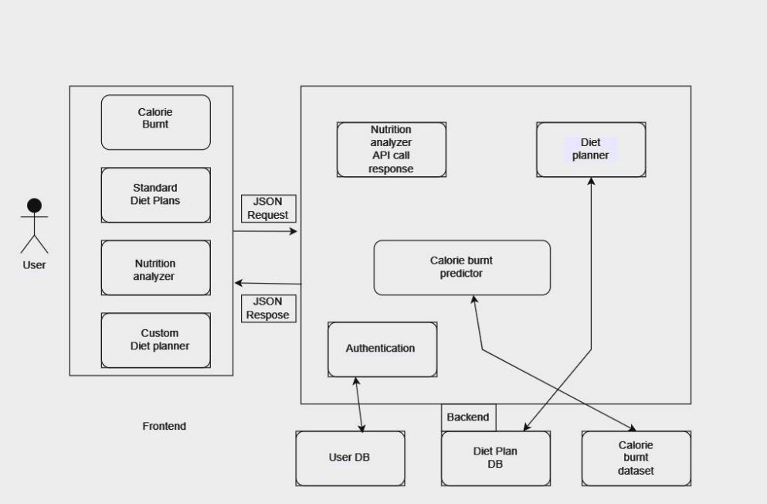
SYSTEM ARCHITECTURE

Slide 9
MODULES
Nutrition Analysis
Calorie Tracker
Diets
Diet Planner

Slide 10
REFERENCES
S. Banerjee and A. C. Mondal, "Nutrient Food Prediction Through Deep Learning," 2021 Asian Conference on Innovation in Technology (ASIANCON), PUNE, India, 2021, pp. 1-5, doi: 10.1109/ASIANCON51346.2021.9545014.
S. -C. Huang, W. -C. Chiang, Y. -T. Yang and J. -S. Wang, "An Image-based AI Nutrition Analysis Platform for Food in Compartment Trays," 2023 14th IIAI International Congress on Advanced Applied Informatics (IIAIAAI), Koriyama, Japan, 2023, pp. 373-374, doi: 10.1109/IIAIAAI59060.2023.00079.
] E. Dashkova and R. Dorokhova, "SmartDiet — Personal wellbeing assistant and diet planner mobile service," 2012 11th Conference of Open Innovations Association (FRUCT), St. Petersburg, Russia, 2012, pp. 35-39, doi: 10.23919/FRUCT.2012.8253106.

Slide 11
REFERENCES
P. Slade, "DIY Activity Tracker: Count Your Calories More Accurately than a Smartphone," in IEEE Spectrum, vol. 58, no. 10, pp. 14-16, October 2021, doi: 10.1109/MSPEC.2021.9563960.
] L. Guo, J. Zhang, J. Yu, G. Wang, Y. Qi and T. Liu, "Diet Planning Models Based on Linear Programming Theory for Catering Problems," 2023 2nd International Conference on Automation, Robotics and Computer vi Engineering (ICARCE), Wuhan, China, 2023, pp. 1-4, doi: 10.1109/ICARCE59252.2024.10492475.

Slide 12
THANK YOU

