Slide 1
Air Quality Prediction Using Advanced ML algorithms

Slide 2
Air Quality Prediction python code using ml
import pandas as pd
import numpy as np
from sklearn.model_selection import train_test_split
from sklearn.ensemble import RandomForestRegressor
from sklearn.metrics import mean_absolute_error, r2_score
import matplotlib.pyplot as plt
import seaborn as sns
# Load dataset (uploaded file)
data = pd.read_csv("city_day.csv")
# Drop rows with missing AQI values
data = data.dropna(subset=['AQI'])
# Select pollutant columns as features
features = ['PM2.5', 'PM10', 'NO', 'NO2', 'NOx', 'NH3', 'CO', 'SO2', 'O3', 'Benzene', 'Toluene', 'Xylene']
X = data[features]
y = data['AQI']
# Fill missing feature values with median values
X = X.fillna(X.median())

Slide 3
# Split data into train/test sets
X_train, X_test, y_train, y_test = train_test_split(X, y, test_size=0.2, random_state=42)
# Initialize and train Random Forest model
model = RandomForestRegressor(n_estimators=100, random_state=42)
model.fit(X_train, y_train)
# Predict AQI values on test data
y_pred = model.predict(X_test)
# Evaluate the model
mae = mean_absolute_error(y_test, y_pred)
r2 = r2_score(y_test, y_pred)
print(f"Mean Absolute Error: {mae:.2f}")
print(f"R² Score: {r2:.2f}")
# Plot feature importance
importances = model.feature_importances_
feature_importance = pd.Series(importances, index=features).sort_values(ascending=False)
plt.figure(figsize=(10,6))
sns.barplot(x=feature_importance, y=feature_importance.index)
plt.title('Feature Importance')
plt.xlabel('Importance Score')
plt.ylabel('Features')
plt.tight_layout()
plt.show()

Slide 4
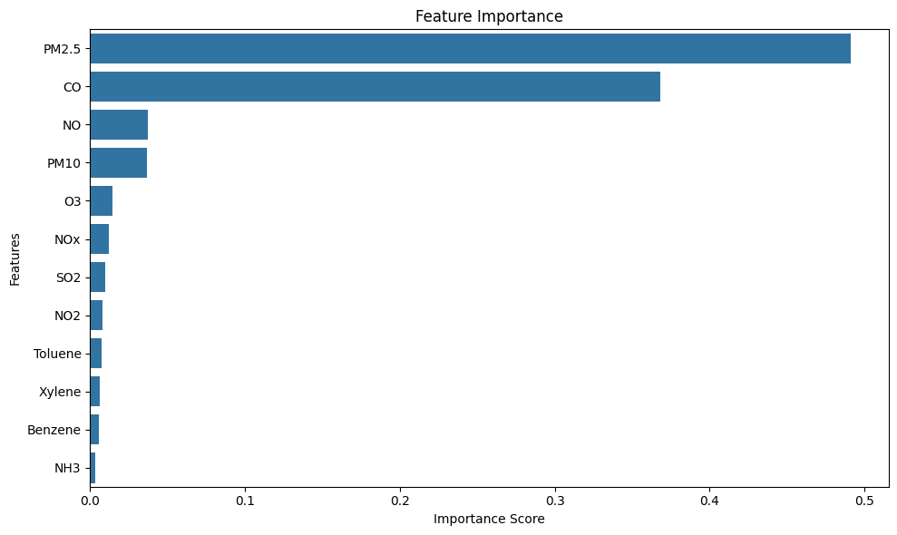
output
Mean Absolute Error: 20.84 R² Score: 0.91

