Slide 1


SMART INDIA HACKATHON 2025
Problem Statement ID – 25128
Problem Statement Title - Student Innovation: Swadeshi for Atmanirbhar Bharat
Theme- Clean & Green Technology
PS Category- Software
Team ID- 80408
Team Name-SYNTAX SENA 2.O

Slide 2

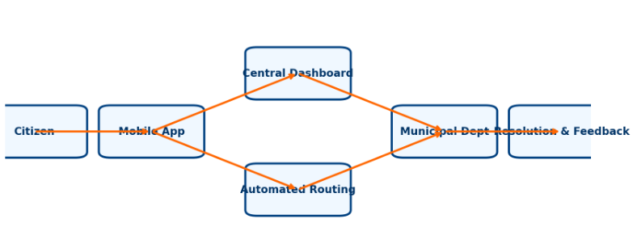
Crowd Civic Issue Reporting and Resolution System
✨ Detailed Explanation
📱 Mobile app → Report with photo + location + voice/text
🌍 Dashboard → Live city map of issues
⚡ Smart routing → Auto-assigns to the right dept
🔔 Citizens track status in real-time
✅ How It Solves the Problem
🤝 Bridges citizen ↔ government gap
⚡ Enables faster, transparent resolutions
🧠 Prioritizes issues using AI & data insights
🌟 Innovation & Uniqueness
📍 Geo-tag + 📸 photo + 🎙️ voice reporting
🤖 Automated AI-based routing
📊 Real-time feedback & analytics
🏙️ Scalable → Future Smart City integration

Slide 3

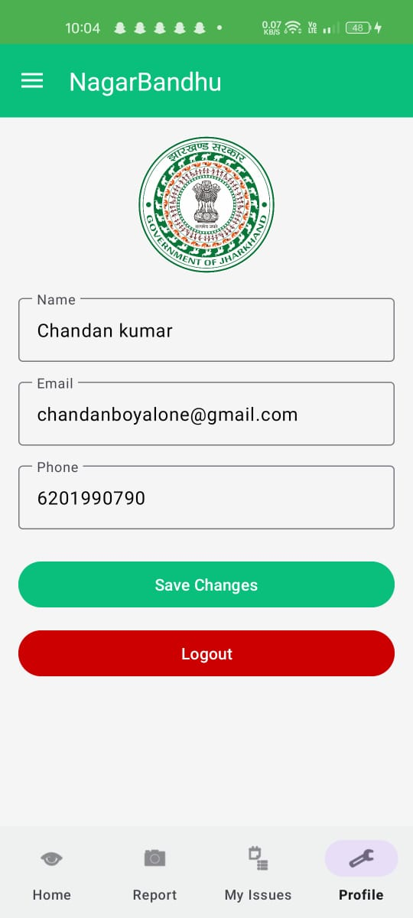
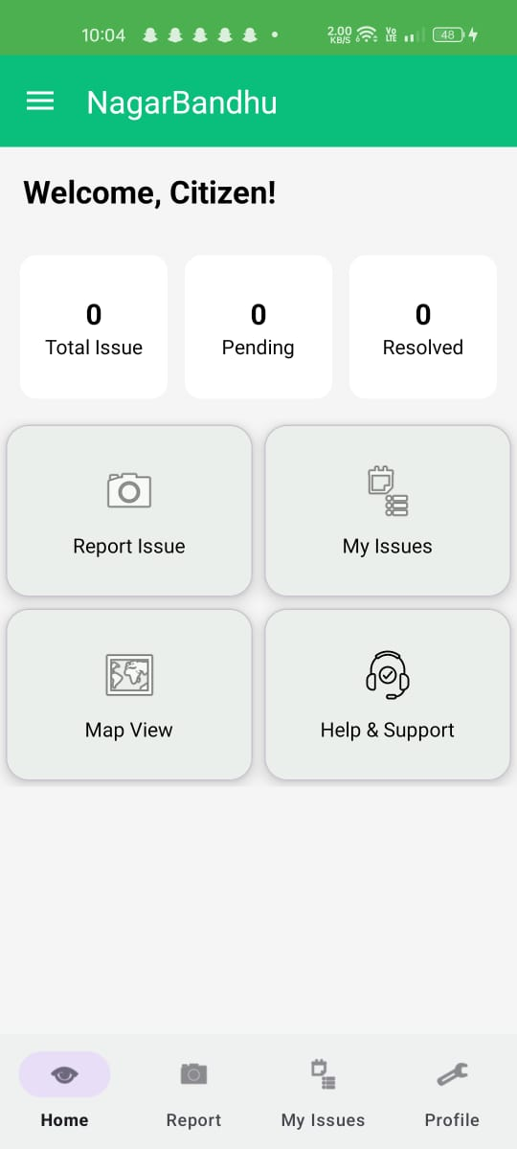
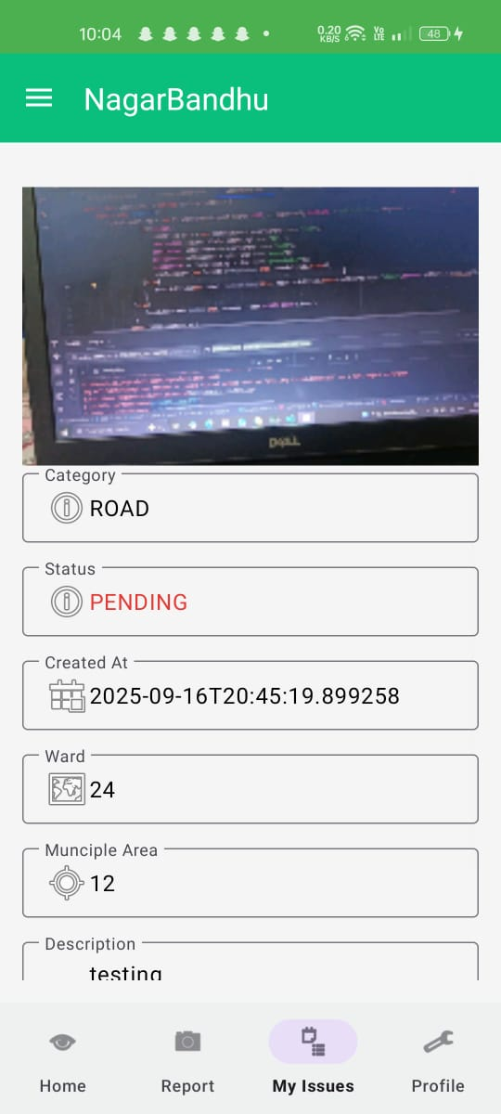


TECHNICAL APPROACH
📱 User App (Frontend) → Android/Flutter
🖥️ Admin Portal (Frontend) → Web (React/Angular)
🛠️ Backend → Java + Spring Boot
🗄️ Database → PostgreSQL

Slide 4
FEASIBILITY AND VIABILITY
✅ Feasibility
Tech stack is proven & scalable
Citizens already use smartphones daily
⚠️ Challenges / Risks
Low user adoption
Data overload for the government
Network/connectivity issues
💡 Strategies
Awareness campaigns 📢
Smart filters & AI 🤖
Offline mode 🌐

Slide 5

IMPACT AND BENEFITS
🌱 Environmental
Faster waste management → cleaner surroundings.
Reduced pollution from unattended garbage.
Supports sustainable, smart-city initiatives.
👥 Social
Empowers citizens to actively participate
Builds trust & transparency in governance
Enhances safety & quality of life.
💰 Economic
Saves municipal resources via efficient workflows
Reduces repair/maintenance costs with early detection.
Boosts productivity by minimizing civic disruptions.
📊 Governance
Transparent monitoring of civic departments.
Measurable performance via analytics
Increased accountability of officials.
💻 Technological
Promotes digital adoption among citizens
Scalable for integration with future smart-city platforms.
Data-driven insights for better urban planning.

Slide 6

RESEARCH AND REFERENCES
📚 References
[1] Ministry of Housing and Urban Affairs, Smart City Mission, Government of India. [Online]. Available: https://smartcities.gov.in
[2] S. Agarwal, R. Gupta, and A. Sharma, “E-governance for urban service delivery: A smart city perspective,” IEEE Access, vol. 9, pp. 112345–112358, 2021.
[3] World Bank, Urban Service Delivery and Technology in Developing Countries. Washington, DC, USA: World Bank, 2020.
[4] T. Nam and T. A. Pardo, “Conceptualizing smart city with dimensions of technology, people, and institutions,” in Proc. 12th Annu. Int. Digital Government Research Conf., 2011, pp. 282–291.
[5] “FixMyStreet Platform – Crowdsourced Civic Reporting,” mySociety, 2023. [Online]. Available: https://www.fixmystreet.com (ISC), 2021, pp. 201–207.

