Slide 1
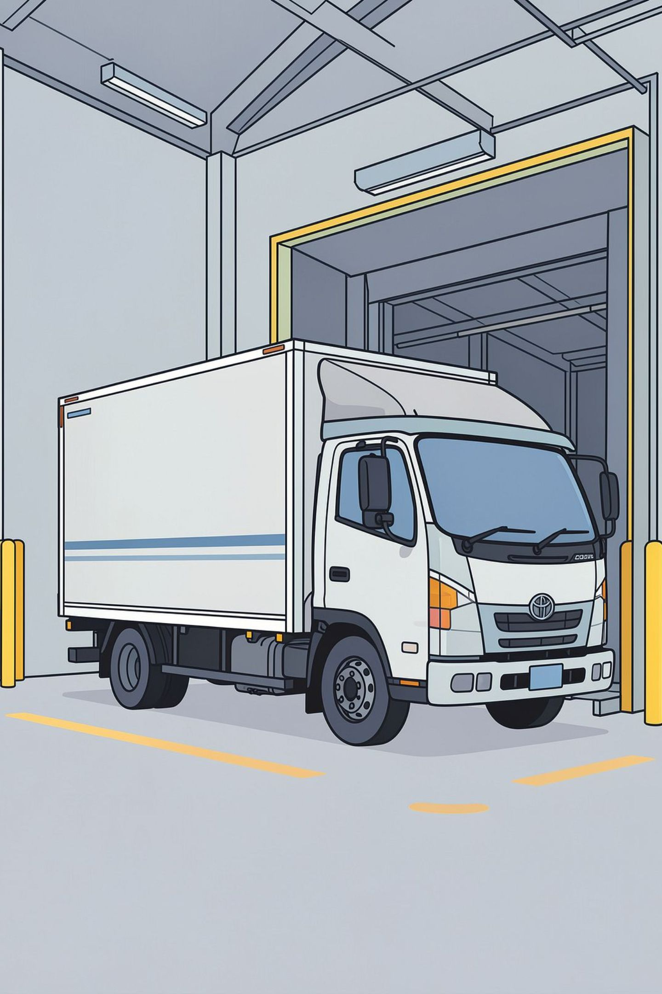
CargoSync — SRS: Introduction & Overview
Cloud-native logistics and fleet orchestration platform that connects shippers with nearby carriers and automates load planning, routing, and chain‑of‑custody verification. This SRS covers the system objectives, problem context, and high‑level feasibility for an enterprise‑grade marketplace and optimisation engine.

Slide 2




Problem Statement: Core Operational Frictions
Wasted payload capacity
Inefficient loading sequences
Manual load planning yields inefficient 3D packing and under‑utilised volumetric capacity.
Cargo loaded without drop‑order awareness forces in‑route rehandling and delays.
Fragmented capacity sourcing
Unreliable chain of custody
SMBs cannot reliably find nearby, vetted carriers that match volume and weight requirements.
Paper manifests and manual handoffs increase disputes, tampering risk, and delayed payouts.

Slide 3

Scope — What CargoSync Will Do
Unified platform combining: user registration (shippers & truckers), granular job posting with box‑level attributes, automated 3D bin‑packing, reverse‑sequence route optimisation, proximity‑based marketplace matcher, mobile QR scanning for chain‑of‑custody, and automated payment and dispute workflows.

Slide 4
Objectives (Functional Goals)
3D load automation
Reverse delivery sequencing
Proximity marketplace
Compute optimal spatial arrangements using 3D bin‑packing to maximise utilisation and respect weight/stacking constraints.
Match demand to nearby, rated carriers using volume, weight, availability and SLA filters.
Derive load order that minimises mid‑route rehandling by placing last stops accessible first in the load plan.
QR-driven custody
Immutable, timestamped handoffs via mobile QR scans and audit trail for dispute resolution and automated payout triggers.

Slide 5

Existing System & Key Limitations
Current processes rely on phone brokers, spreadsheets and visual estimation. This creates:
High volumetric volatility and under‑utilisation.
Route friction and longer dwell times at stops.
Lack of real‑time visibility — frequent manual check‑calls.
Frequent dispute claims due to unverifiable handoffs.

Slide 6
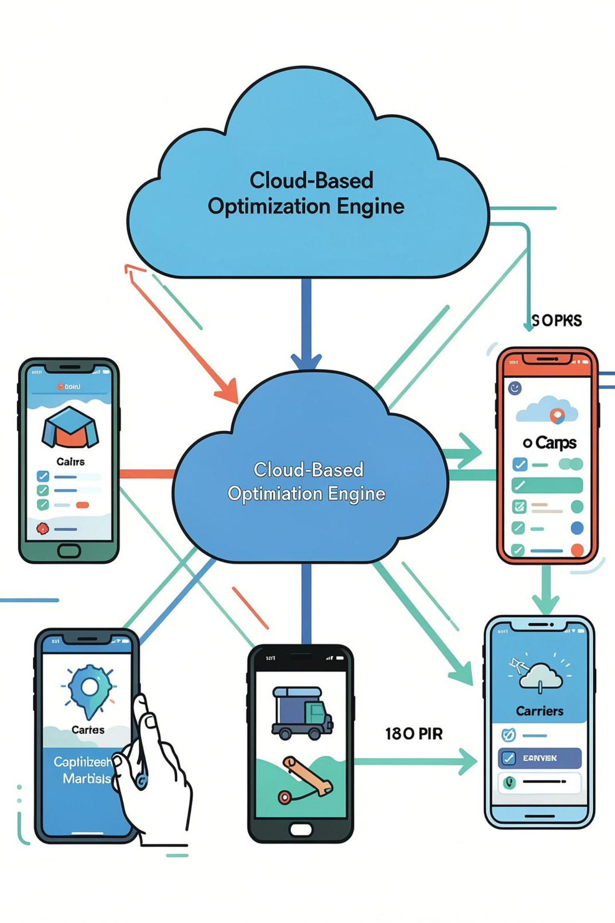
Proposed System Architecture (High Level)
Modular cloud services: API gateway → Matchmaking & Marketplace → 3D packing engine → Routing & sequencing service → Mobile clients (drivers, recipients) → Audit ledger & payments. Each interaction is evented for traceability and horizontal scalability.

Slide 7
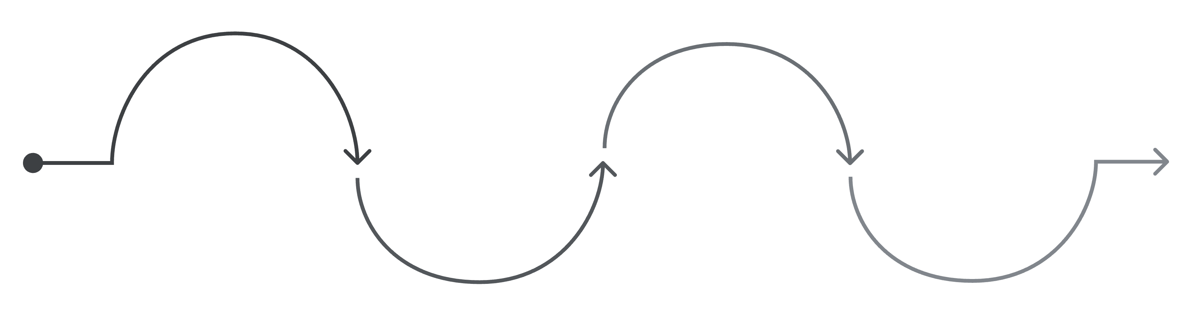
How It Works — Key Workflows
Compute Load
Recipient Verify
Post Job
System plans 3D load & suggests carriers
Driver Scans
Final scan completes custody and payment
Shipper creates box-level job
Driver scans QR at pickup and handoffs
Automated validation at each touchpoint reduces disputes, enforces load constraints, and triggers settlement rules automatically.

Slide 8



Feasibility Summary
1
2
Technical
Operational
Feasible using cloud compute (e.g., AWS/GCP), containerised packing/routing microservices, and smartphone QR scanning.
User workflows split by role reduce onboarding friction; design focuses on minimal in‑field steps for drivers and warehouse staff.
3
Economic
SaaS + transaction commissions; savings from route optimisation and reduced claims support positive ROI in early adoption.

Slide 9




Non-Functional Requirements (Highlights)
Security & Integrity
Performance
Encrypted data at rest and in transit; tamper‑evident custody records; role‑based access control for shippers, carriers, and ops.
Sub‑second UI responses for lookup; packing and routing results within operational SLA (configurable, e.g., ≤10s for typical jobs).
Reliability & Scalability
Usability
Design for horizontal scaling of compute‑intensive packing engines and high‑availability mobile sync for offline scanning.
Minimal driver interactions: scan, confirm, navigate — optimised for low bandwidth and rugged device usage.

Slide 10
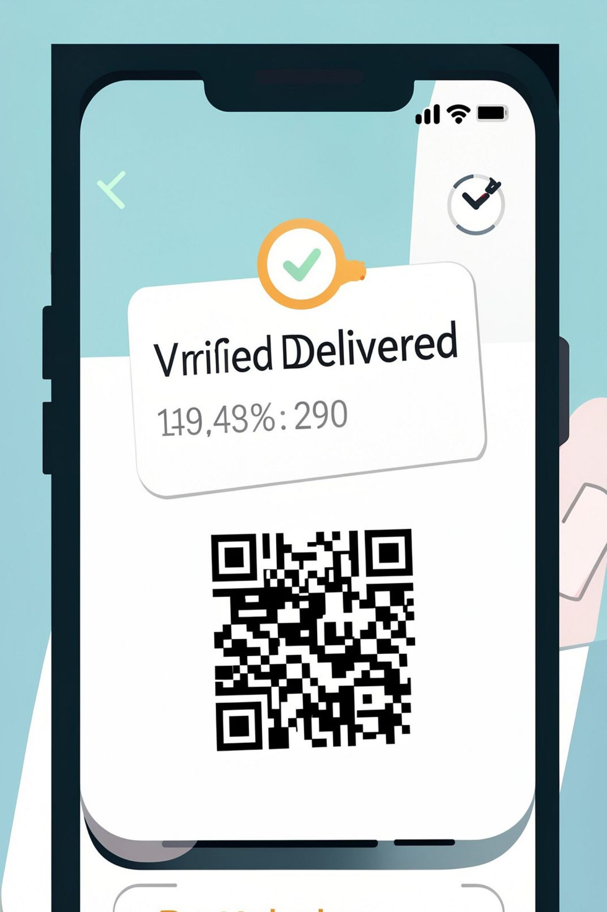

Next Steps & Acceptance Criteria
Prioritised milestones for MVP:
Core APIs, auth, and user roles implemented.
Box-level job posting + 3D packing service with sample truck types.
Marketplace matcher with proximity & rating filters.
Mobile scanning app for pickup and per-stop custody verification.
End-to-end payments and dispute workflow with automated triggers.
Acceptance: successful end-to-end test with live truck, 80%+ load utilisation improvement in pilot runs, and verified chain‑of‑custody for 100 consecutive deliveries.

Slide 11
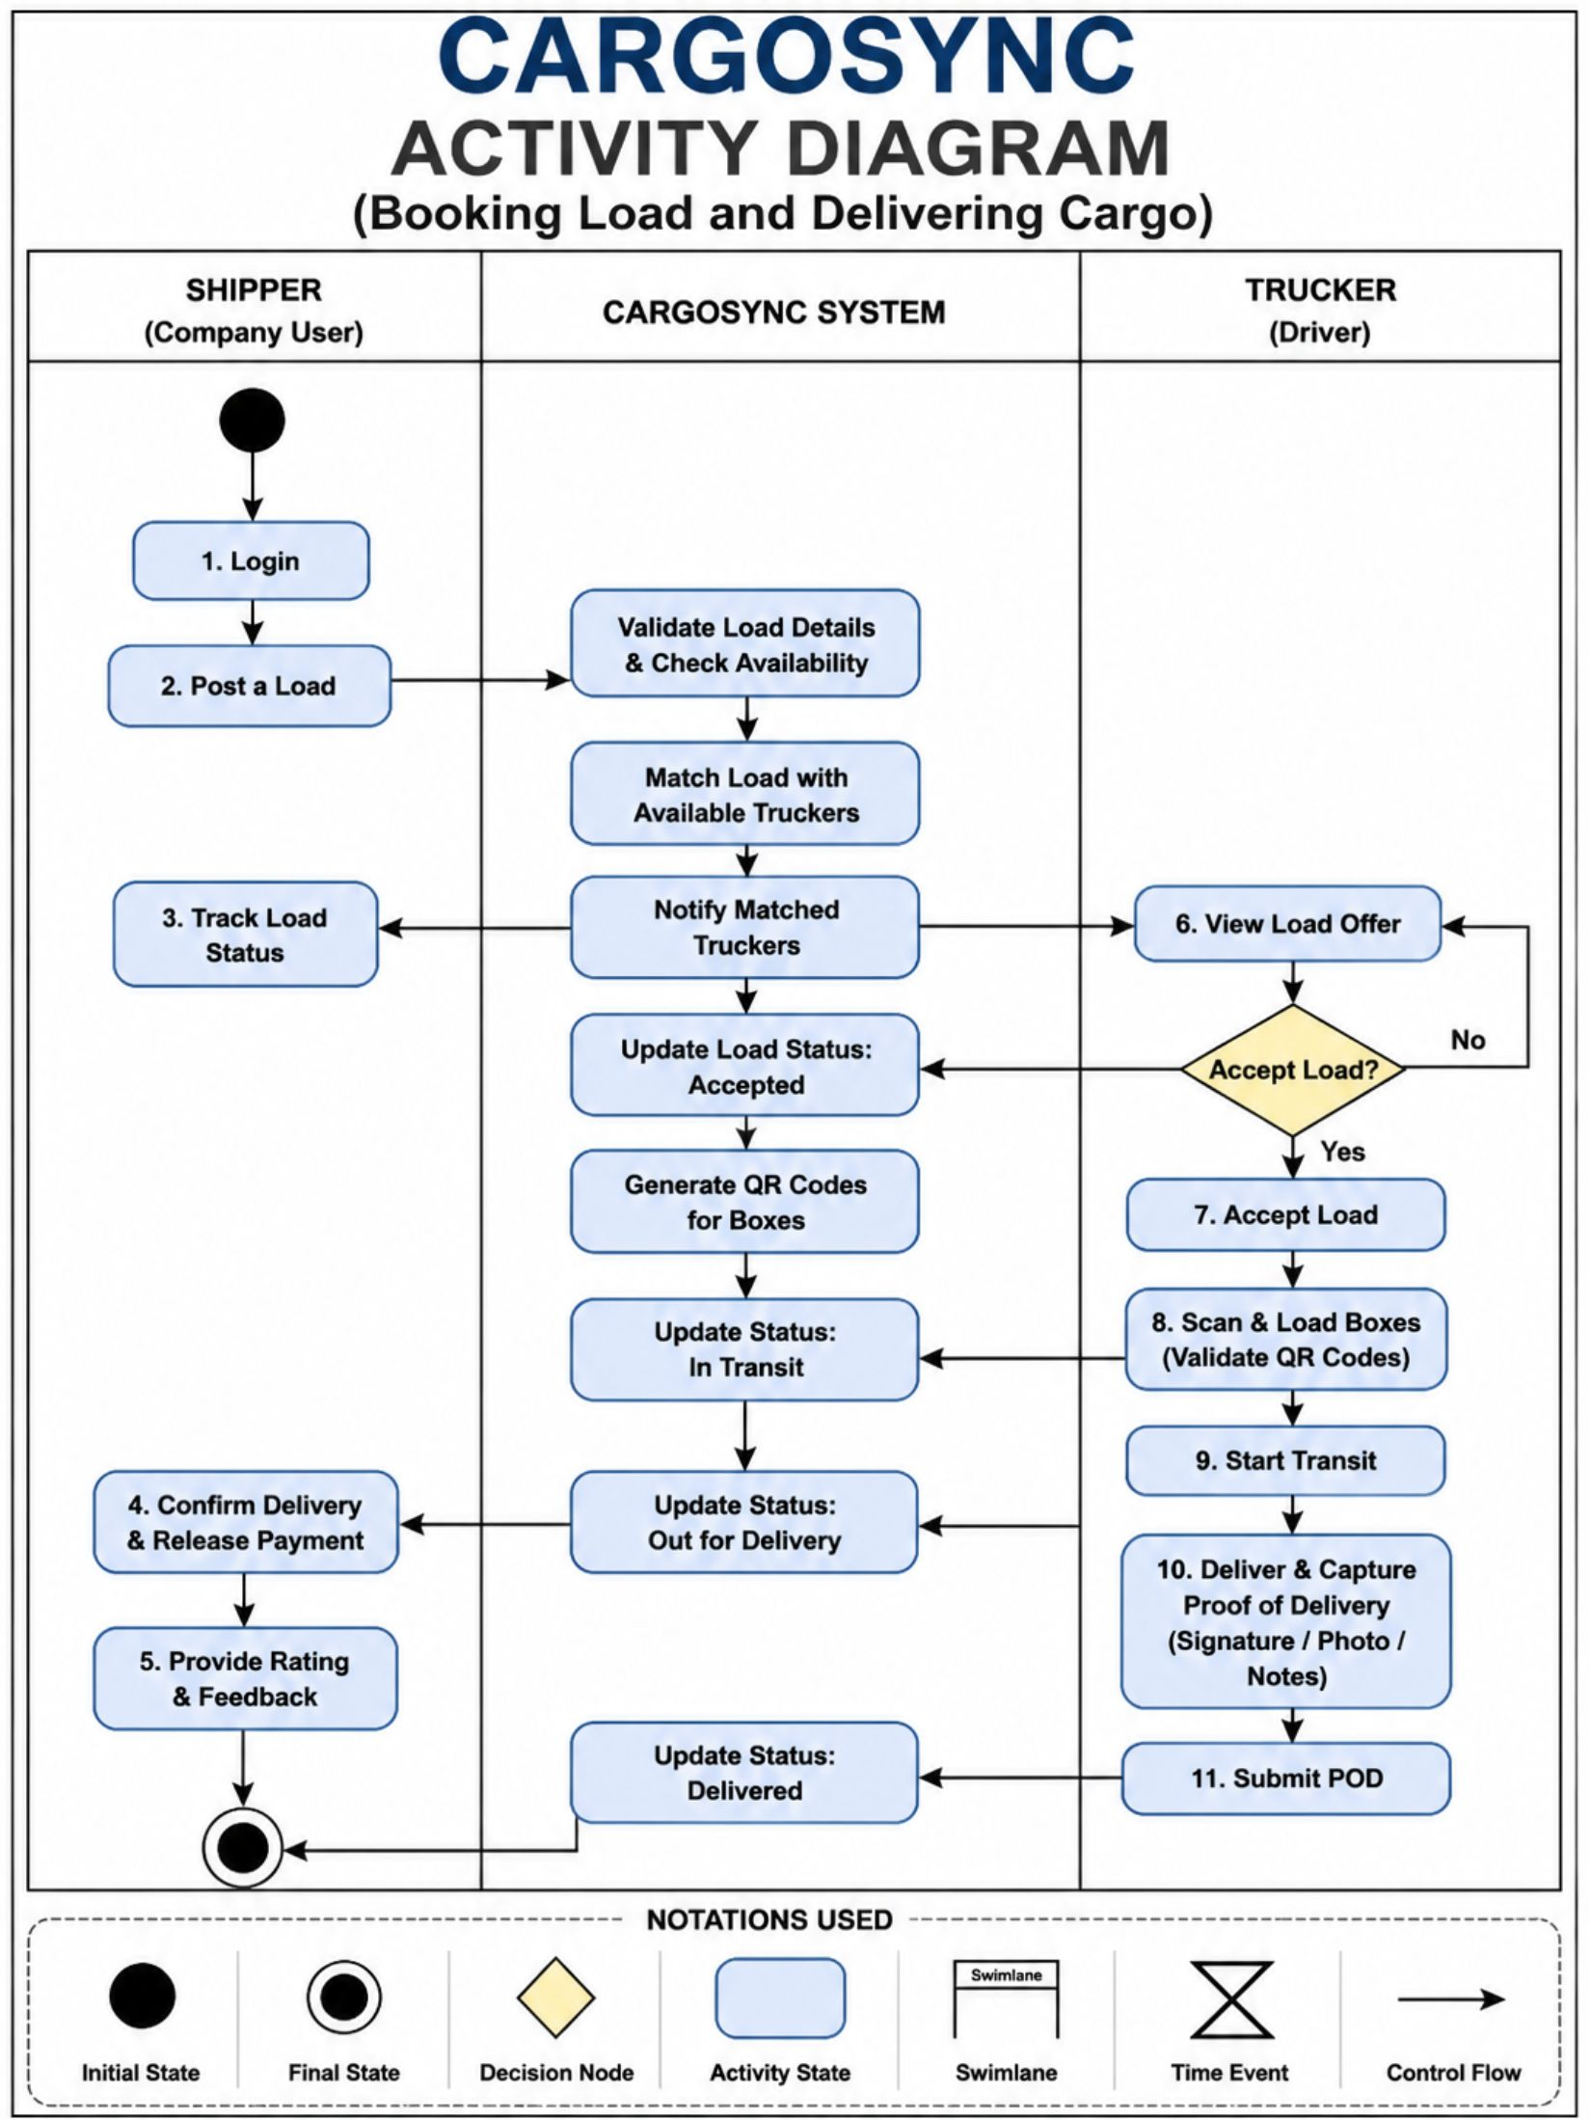
PROJECT DIAGRAMS
ACTIVITY DIAGRAM

Slide 12
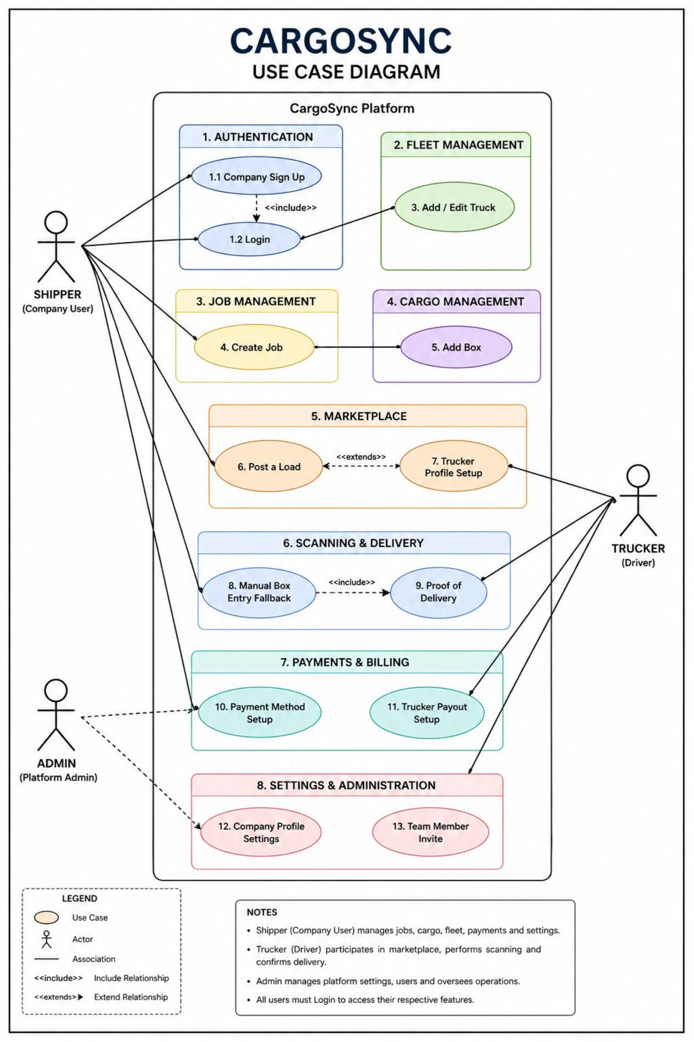
USE CASE DIAGRAM

Slide 13
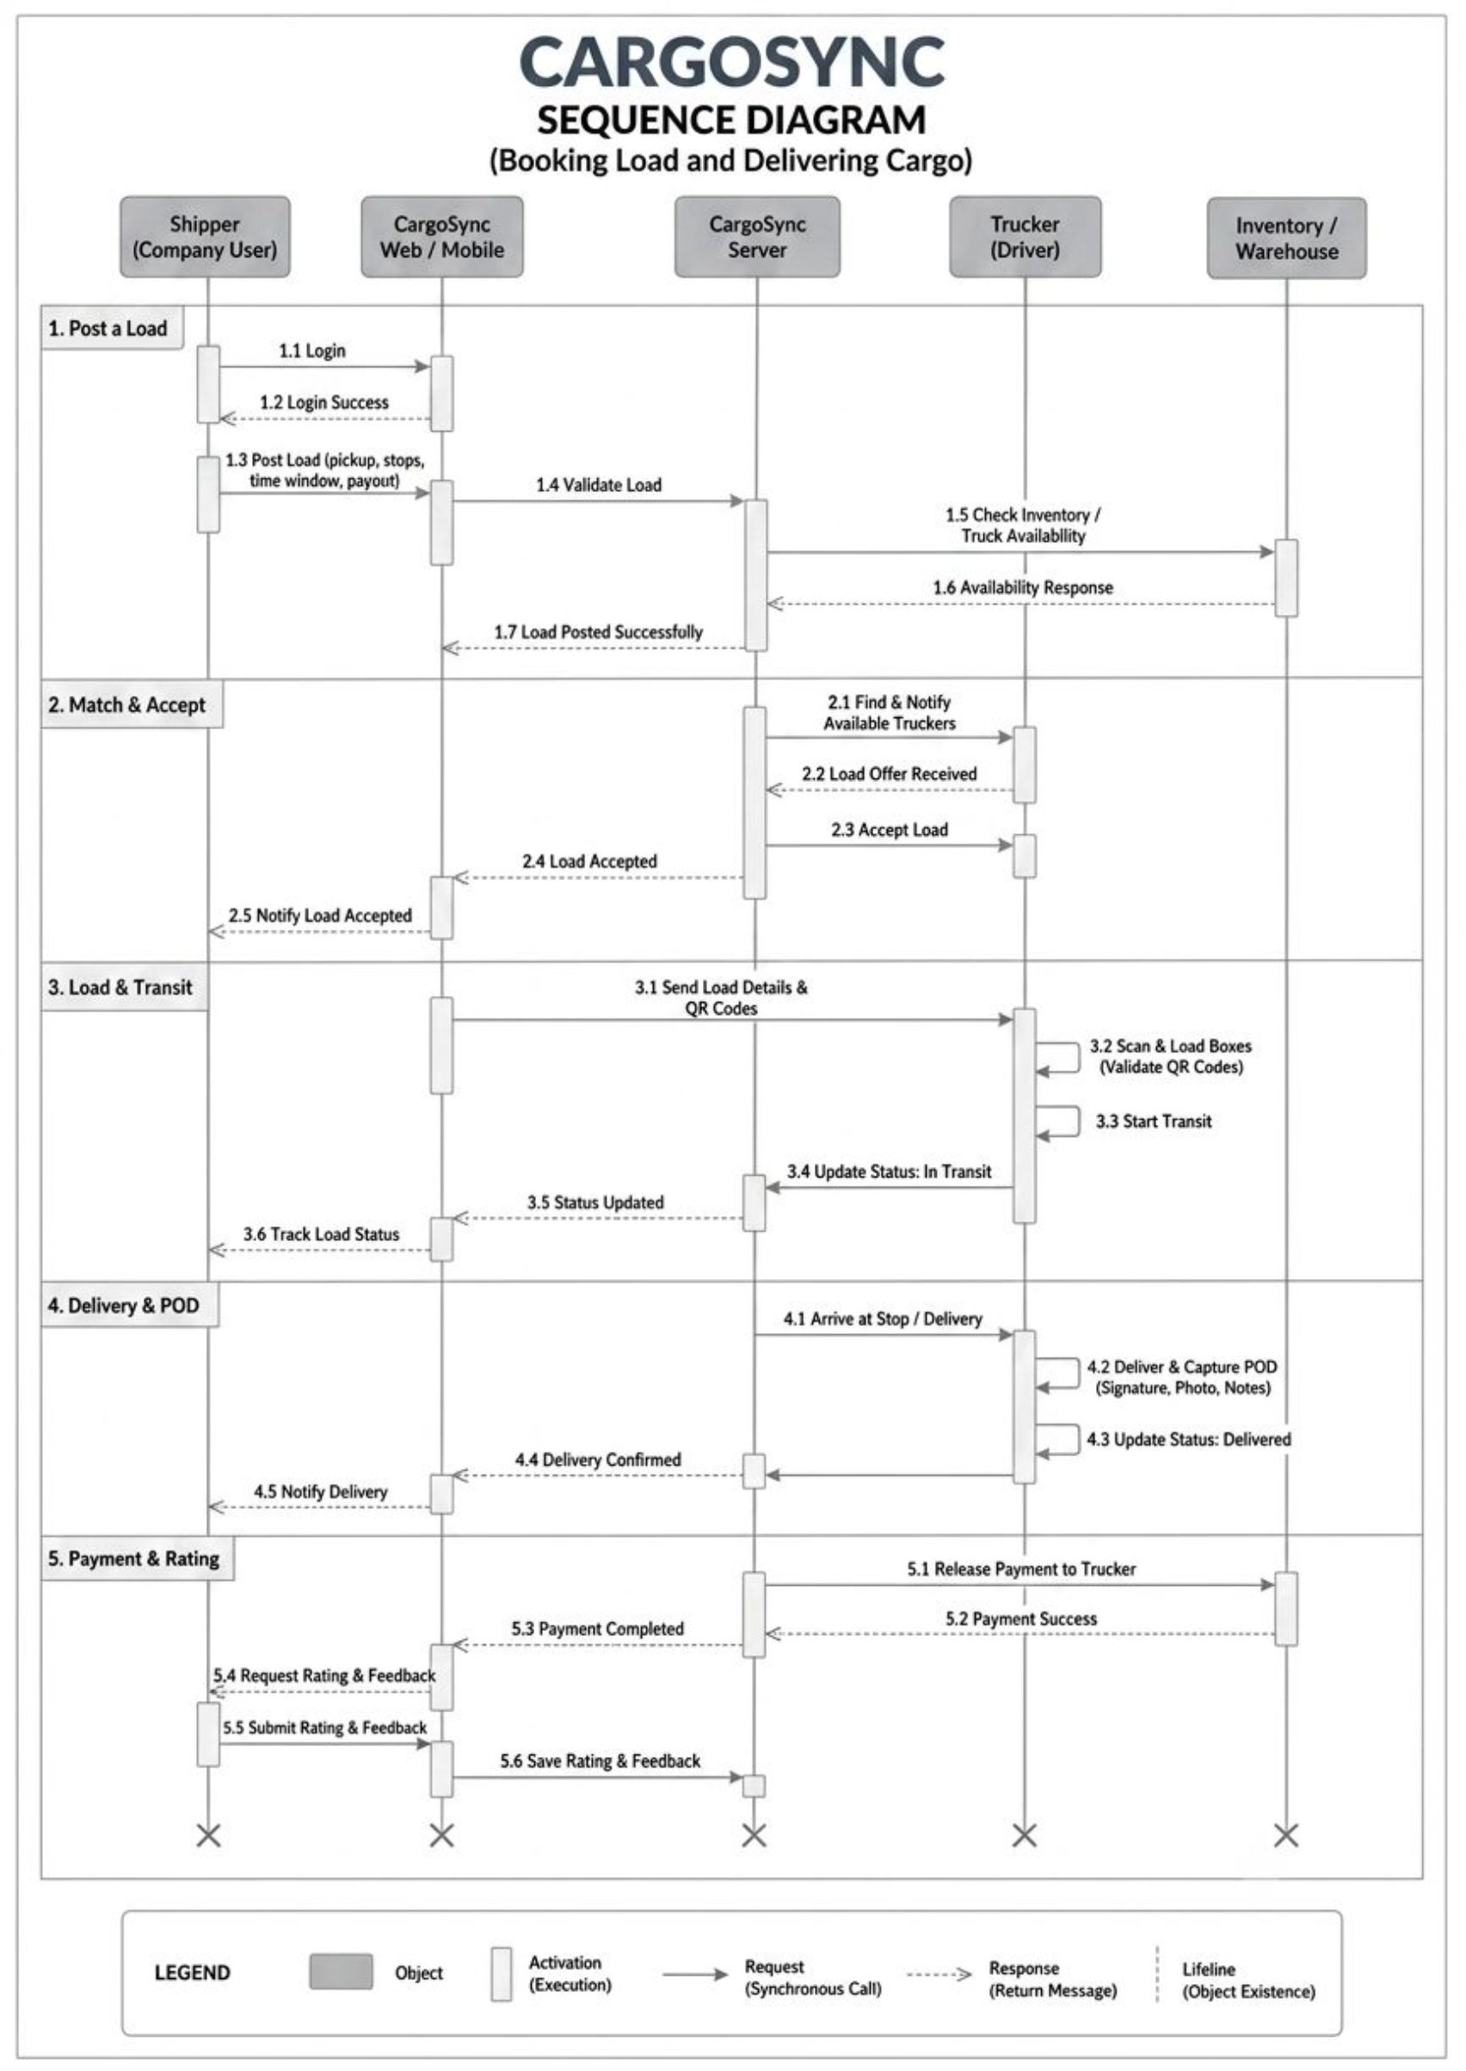
SEQUENCE DIAGRAM

Slide 14
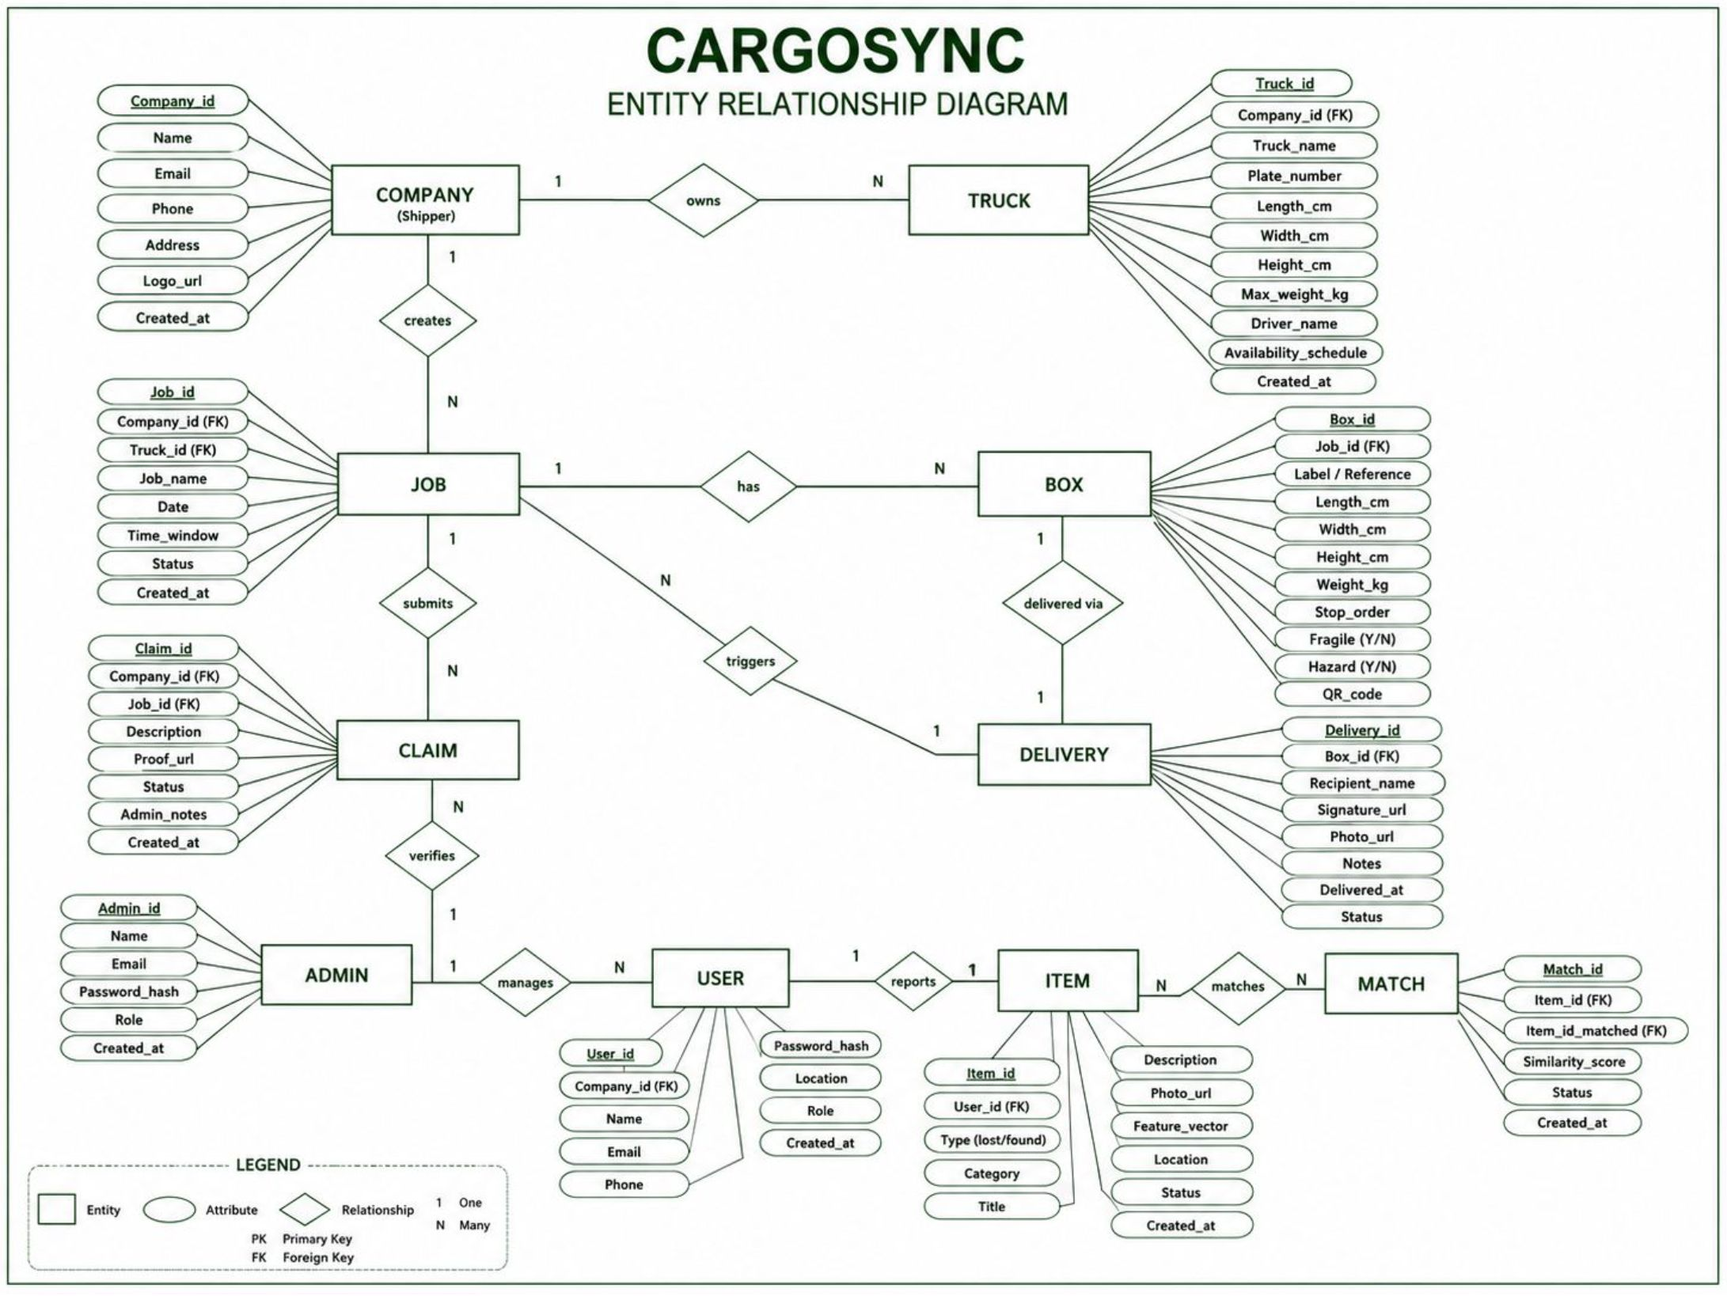
ER DIAGRAM

Slide 15

CargoSync: The Future of Logistics
CargoSync revolutionises logistics by connecting shippers and carriers with unparalleled efficiency. Through intelligent load optimisation, real-time tracking, and secure chain-of-custody, we ensure maximum payload utilisation, reduced rehandling, and reliable, dispute-free deliveries. This platform empowers businesses with transparent operations and drives significant cost savings, transforming the future of freight.

