Slide 1

DIABETES PREDICTION (PSYLIQ-ASSESSMENT PROJECT
BY
TOYINBO STEPHEN OLUDAYO

Slide 2
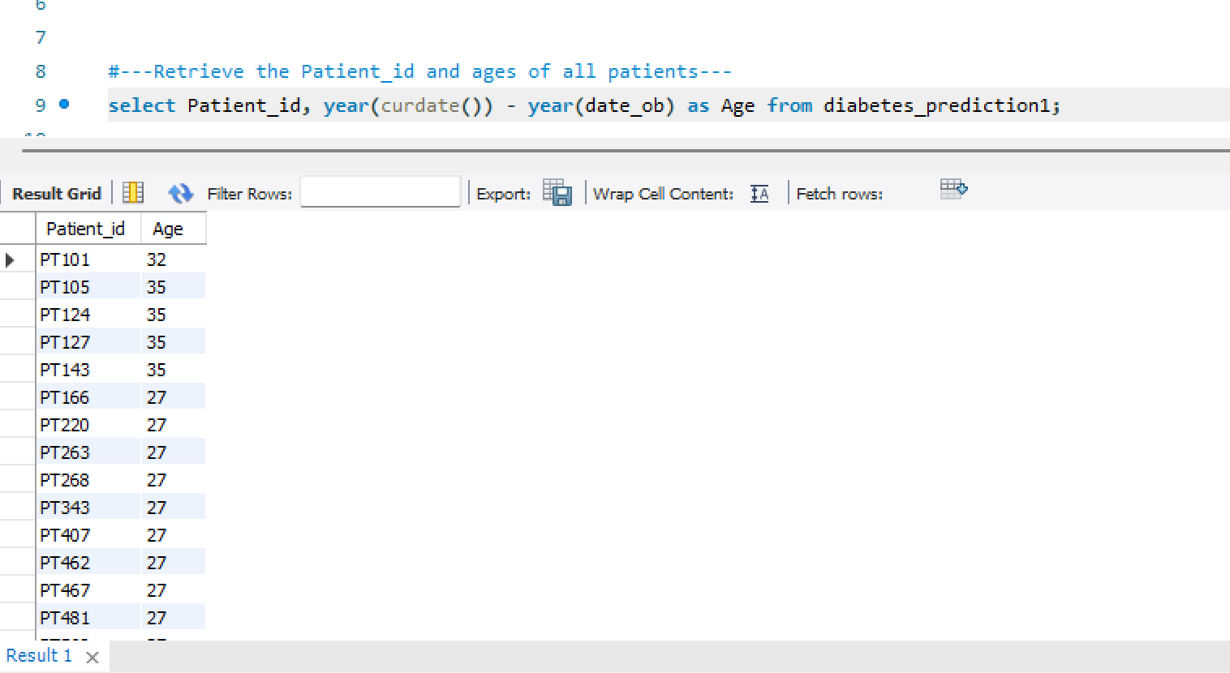
Retrieve the Patient_id and ages of all patients.

Slide 3
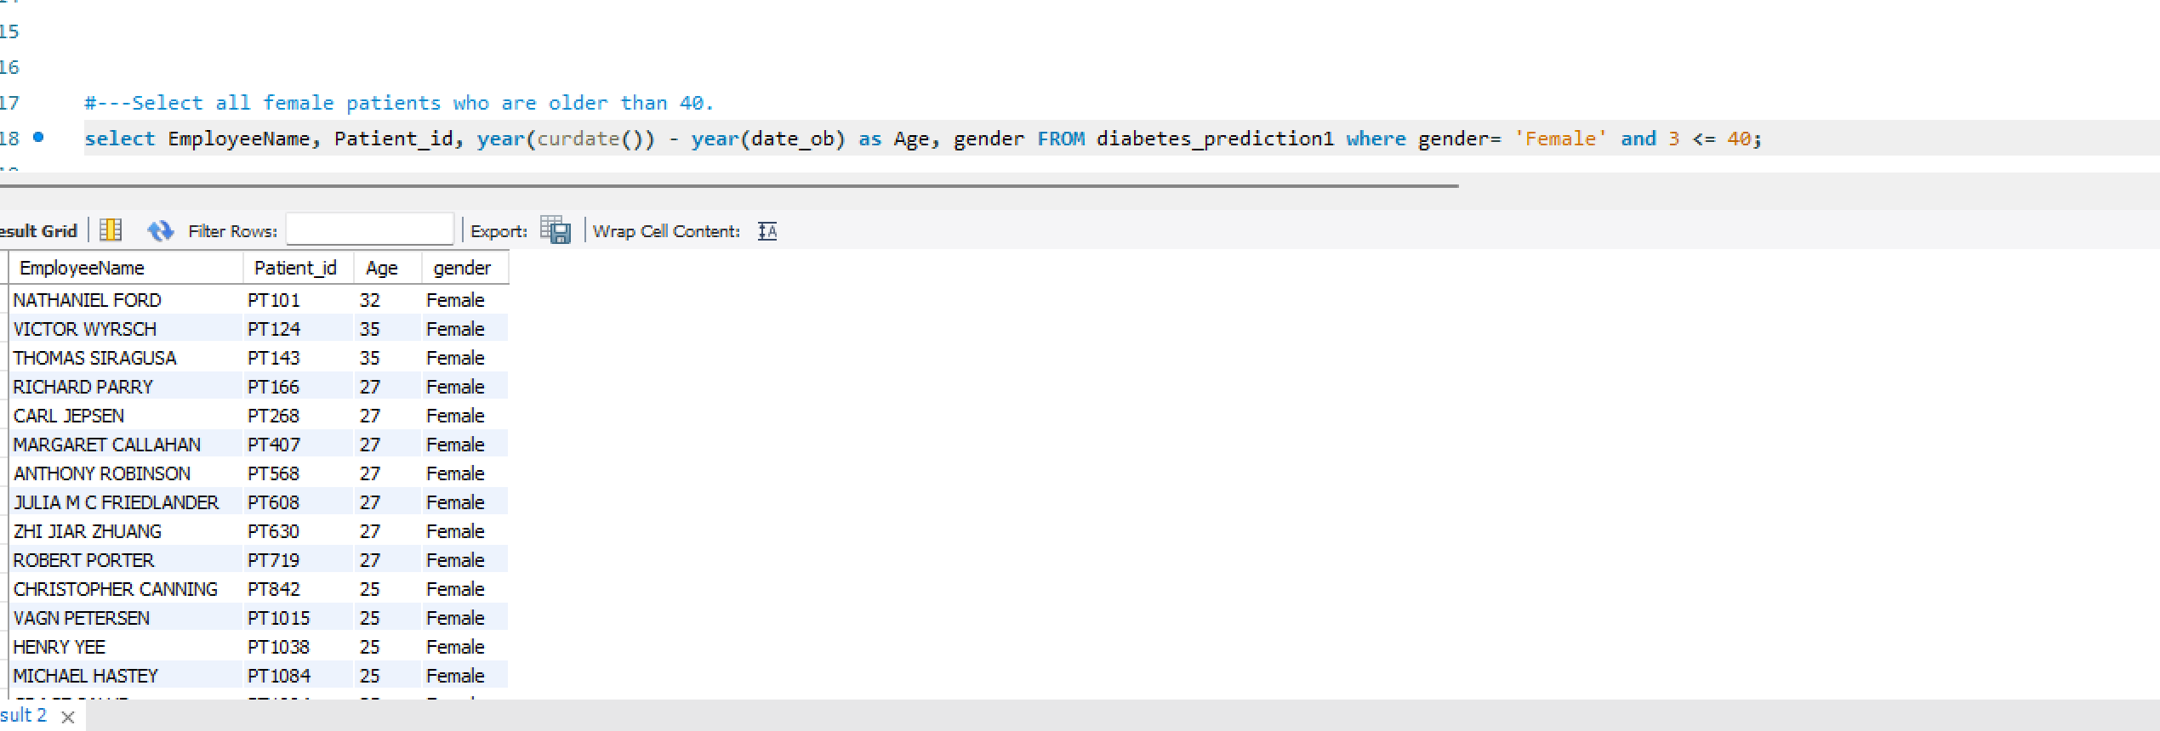
Select all female patients who are older than 40.

Slide 4
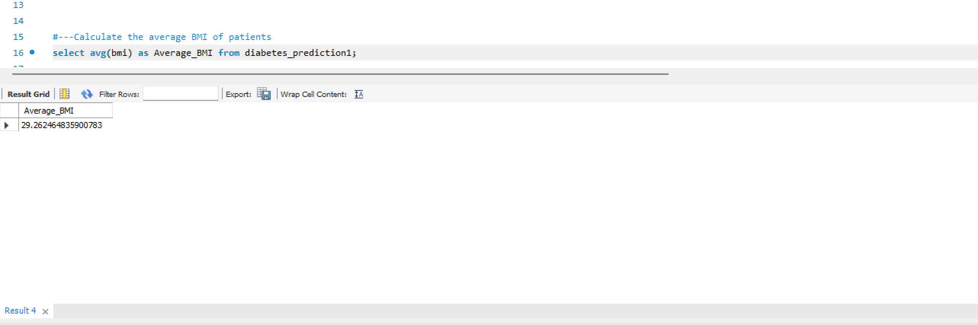
Calculate the average BMI of patients.

Slide 5
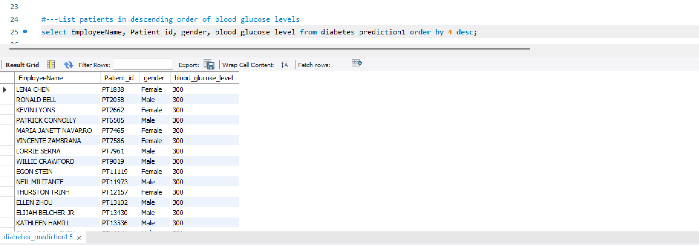
List patients in descending order of blood glucose levels.

Slide 6
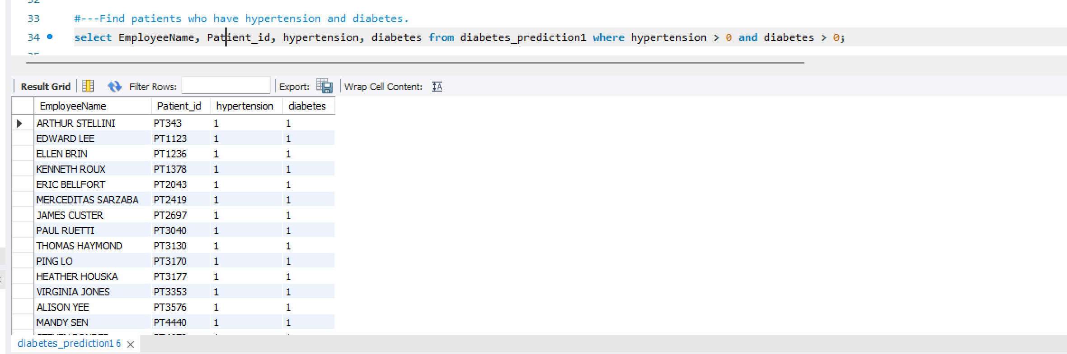
Find patients who have hypertension and diabetes.

Slide 7
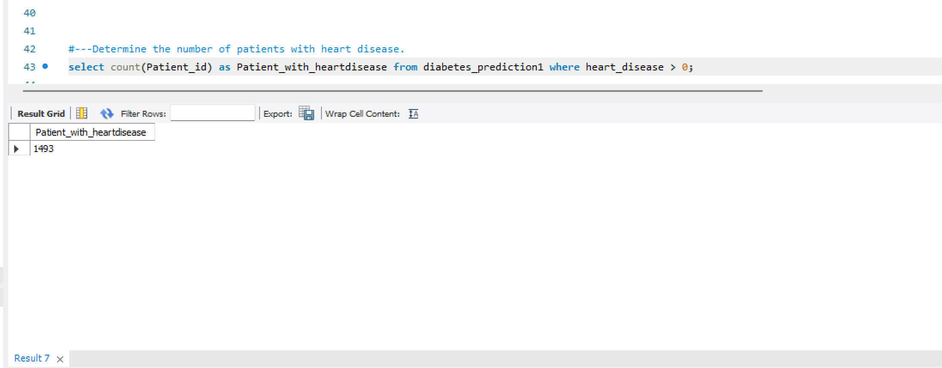
Determine the number of patients with heart disease.

Slide 8
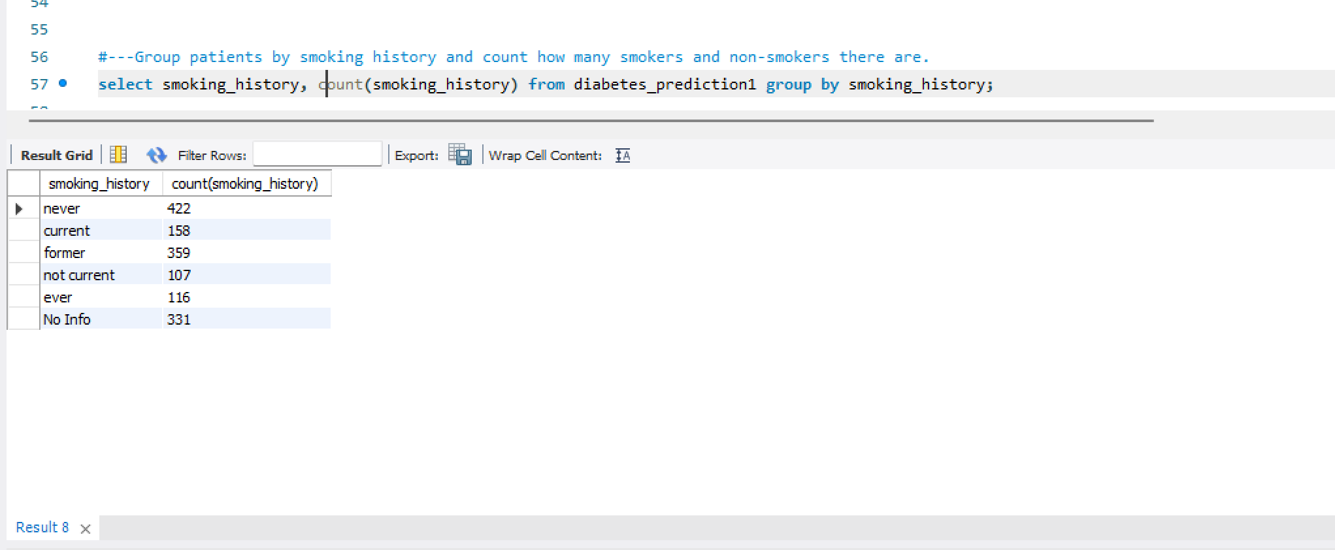
Group patients by smoking history and count how many smokers and non smokers there are.

Slide 9
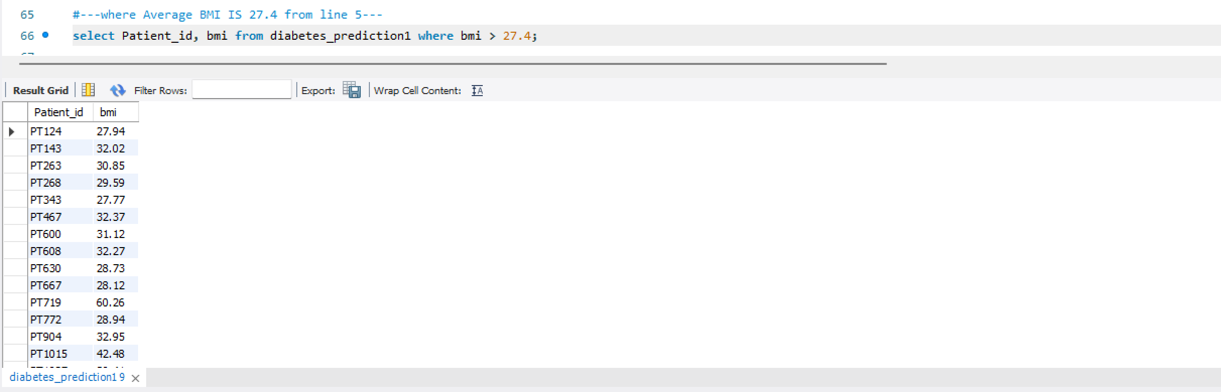
Retrieve the Patient_ids of patients who have a BMI greater than the average BMI.

Slide 10
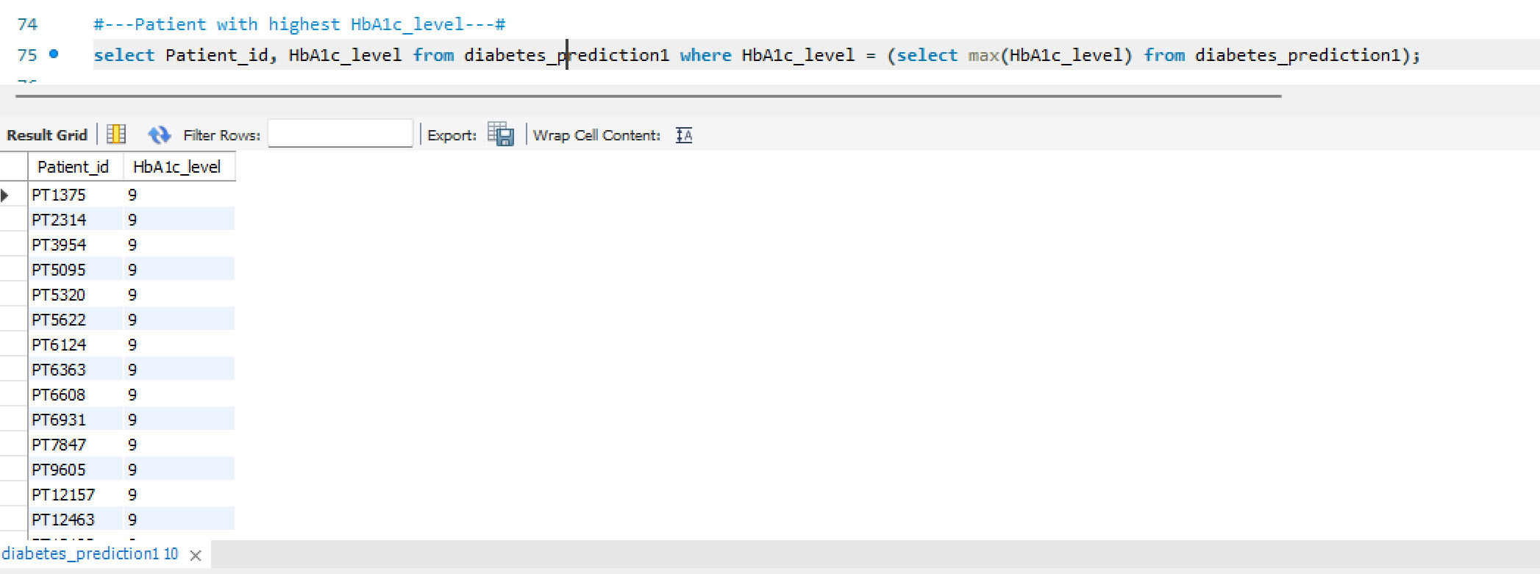
Find the patient with the highest HbA1c level and the patient with the lowest HbA1clevel.

Slide 11
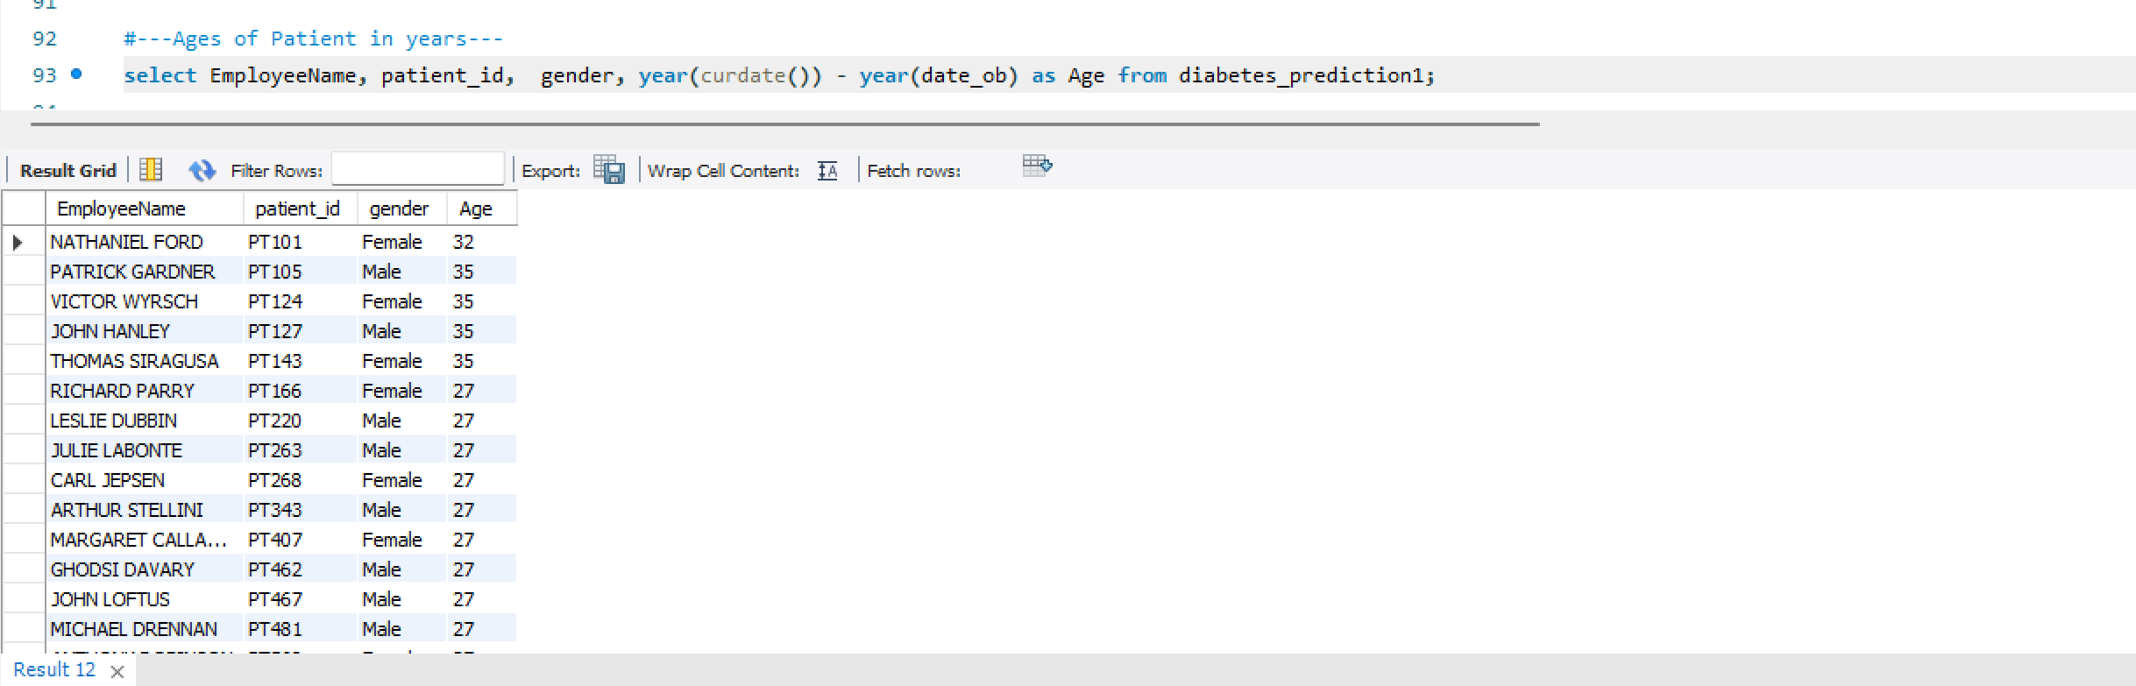
Calculate the age of patients in years (assuming the current date as of now).

Slide 12
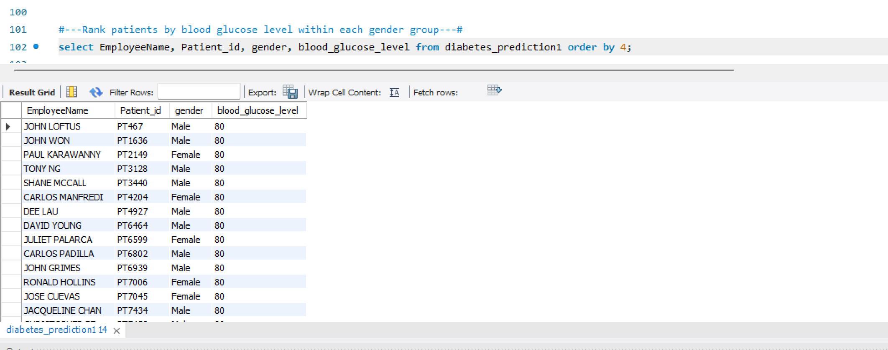
Rank patients by blood glucose level within each gender group.

Slide 13
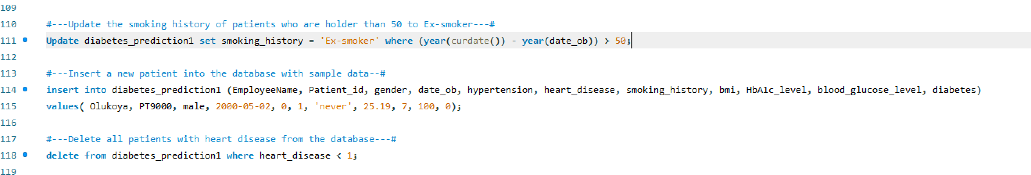

Slide 14
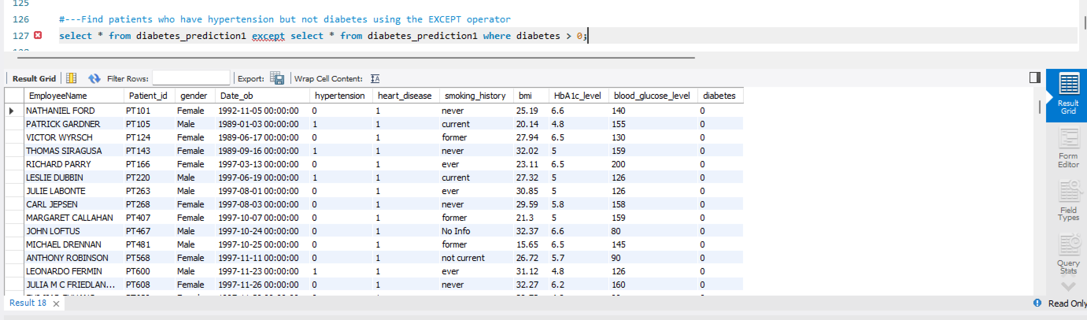
Find patients who have hypertension but not diabetes using the EXCEPT operator.

Slide 15
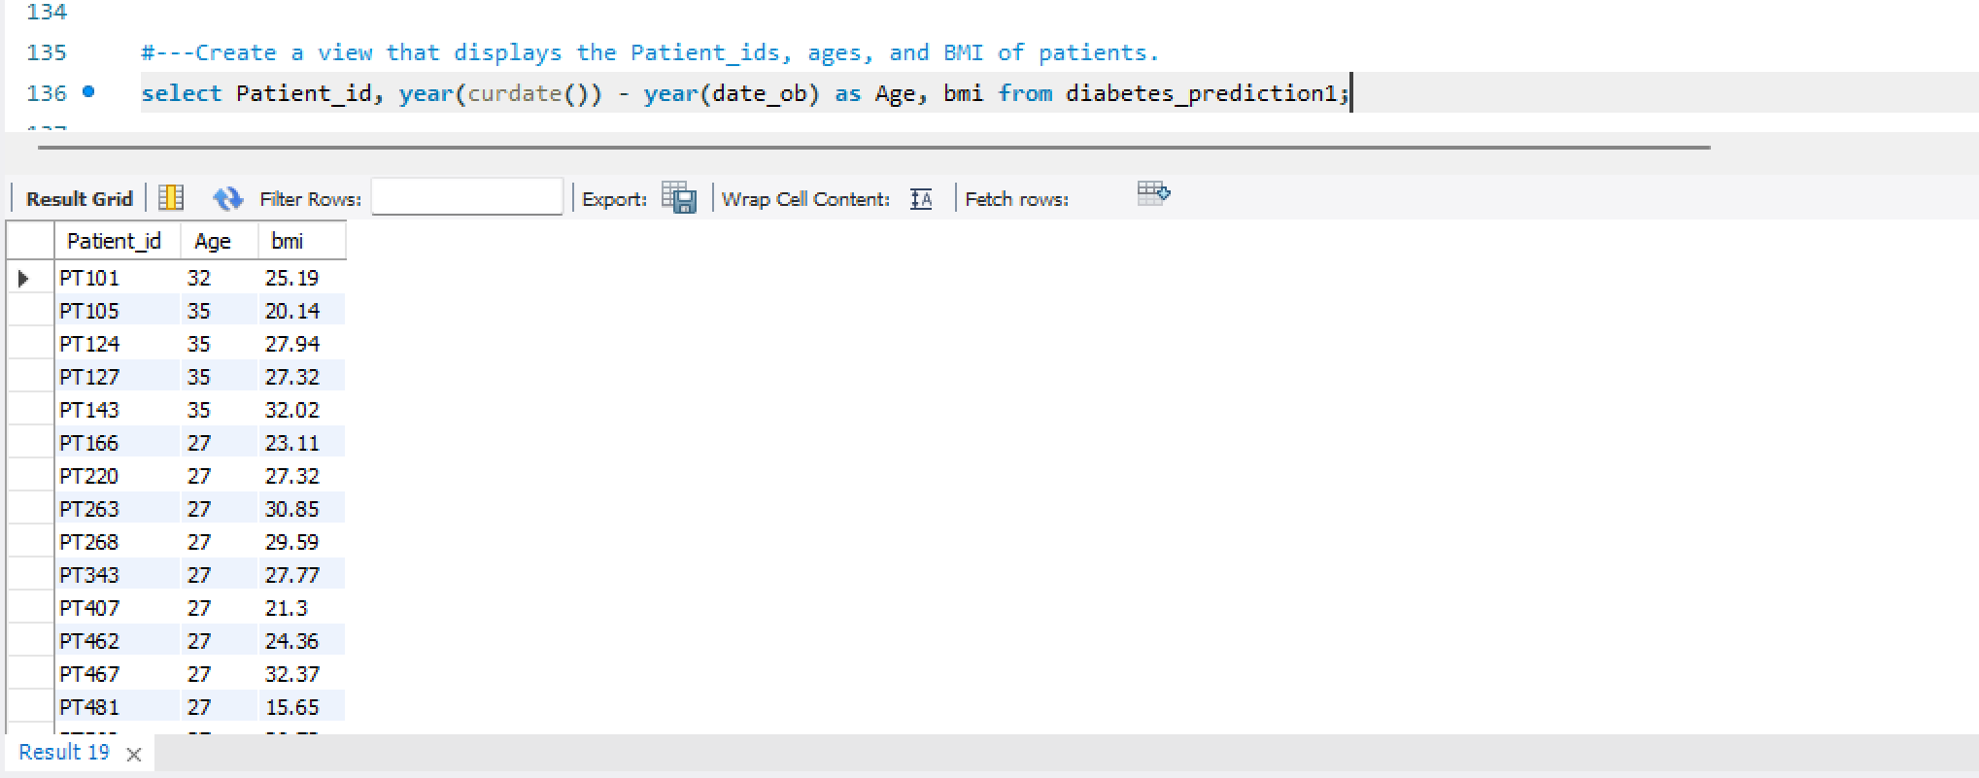
Create a view that displays the Patient_ids, ages, and BMI of patients.

Slide 16
Suggest improvements in the database schema to reduce data redundancy and improve data integrity
My observation regarding the dataset is in respect to the values in which patients with hypertension, heart disease and diabetes are interpreted. The values should have been represented with either A yes or No to enhance easy interpretation and understanding of the dataset.
The tables can also be broken down into different table. For example, we can have a table for Employees, table for patients, and one for medical history. By doing this, we can avoid repetition of information like employee names or patient names and we can link the tables using a unique id. This way, we can access and analyze the data without redundancy.

Slide 17
Explain how you can optimize the performance of SQL queries on this dataset.
In order to optimize the performance of SQL queries on thus dataset, the following must be considered:
Indexing: Make sure to properly index the columns used in your queries. This helps the database quickly find the relevant data, improving query performance.
Query Optimization: Take a look at your queries and make sure they are written efficiently. Avoid unnecessary joins, select only the necessary columns, and use appropriate WHERE clauses to filter data.
Data Partitioning: If your dataset is large, consider partitioning the data into smaller, more manageable chunks. This can improve query performance by reducing the amount of data that needs to be scanned.

