Slide 1


KEYLOGGERS
IN CYBERSECYRITY
PRESENTED
BY
DHATCHAYINI.M
PODHIGAI COLLEGE OF ENGINEERING AND TECHNOLOGY BE.CSE-3 YEAR

Slide 2
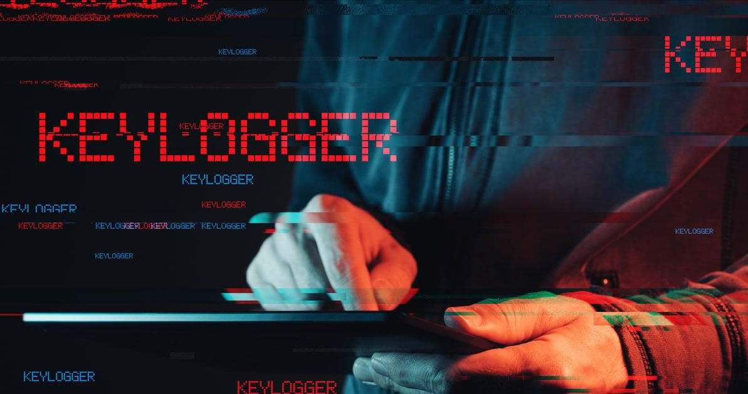

Slide 3
OUTLINE
▶ What is Keylogger in Cybersecurity?
▶ Types of Keyloggers
▶ How to Detect a Keylogger?
▶ How to Prevent a Keylogger Attack?
▶ Danger of Keystroke Loggers
▶ Protecting Yourself from Keyloggers
▶ Conclusion

Slide 4
What is a Keylogger?
▶ A keylogger, also called a keystroke logger or keyboard capturer, is a malicious software or hardware device that secretly records and captures each keystroke entered on a computer or mobile device. Its primary objective is to covertly monitor and obtain confidential information, such as login credentials, credit card details, and other private data, by tracking every key the user presses.

Slide 5
.
▶ Keyloggers can be distributed in different ways, such as through infected software downloads, harmful email attachments, hijacked websites, and compromised external devices. Once a keylogger is installed on someone’s system or device, it operates covertly, often transmitting the collected data to a remote server managed by the attacker.

Slide 6


Slide 7
Types of Keyloggers
▶ There are different types of keyloggers that vary in their functionality, distribution methods, and target platforms. Here are some common keyloggers types:

Slide 8


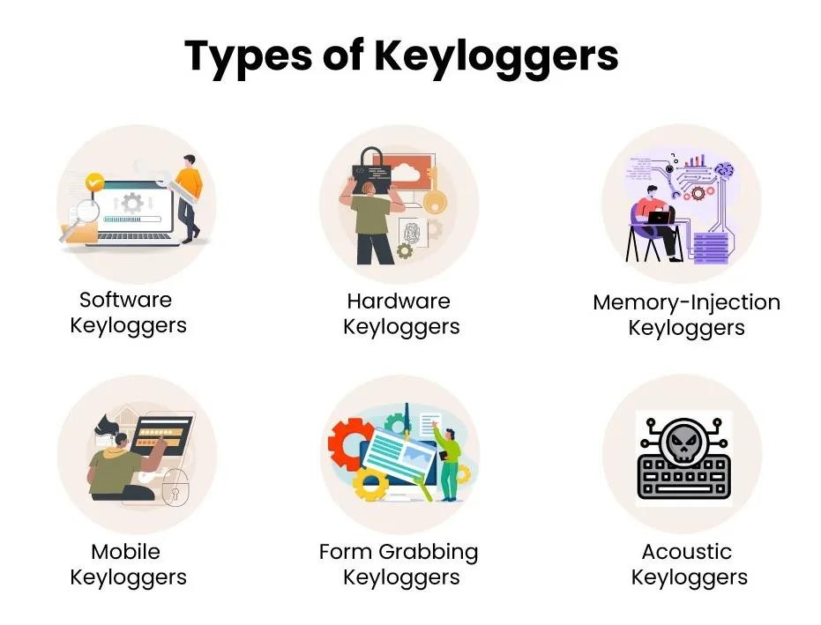

Slide 9
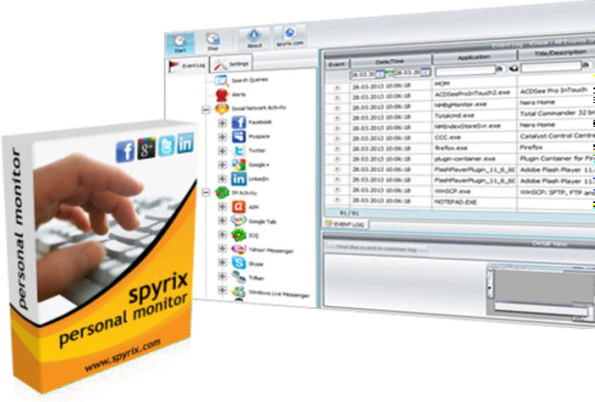
Software Keyloggers
These are the software programs
or scripts installed on
a target system to capture
and record keystrokes as users type.

Slide 10

Hardware Keyloggers
These are hardware devices attached
between the keyboard and the computer or embedded within a computer peripheral.

Slide 11
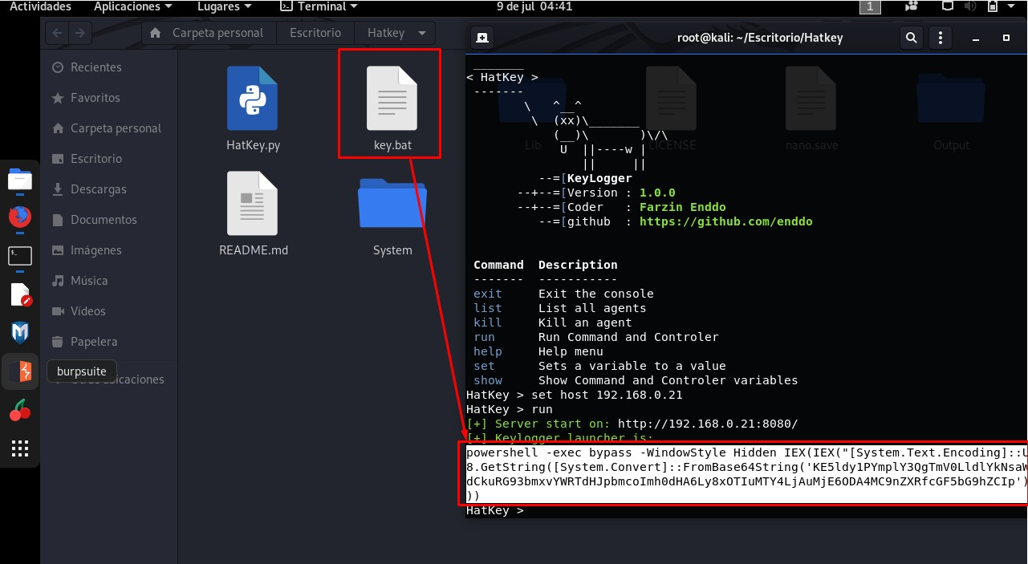
Memory-Injection Keyloggers
These keyloggers inject
malicious code into
running processes to capture keystrokes or intercept data.

Slide 12


Mobile Keyloggers
These target smartphones
and tablets, capturing touch
inputs and virtual keyboard keystrokes.

Slide 13

Form Grabbing Keyloggers
These keyloggers target web forms,
capturing the data entered by a user before it is encrypted and sent to the server.

Slide 14
Acoustic Keyloggers
These unique keyloggers use sound to capture keystrokes. By analyzing the sound of typing, attackers can reconstruct what keys were pressed.

Slide 15
How to Detect a Keylogger?
slowdownsUnusual system
Unexpected increase in network traffic
Suspicious behavior of antivirus or security software

Slide 16
.
Unexplained pop-ups or browser redirects
Passwords or accounts compromised without reason
Exceptional battery drainage on mobile devices

Slide 17
How to Prevent a Keylogger Attack?
Use reputable antivirus and anti-malware software
Enable a firewall to block unauthorized access
Use a virtual keyboard for sensitive tasks

Slide 18
Be cautious when using public systems or networks
Regularly update your operating system and applications
.
Implement two-factor authentication for online accounts
Regularly monitor your accounts for unauthorized activities

Slide 19
.
Consider using a hardware-based authentication method
Educate yourself about phishing and social engineering tactics
Be cautious about downloading files from untrusted sources or clicking suspicious links or email attachments

Slide 20
Danger of Keystroke Loggers
Unlike other forms of malware, keylogging malware doesn’t damage your computer or operating system. The main danger of keyloggers is that malicious users can identify and exploit your personal information. The following examples illustrate some of the risks of a keylogger attack.

Slide 21
.➢ Hackers can steal credit card information and make
unauthorized purchases.
Malicious users can log in to your email accounts and steal information or scam your contacts.
Hackers can log in to your bank accounts and transfer money out.
Malicious users can access your company’s network
and steal confidential information.

Slide 22

Protecting Yourself from Keyloggers
With access to your personal information, malicious users can cause a lot of damage.

Slide 23
.
It’s therefore important to protect yourself from keyloggers so
you don’t become a victim. The good news is that you can reduce the likelihood of an attack with behaviors and precautions. According to Verizon’s 2022 Data Breach Investigations Report, 82% of breaches involve a human element. By being aware of the dangers, you can bolster your cybersecurity and better protect yourself against keylogging attacks.

Slide 24
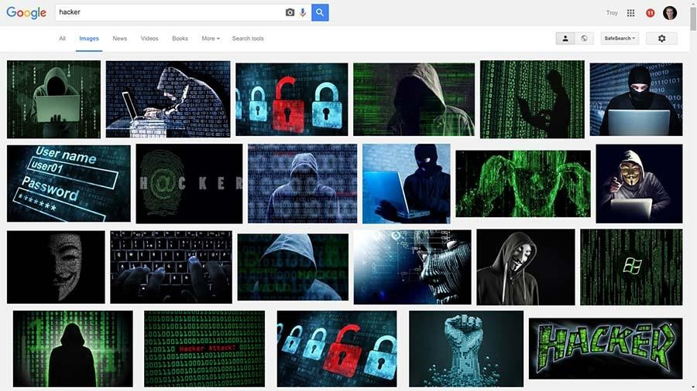
.
The best protection against keylogging
attacks is education about how the attacks occur. Consider the following precautions you can take to avoid becoming a victim:

Slide 25
.
Verify that emails are sent from legitimate sources
Verify that websites are legitimate.
Use a unique and strong password.

Slide 26
Conclusion
It is advisable to stay vigilant with a proactive internet security system. Xcitium Antivirus works best with proactive protection features like a Default Deny System, Containment technology and Sandboxing battle against even the most threatening keylogging activities.

Slide 27
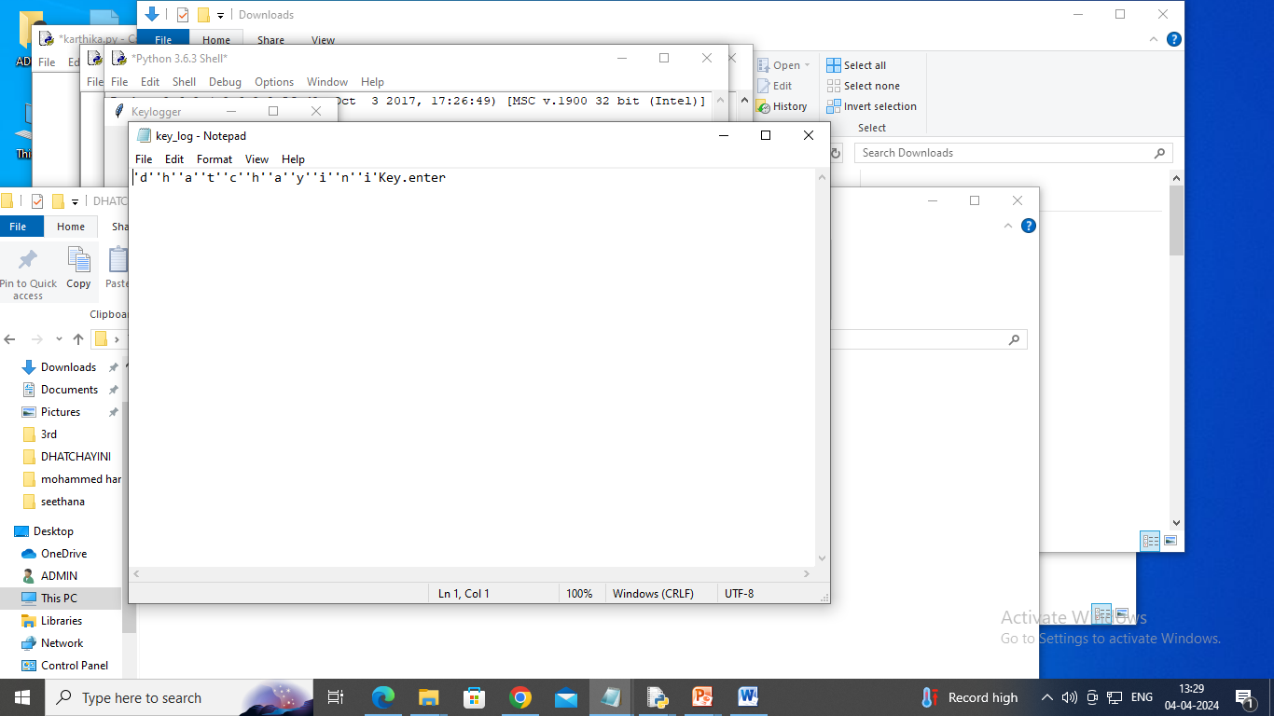

Slide 28
.
.
THE END

