Slide 1


Department of Information Technology
Velagapudi Ramakrishna Siddhartha Engineering College
Human Disease Prediction based on Symptoms
Machine Learning
B.Tech in Information Technology
EPICS Review Presentation
Presented By:
Mr. Uday Kiran K (208W1A1293)
Ms. Dhatri Phani Priya K (208W1A1294)
Mr. Guna Sri Manjunadh P (208W1A12B1)
Under the guidance of
Y.Kalyan Chakravati , Assistant professor

Slide 2
Agenda
Problem Definition
Objectives and Outcomes
Literature Review
Societial Impact
Dataset Description
Requirements
Architecture diagram
Algorithm Standard Format
Implementation steps
Result and Analysis

Slide 3
Problem Definition
Early detection and lifestyle changes or surveillance, to reduce the risk of disease, or to detect it early enough to treat it most effectively.
The user will give few symptoms to the GUI.
The machine will predict the disease name based on the accuracy.

Slide 4

Objectives and Outcomes
To predict the accurate disease of the patient using given symptoms.
By the given symptoms, we can calculate accuracy between 0 and 1.
By obtained accuracy rate we can predict the disease.
This project provides graphical user interface for the user to enter the symptoms.

Slide 5
Literature Review
S.NO | PAPER | METHODOLOGY | ALGORITHM | RESULTS | REMARKS
1 | Disease prediction by Machine Learning over Big data from HealthCare Communities. Year:2022 | Min Chen, Yixue Hao, Kai Hwang describes about the prediction of chronic diseases. | CNN-MDRP | Deals with both structured and unstructured data | Predict only one disease.
2 | Pandemic coronavirus: World effects analysis and prediction using machine-learning techniques Year:2021 | Dimple Tiwari,Bhoopesh Singh Bhati,Fadi Al-Turjman,Bharti Nagpal proposed a model that predict corona virus based on the symptoms . | Naive-Bayes, SVM and Linear-Regression | Linear Regression predicts better than SVM. | SVM and Regression is not more trustworthy than Naive-Bayes

Slide 6
S.NO | PAPER | METHODOLOGY | ALGORITHM | RESULT | REMARKS
3 | Designing Disease Prediction Model Using machine Learning Approach. Year:2020 | Dhiraj Dahiwade, Gajanan Patle, Ektaa Meshram proposed general disease prediction model based on the symptoms of the patient. | k-Nearest Neighbour(KNN) and | Prediction time is less Gives accurate prediction | The complexity of algorithm is more i.e the time and the memory requirement is more in KNN
4 | Application of Machine Learning in Disease Prediction. Year:2022 | Pahulpreet Singh Kohli, Shriya Arora describes about disease diagnosis and early detection of fatal disease such as Heart disease, Diabetes, Breast Cancer | Decision Tree, Random forest | This model exhibits best accuracy than the existing models | Uses different algorithms for different diseases prediction.

Slide 7
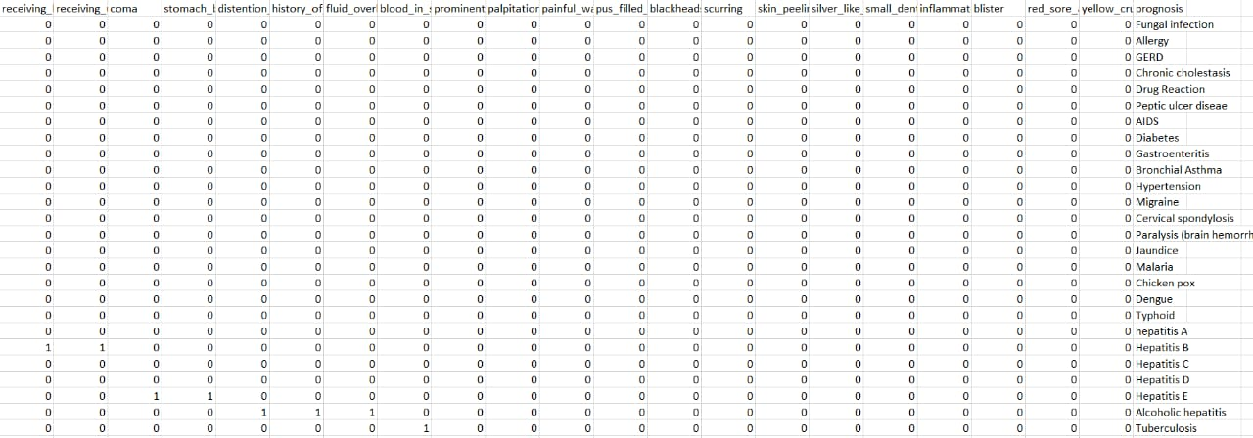
Dataset Description
Health Care domain dataset (https://github.com/anujdutt9/Disease-Prediction-from-Symptoms/tree/master/dataset).
This dataset contains 133 attributes in which 132 attributes represents the symptoms and the other one is the disease(output).

Slide 8
Requirements
Software:
Operating System : Windows 10 or Higher Versions
Platform : Jupyter Notebook
Front End : Python Tkinter
Back End : MySQL
Hardware:
-8GB RAM and 256GB SSD
- Minimum i5 processor

Slide 9
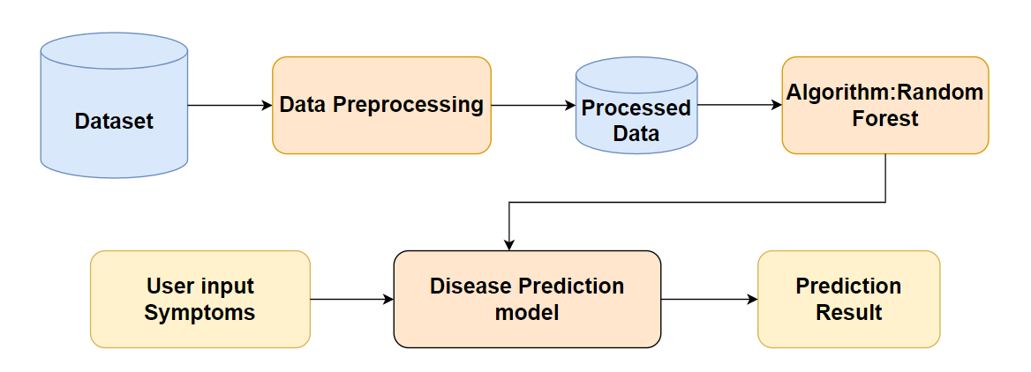
Architecture diagram

Slide 10
Algorithm
Algorithm : Random Forest.
Step1 – Start with the selection of random samples from a given dataset.
Step2 - Next, this algorithm will construct a decision tree for every sample. Then it will get the prediction result from every decision tree.
Step3 - In this step, voting will be performed for every predicted result.
Step4 - Select the most voted prediction result as the final prediction result.
Step5 – End.

Slide 11
Reference
[1] S Radhika, S Ramiya Shree, V Rukhmani Divyadharsini, A Ranjitha(2020) Symptoms Based Disease Prediction Using Decision Tree and Electronic Health Record Analysis.
[2] Dhiraj Dahiwade, Prof. Gajanan Patle, Prof. Ektaa Meshram (2020) Designing Disease Prediction Model Using Machine Learning Approach.
[3] Pahulpreet Singh Kohli, Shriya Arora (2022) Application of Machine Learning in Disease Prediction.

Slide 12


