Slide 1
Project Poseidon
MVP 1
Dhaval Patel [ 200439819 ]

Slide 2




UN Sustainable Development Goals
Goal 6 - Clean water and sanitation
Goal 3 – Good Health and Well-Being
Ensure access to water and sanitation for all
Ensure healthy lives and promote well-being for all at all ages.
Goal 17 – Partnerships for Goals
Goal 11 – Sustainable Cities and communities
Revitalize the global partnership for sustainable development
Make Communities inclusive, safe, resilient and sustainable

Slide 3

MVP 1
MVP 3
MVP 2
16th June 2021
PROPOSED MVP 1
IMPLEMENTED MVP 1
MVP 1
Data preprocessing
Training the model
packaging and deploying the model
Crafting the UI for making prediction
Plot map of the water pumps
Data preprocessing
Training the model
packaging and deploying the model
Plot map of the water pumps
6th June 2021
2nd June 2021
Status for MVP 1
Sprint 1
19th May 2021

Slide 4
Implementation challenges for MVP 1
Finding the Dataset
Preprocessing the data
Determining Feature Engineering Depth
Configuration of Geopandas library and Map plot features
Deciding the model, model parameters and architecture
Training time for the initial designed models was huge.

Slide 5
Project changes
Creating a web interface for the users
The only change from proposed MVP1 tasks is implementing a web user interface in Django.
The Demo includes the standalone interface for using the model

Slide 6

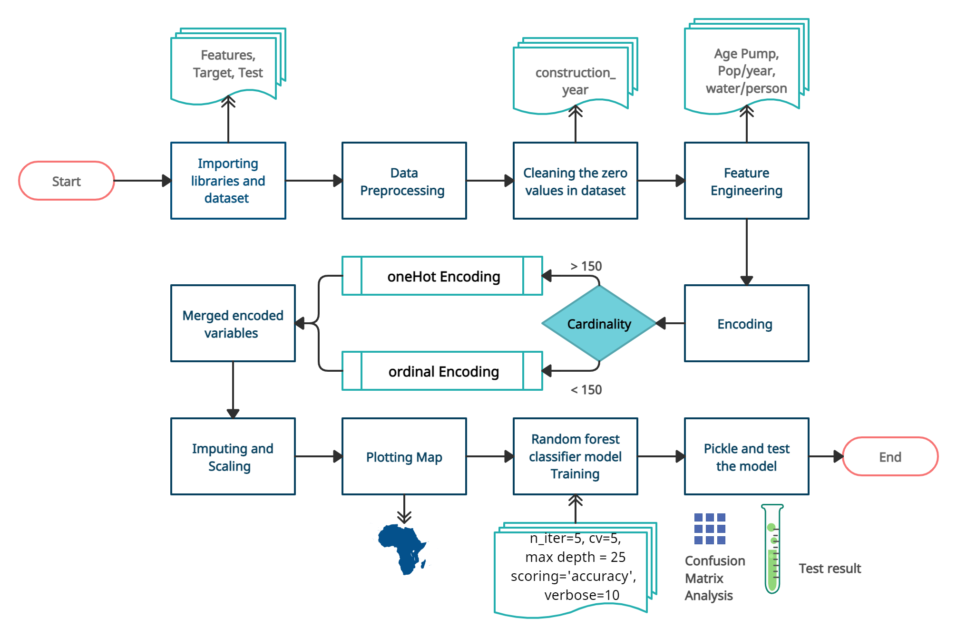
FLOW DIAGRAM

Slide 7
DEMO

Slide 8
Project issues
DEPLOYING THE MODEL ON DJANGO WEB INTERFACE
The complexity of the model can cause issue when creating the form for prediction as the model input contains 40 variables
The size of the pickle model is 145 MB
Creating a Web interface
Complexity in preprocessing the input from the users to make it suitable for the model
Perform data preprocessing task on Django

Slide 9
Reflection
MVP 3
MVP 2
Status – on track
Important feature – model training
Barriers to over come
Understanding of technology (Django)
Other classes work
Limited time for MVP 2
Working with model with 40 parameters
16th June 2021
MVP 1
9th June 2021
Sprint 2
2nd June 2021
19th May 2021
Next Up
Overall MVP Status
Focus on pending MVP1 task
Work on proposed MVP 2 tasks

Slide 10
Thank you
Questions ?

