Slide 1
Project Poseidon
MVP 2
Dhaval Patel [ 200439819 ]

Slide 2




UN Sustainable Development Goals
Goal 6 - Clean water and sanitation
Goal 3 – Good Health and Well-Being
Ensure access to water and sanitation for all
Ensure healthy lives and promote well-being for all at all ages.
Goal 17 – Partnerships for Goals
Goal 11 – Sustainable Cities and communities
Revitalize the global partnership for sustainable development
Make Communities inclusive, safe, resilient and sustainable

Slide 3

MVP 2
Implemented MVP 2 tasks
MVP 3
Training the shallow model
Identifying important features
Deploy model on a Django based web portal
Using the portal to predict status
MVP 2
16th June 2021
9th June 2021
Status for MVP 2
MVP 1
Sprint 2
2nd June 2021
19th May 2021

Slide 4
Implementation challenges for MVP 2
Create a shallow model with low features
Deploy the shallow model on Django webapp
Implementation challenges in Django - MVT framework

Slide 5
Project changes for MVP 2
Plotting the map on the WebApp
Creating the chat forum

Slide 6

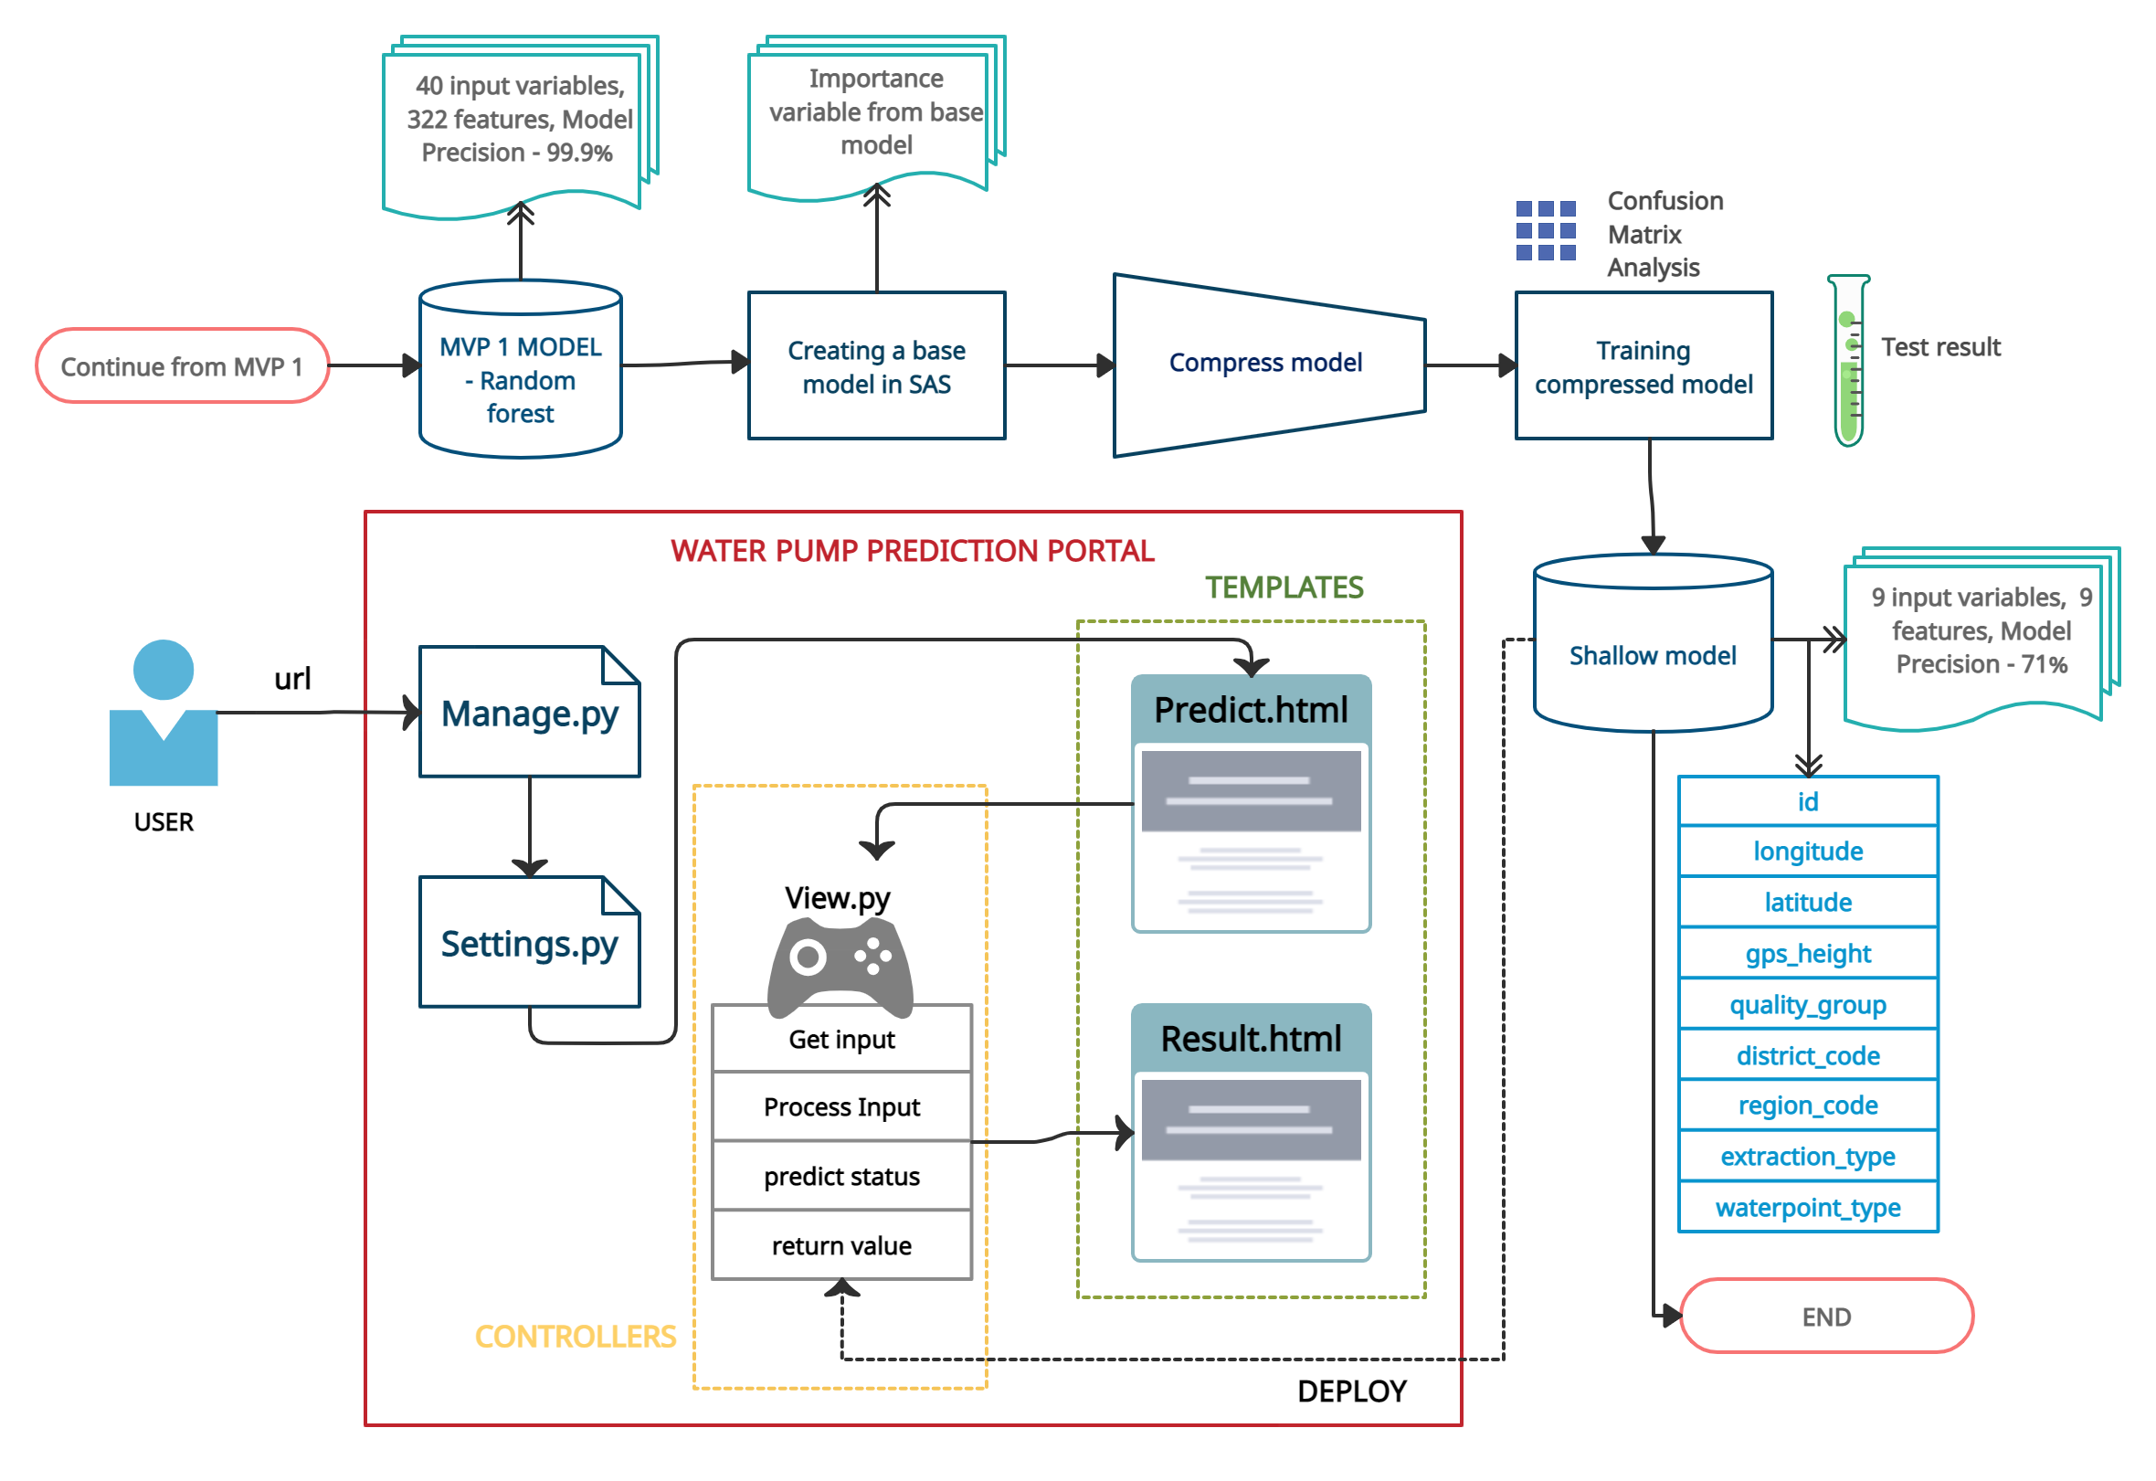
FLOW DIAGRAM

Slide 7
DEMO

Slide 8
Project issues resolved from MVP 1
Deploying the model on Django web interface
The complexity of the model can cause issue when creating the form for prediction as the model input contains 40 variables
The size of the pickle model is 145 MB
Shallow Model – 9 input parameters, 9 features and 87 KB model with 70 percent accuracy
Creating a Web interface
Complexity in preprocessing the input from the users to make it suitable for the model
Perform data preprocessing task on Django
Web portal using Django MVT framework

Slide 9
Project issues from MVP 2
Plotting the map for status of all water pump
How to integrate the plotly API or use to plot map from scratch using Geo pandas ?
Creating the chat functionality
Create the chat functionality for users either using Django or using any other frame work like wordpress.

Slide 10
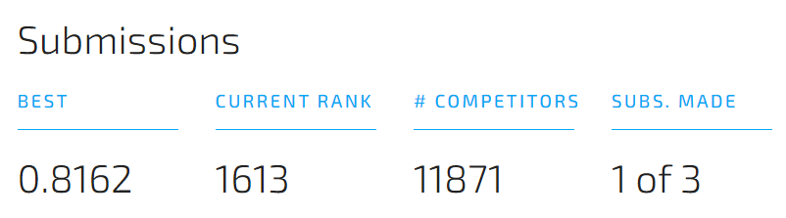
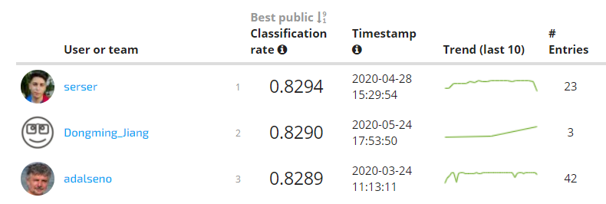
Reflection
MVP 3
Sprint 3
Status – on track
Important feature – web portal
Barriers to over come
Understanding of technology (WordPress)
Other classes work
Limited time for MVP 3
MVP 2
16th June 2021
MVP 1
9th June 2021
2nd June 2021
19th May 2021
Overall MVP Status

Slide 11
Thank you
Questions ?

