Slide 1
Musicthon
Created By : Dhaval

Slide 2
Description
Musicthon - is a Progressive Web App(PWA), which primarily aims at providing offline feature to users, so that they never ever feel detach with their passion/interest - Music.
For providing offline feature, it makes use of service-worker.
There is also a Download feature available to fully enjoy the music without any buffering.

Slide 3
Description - continued
With download feature, there is a risk of data getting pirated but with Musicthon the data remains protected - reducing the risk of piracy and it does by encrypting the data while downloading.
The downloaded encrypted data can only be played on the Musicthon Web App as only this app knows how to decrypt the data.

Slide 4
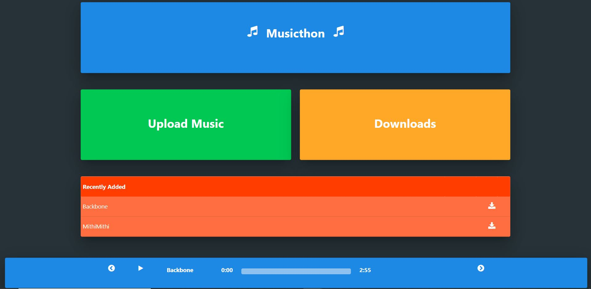
Home Page
Homepage has 2 options : 'Downloads' will store the downloaded data while 'upload' will allow user to upload their own creation.
Recently Added : it displays the list of songs that are present in the database.
The Page-footer acts as an audio player. User can tap on the song which he would like to play. Audio Player provides some controls like play/pause, Current time of the song, Duration of the song, song name, previous/next song option.

Slide 5
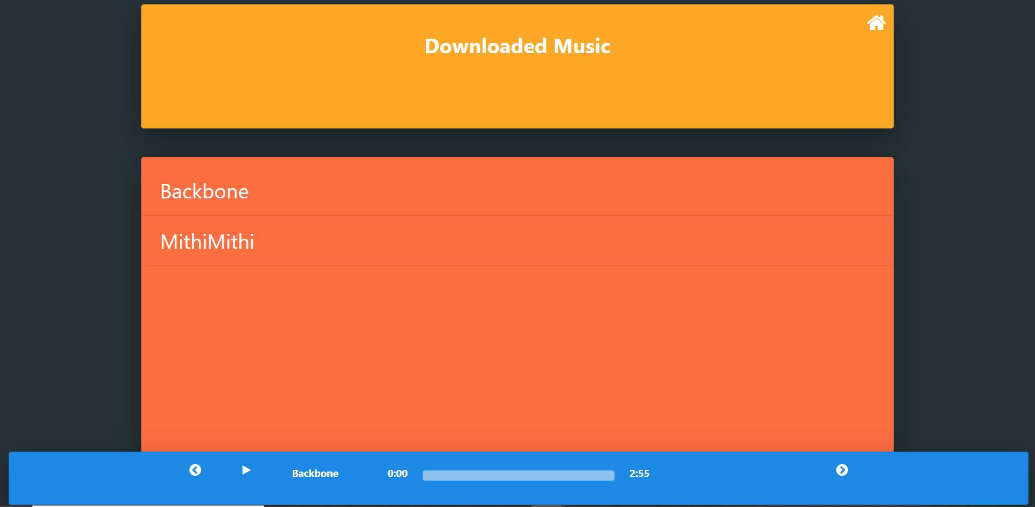
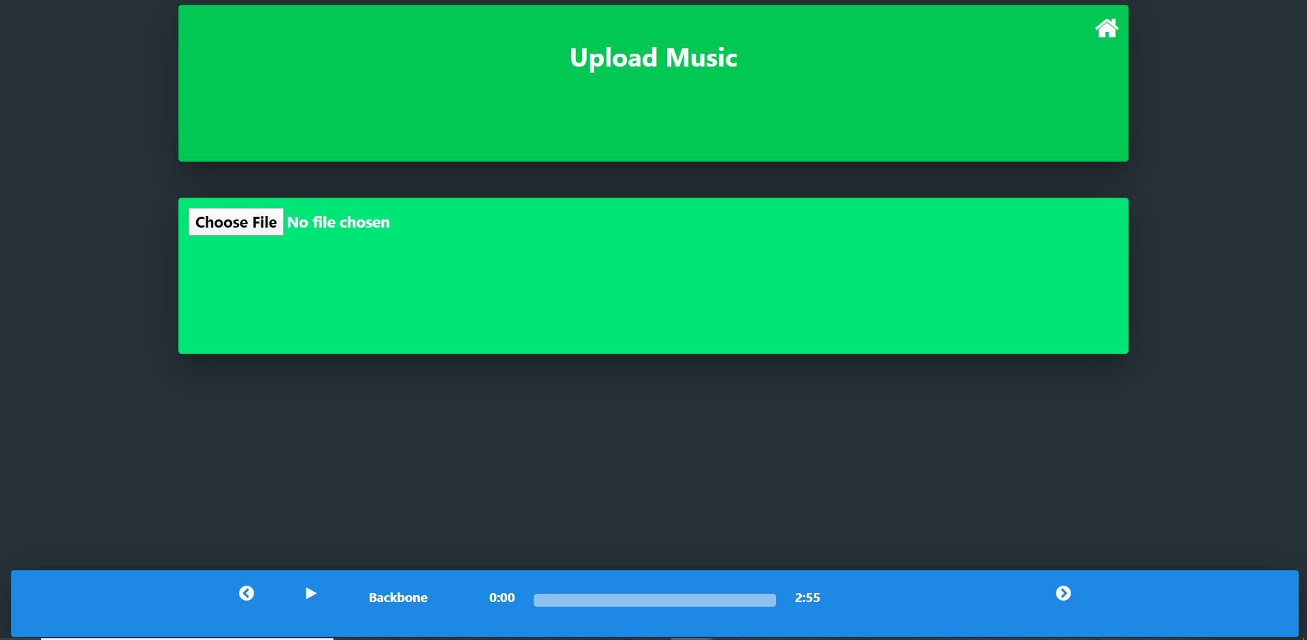
Download Page
Downloaded Song displays the list of songs that are downloaded.
Similar to the homepage, the page-footer acts like an Audio PLayer with similar controls.
Upload Song : an option to allow user to upload the music created by them

Slide 6
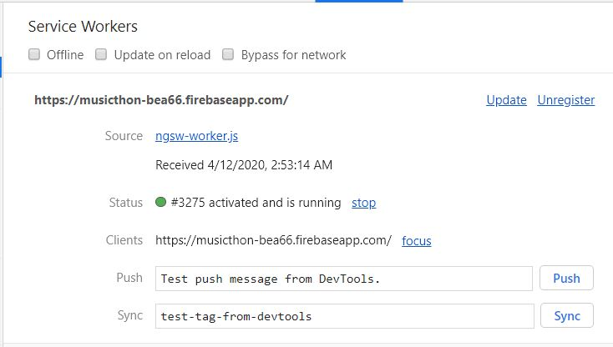
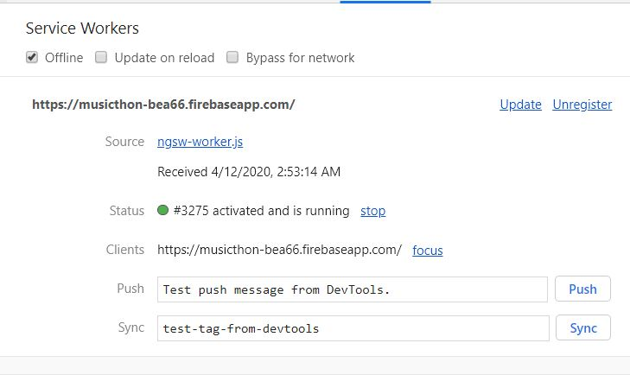
Service Worker
Service worker created when the device was connected to the internet.
Status is Activated
The status of service worker is still activated even when the app is in offline mode (As you can see in the top-left corner the offline checkbox is ticked.)
As the status is active, all the API calls will be directed to this service-worker.

Slide 7
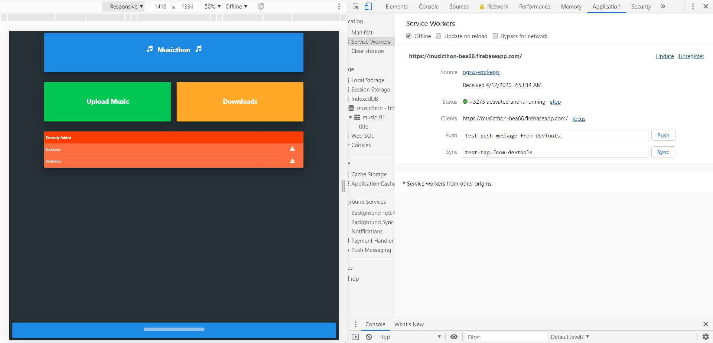
App in Offline Mode
As you can see, the App is still running in the offline mode. As the app had already fetched and stored the data while the device was connected to network, the app is able to display the list of songs in the recently added section.

Slide 8
Future Work
A login/sign up funcitonality can be created so that the system can keep a record of the users.
With upload music option already there, a like feature can be applied to every custom created music and the top 50 or 100 custom created music with most likes could be displayed in the recently added section along with their names provided the login/signup functionality is created.
A video playlist can also be created so that user can upload videos of them playing instruments like piano, guitar etc and can help others to learn those instruments provided their video has enough like to get them to the top 50/100 videos.
Also a lyrics feature can be added which can be played along with the song to make the music even more enjoyable.

Slide 9
Thank You

