Slide 1
Recommendation System
On Indian Devotional Music

Slide 2
Team Members:
Akshay Choudhary
Akshay Shedge
Dhaval Raval
Mentor:- Ms. Bhanupriya

Slide 3
What is the Business Problem?
POC for Recommendation Engine for a Devotional Songs Music application targeted for Indian users.
Objective
The aim of this project is to build a feature of recommendation system to support a music app. As the first phase we need to develop the proof of concept to make the client understand how effective the feature could be.

Slide 4
Project Architecture
EDA
Business Objectives
Data Collection
Model evaluation & feedback
Deployment
Final Presentation
Model Building

Slide 5
What is recommendation system?
A recommender system, or a recommendation system, is a subclass of information filtering system that seeks to predict the "rating" or "preference" a user would give to an item.
In our case, by using music recommender system, the music provider can predict and then offer the appropriate songs to their users based on the characteristics of the music that has been heard previously.

Slide 6
How does the Recommendation System works for Music Streaming Services?
This is an approach where the machine learning algorithm collects a huge amount of data based on users’ behaviors, activities, and preferences. And then it recommends the Audio to those having similar choices.
For example, Person X likes the songs a, b, c, and d; and Person Y likes the songs a, b, g, and h. In this scenario, the machine learning algorithm will predict that X will also like g & h and Y will also like c & d because of their similar liking towards a & b.

Slide 7
In most of the services, algorithm looks at the duration of the time one has spent on a song, and if it is for more than 30 seconds, then the platform takes it as a check on their recommendations.
The longer one spends on a song or a playlist, the better their suggestions will get.
So, if one doesn’t like the first 28-second of a song, it is better to skip it before the 29-second mark to never get to listen to something like that again.

Slide 8
What are the different types of Recommendation System?
Collaborative Recommender system
Content-based recommender system
Knowledge-based Recommender system
Demographic based recommender system
Utility based recommender system
Hybrid recommender system

Slide 9
Data Collection Overview
We have used API i.e Exportify Music Converter to get the desired data.
Our motive is to collect Indian devotional songs which are Aarti, Bhajan, Gazals, etc with various Indian languages.
According to our data collection process, we have collected around 5189 rows and 34 columns.

Slide 10
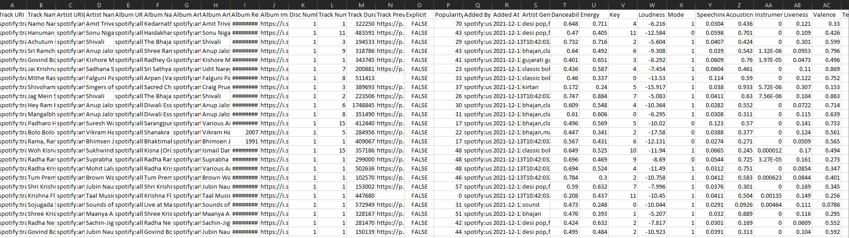
Dataset Columns Descriptions

Slide 11
Danceability: Describes how suitable a track is for dancing based on a combination of musical elements including tempo, rhythm, overall regularity, stability, beat, etc.
Valence: Describe the musical positiveness conveyed by a track. Tracks with high valence sounds more positive (eg. happy, cheerful). While tracks with low valence sounds more negative (eg. sad, depressed, angry).
Acousticness: A confidence measure from 0.0 to 1.0 of whether the track is acoustic (effect of sound in sense of hearing).
Duration_ms: The duration of the track in milliseconds.
Energy: Represents a perceptual measure of intensity and activity. Typically, energetic tracks feel fast, loud and noisy. For example, death metal has high energy, while a Bach prelude scores low on the scale.
Instrumentalness: Predicts whether a track contains no vocals. “Ooh” and “Aah” sounds are treated as instrumental in this context. Rap or spoken word tracks are clearly “vocal”.
Time Complexity: An estimated overall time signature of a track. The time signature (meter) is a notational convention to specify how many beats are in each bar (or measure).

Slide 12
Liveness: Detects the presence of an audience in the recording. Higher liveness values represent an increased probability that the track was performed live.
Loudness: The overall loudness of a track in decibels (dB). Loudness values are averaged across the entire track and are useful for comparing relative loudness of track.
Mode: Indicates the modality (major and minor) of a track, the type of scale from which its melodic content is derived. Major is represented by 1 and minor is 0.
Speechiness: This detects the presence of spoken words in a track. The more exclusively speech - like the recording (eg. talk show, audio book, poetry), the closer to 1.0 the attribute value.
Tempo: The overall estimated tempo of a track in beats per minutes (BPM). In musical terminology, tempo is the speed or pace of a given piece, and derived directly from the average beat duration.
Key: The estimated overall key of the track. Integers map to pitches using standard Pitch Class Notation. Eg. 0 = c. 1 = C#, 2 = D, and so on.
Explicit: Explicit with regards to music generally means the track contains some form of vulgar language, details of lewd or lascivious acts, aggressive or offensive language, or language otherwise deemed to be unsuitable for a child.

Slide 13
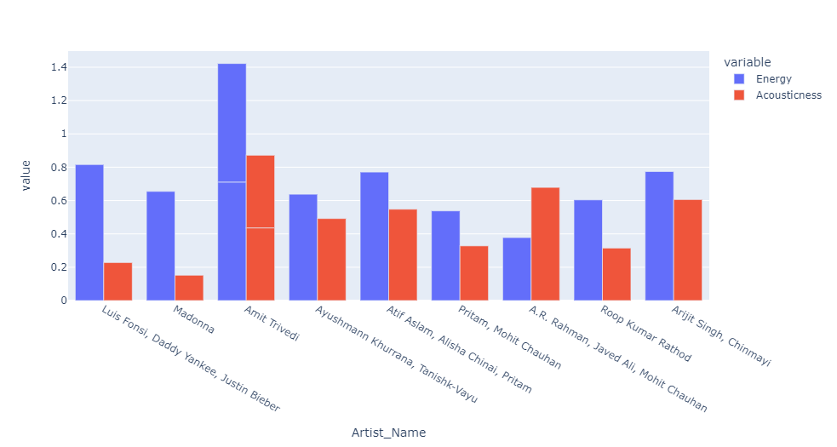
Exploratory Data Analysis (EDA)
Difference between Energy and Acousticness in top 10 songs.

Slide 14
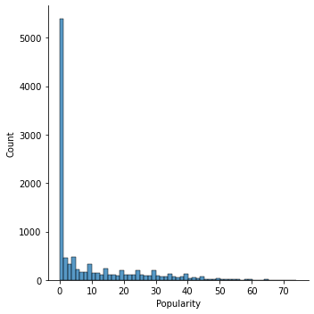
Popularity Count

Slide 15
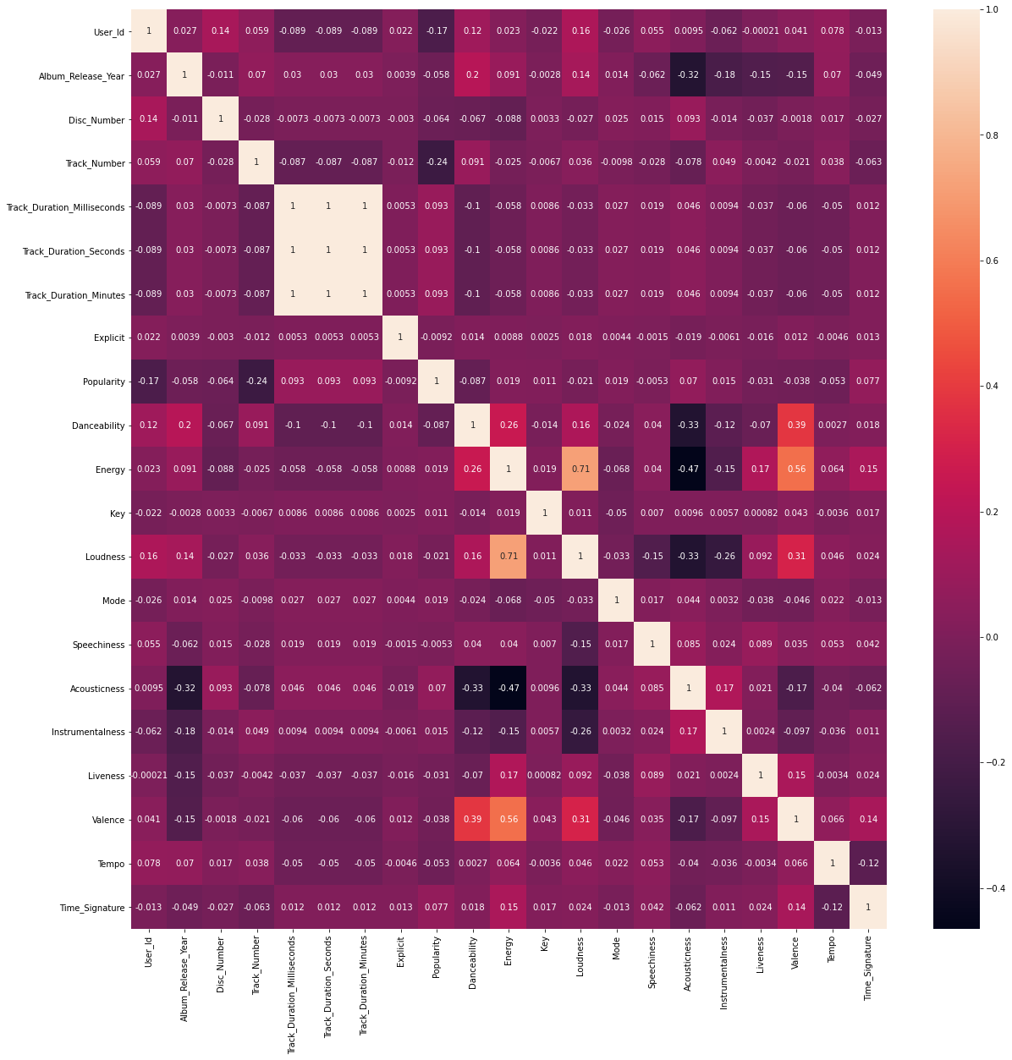
Data Correlation

Slide 16
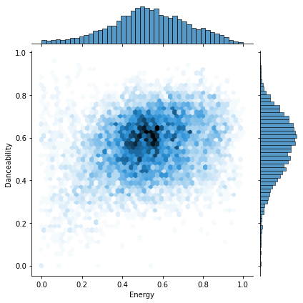
Relation Between Danceability and Energy

Slide 17
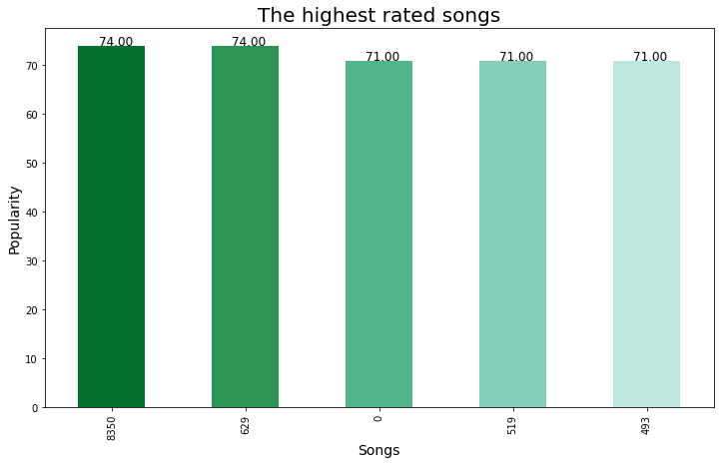
Top 5 Highest Rated Songs

Slide 18
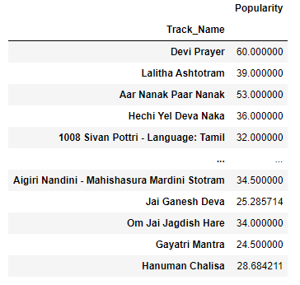
Model Building
Our Model is based on Collaborative System.
Based on our recommendation system, we called song: ‘Devi Prayer’ and got recommendation based on correlation as:

Slide 19
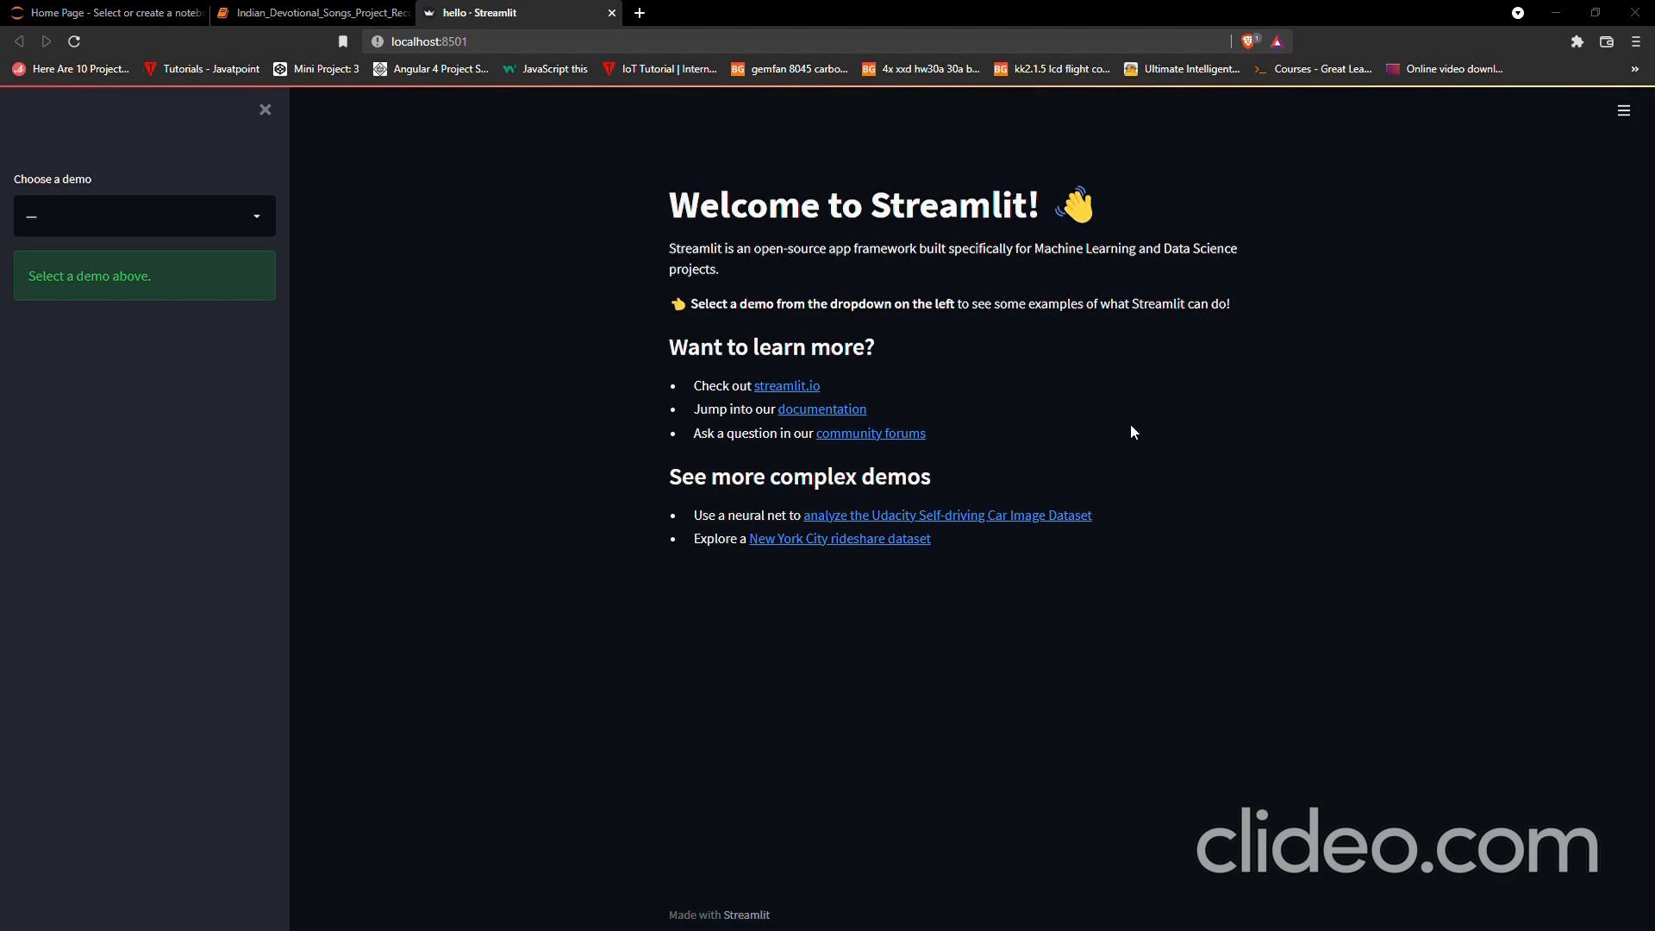
Model Deployment
Deployment is done
using Streamlit.

Slide 20
Thank You.

